Slide 1
GitHub and Git

Slide 2
GitHub
Git is a version control system
GitHub is the place where people store their projects

Slide 3
Tutorial
Create a GitHub Account
Create and use a repository
Start and manage a new branch
Make changes to a file and push them to GitHub as commits
Open and merge a pull request

Slide 4
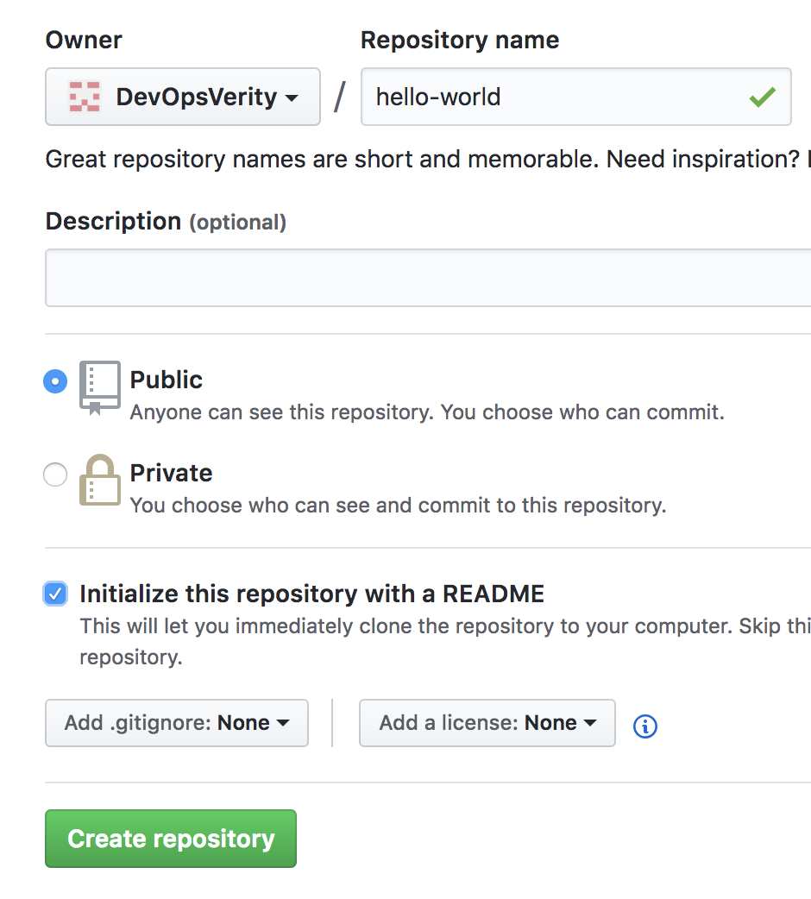
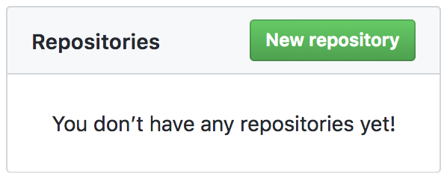
Creating New Repository

Slide 5
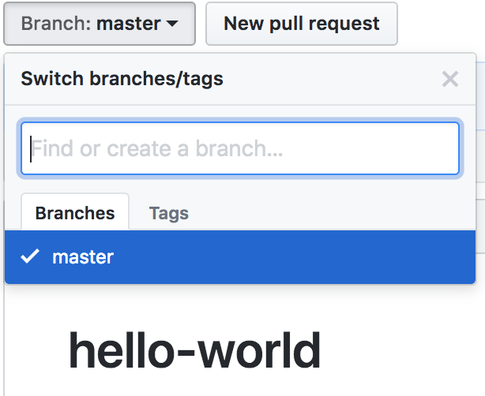
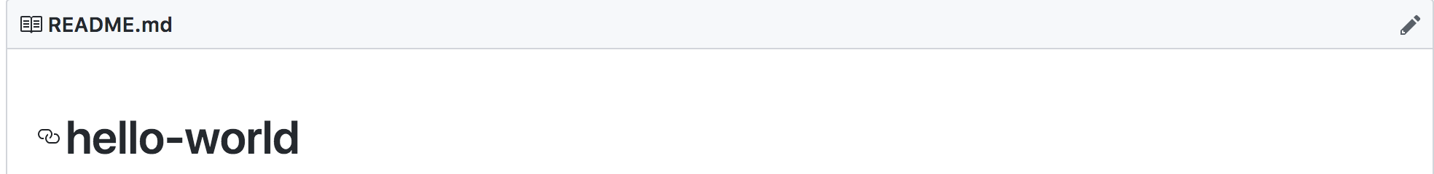
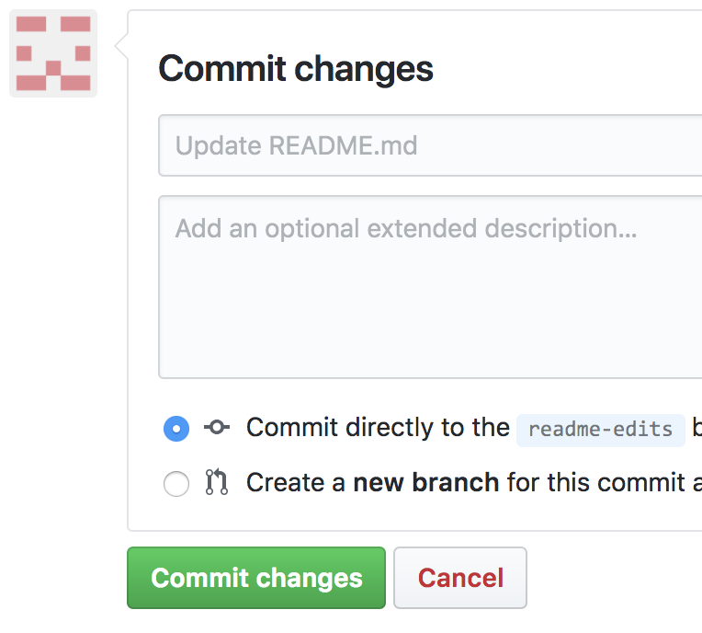
Branching and Commit
Create a branch names readme-edit
Edit the readme in the branch by clicking edit icon
Write something and commit

Slide 6
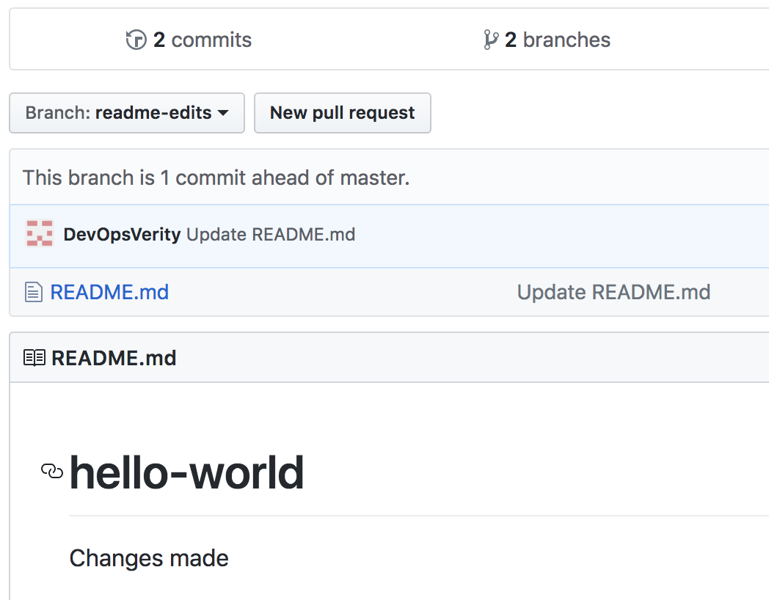
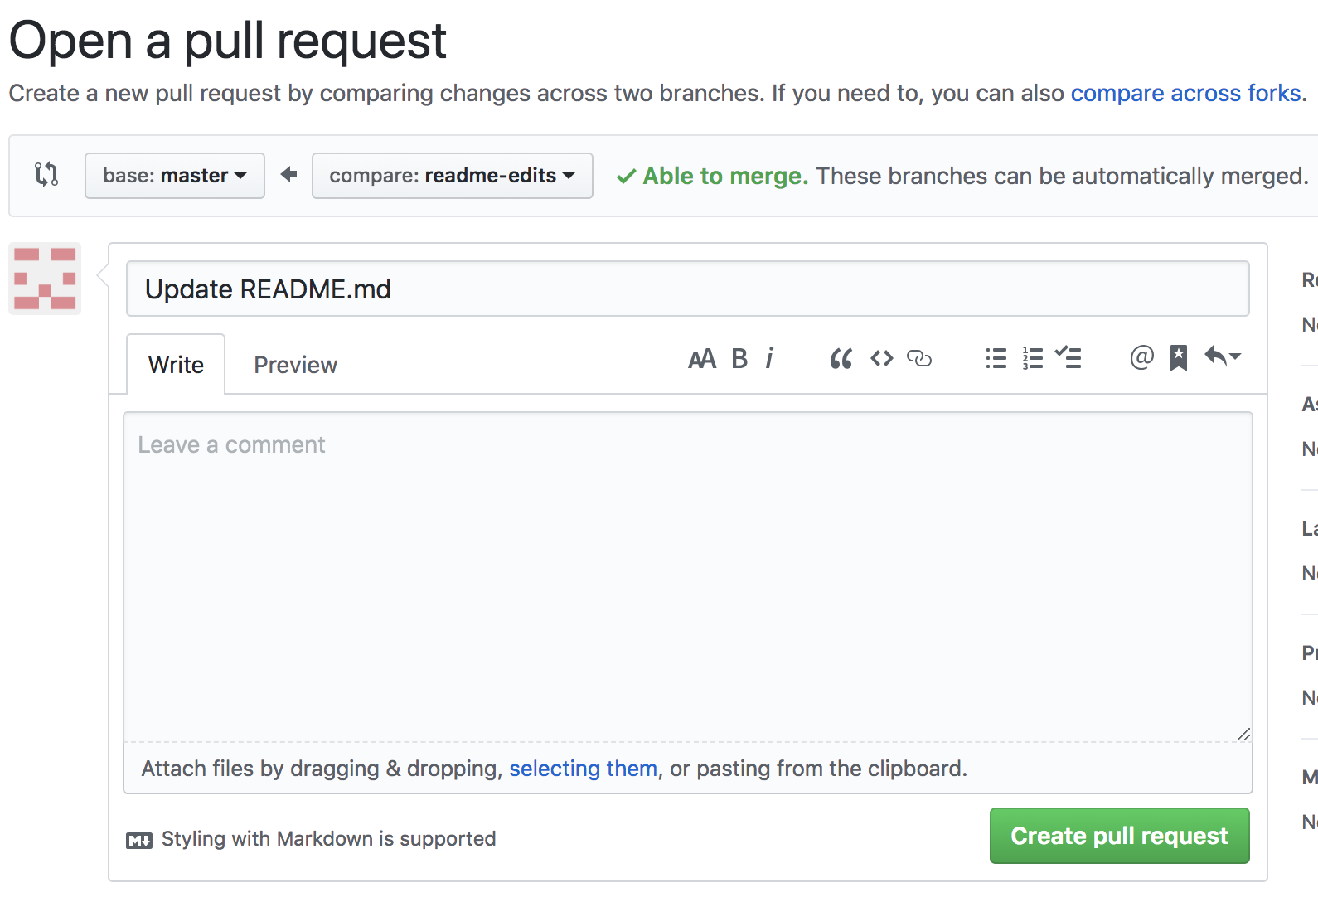
Pull Request
To do comparisons and merge changes
Look at the changes
Create a pull request
When you open a pull request, you’re proposing your changes and requesting that someone review and pull in your contribution and merge them into their branch. Pull requests show diffs, or differences, of the content from both branches. The changes, additions, and subtractions are shown in green and red.

Slide 7
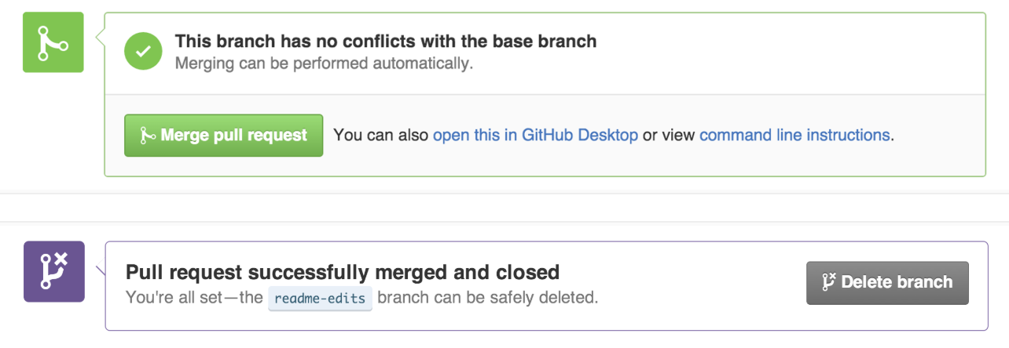
Merging
Click the Merge pull request button to merge the changes into master
Click Confirm merge
Delete the branch, since its changes have been incorporated, with the Delete branch button

Slide 8
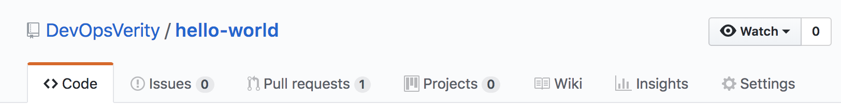
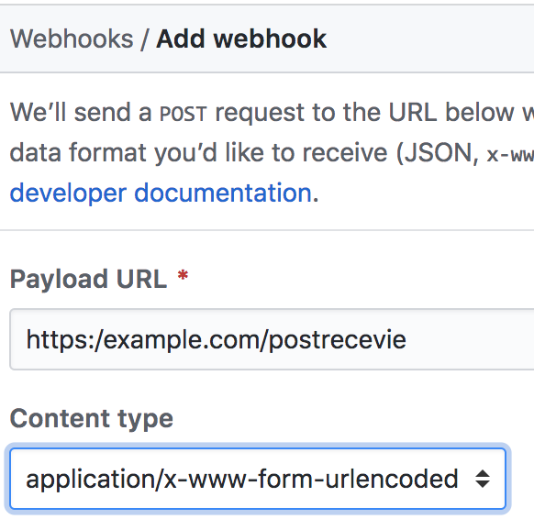
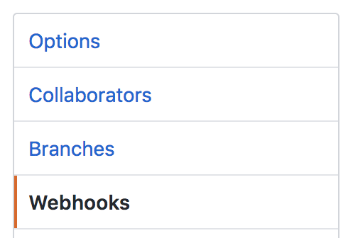

Setting up Webhooks in GitHub
Webhook will notify Jenkins when new commit is done
GitHub web > Go to "Settings" (of repository) > Click "Webhooks" > Click "Add webhook"
Enter "Payload URL" http://localhost:8080/github-webhook/
Select Application type "application/json"
Click "Add webhook"

Slide 9

Download & Install GitHub Desktop
Open the browser and go to https://desktop.github.com/
Click “Download for Windows (64bit)”
Run the installer
Follow the instructions from the wizard until the installation is completed
Do login in GitHub Desktop(File > Options > Accounts > Sign in)

Slide 10
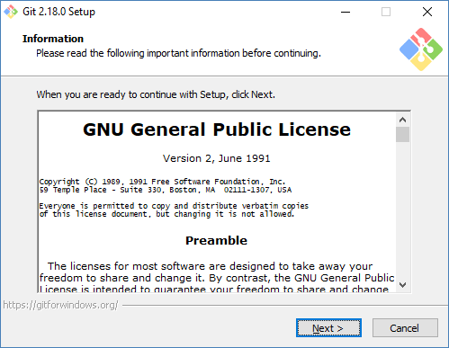
Git
Download Git from https://git-scm.com/downloads if not already installed
Run the installer
Follow the instructions from the wizard until the installation is completed
Create a folder(eg. git) in any drive in your machine(e.g. C:\git)
Launch GitBash from C:\Program Files\Git\git-bash.exe
Launch following commands in GitBash:
cd /C/git
git config --global user.name "<your github username>"
git config --global user.email "<your email id>"

Slide 11
Some Git Commands
git clone https://github.com/umangsaltuniv/testing.git
cd testing
Copy HelloWorld.java file from Git folder and paste it in to C:\git\testing
git add HelloWorld.java
git status
git commit -m "myfirstcommit" HelloWorld.java
git push -u origin master
Go to GitHub web and click repository link name(e.g. testing)

