Slide 1
Jenkins and Maven

Slide 2
Jenkins
Automation server written in Java which helps to automate the build process with continuous integration and facilitating technical aspects of continuous delivery.
It can execute Apache Ant, Apache Maven based projects as well as arbitrary shell scripts and Windows batch commands.
Builds can be triggered by various means such as commit or scheduling

Slide 3
Maven
Maven was originally started to simplify the build processes
It can be used for building and managing any Java-based project.
Maven’s Objectives
Making the build process easy
Providing a uniform build system
Providing quality project information
Providing guidelines for best practices development
Allowing transparent migration to new features

Slide 4
Jenkins Installation
Jenkins can be installed stand-alone or one can use a docker container that has devopstraining installation.
We will use Docker based system
devopstraining
Provides a good user experience of Jenkins to model and present the process of software delivery

Slide 5
Maven Installation(if not already in docker image)
In terminal,
docker container ls -a
docker exec –it <<container id>> /bin/bash
Go to lib
Run apk add maven
mvn --version

Slide 6
Tomcat Installation(if not already in docker image)
In terminal,
docker container ls -a
docker exec –it <<container id>> /bin/bash
wget http://mirrors.estointernet.in/apache/tomcat/tomcat-9/v9.0.20/bin/apache-tomcat-9.0.20.zip -O /tmp/apache-tomcat-9.0.20.zip
Note: if above tomcat version version does not work, use another version from
http://mirrors.estointernet.in/apache/tomcat/
Go to /tmp
unzip apache-tomcat-9.0.20.zip
Go to apache-tomcat-9.0.20/bin
Give access by below command:
chmod +x *.sh

Slide 7
Tomcat Installation(Cont…)
In terminal,
Edit server.xml under conf:
vi server.xml
edit port 8080 to 8089
press esc > press shift key+colon > write wq > press enter
Go to /tmp/apache-tomcat-9.0.20/bin
To start server:
sh startup.sh
To stop server:
sh shutdown.sh

Slide 8
Jenkins Hands-on
In next set of slides we will
Download a Docker image which has Jenkins, maven, tomcat installed
Create a pipeline to do following tasks in sequence
Download sources from a GitHub repository and use maven to build it
Perform PMD
Code Compile
Static Code Analysis
Perform Static Code Analysis
Run Junit based tests on it
Perform Code coverage
Make build
Tomcat server up
Deploy war on tomcat
Run the system test

Slide 9
Docker Image with Preinstalled Jenkins
Run the following command
Note: Make sure you have created blueoceantest folder is created under C:\Users\<username>\
Windows
docker run --rm -u root -p 8089:8089 -p 8080:8080 -v jenkins-data:/var/jenkins_home -v /var/run/docker.sock:/var/run/docker.sock -v c:\\"%HOMEPATH%"\blueoceantest:/home umangsaltuniv/devopstraining
(Note: command for jenkinsci/blueocean is mentioned below)
docker run --rm -u root -p 8089:8089 -p 8080:8080 -v jenkins-data:/var/jenkins_home -v /var/run/docker.sock:/var/run/docker.sock -v c:\\"%HOMEPATH%“\blueoceantest:/home jenkinsci/blueocean
Linux/Mac
docker run --rm -u root -p 8089:8089 -p 8080:8080 -v jenkins-data:/var/jenkins_home -v /var/run/docker.sock:/var/run/docker.sock -v $HOME:/home umangsaltuniv/devopstraining

Slide 10
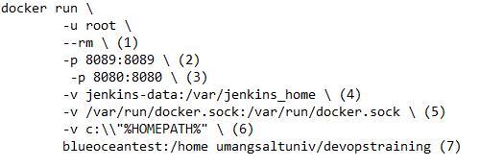
Understanding the Command
Automatically removes the Docker container when it is shut down
Maps port 8089 on the host machine to port 8089 of the umangsaltuniv/devopstraining container for tomcat server
Maps port 8080 on the host machine to port 8080 of the umangsaltuniv/devopstraining container for jenkins server
Let’s not worry about it right now
(But highly recommended) Maps the /var/jenkins_home directory in the container to the Docker volume with the name jenkins-data (automatically created if non-existen). Makes Jenkins state to persist each time you restart Jenkins
Allows umangsaltuniv/devopstraining container to communicate with the Docker daemon when we use “agent” command in pipeline code
Maps the %HOMEPATH% directory on the host machine to the /home directory in the container. Mac has slightly different syntax

Slide 11
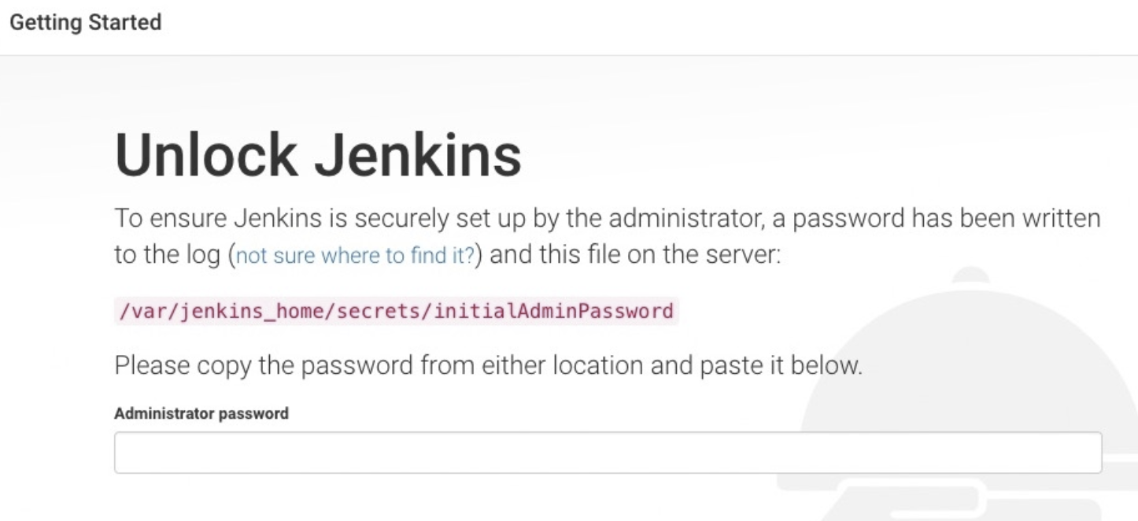
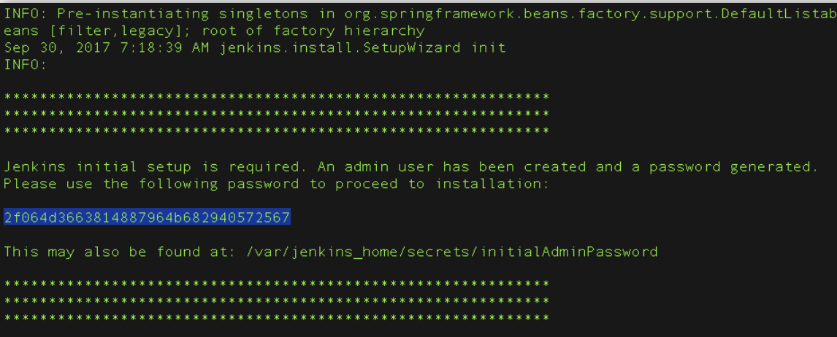
Unlocking Jenkis
After the 2 sets of asterisks appear in the terminal/command prompt window, browse to http://localhost:8080 and wait until the Unlock Jenkins page appears
From the terminal/command prompt window again, copy the automatically-generated alphanumeric password (between the 2 sets of asterisks)
On Customize Jenkins page click Install suggested plugins

Slide 12
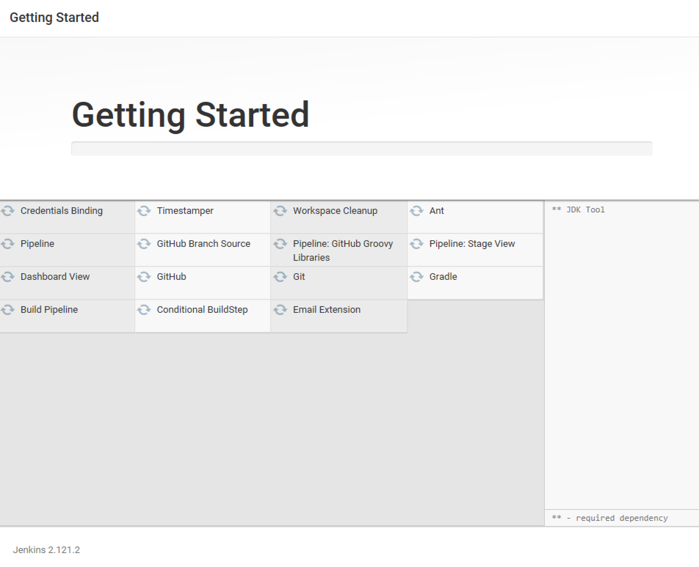
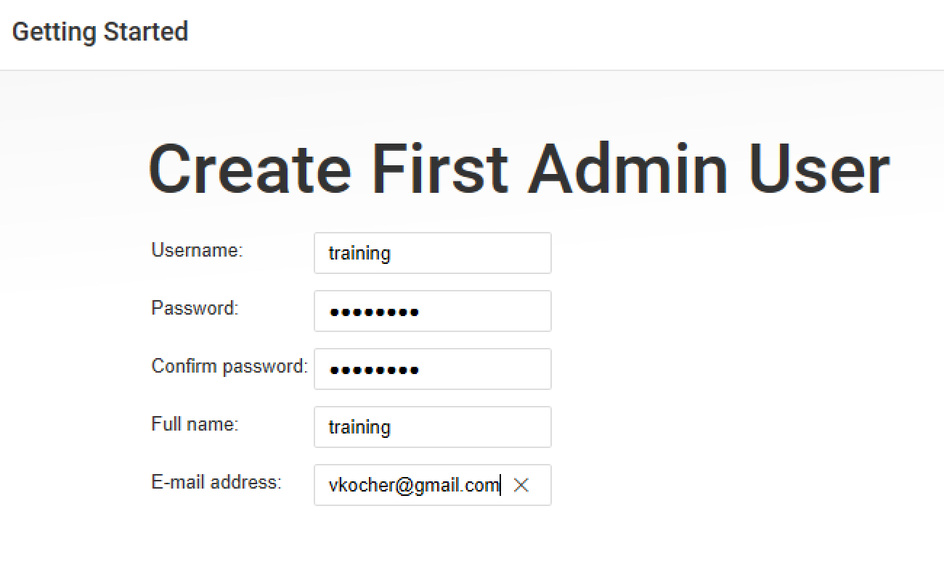
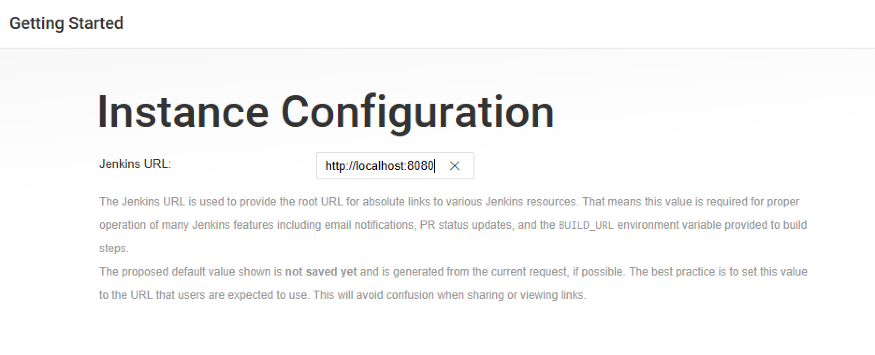
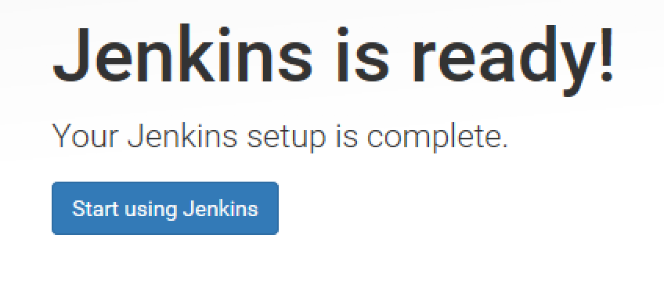
Getting Started
When the Create First Admin User page appears, specify your details in the respective fields and click Save and Finish.
When the Jenkins is ready page appears, click Start using Jenkins.
Please note
This page may indicate Jenkins is almost ready! instead and if so, click Restart.
If the page doesn’t automatically refresh after a minute, use your web browser to refresh the page manually.
If required, log in to Jenkins with the credentials of the user you just created and you’re ready to start using Jenkins!
you can stop the umangsaltuniv/devopstraining Docker container by typing Ctrl-C

Slide 13
Step 1 - Getting Sample Code(App & System Tests)
Open the browser and go to https://github.com/login
Login to your account
Launch URL https://github.com/umangsaltuniv/verity-devops
Click Fork at right top section
"verity-devops" repository will be added on your GitHub account
Launch URL https://github.com/umangsaltuniv/EMSystemTests.git
Click Fork at right top section
“EMSystemsTests” repository will be added on your GitHub account
Note: verity-devops project has Expense Manager sample app & some unit tests those will run on the app to do unit testing of the app. EMSystemTests project has system test that will run on the app to do system testing of the app

Slide 14
Step 2 - Cloning Sample Code(App)
After forking verity-devops repository on GitHub Web, Click “Clone or download”
Click “Open in Desktop”
Click “Open GitHubDesktop”
In GitHub Desktop, before clicking Clone on the Clone a Repository dialog box, ensure Local Path is set to C:\DO-United\GitHubRepo\verity-devops
Click Clone
Note down the URL where you forked (https://github.com/<Your username>/verity-devops.git)
GitHub Desktop will be opened in cloned repository
Notes:
Select workspace location where you need to keep repository code(e.g. C:\Users\<yourusername>\blueoceantest\workspace\)
Copy Repository URL(e.g. https://github.com/umangsaltuniv/verity-devops.git) and note down it somewhere (you will need this URL later)

Slide 15
Step 2 - Cloning Sample Code(System Tests)
After forking EMSystemTests on GitHub Web, Click “Clone or download”
Click “Open in Desktop”
Click “Open GitHubDesktop”
In GitHub Desktop, before clicking Clone on the Clone a Repository dialog box, ensure Local Path is set to C:\DO-United\GitHubRepo\EMSystemTests
Click Clone
Note down the URL where you forked (https://github.com/<Your username>/EMSystemTests.git)
GitHub Desktop will be opened in cloned repository
Notes:
Select workspace location where you need to keep repository code(e.g. C:\Users\<yourusername>\blueoceantest\workspace\)
Copy Repository URL(e.g. https://github.com/umangsaltuniv/EMSystemTests.git) and note down it somewhere (you will need this URL later)

Slide 16
Step 3 - Create Pipeline Project
Go to Jenkins Dashboard
Click “New Item” at top left section
Enter project name(verity-devops) > Select Pipeline > Click OK
Note: Make sure jenkins pipeline project name & github repository name should be same(e.g verity-devops)
Go to Pipeline section
Choose the ”Pipeline script from SCM” option from the ”Definition” field
Choose the ”Git” option from the ”SCM” field
Enter your Repository URL(e.g. https://github.com/<Your username>/verity-devops.git)
Enter “Jenkinsfile.txt” under “Script Path” section
Click Apply > Save

Slide 17
Step 4 - Create Jenkinsfile
Create and save new text file with the name Jenkinsfile.txt at the root of your local verity-devops Git repository
Write the pipeline code (see next pages) into your empty Jenkinsfile stage by stage

Slide 18
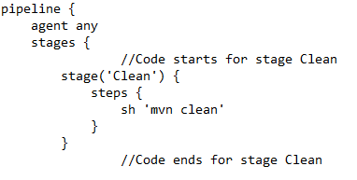
Add Stage 1 – Clean
Clean defines a stage that appears on the Jenkins UI
sh runs the Maven command to cleanly target folder that includes code compiled classes, unit test reports, war files etc

Slide 19
Step 5- Saving Jenkinsfile/Commit
Save the edited Jenkinsfile and commit it to GitHub Web by following steps:
Open GitHub Desktop
JenkinsFile will be selected & displayed under Current repository “verity-devops”
Select Current branch as “master”
Enter Summary under “Summary” section
Click “Commit to master”
Click “Fetch origin”
Go to your repository on GitHub Web & Refresh the page
JenkinsFile will be displayed there

Slide 20
Step 6 - Running The Pipeline
Go to Jenkins Dashboard
Click “Open Blue Ocean” at left section
Click your pipeline project
Click Run
Then quickly click the ”OPEN” link which appears at the lower right section to see running progress of your Pipeline project
Jenkins Initially queues the project to be run on the agent

Slide 21
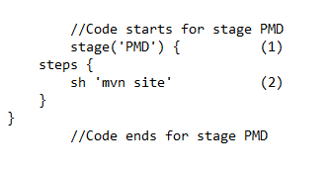
Add Stage 2 – PMD
PMD defines a stage that appears on the Jenkins UI
sh runs the Maven command to detect programming mistake detector

Slide 22
Step 7- Saving Jenkinsfile/Commit
Save the edited Jenkinsfile and commit it to GitHub Web by following steps:
Open GitHub Desktop
JenkinsFile will be selected & displayed under Current repository “verity-devops”
Select Current branch as “master”
Enter Summary under “Summary” section
Click “Commit to master”
Click “Fetch origin”
Go to your repository on GitHub Web & Refresh the page
JenkinsFile will be displayed there

Slide 23
Step 8 - Running The Pipeline
Go to Jenkins Dashboard
Click “Open Blue Ocean” at left section
Click your pipeline project
Click Run
Then quickly click the ”OPEN” link which appears at the lower right section to see running progress of your Pipeline project
Jenkins Initially queues the project to be run on the agent

Slide 24
Getting the PMD reports
Launch below command in cmd
docker container ls –a
docker exec –it <<container id>> /bin/bash
ls var/jenkins_home/workspace/ExpenseManager/target/site/
pmd.html is stored in var/jenkins_home/workspace/ExpenseManager/target/site/
The following command will download pmd.html to local machine
docker cp <<container id>>:var/jenkins_home/workspace/ExpenseManager/target/site/pmd.html D:\pmd.html

Slide 25
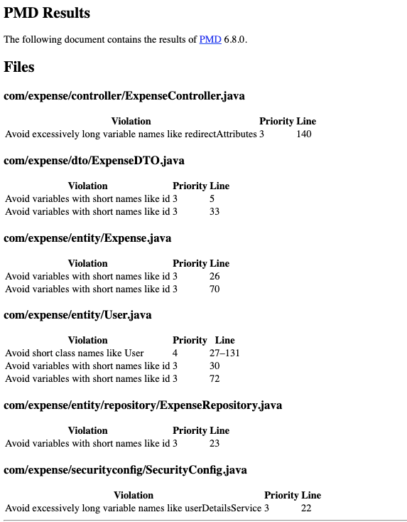
PMD Result
You can see result in pmd.html

Slide 26
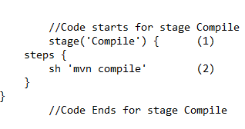
Add Stage 3 – Compile
Compile defines a stage that appears on the Jenkins UI
sh runs the Maven command to compile the source code

Slide 27
Step 9- Saving Jenkinsfile/Commit
Save the edited Jenkinsfile and commit it to GitHub Web by following steps:
Open GitHub Desktop
JenkinsFile will be selected & displayed under Current repository “verity-devops”
Select Current branch as “master”
Enter Summary under “Summary” section
Click “Commit to master”
Click “Fetch origin”
Go to your repository on GitHub Web & Refresh the page
JenkinsFile will be displayed there

Slide 28
Step 10 - Running The Pipeline
Go to Jenkins Dashboard
Click “Open Blue Ocean” at left section
Click your pipeline project
Click Run
Then quickly click the ”OPEN” link which appears at the lower right section to see running progress of your Pipeline project
Jenkins Initially queues the project to be run on the agent

Slide 29
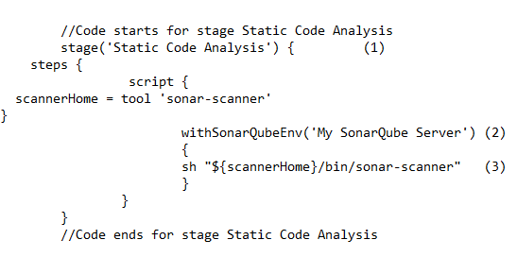
Add Stage 4 – Static Code Analysis
Static Code Analysis defines a stage that appears on the Jenkins UI
Connects to SonarQube server
sh runs the sonar command to perform the static code analysis

Slide 30
Step 11- Saving Jenkinsfile/Commit
Save the edited Jenkinsfile and commit it to GitHub Web by following steps:
Open GitHub Desktop
JenkinsFile will be selected & displayed under Current repository “verity-devops”
Select Current branch as “master”
Enter Summary under “Summary” section
Click “Commit to master”
Click “Fetch origin”
Go to your repository on GitHub Web & Refresh the page
JenkinsFile will be displayed there

Slide 31
Step 12 - Running The Pipeline
Go to Jenkins Dashboard
Click “Open Blue Ocean” at left section
Click your pipeline project
Click Run
Then quickly click the ”OPEN” link which appears at the lower right section to see running progress of your Pipeline project
Jenkins Initially queues the project to be run on the agent

Slide 32
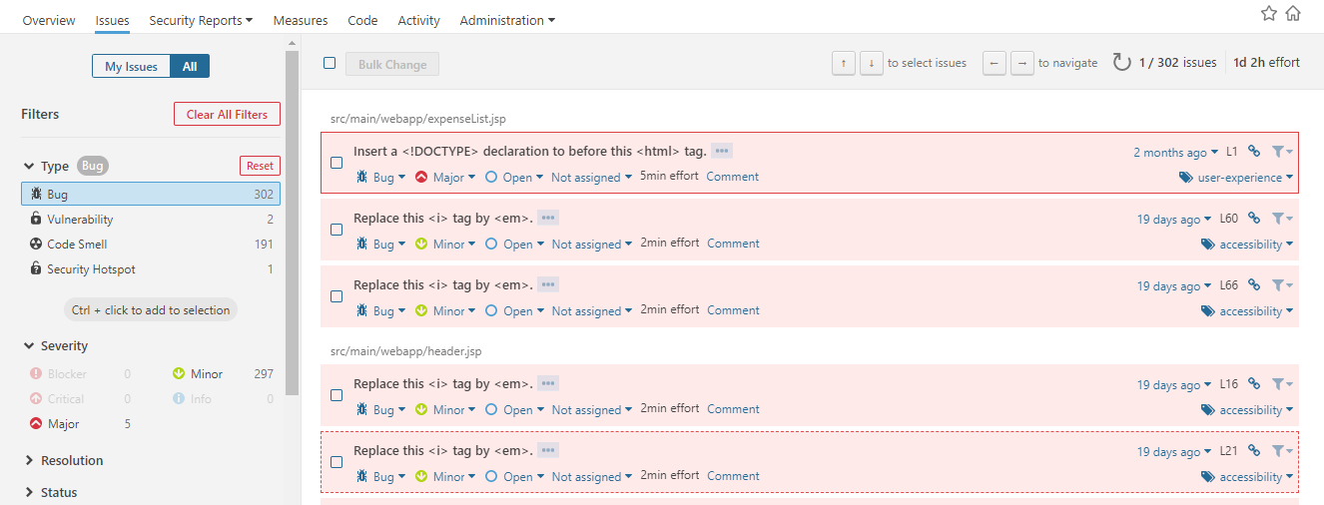
Static Code Analysis Results
Go to SonarQube web
See the results

Slide 33
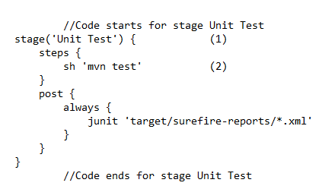
Add Stage 5 – Unit Test
Unit Test defines a stage that appears on the Jenkins UI
sh runs the Maven command to run the unit tests
Note: This junit command generates a JUnit XML
report, which is saved to the target/surefire
reports directory

Slide 34
Step 13- Saving Jenkinsfile/Commit
Save the edited Jenkinsfile and commit it to GitHub Web by following steps:
Open GitHub Desktop
JenkinsFile will be selected & displayed under Current repository “verity-devops”
Select Current branch as “master”
Enter Summary under “Summary” section
Click “Commit to master”
Click “Fetch origin”
Go to your repository on GitHub Web & Refresh the page
JenkinsFile will be displayed there

Slide 35
Step 14 - Running The Pipeline
Go to Jenkins Dashboard
Click “Open Blue Ocean” at left section
Click your pipeline project
Click Run
Then quickly click the ”OPEN” link which appears at the lower right section to see running progress of your Pipeline project
Jenkins Initially queues the project to be run on the agent

Slide 36
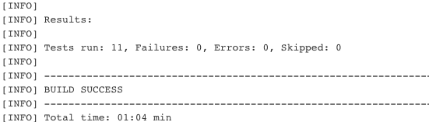
Unit Test Result
You can see result at below location in container:
/var/jenkins_home/workspace/ExpenseManager/target/surefire-reports/

Slide 37
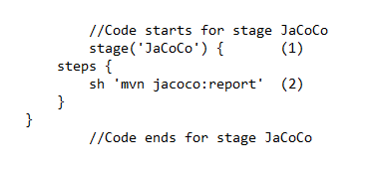
Add Stage 6 – JaCoCo
JaCoCo defines a stage that appears on the Jenkins UI
sh runs the Maven command to perform the code coverage

Slide 38
Step 15- Saving Jenkinsfile/Commit
Save the edited Jenkinsfile and commit it to GitHub Web by following steps:
Open GitHub Desktop
JenkinsFile will be selected & displayed under Current repository “verity-devops”
Select Current branch as “master”
Enter Summary under “Summary” section
Click “Commit to master”
Click “Fetch origin”
Go to your repository on GitHub Web & Refresh the page
JenkinsFile will be displayed there

Slide 39
Step 16 - Running The Pipeline
Go to Jenkins Dashboard
Click “Open Blue Ocean” at left section
Click your pipeline project
Click Run
Then quickly click the ”OPEN” link which appears at the lower right section to see running progress of your Pipeline project
Jenkins Initially queues the project to be run on the agent

Slide 40
Getting the JaCoCo reports
Launch below command in cmd
docker container ls –a
docker exec –it <<container id>> /bin/bash
ls var/jenkins_home/workspace/ExpenseManager/target/site/jacoco
index.html is stored in var/jenkins_home/workspace/ExpenseManager/target/site/jacoco
The following command will download index.html to local machine
docker cp <<container id>>:var/jenkins_home/workspace/ExpenseManager/target/site/jacoco/index.html D:\index.html

Slide 41
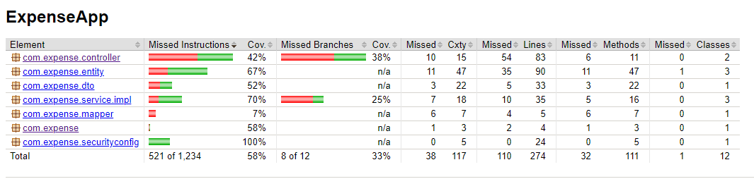
JaCoCo Result
You can see result in index.html

Slide 42
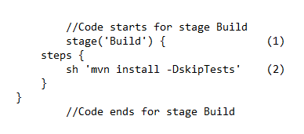
Add Stage 7 – Build
Build defines a stage that appears on the Jenkins UI
sh runs the Maven command to build the web application without running the unit tests

Slide 43
Step 17- Saving Jenkinsfile/Commit
Save the edited Jenkinsfile and commit it to GitHub Web by following steps:
Open GitHub Desktop
JenkinsFile will be selected & displayed under Current repository “verity-devops”
Select Current branch as “master”
Enter Summary under “Summary” section
Click “Commit to master”
Click “Fetch origin”
Go to your repository on GitHub Web & Refresh the page
JenkinsFile will be displayed there

Slide 44
Step 18 - Running The Pipeline
Go to Jenkins Dashboard
Click “Open Blue Ocean” at left section
Click your pipeline project
Click Run
Then quickly click the ”OPEN” link which appears at the lower right section to see running progress of your Pipeline project
Jenkins Initially queues the project to be run on the agent

Slide 45
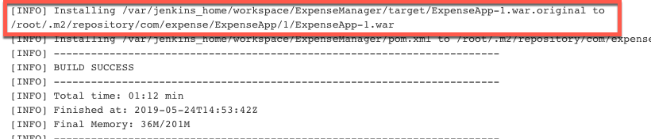
Build Result
The war file would be generated
We can view the presence of the war file using
You can find war at below location in container: /var/jenkins_home/workspace/ExpenseManager/target/

Slide 46
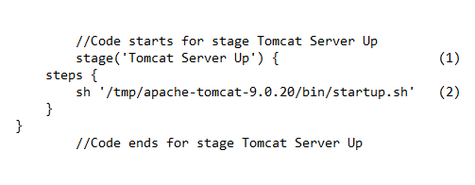
Add Stage 8 – Tomcat Server Up
Tomcat Server Up defines a stage that appears on the Jenkins UI
sh runs the command launch Tomcat server

Slide 47
Step 19- Saving Jenkinsfile/Commit
Save the edited Jenkinsfile and commit it to GitHub Web by following steps:
Open GitHub Desktop
JenkinsFile will be selected & displayed under Current repository “verity-devops”
Select Current branch as “master”
Enter Summary under “Summary” section
Click “Commit to master”
Click “Fetch origin”
Go to your repository on GitHub Web & Refresh the page
JenkinsFile will be displayed there

Slide 48
Step 20 - Running The Pipeline
Go to Jenkins Dashboard
Click “Open Blue Ocean” at left section
Click your pipeline project
Click Run
Then quickly click the ”OPEN” link which appears at the lower right section to see running progress of your Pipeline project
Jenkins Initially queues the project to be run on the agent

Slide 49
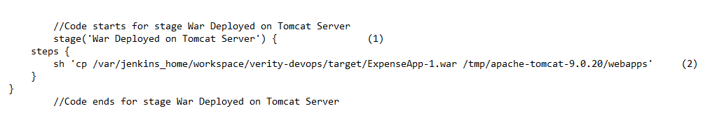
Add Stage 9 – War Deployed on Tomcat Server
War Deployed on Tomcat Server defines a stage that appears on the Jenkins UI
sh runs the command to move war file from code project location to Tomcat’s location

Slide 50
Step 21- Saving Jenkinsfile/Commit
Save the edited Jenkinsfile and commit it to GitHub Web by following steps:
Open GitHub Desktop
JenkinsFile will be selected & displayed under Current repository “verity-devops”
Select Current branch as “master”
Enter Summary under “Summary” section
Click “Commit to master”
Click “Fetch origin”
Go to your repository on GitHub Web & Refresh the page
JenkinsFile will be displayed there

Slide 51
Step 22 - Running The Pipeline
Go to Jenkins Dashboard
Click “Open Blue Ocean” at left section
Click your pipeline project
Click Run
Then quickly click the ”OPEN” link which appears at the lower right section to see running progress of your Pipeline project
Jenkins Initially queues the project to be run on the agent

Slide 52
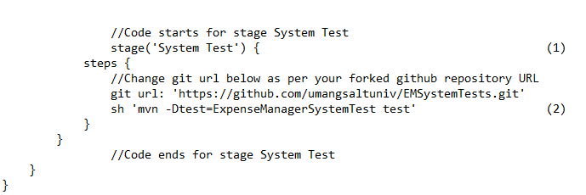
Add Stage 10 – System Test
System Test defines a stage that appears on the Jenkins UI
sh runs the Maven command to run the system tests

Slide 53
Step 23- Saving Jenkinsfile/Commit
Save the edited Jenkinsfile and commit it to GitHub Web by following steps:
Open GitHub Desktop
JenkinsFile will be selected & displayed under Current repository “verity-devops”
Select Current branch as “master”
Enter Summary under “Summary” section
Click “Commit to master”
Click “Fetch origin”
Go to your repository on GitHub Web & Refresh the page
JenkinsFile will be displayed there

Slide 54
Step 24 - Running The Pipeline
Go to Jenkins Dashboard
Click “Open Blue Ocean” at left section
Click your pipeline project
Click Run
Then quickly click the ”OPEN” link which appears at the lower right section to see running progress of your Pipeline project
Jenkins Initially queues the project to be run on the agent

Slide 55
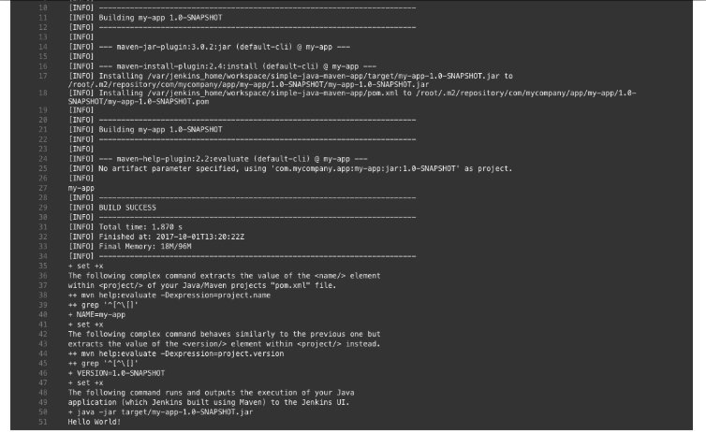
Output
Jenkins will show output of Deliver stage by showing execution results of your web application

