Slide 1
Puppet

Slide 2
Download Puppet
Open the browser and go to https://puppet.com/download-learning-vm
Enter your email id at right section & Click “Download Learning VM”
Click "Download now“
OVA file will be downloaded
Once download is finished, unzip the ova file

Slide 3
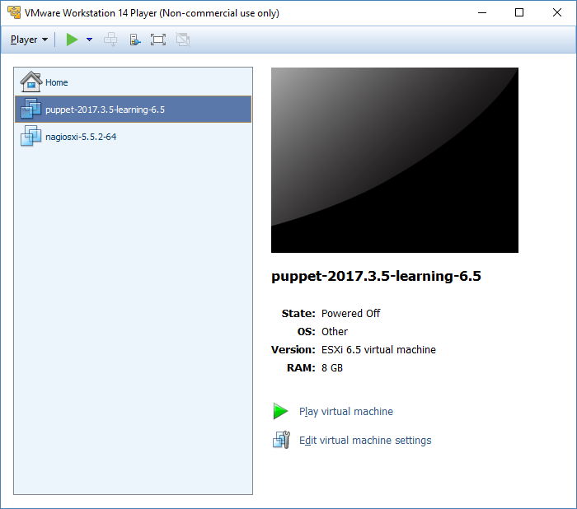
Setup Puppet UI
Pre-requisite: Disable Hyper-V option(Control Panel > Programs > Turn Windows features on or off >De-select Hyper-V > Restart the machine).
Note: If you find any Windows Defender issue while setting up puppet in VM, then launch cmd with adminstrator rights, launch command bcdedit /set hypervisorlaunchtype off and then restart your machine
Launch VMWare Workstation
Go to Player > File > Open > Import ova file from machine > Import
It may take some time, once file import is finished then puppet image will be displayed in VMWare Workstation
Click “Edit virtual machine settings” > Set RAM to 8GB > OK

Slide 4
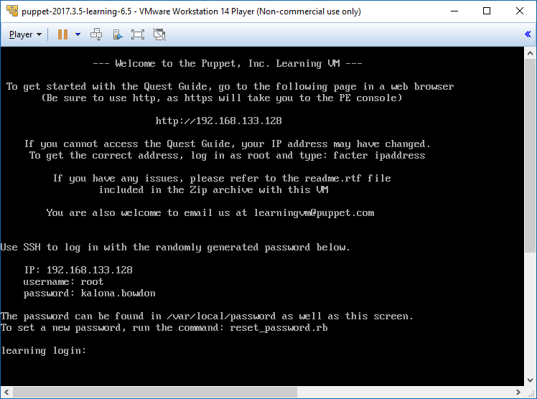
Setup Puppet UI
Play the image
Puppet terminal will be launched

Slide 5
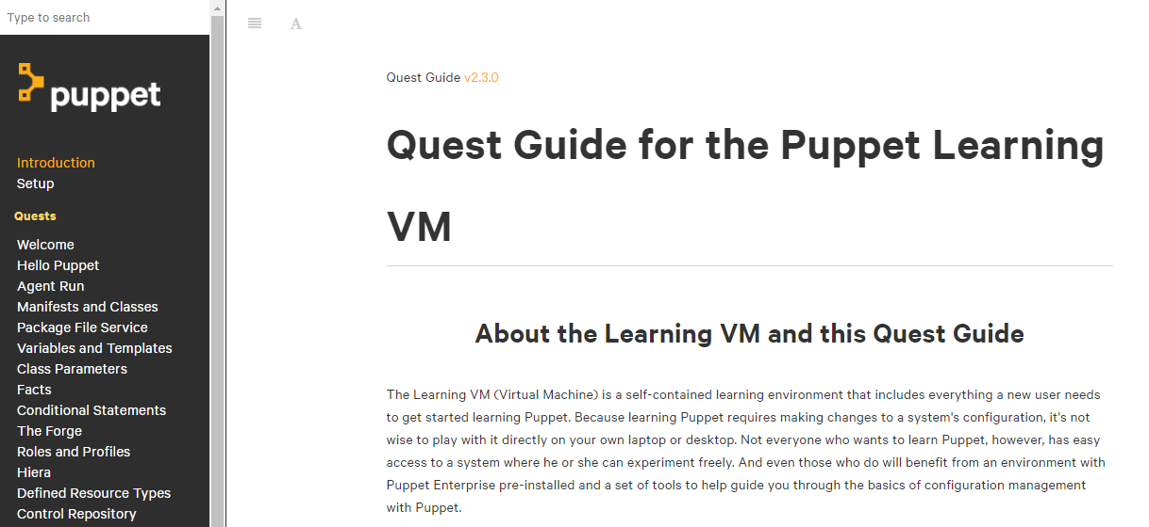
Setup Puppet UI
Launch puppet terminal ip address(e.g. 192.168.229.101) in your machine’s browser to get puppet guide
Note: Use Chrome browser instead of IE for accessing puppet guide
Click "English“
Puppet Guide will be opened up
Follow the instructions those are mentioned in puppet guide

Slide 6
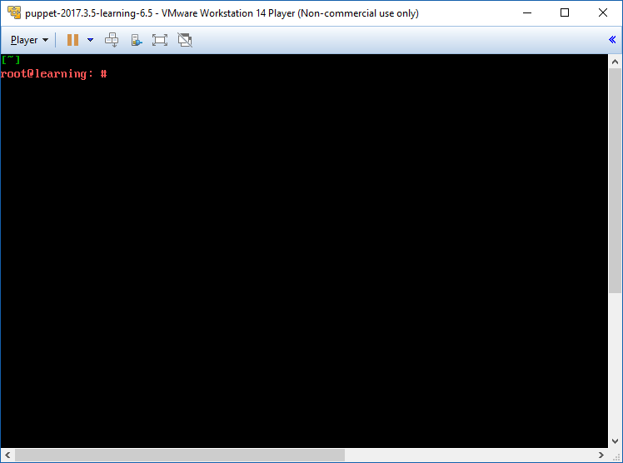
Setup Puppet
Login to the terminal by entering username(root) & password(e.g. kalona.bowdon)

Slide 7
Setup Puppet
Run following commands in Puppet terminal:
quest begin hello_puppet
ssh learning@hello.puppet.vm
(Password is puppet)
curl -k https://learning.puppetlabs.vm:8140/packages/current/install.bash | sudo bash
(It will install Puppet Agent)
sudo puppet resource file /tmp/test
touch /tmp/test
sudo puppet resource file /tmp/test
sudo puppet resource file /tmp/test content='Hello Puppet!'
cat /tmp/test
sudo puppet resource package httpd
sudo puppet resource package bogus-package ensure=present
sudo puppet resource package bogus-package ensure=present provider=gem
sudo puppet resource package httpd ensure=present
exit

Slide 8
Setup Puppet
Run following commands in Puppet terminal:
quest begin agent_run
ssh learning@agent.puppet.vm
(Password is puppet)
sudo puppet agent -t
exit
puppet cert list
puppet cert sign agent.puppet.vm
ssh learning@agent.puppet.vm
(Password is puppet)
sudo puppet agent -t
exit

Slide 9
Setup Puppet
Run following commands in Puppet terminal:
vim /etc/puppetlabs/code/environments/production/manifests/site.pp ssh
Write below code & then use ESC then :wq to save your file:
node 'agent.puppet.vm' {
notify { 'Hello Puppet!': }
}
Run following commands in Puppet terminal:
ssh learning@agent.puppet.vm
(Password is puppet)
sudo puppet agent -t

Slide 10
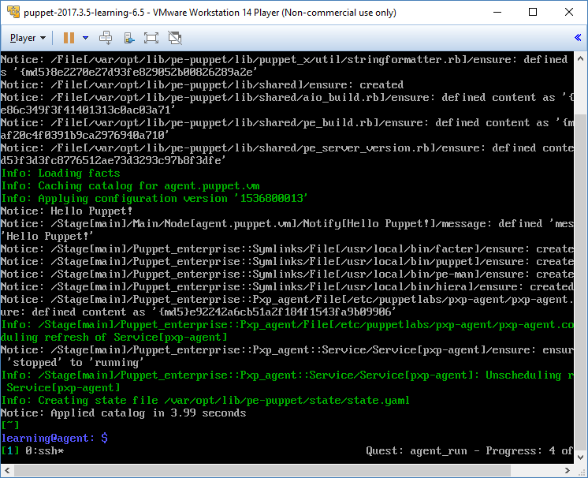
Setup Puppet
Output will be displayed something like this in terminal:
Notice: Hello Puppet!
Notice: /Stage[main]/Main/Node[agent.puppet.vm]/Notify[Hello Puppet!]/message: defined 'message' as 'Hello Puppet!‘
Notice: Applied catalog in 3.99 seconds
Close VMWare Workstation

