Slide 1
Sampling
Slides

Slide 2
What we are covering
Review of Vitamin
Show of issue of unequal bins
Review of last part of content
Automation and Iteration
Advanced Table Functions
Sampling (Different Kinds of samples)
Garbage In, Garbage Out Principle
What are possible issues in the data you have an are working with?
Project Checkpoint!
Fizzbuzz part 2
→ Make this a Vitamin
→

Slide 3
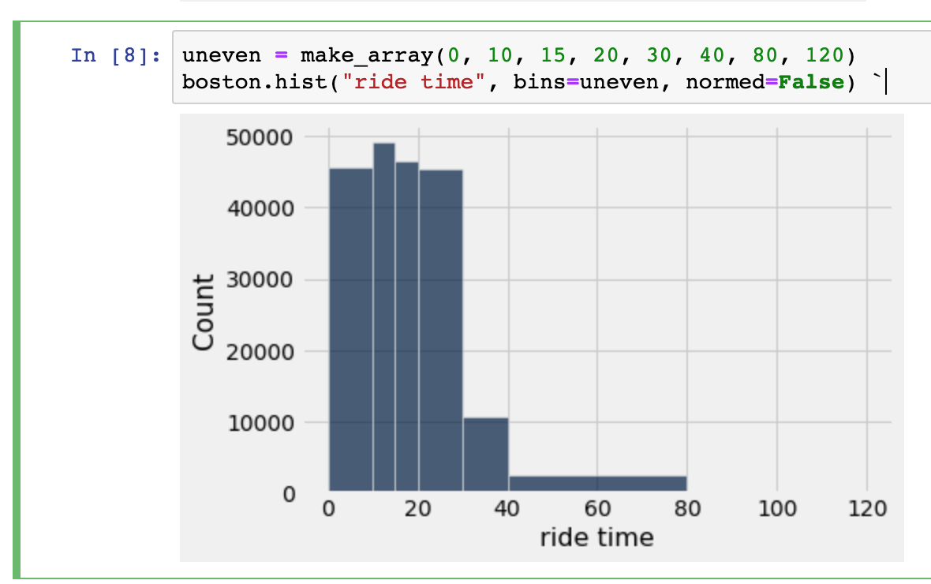
Binning

Slide 4
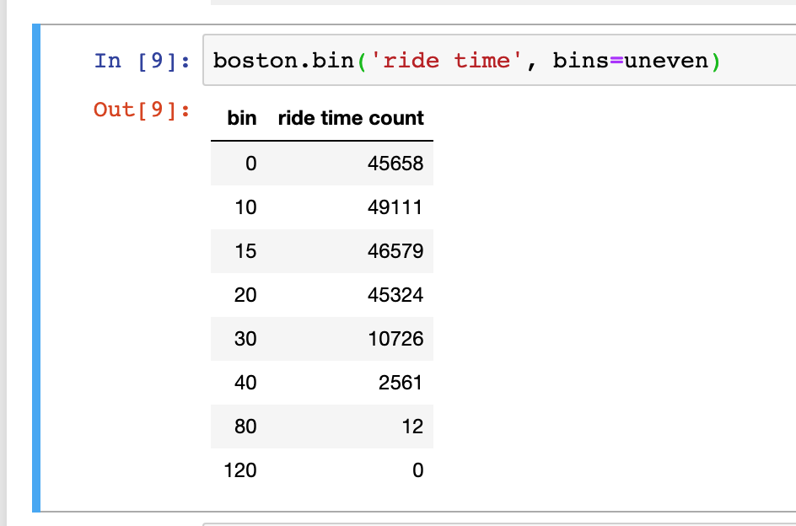
Binning

Slide 5
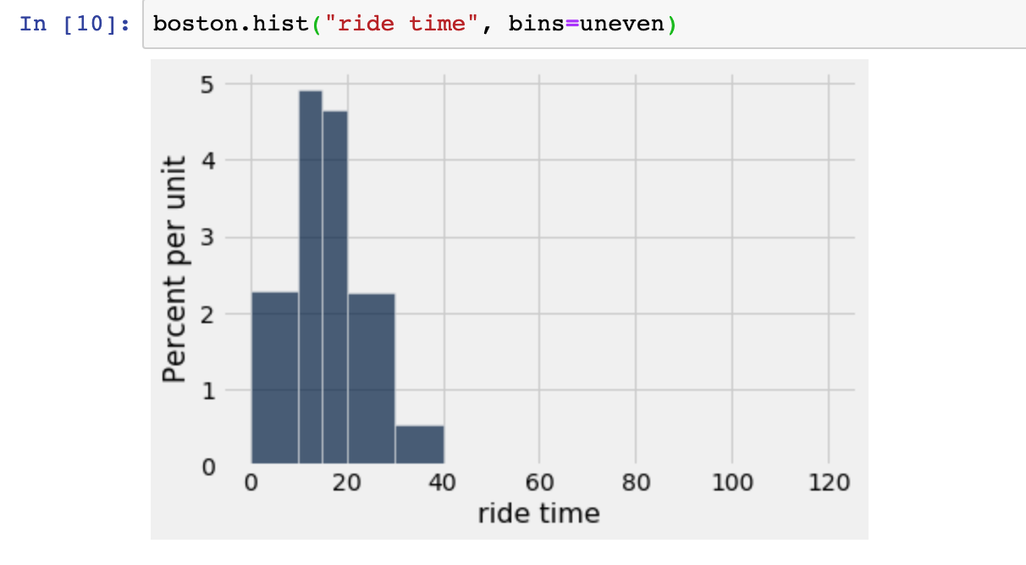
Binning

Slide 6
Grouping with multiple variables
Review Vitamin
We can’t tell how heights are distributed within a bin.
Show off issue of unequal bins (and normalization)
Fizzbuzz part 2
→ Make this a Vitamin
→

Slide 7
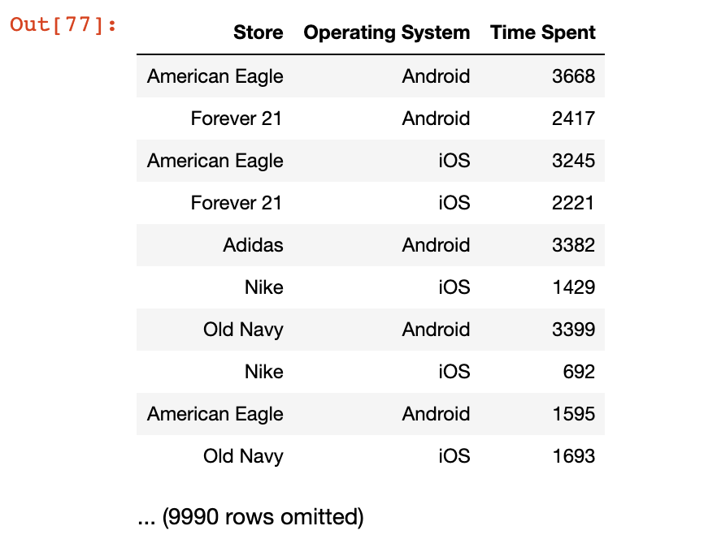
Shopping Data
The following is Synthetic data for the amount of time spent inside stores located in ___ Mall
Each row represent an individual’s visit at a store
Store is a String
containing the name of
the Department Store
Operating System is string containing the operating system on the person’s phone when they visited
Time Spent is an integer representing how many minutes they were physically at that store for that visit

Slide 8
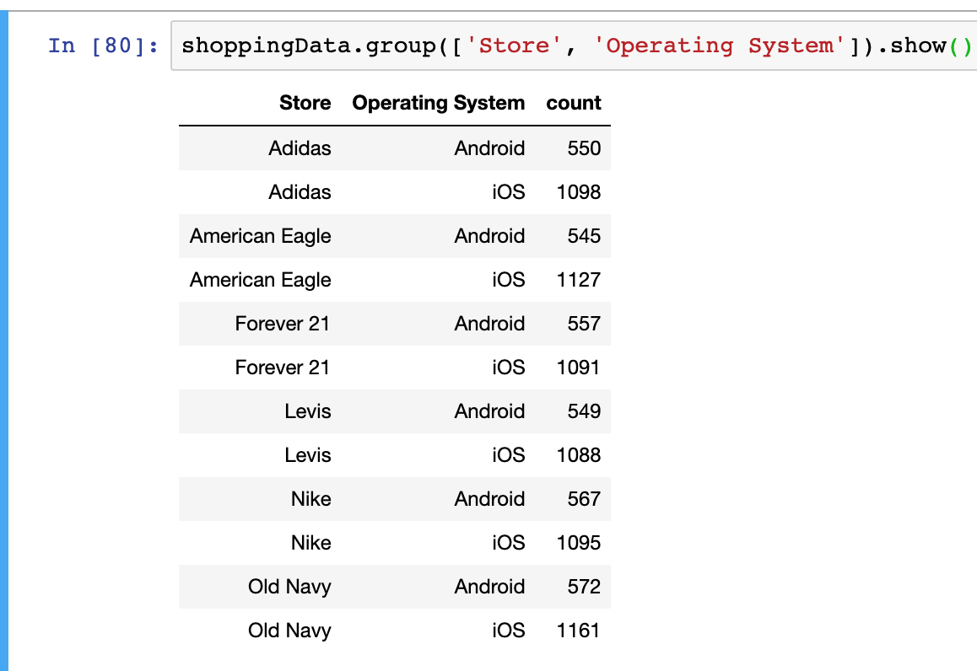
Group with multiple columns

Slide 9
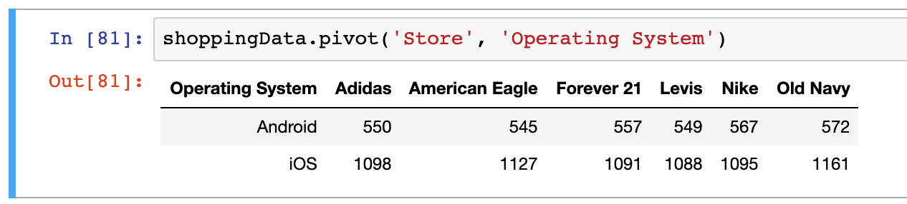
Pivot

Slide 10
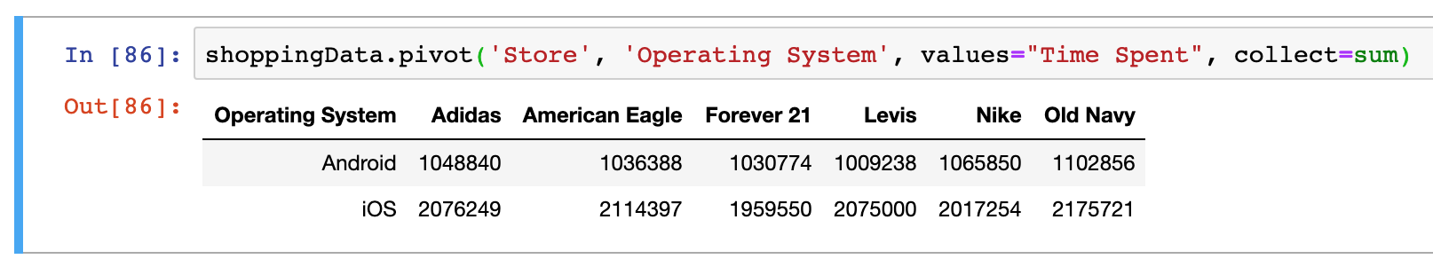
Pivot

Slide 11
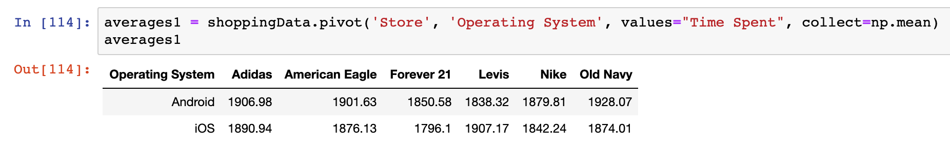
Pivot (Average)

Slide 12
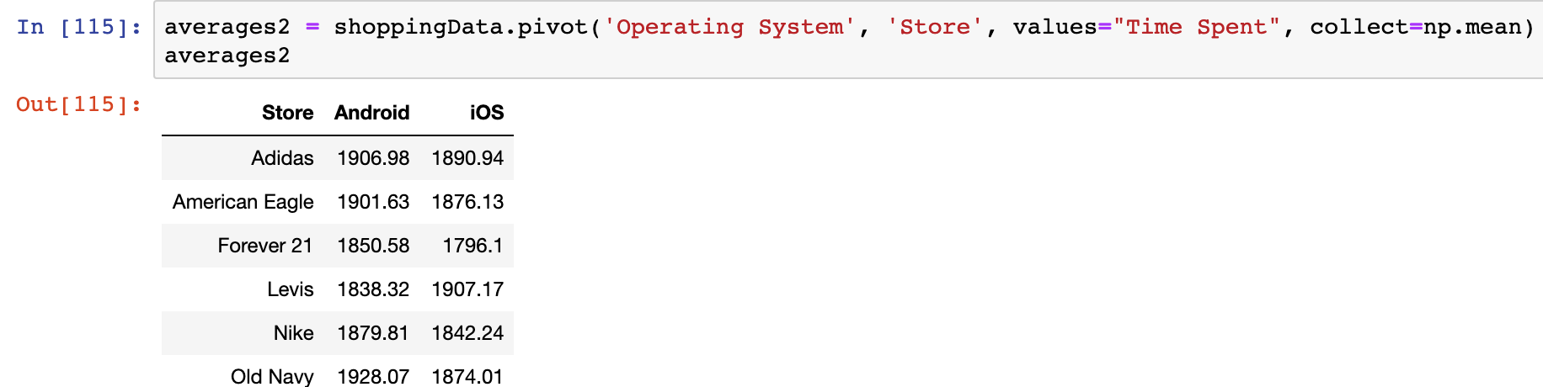
Pivot

Slide 13
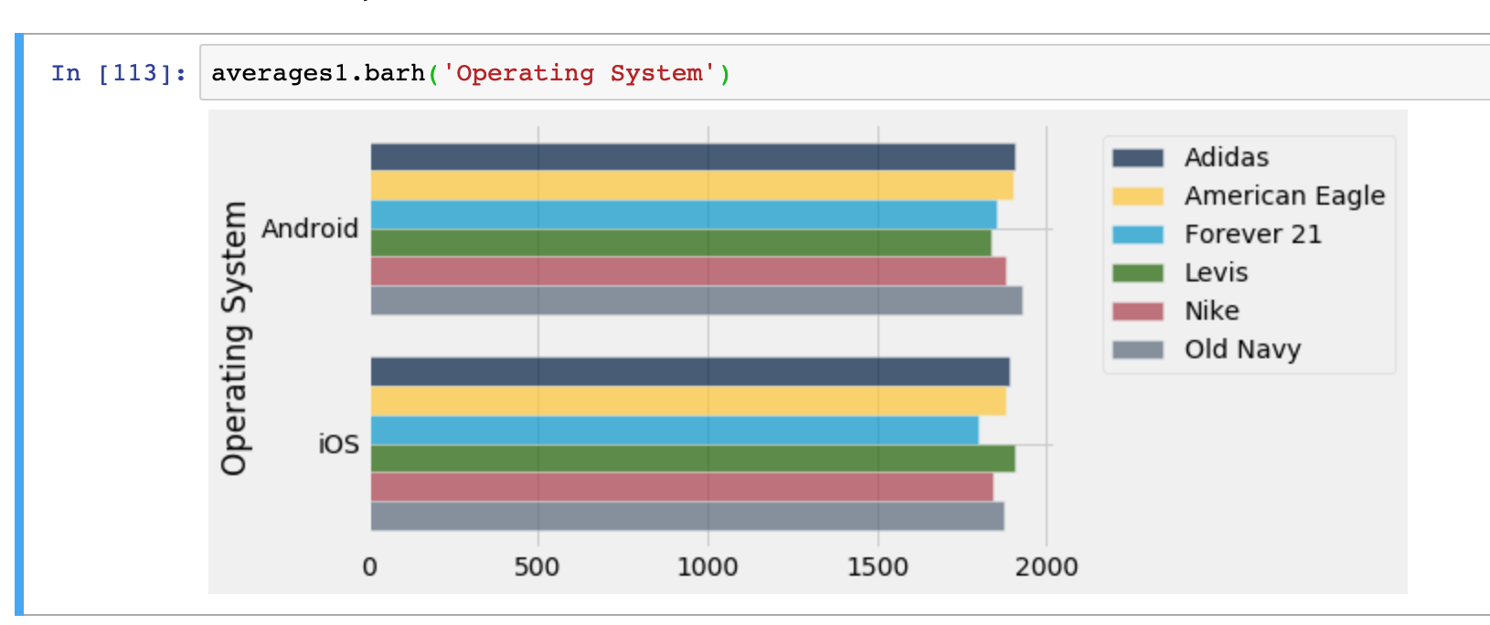
Visualizing Pivots

Slide 14
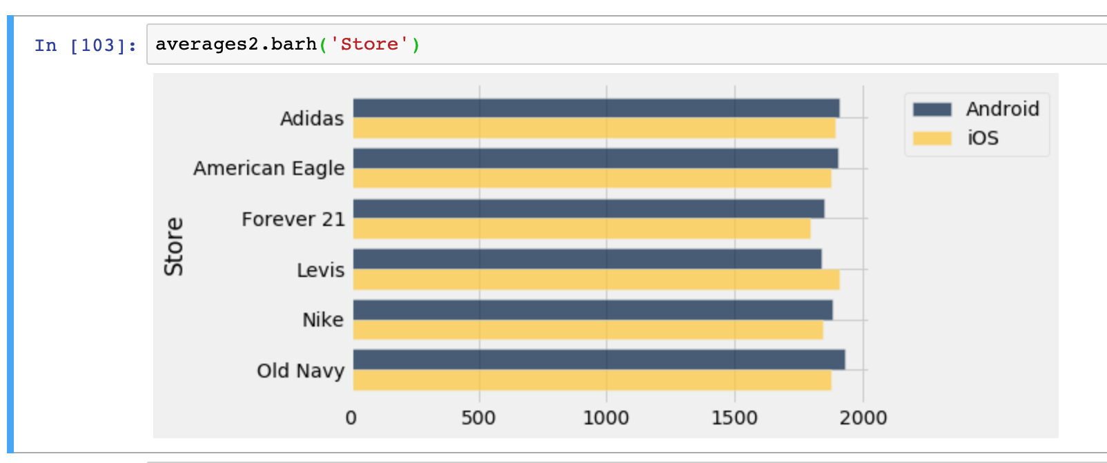
Visualizing Pivots

Slide 15
Joins

Slide 16
Automation and Iteration
In programming you often need to repeat a process over and over again
Examples at work
For

Slide 17
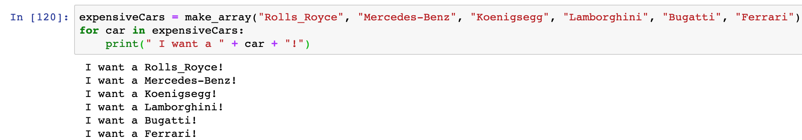
Automation and Iteration

Slide 18
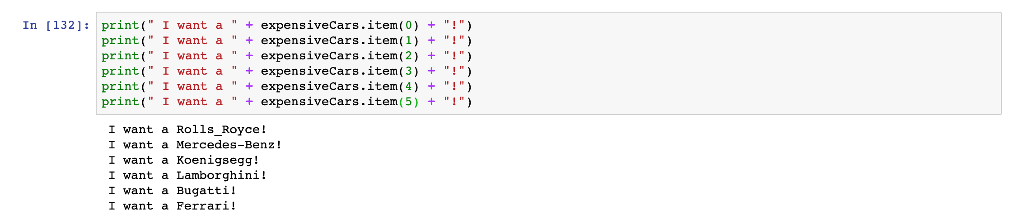
Automation and Iteration

Slide 19
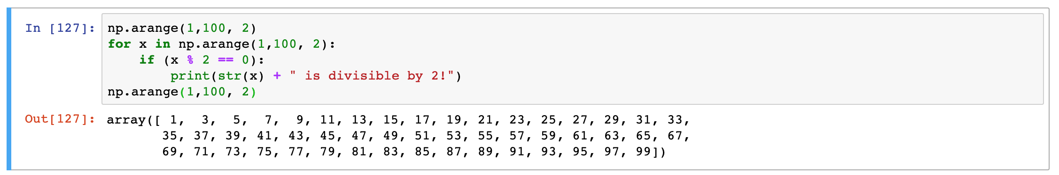
Automation and Iteration QUESTION TO ASK

Slide 20
Sampling
While we would like to ideally do data science on all the data that’s available, often that’s not possible
Either the data we have is not complete
Or we can’t really handle/process all the data we have
Sampling is a science, bad samples can lead to bad results
A well-known example of sampling comes from elections
No way of knowing the entire population’s voting preferences, but can take a sample
A statistically accurate way of taking samples is a simple random sample

Slide 21
Simple Random Sample
A subset of a statistical population in which each member of the subset has an equal probability of being chosen.
Jars
Example: Jar of Candy with Blue and Red Candy
Random select candy from the jar till you get the sample size you want
Each candy has an equal chance of being chosen
Other sampling methods
Stratified Samples
Convenience Samples
Ext…

Slide 22
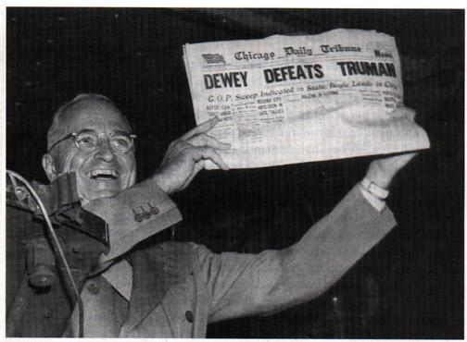
(Bad) Sampling

Slide 23
(Bad) Sampling
"Dewey Defeats Truman" was an incorrect banner headline on the front page of the Chicago Daily Tribune on November 3, 1948, the day after incumbent United States President, Harry S. Truman, won an upset victory over Republican challenger and Governor of New York, Thomas E. Dewey, in the 1948 presidential election.

Slide 24
(Bad) Sampling
Why was the Chicago Daily Tribune confident that Dewey would win?
All three major polls predicted Dewey would win. The closest poll to the actual results had a 5% advntage for Dewey
Polls suffered from numerous problems with sampling
Stoped Polling too soon (Truman energized voting days before the election, but last predictions stopped weeks before the election)
Pollsters used telephones which favored more well-to-do households
Tried to match samples with demographics (ie. interviewing 10 men, 11 women, 8 african americans, 2 asians, and 11 caucasians because that was the demographics.)
Did Bad Sampling Affect predictions for the 2016 Election? (Probably)
This is a hot topic of debate amongst experts (Nassim Taleb vs. Nate Silver)

Slide 25
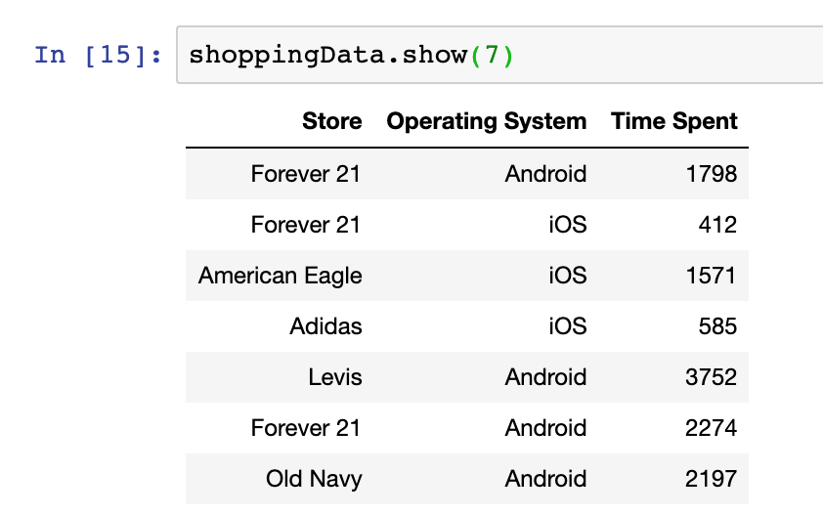
Sampling in Python
All ready did sampling in Python (show off show)

Slide 26
Sampling in Python
For our shopping dataset, we could select a sample by randomly choosing a number k from 1-10 then choosing every kth number after that.
Is this a random sample?

Slide 27
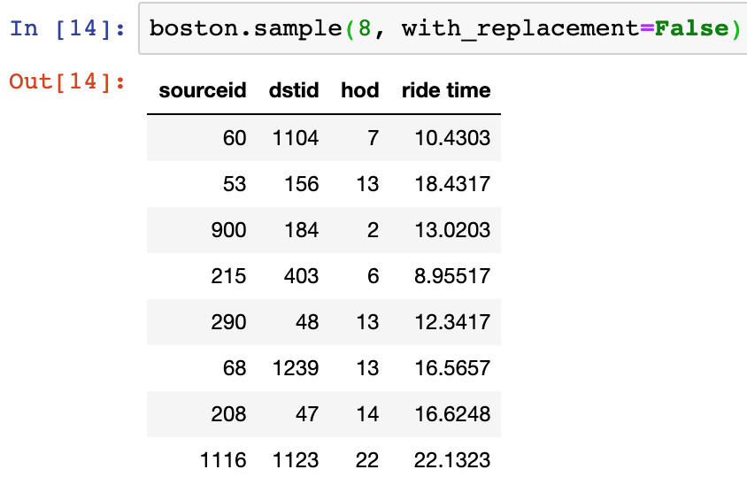
Sampling in Python
Sample method
table.sample(k)
In the future would
recommend using this

Slide 28
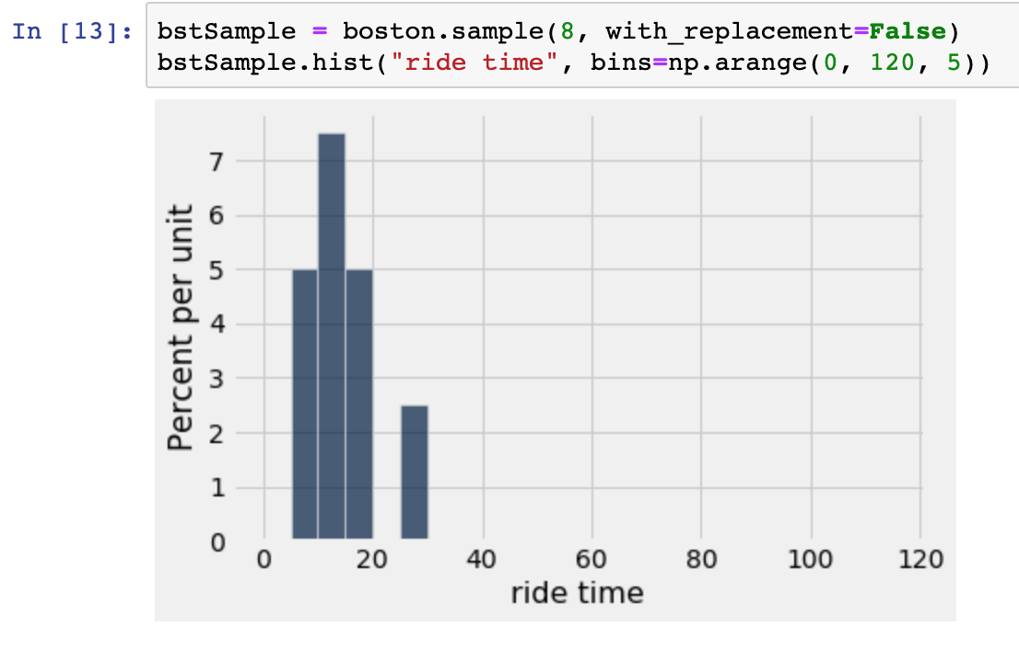
Sampling in Python

Slide 29
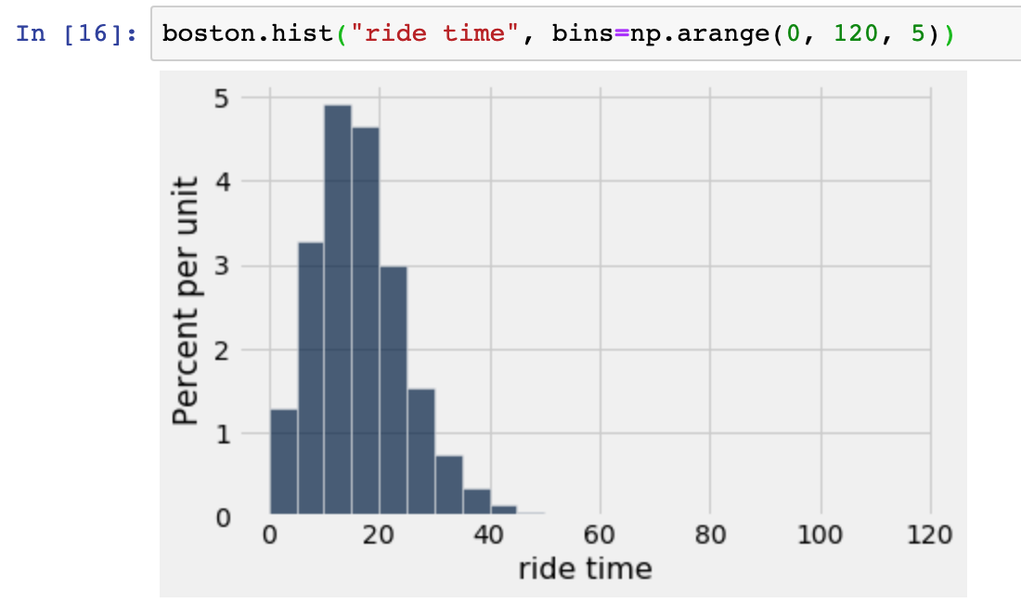
Sampling in Python

Slide 30
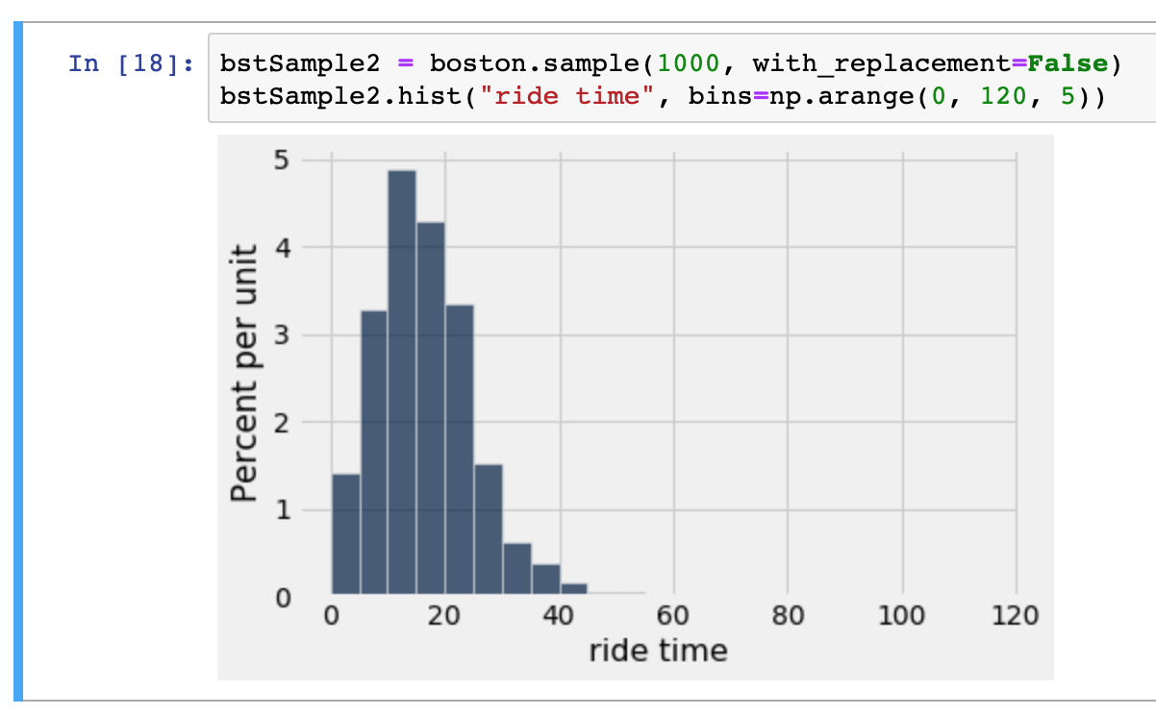
Sampling in Python

Slide 31
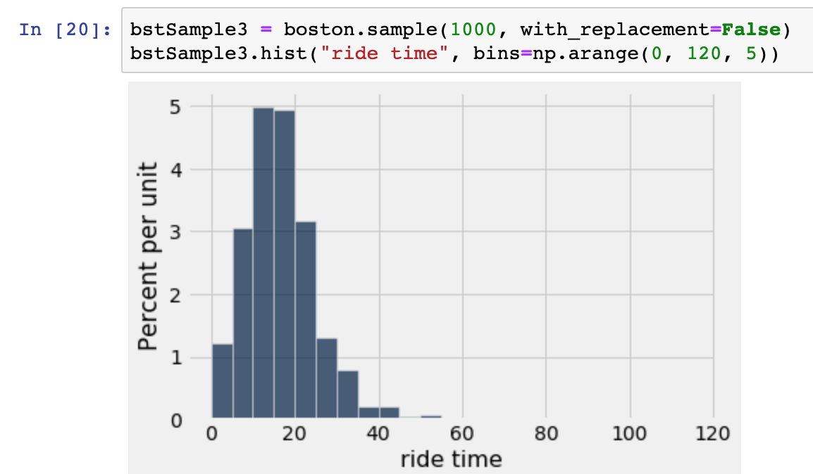
Sampling in Python

Slide 32
Sampling in Python
For a large random sample, the histogram of the sample resembles the histogram of the population, with high probability.
We will delve into this further next lecture and give a formal name for this principle (arguable the backbone of statistics)
Finish up sampling
Hypothesis testing

