Slide 1
Curves
Slides

Slide 2
Deck Order
Story about drops
Using Mean, but median is more relevant here
How to calculate mean/median
Concept of Percentile
80th Percentile
80% of values below, 20% of values above
Care with duplicates
Back to story about drops, standard deviation
Concept of Skew (Left Skew, Right Skew)
Normal Distribution
What it means
Central Limit Theorem

Slide 3
What we are covering
Calculating Sample Statistics
Mean -> Suffers from skew
Median
Percentile
Standard Deviation
Types of distributions
Left Skew, Right Skew
Normal Distribution
68% of the data falls between one std of the normal curve
95% of the data is within 2 standard deviations (σ) of the mean (μ).
99.7% of the data is within 3 standard deviations (σ) of the mean (μ).

Slide 4
Median
Doesn’t suffer from outliers
Middle of the histogram is the median

Slide 5
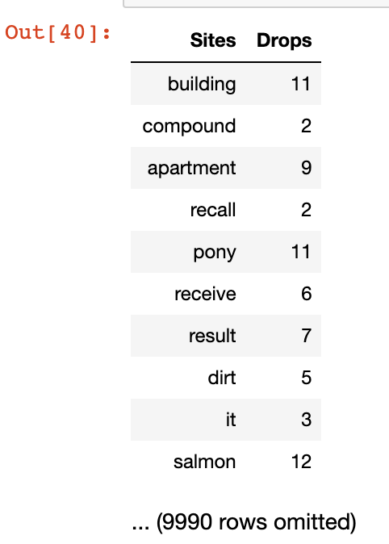
First One (February)
Average = 2.8
Median = 2.2
Std Deviation = ?

Slide 6
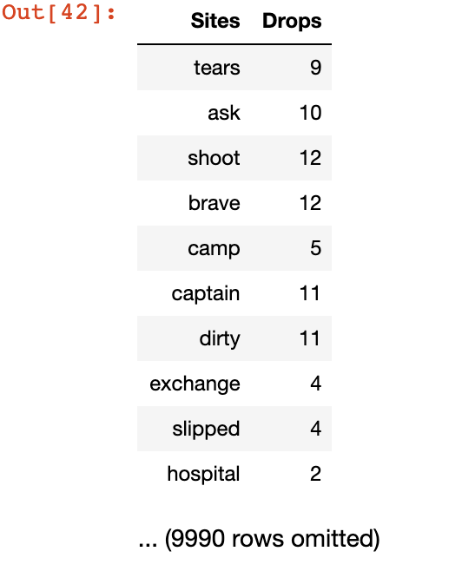
Second One (March)
Average = 9.2
Median = 1.1
Std Deviation = ?

Slide 7
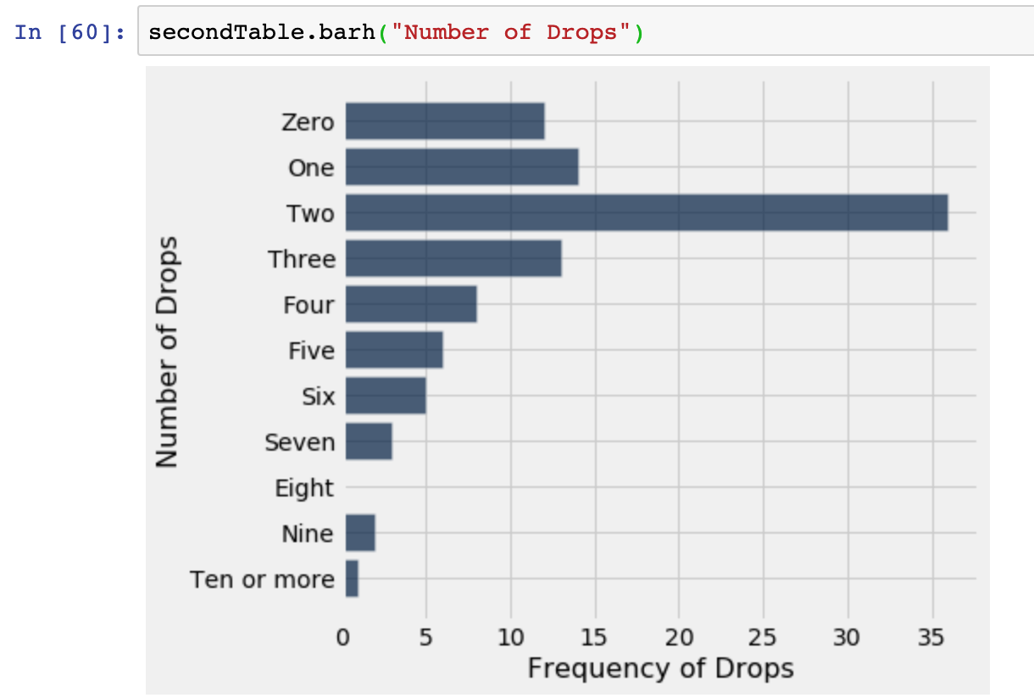
First One (February)

Slide 8
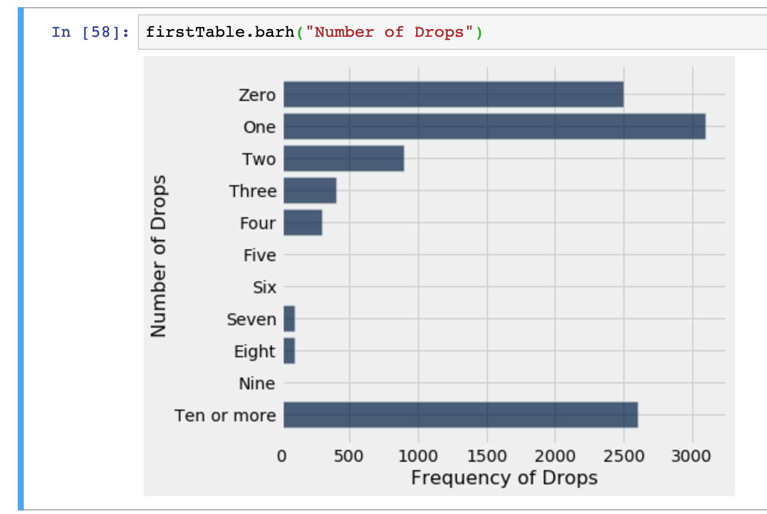
Second One (February)

Slide 9
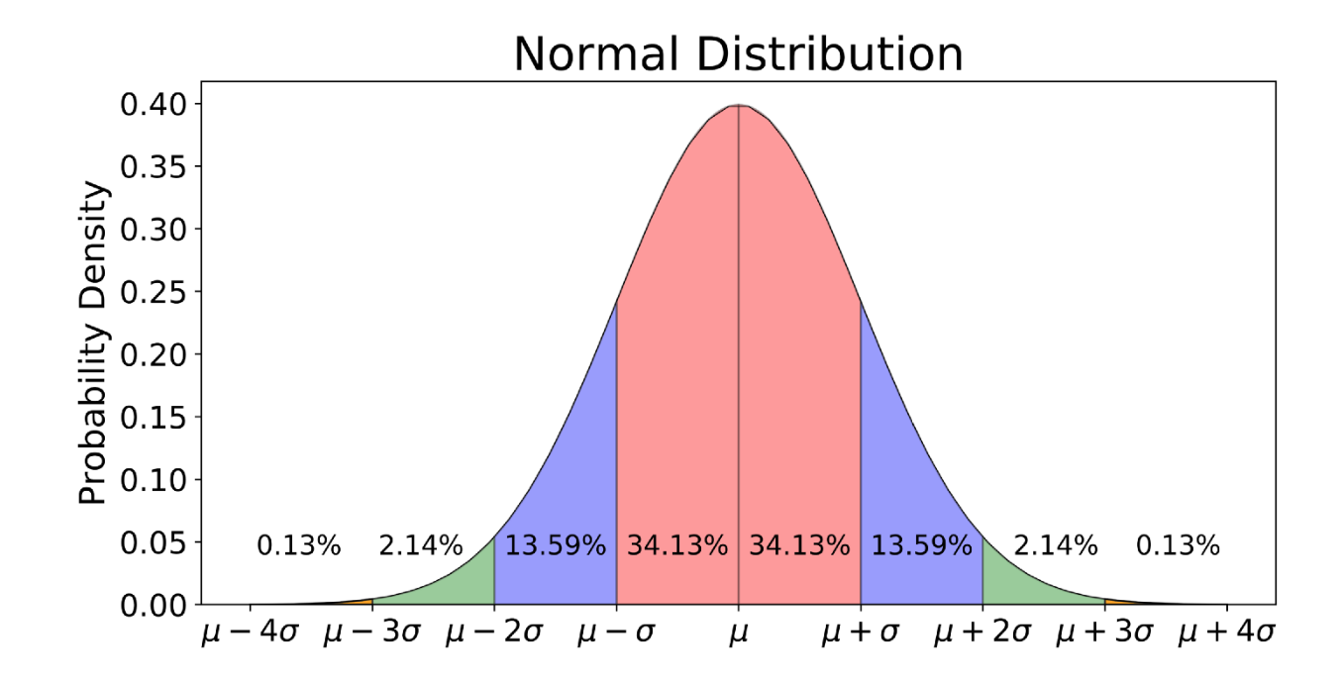
Normal Distribution

Slide 10
What we are covering
Normal Distribution
68% of the data falls between one std of the normal curve
95% of the data is within 2 standard deviations (σ) of the mean (μ).
99.7% of the data is within 3 standard deviations (σ) of the mean (μ).
Examples of normal distributions
SAT scores
Height of American Men

Slide 11
What we are covering
Normal Distribution
68% of the data falls between one std of the normal curve
95% of the data is within 2 standard deviations (σ) of the mean (μ).
99.7% of the data is within 3 standard deviations (σ) of the mean (μ).
Examples of normal distributions
SAT scores
Height of American Men

Slide 12
What we are covering
Standard Deviation
Root mean square of deviations from average.
Measure of disruption, how tightly values cluster around the mea

