Slide 1
Probability and Hypothesis Testing
Slides

Slide 2
Deck Order
Check on sampling with/without replacement
Testing Hypotheses
Choosing between one or another hypothesis
Cite examples
Use this on life expectancy data and go through the process
Model and Alternative Viewpoint
Null and Alternative Hypothesis
np.count_nonzero(sample_averages <= observed_statistic) / repetitions
Concept of joins
If you use a p % cutoff for the P-value, and the null hypothesis happens to be true, then there is about a p % chance that your test will conclude that the alternative is true.

Slide 3
Deck Order
This is a clearly defined model about chances. It says that the data were generated at random under clearly specified assumptions about the randomness. The word “null” reinforces the idea that if the data look different from what the null hypothesis predicts, the difference is due to nothing but chance.
The alternative hypothesis. This says that some reason other than chance made the data differ from the predictions of the model in the null hypothesis.

Slide 4
Deck Order
If the P-value is less than 5%, it is considered small and the result is called “statistically significant.”If the P-value is even smaller – less than 1% – the result is called “highly statistically significant.
Null Hypothesis. The average score of the students in Section 3 is like the average score of the same number of students picked at random from the class.
Alternative Hypothesis. No, it’s too low.
Importance of replicability and avoiding p-hacking

Slide 5
What we are covering
Calculating Sample Statistics
Mean -> Suffers from outlier problem
Median
Percentile
Standard Deviation
We want to buil
Types of distributions
Left Skew, Right Skew
Normal Distribution
68% of the data falls between one std of the normal curve
95% of the data is within 2 standard deviations (σ) of the mean (μ).
99.7% of the data is within 3 standard deviations (σ) of the mean (μ).

Slide 6
Median
Doesn’t suffer from outliers
Middle of the histogram is the median

Slide 7
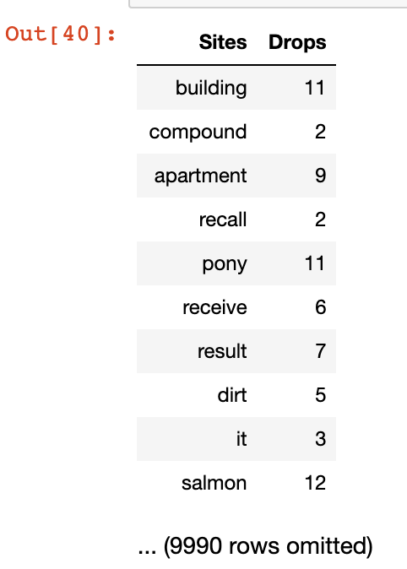
First One (February)
Average = 2.8
Median = 2.2
Std Deviation = ?

Slide 8
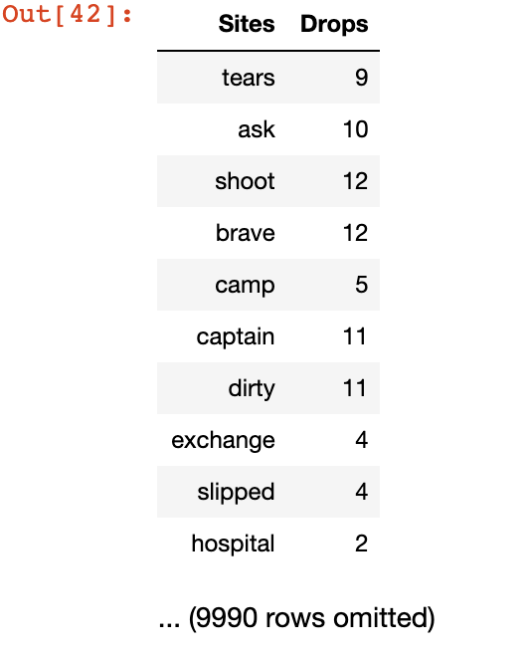
Second One (March)
Average = 9.2
Median = 1.1
Std Deviation = ?

Slide 9
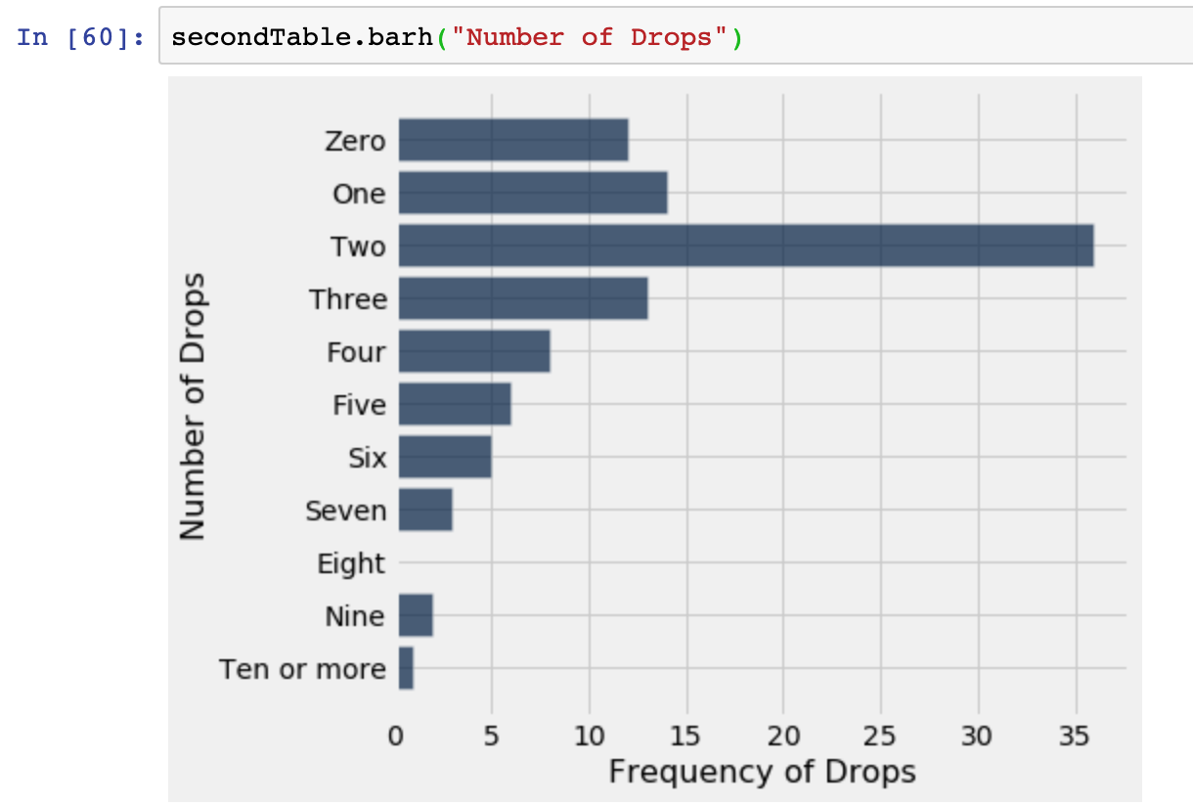
First One (February)

Slide 10
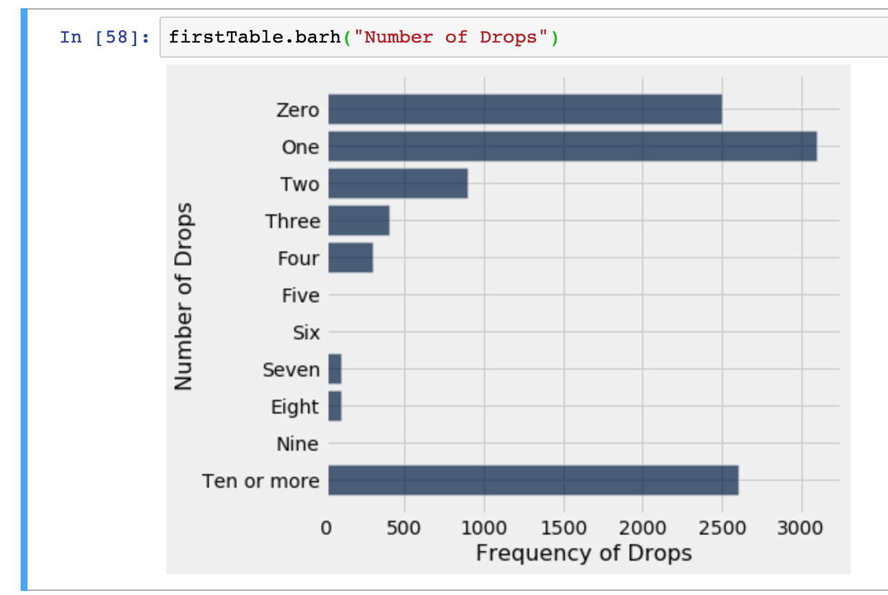
Second One (February)

Slide 11
What we are covering
Standard Deviation
Root mean square of deviations from average.
Measure of disruption, how tightly values cluster around the mean
Show off uber dataset, how most data is withing a couple of stds

Slide 12
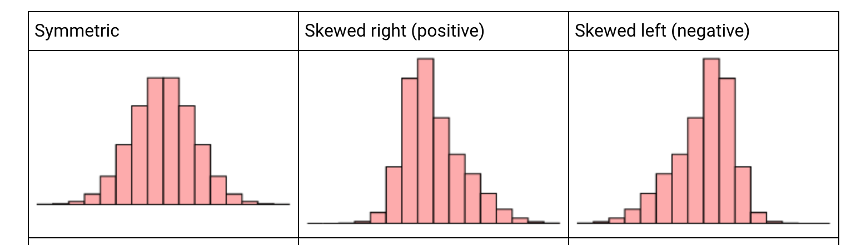

Slide 13
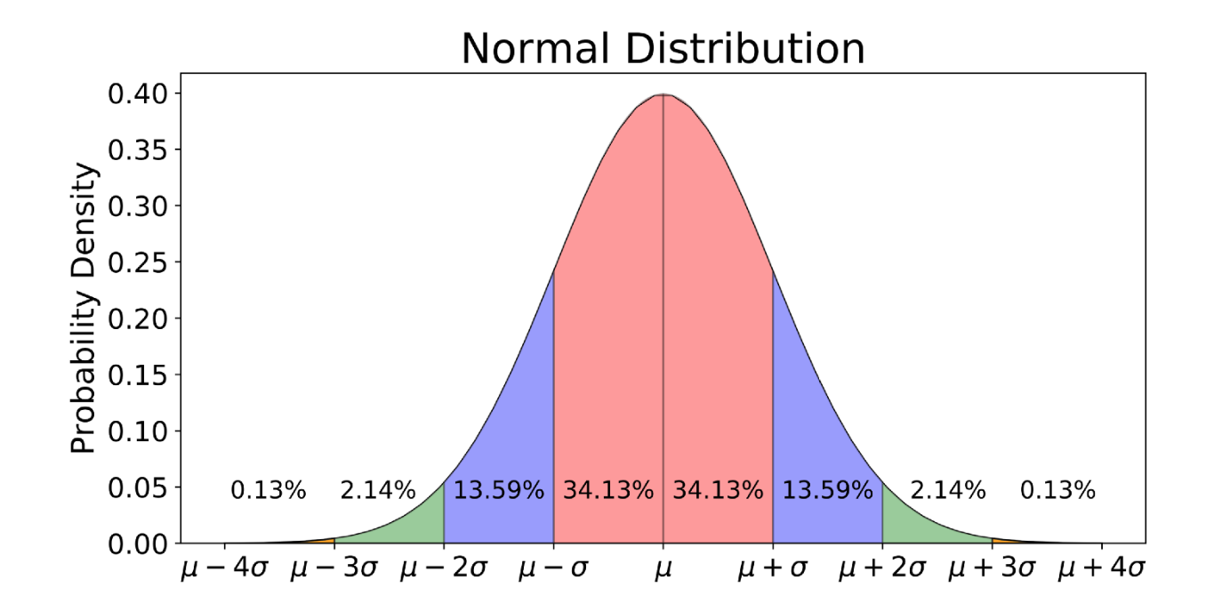
Normal Distribution

Slide 14
What we are covering
Normal Distribution
68% of the data falls between one std of the normal curve
95% of the data is within 2 standard deviations (σ) of the mean (μ).
99.7% of the data is within 3 standard deviations (σ) of the mean (μ).
Examples of normal distributions
SAT scores
Height of American Men

Slide 15
What we are covering
Normal Distribution
68% of the data falls between one std of the normal curve
95% of the data is within 2 standard deviations (σ) of the mean (μ).
99.7% of the data is within 3 standard deviations (σ) of the mean (μ).
Examples of normal distributions
SAT scores
Height of American Men

Slide 16
What we are covering
Sampling and the Central Limit Theorem
Golden Rule = One should treat others as one would like others to treat oneself
If we have detailed info about a population, we can infer information from the sample
If we have detailed info about the sample we can draw information about the population
Every Population has
The Central Limit Theorem says that the probability distribution of the sum or average of a large random sample drawn with replacement will be roughly normal, regardless of the distribution of the population from which the sample is drawn.
Standard Error = s / sqrt(n) which helps us determine using a normal distributions
Law of Large Numbers

Slide 17
What we are covering
Sampling and the Central Limit Theorem
The Central limit Theorem states that when sample size tends to infinity, the sample mean will be normally distributed. The Law of Large Number states that when sample size tends to infinity, the sample mean equals to population mean.
The Law of Large Numbers tells us where the center (maximum point) of the bell is located. Again, as the sample size approaches infinity the center of the distribution of the sample means becomes very close to the population mean.
The Law of Large Numbers tells us where the center (maximum point) of the bell is located. Again, as the sample size approaches infinity the center of the distribution of the sample means becomes very close to the population mean.

Slide 18
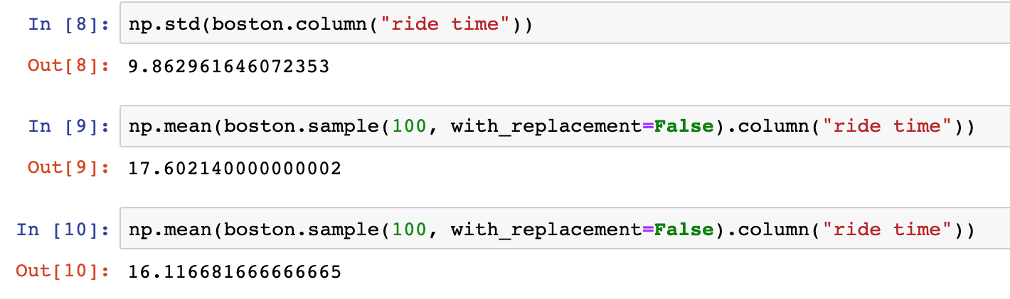
What we are covering

Slide 19
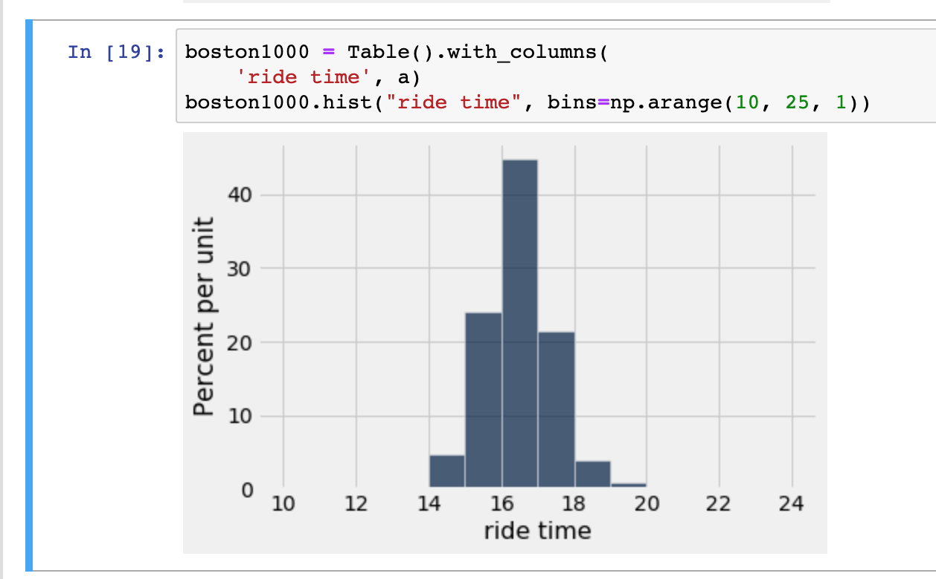
What we are covering

Slide 20
What we are covering

Slide 21
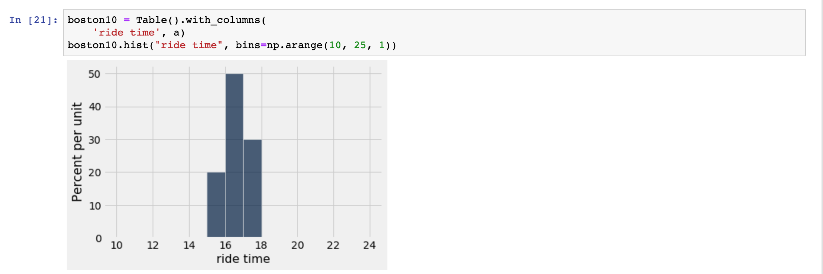
What we are covering

Slide 22
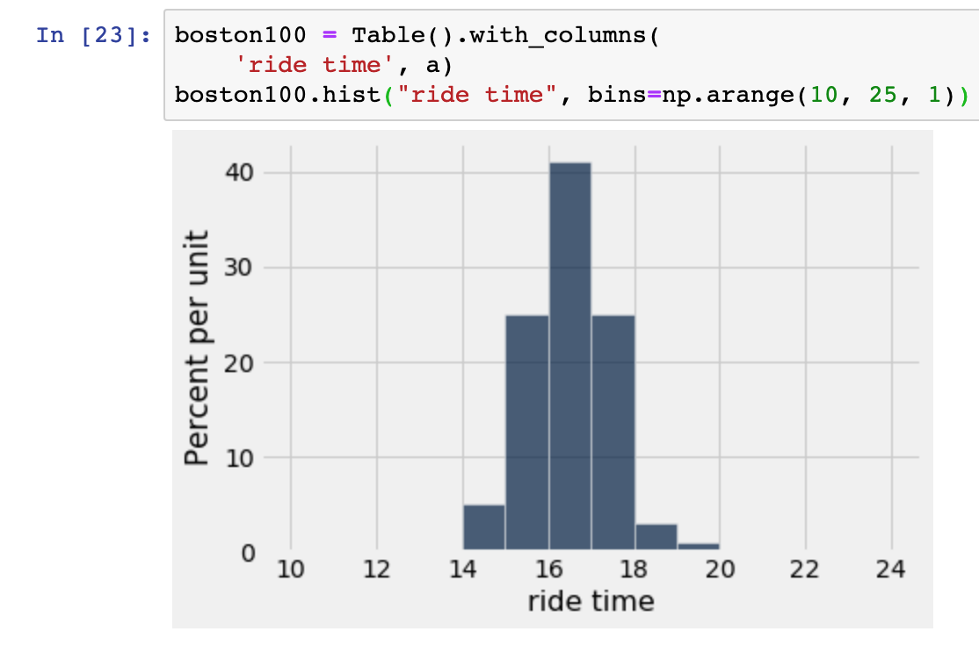
What we are covering

Slide 23
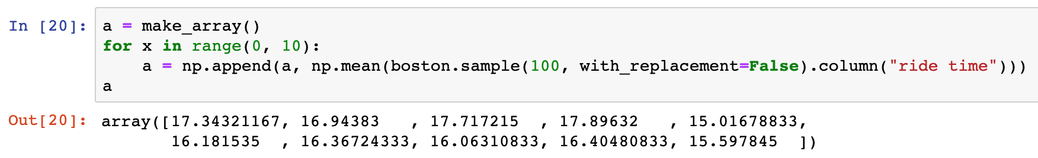
What we are covering

