Slide 1
Predictions

Slide 2
Make sure to work through those Vitamins!
Project Proposal by end of the day today
Will give everyone feedback by EOD Thursday
I’m here for help!
One more vitamin (!)
Monday lab day
Wednesday: Predictions
Friday: Machine Learning
Monday: Lab day
Wednesday: Case Studies
Friday: Last Class
Telework total?
Make sure to reach out to get cross surveys

Slide 3
Jupyter conference

Slide 4
Where Predicates (
Predicate | Description
are.equal_to(Z) | Equal to Z
are.above(x) | Greater than x
are.above_or_equal_to(x) | Greater than or equal to x
are.below(x) | Less than x
are.below_or_equal_to(x) | Less than or equal to x
are.between(x,y) | Greater than or equal to x and less than y
are.between_or_equal_to(x,y) | Greater than or equal to x, and less than or equal to y
are.contained_in(A) | Is a substring of A (if A is a string) or an element of A (if A is a list/array)
are.containing(S) | Contains the string S
are.strictly_between(x,y) | Greater than x and less than y

Slide 5
Where Predicates (Any of these predicates can be negated by adding not_ in front of them, e.g. are.not_equal_to(Z) or are.not_containing(S))

Slide 6
Predictions

Slide 7
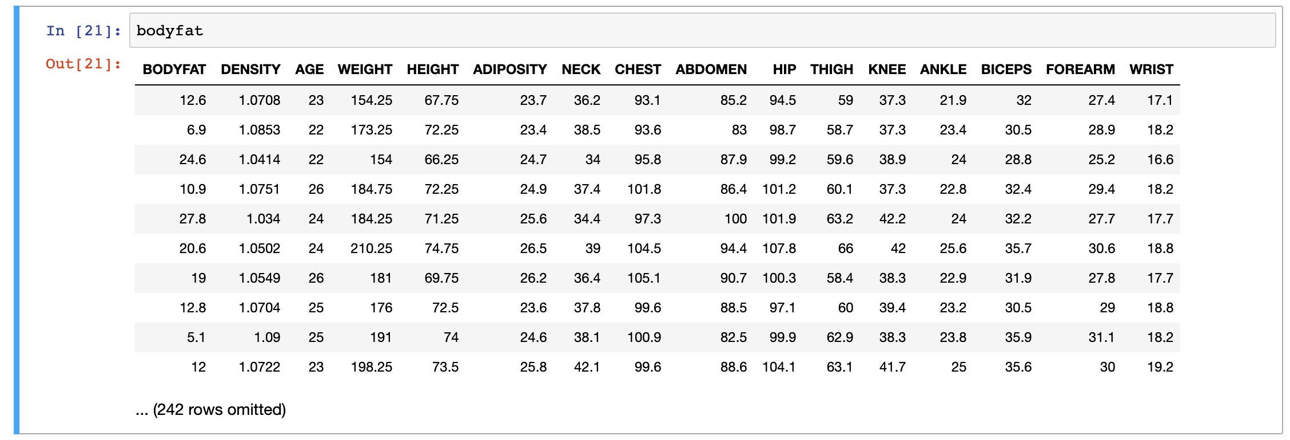

Slide 8
Show off two tables with correlations
What’s the actual r value
Issue of Outliers…
np.corrcoef(bodyfat.column("AGE"), bodyfat.column("WEIGHT"))
Row 41

Slide 9
Show off two tables with correlations
Percentage of body fat, age, weight, height, and ten body circumference measurements (e.g., abdomen) are recorded for 252 men. Body fat, one measure of health, has been accurately estimated by an underwater weighing technique. Fitting body fat to the other measurements using multiple regression provides a convenient way of estimating body fat for men using only a scale and a measuring tape. This dataset can be used to show students the utility of multiple regression and to provide practice in model building.

Slide 10
Show off two tables with correlations
Estimate the percentage of body fat for each member of your group using your regression model. Is this model appropriate for all the members of your group? How about for other people in class? What is the most general audience to which your model can be applied? (Note: 1 inch = 2.54 cm.)

Slide 11
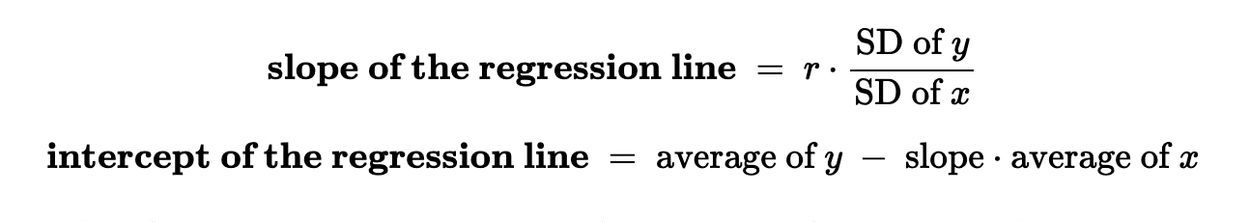
Show off two tables with correlations

