Slide 1
Cause and Effect

Slide 2


Slide 3
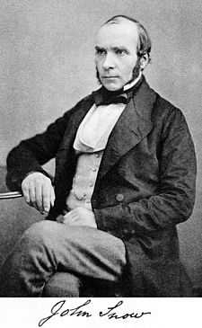

Slide 4

UMich

Slide 5
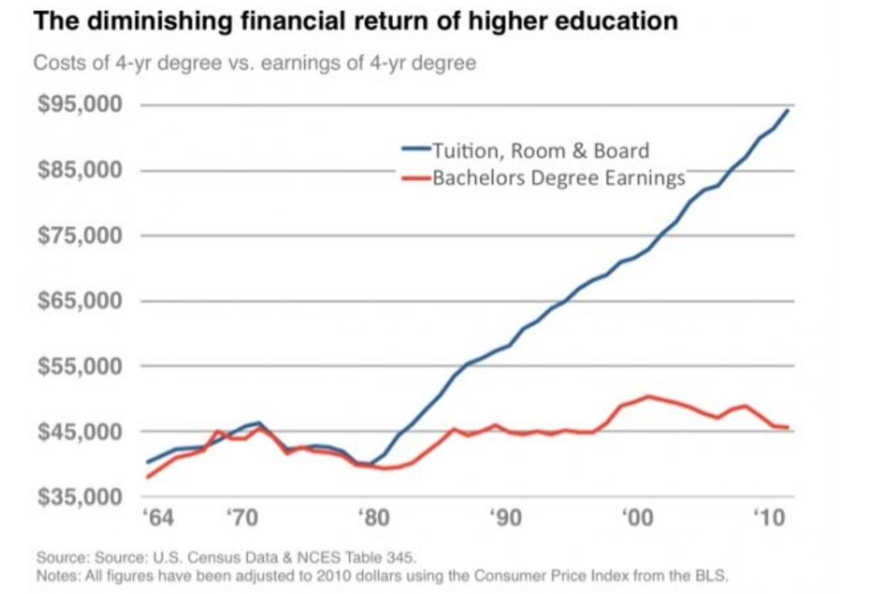

Slide 6


Slide 7


Lying With Statistics

Slide 8
Common Types of Misuse of Statistics
Faulty Polling (Data Gathering)
Flawed Correlations
Misleading Data Visualizations
And Much More!

Slide 10
Misleading numbers…
On Nov 29th 2016, the Office of Personnel Management (OPM) released a guide/study titled “Compensation Flexibilities to Recruit and Retain Cybersecurity Professionals”
In it OPM hoped to highlight compensation actions to meet the ever growing need for talented cybersecurity workforce to address complex and ever-evolving cyber threats
In it, the OPM proposed a strategy where the federal government could match competitive compensations for a wide vareity of career stages
Let’s look at one particular compensation strategy…

Slide 11
Misleading statistics…
An agency wants to hire a student who is graduating with a degree in cybersecurity for a Information Security position in Washington, DC.
Already has a locally competitive offer of of $95,000.
How can the federal government compete with this?
OPM has a solution!

Slide 12
Misleading statistics…
First the agency establishes a base pay at GS-7, step 10, on special rate at ($61,441) based on the competing job offer.
Then the agency offers a recruitment incentive of 10 percent with a three-year service agreement.
$61,441 x .10 (10 percent) x 3 years = $18,432.
The agency also offers to repay the candidate’s student loan of $21,000

Slide 13
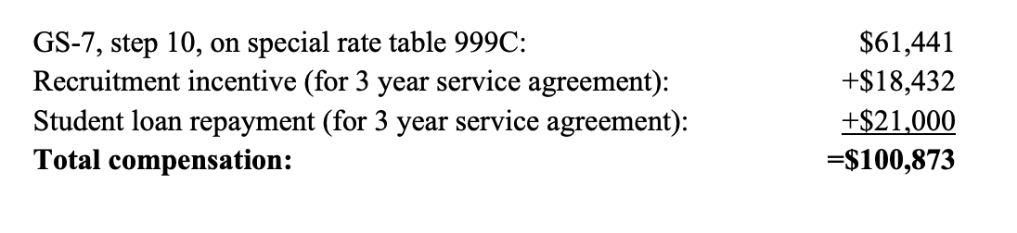
Seems like we beat the offer!
*
Time to poach from private industry!
Screenshot from ““Compensation Flexibilities to Recruit and Retain Cybersecurity Professionals”

Slide 14
Unfortunately No…
Year 1
61,441
+6144*
+7,000*
=74585
Year 2
61,441
+6144*
+7,000*
=74585
Year 3
61,441
+74,585*
+7000*
=74585
Total Compensation = $223,755 (*with a service agreement of three years)

Slide 15
Vs.
Year 1
95,000
Year 2
95,000
Year 3
95,000
Total Compensation = $285,000
Total Difference = $61,245
This brilliant math comes from “Compensation Flexibilities to Recruit and Retain Cybersecurity Professionals” published by OPM. Credit to _____ for pointing this out 2 years ago (it’s still on their website!)

