Slide 1
Data Types and Tables

Slide 2
Review of Last Lecture

Slide 3
Feedback from poll
Send out results b4 lecture
Point out second question mistake
HW and Python 3

Slide 4
What to cover
Data Types (what are data types.)
Numbers
What is a function (leverage other definition)
Functions with numbers (abs, min, max)
Cover the need to import (import math)
Concept of packages (numpy and datascience)
--> Analogy of power users and tool
Help statement (to figure out what is going on.)
* Do numerical numbering on slides to correspond to the demo notebook
Strings
Adding strings
String method/functions/routines (mean the same thing)
Replace, upper, lower, ext..
Get help (how to get it) --> Stack overflow screenshot..
DEMO TIME
Array
array([13.6 , 14.387, 14.585, 15.164]) (difference between this is that it allows you to apply functions)
Multiplying with lists, (grade shift)
Requirement for uniformity of values
Converting between data types (float to int, int to float, ext.)
Example of when you get data when conversation matters… (operational example)
Errors when adding between types
Comparing between data types
< >
Type True and False

Slide 5
What to cover
Arrays
Requirement for uniformity of values
Table().with_columns('Number of petals', make_array(8, 34, 5))

Slide 6
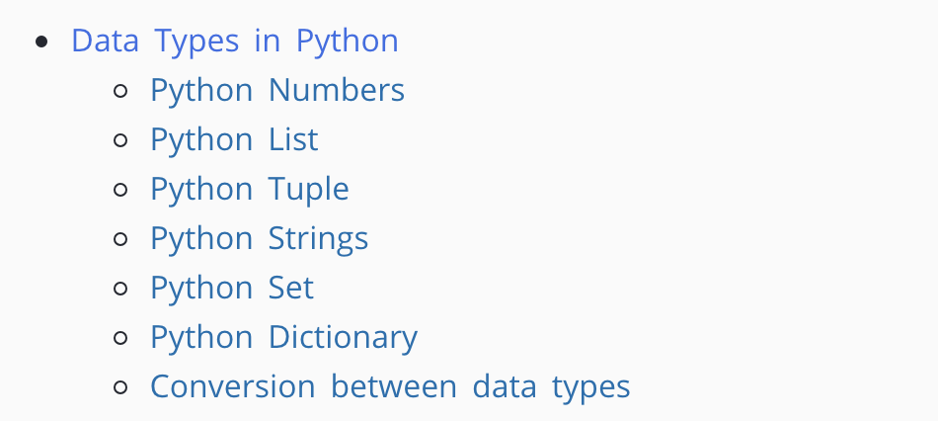
Outline

Slide 7
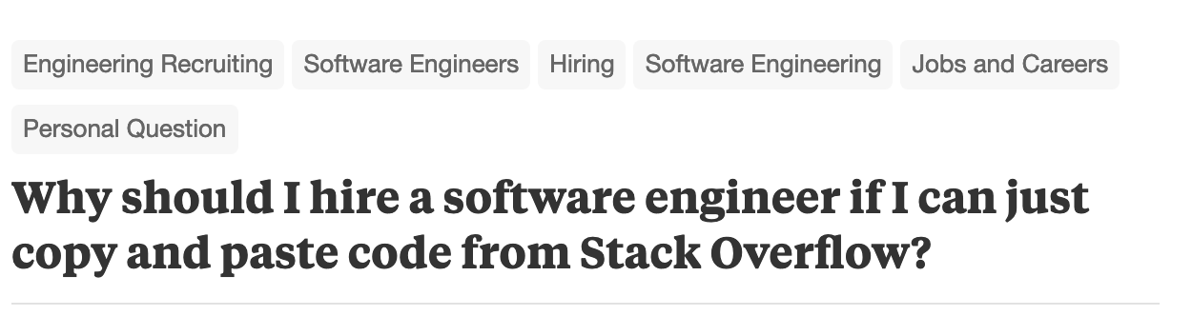
Screen shot 1

Slide 8
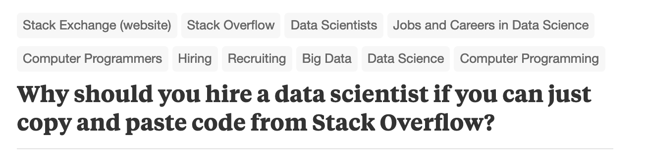
Screen shot 2

Slide 9
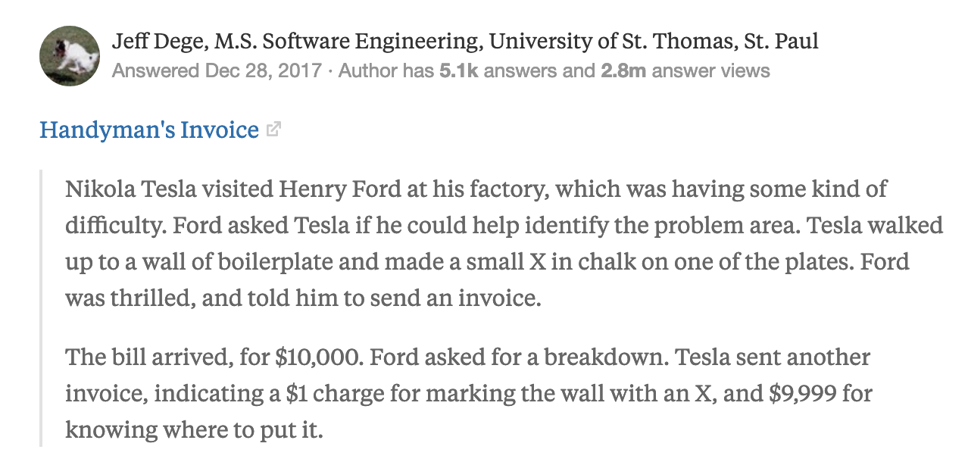
Screen shot 3

