Slide 1
Curves
Slides

Slide 2
Deck Order
Story about drops
Using Mean, but median is more relevant here
How to calculate mean/median
Concept of Percentile
80th Percentile
80% of values below, 20% of values above
Care with duplicates
Back to story about drops, standard deviation
How to calculate in Python, std
Concept of Skew (Left Skew, Right Skew)
Normal Distribution
What it means
Central Limit Theorem

Slide 3
What we are covering
Calculating Sample Statistics
Mean -> Suffers from outlier problem
Median
Percentile
Standard Deviation
Types of distributions
Left Skew, Right Skew
Normal Distribution
68% of the data falls between one std of the normal curve
95% of the data is within 2 standard deviations (σ) of the mean (μ).
99.7% of the data is within 3 standard deviations (σ) of the mean (μ).

Slide 4
Median
Doesn’t suffer from outliers
Middle of the histogram is the median

Slide 5
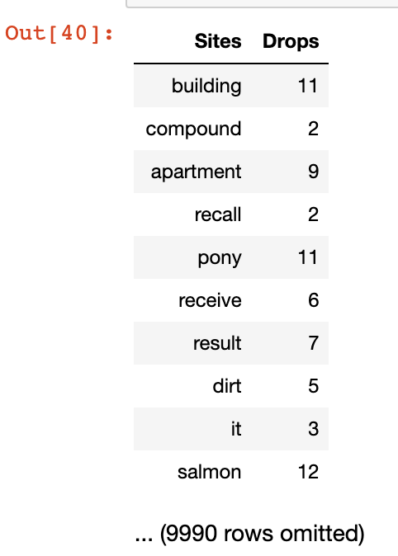
First One (February)
Average = 2.8
Median = 2.2
Std Deviation = ?

Slide 6
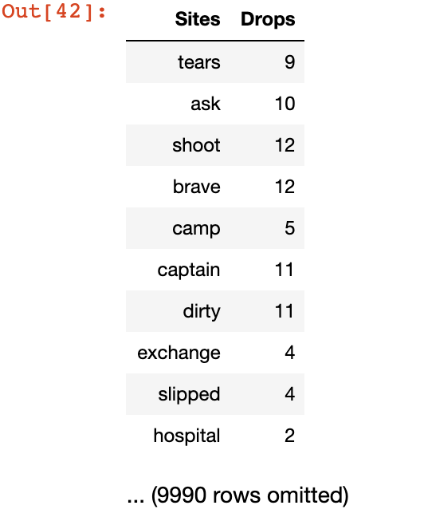
Second One (March)
Average = 9.2
Median = 1.1
Std Deviation = ?

Slide 7
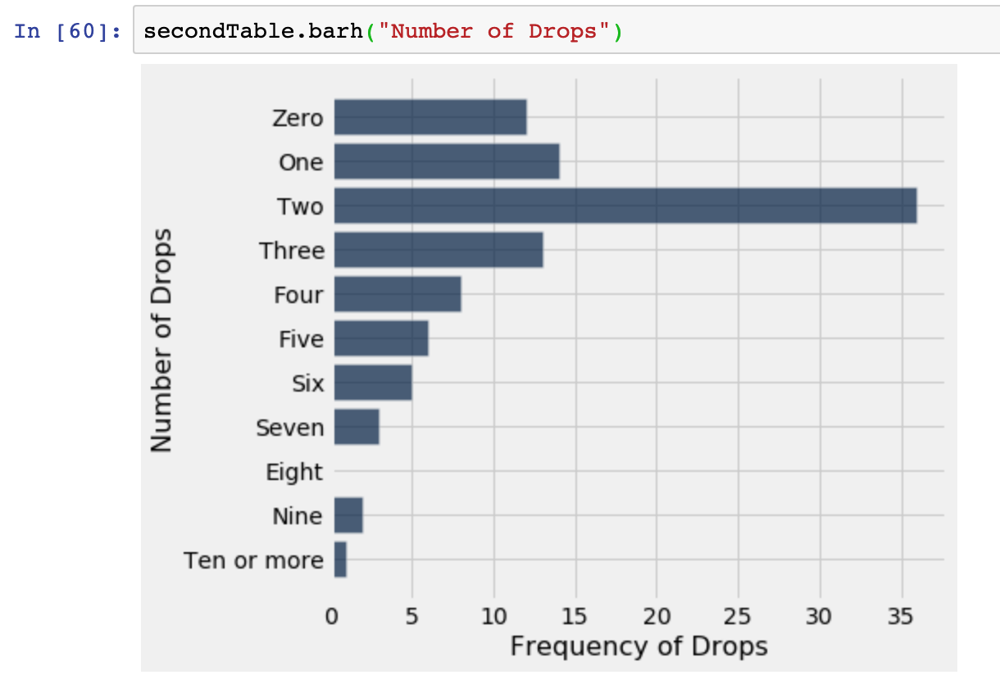
First One (February)

Slide 8
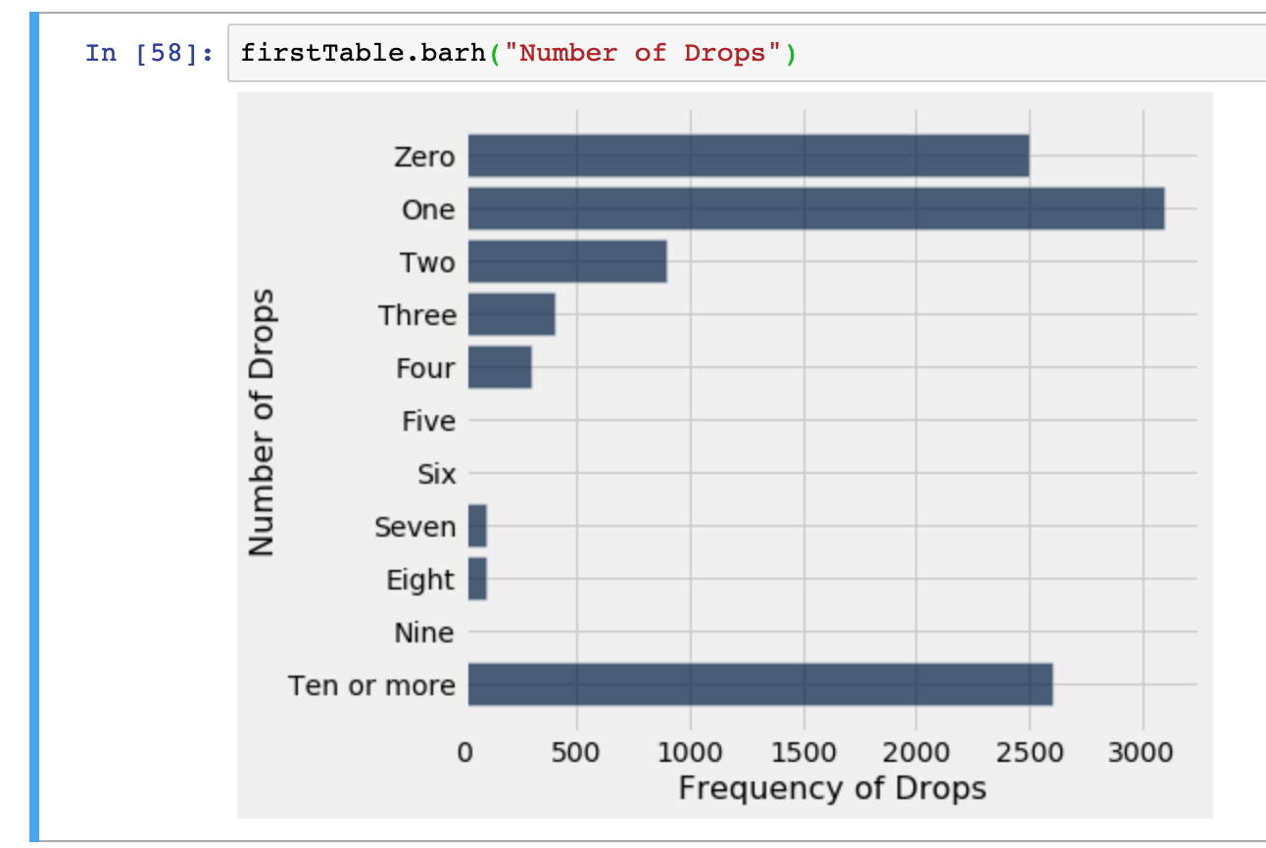
Second One (February)

Slide 9
What we are covering
Standard Deviation
Root mean square of deviations from average.
Measure of disruption, how tightly values cluster around the mean
Show off uber dataset, how most data is withing a couple of stds

Slide 10
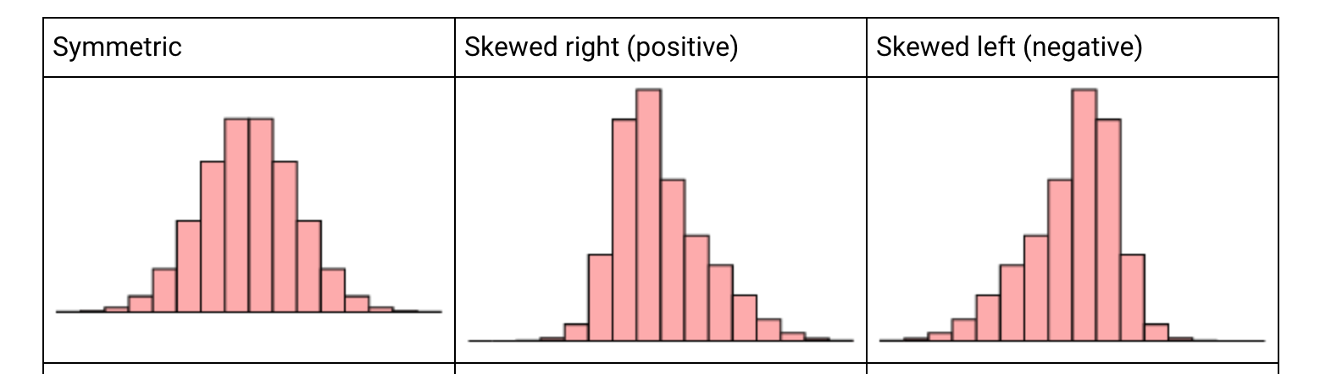

Slide 11
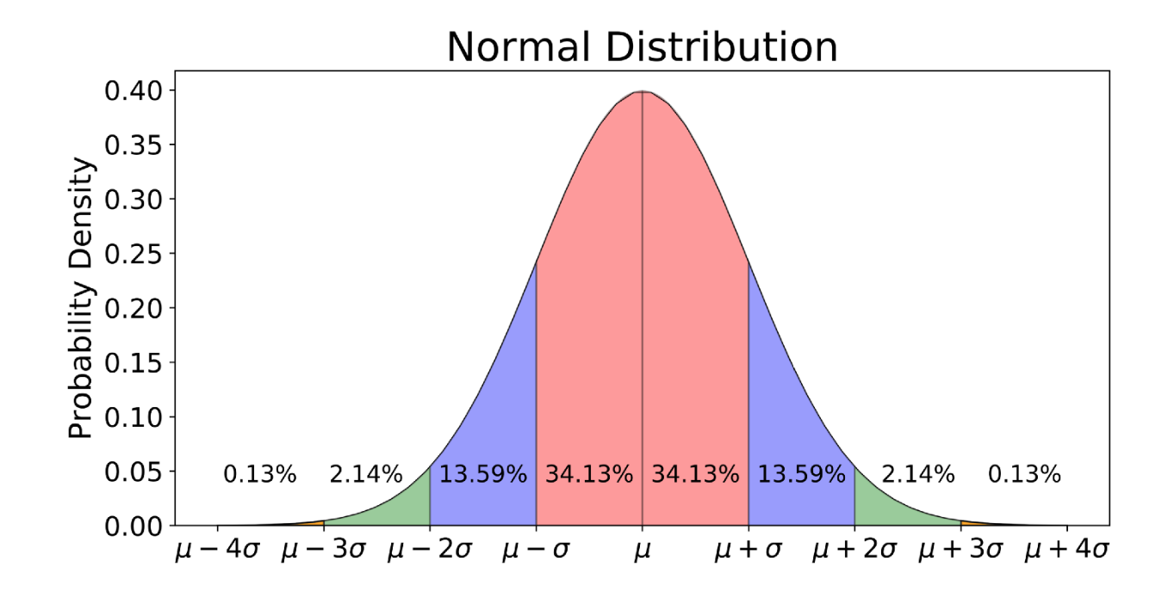
Normal Distribution

Slide 12
What we are covering
Normal Distribution
68% of the data falls between one std of the normal curve
95% of the data is within 2 standard deviations (σ) of the mean (μ).
99.7% of the data is within 3 standard deviations (σ) of the mean (μ).
Examples of normal distributions
SAT scores
Height of American Men

Slide 13
What we are covering
Normal Distribution
68% of the data falls between one std of the normal curve
95% of the data is within 2 standard deviations (σ) of the mean (μ).
99.7% of the data is within 3 standard deviations (σ) of the mean (μ).
Examples of normal distributions
SAT scores
Height of American Men

Slide 14
What we are covering
Sampling and the Central Limit Theorem
Golden Rule = One should treat others as one would like others to treat oneself
If we have detailed info about a population, we can infer information from the sample
If we have detailed info about the sample we can draw information about the population
Every Population has
The Central Limit Theorem says that the probability distribution of the sum or average of a large random sample drawn with replacement will be roughly normal, regardless of the distribution of the population from which the sample is drawn.
Standard Error = s / sqrt(n) which helps us determine using a normal distributions
Law of Large Numbers

Slide 15
What we are covering
Sampling and the Central Limit Theorem
The Central limit Theorem states that when sample size tends to infinity, the sample mean will be normally distributed. The Law of Large Number states that when sample size tends to infinity, the sample mean equals to population mean.
The Law of Large Numbers tells us where the center (maximum point) of the bell is located. Again, as the sample size approaches infinity the center of the distribution of the sample means becomes very close to the population mean.
The Law of Large Numbers tells us where the center (maximum point) of the bell is located. Again, as the sample size approaches infinity the center of the distribution of the sample means becomes very close to the population mean.

Slide 16
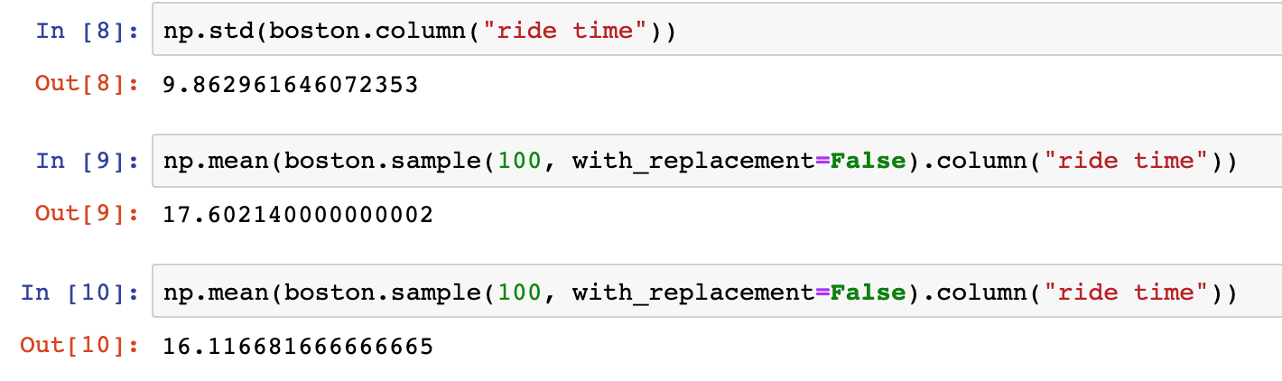
What we are covering

Slide 17
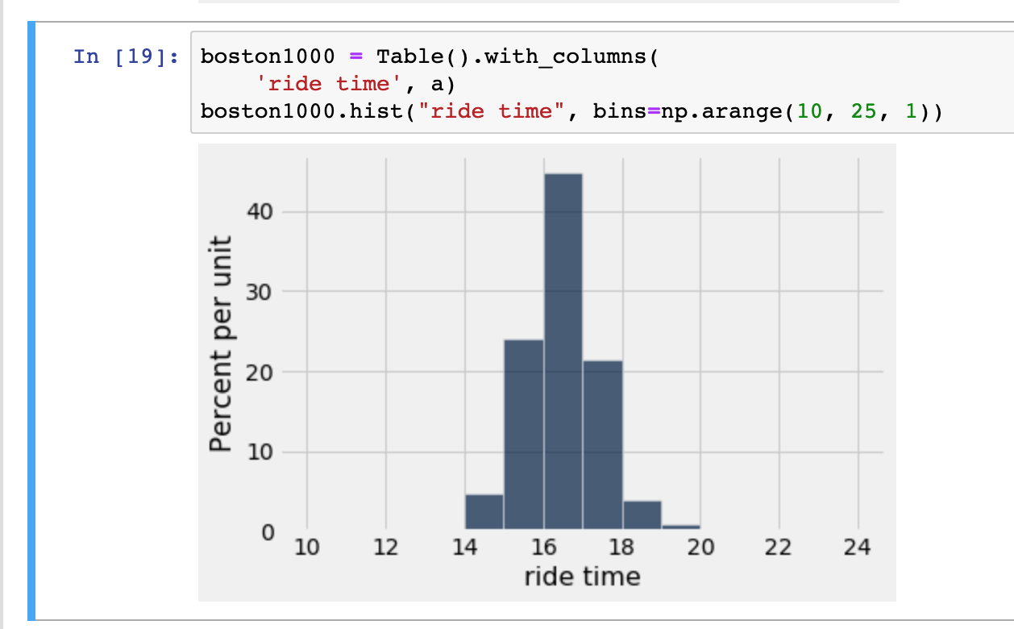
What we are covering

Slide 18
What we are covering

Slide 19
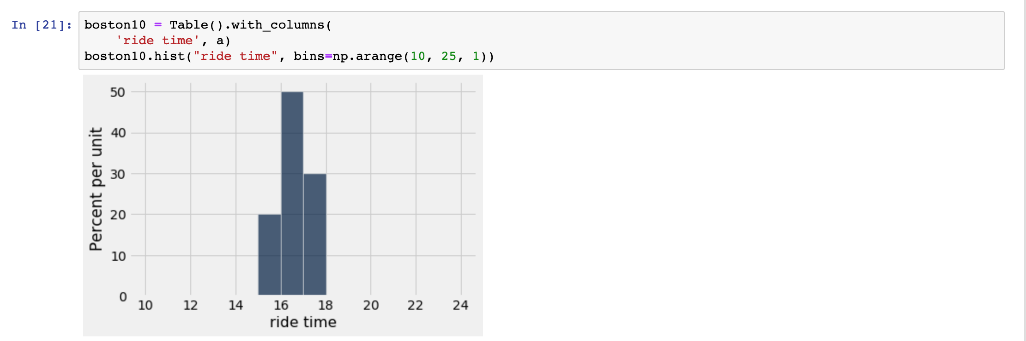
What we are covering

Slide 20
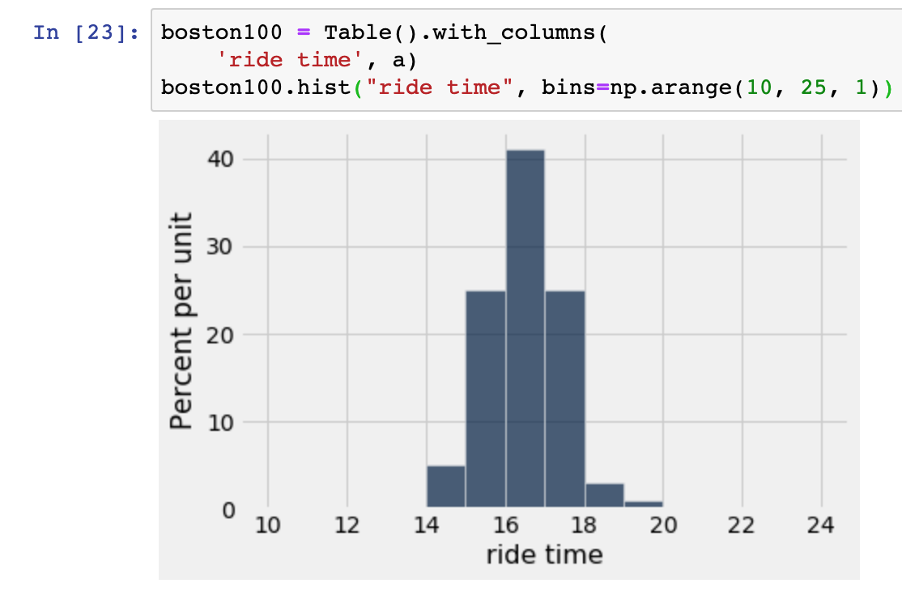
What we are covering

Slide 21
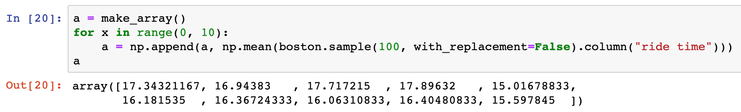
What we are covering

