Slide 1
Visualizations and Grouping

Slide 2
Visualizing Categorical Variables
Barh

Slide 3
Histograms

Slide 4
Binning Slide

Slide 5
Creating bins
Np.arange

Slide 6
Histograms Explained
Bin function
Left is starting point, right is count
Does this thing called NORMALIZATION … .

Slide 7
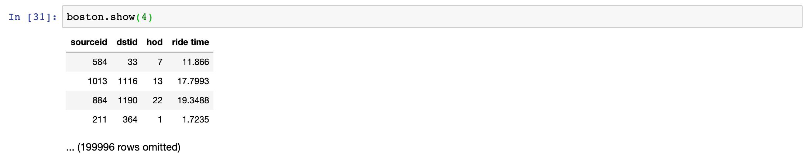

Slide 8
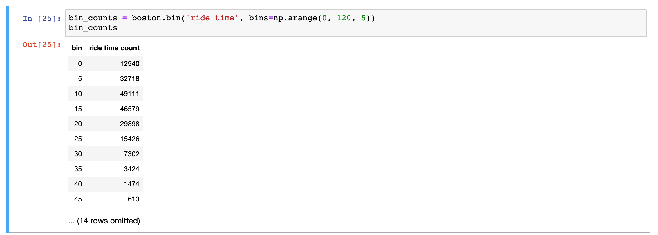

Slide 9
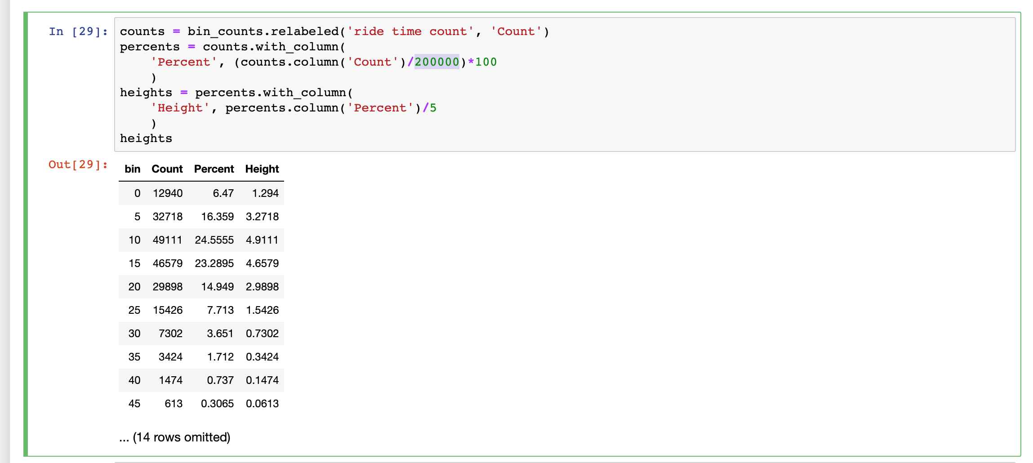

Slide 10
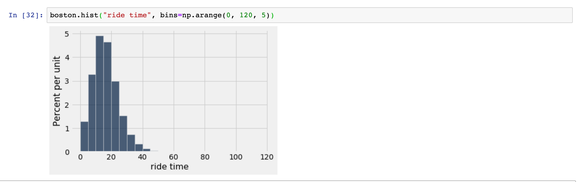

Slide 11
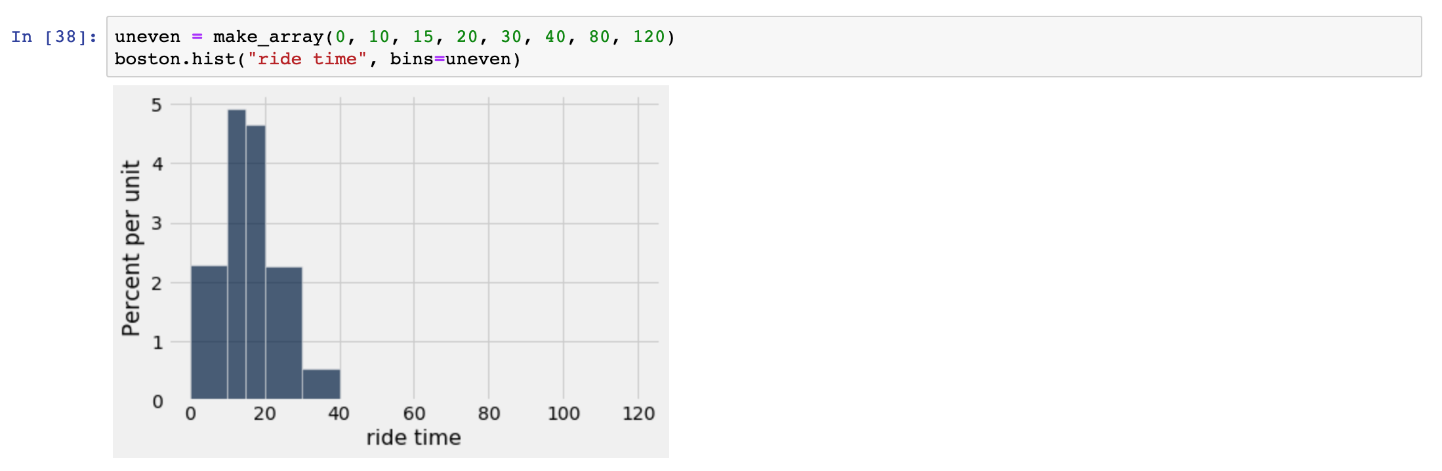

Slide 12
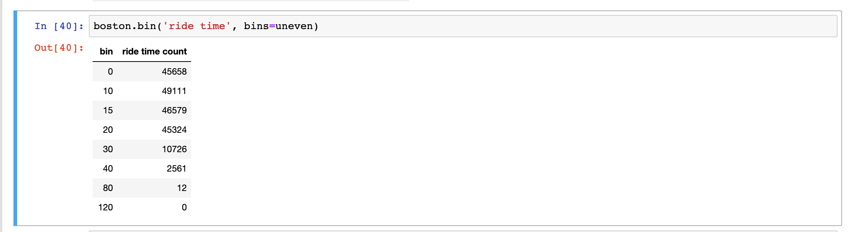

Slide 13
Summarizing Histograms
Area of Each Bar = Percent of Entries in Each Bin
area of bar=height of bar×width of bin
height of bar = area of bar / width of bin = percent of entries in bin / width of bin
The total area sums to 100%
Histograms display the distributions of quantitative variables.

Slide 14
If/Else statements
JOIN
Understanding pivot
for i in np.arange(5):print(hello)
Np.append

