Slide 1
Digital Portfolio
STUDENT NAME: Sanjay J
REGISTER NO AND NMID: 2428B0347 And C36C6AB7D182277A26A4394C490905C7
DEPARTMENT: B Sc Computer Science With Data Analysis
COLLEGE: KPR College Arts Science And Research / Bharathiyar University

Slide 2
Digital Portfolio: A Showcase of Skills & Achienevemts

Slide 3


AGENDA
Problem Statement
Project Overview
End Users
Tools and Technologies
Portfolio design and Layout
Features and Functionality
Results and Screenshots
Conclusion
Github Link
3/21/2024 Annual Review

Slide 4

PROBLEM STATEMENT
In the digital era, traditional resumes and CVs are no longer sufficient to effectively showcase a person’s skills, achievements, and experiences. Employers, clients, and academic institutions expect interactive, visually appealing, and easily accessible profiles. Without a centralized platform, individuals often struggle to present their competencies and achievements in a structured and engaging way. Hence, there is a need to design and develop a Digital Portfolio that serves as a dynamic, user-friendly, and interactive representation of one’s professional and personal journey.

Slide 5

PROJECT OVERVIEW
This project focuses on creating a Personal Digital Portfolio Website that highlights skills, certifications, projects, and achievements in an interactive format. Unlike static resumes, this portfolio integrates visuals, responsive design, and real-time project showcases. It is aimed at bridging the gap between talent and opportunities by offering an engaging first impression to recruiters, clients, and collaborators.

Slide 6

WHO ARE THE END USERS?
Students – to showcase academic achievements, internships, and skills.
Job Seekers – to present a professional profile to potential employers.
Freelancers – to demonstrate completed projects and attract clients.
Researchers/Academics – to highlight publications, conferences, and academic contributions.
General Professionals – to create a strong online personal brand.

Slide 7

TOOLS AND TECHNIQUES
Frontend: HTML5, CSS3, JavaScript
Design Frameworks: Bootstrap / Tailwind CSS (for responsive design)Version Control: Git & GitHub
Optional Enhancements: React.js for dynamic UI, Node.js for backend integration
Graphics Tools: Canva / Figma (for portfolio layout and visuals)

Slide 8
POTFOLIO DESIGN AND LAYOUT
Homepage: Introduction, professional tagline, and profile photo.
About Section: Brief biography, career objectives, and personal statement.
Skills Section: Technical and soft skills displayed with progress bars/icons.
Projects Section: Showcasing personal and academic projects with descriptions, screenshots, and links.
Certifications & Courses: List of online courses and certificates earned.
Experience Section: Internships, leadership roles, or work experience.
Contact Section: Contact form, email, social media, and GitHub/LinkedIn links.
Responsive Design: Mobile, tablet, and desktop-friendly interface.
8

Slide 9
FEATURES AND FUNCTIONALITY
Interactive navigation bar for smooth scrolling between sections.
Responsive design for seamless viewing on all devices.
Project showcase cards with GitHub/Live Demo links.
Modal popups for detailed project information.
Social media integration (LinkedIn, GitHub, Twitter).
Contact form with email functionality.
Light/Dark theme toggle option for personalization.

Slide 10
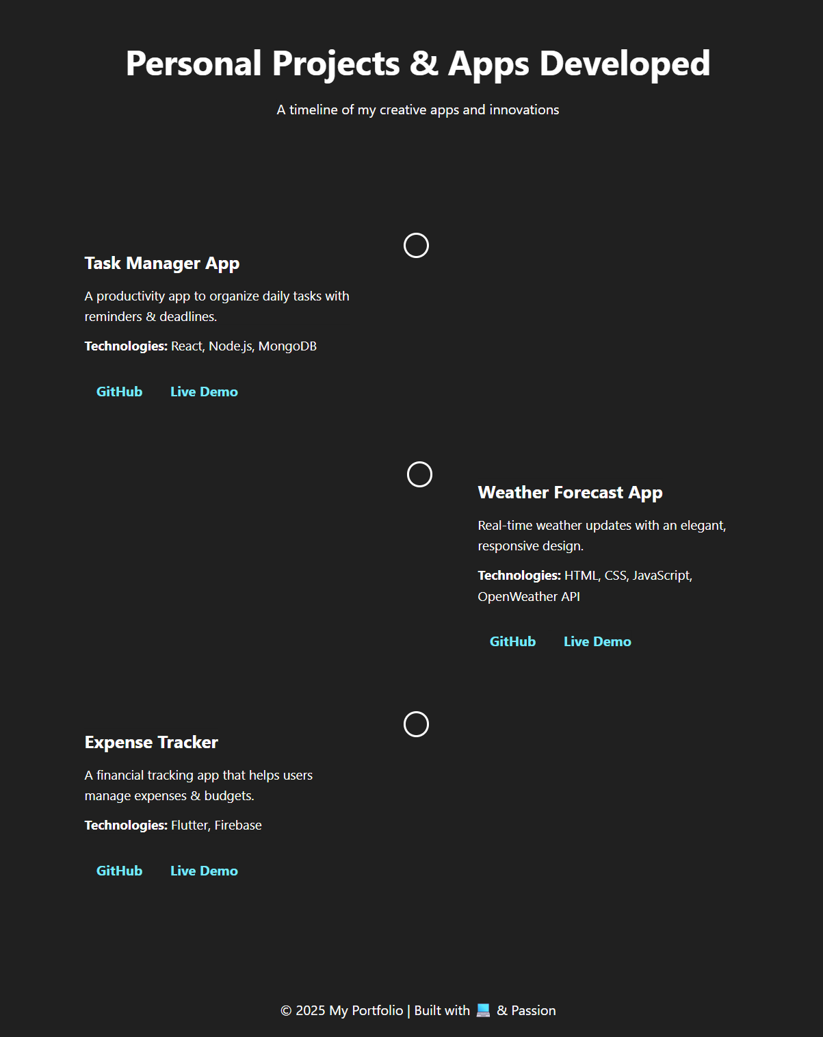

RESULTS AND SCREENSHOTS
Successfully developed and deployed a personalized portfolio website.
Improved professional branding and visibility in job and freelance opportunities.
Provided a centralized platform for showcasing skills, achievements, and projects.
3/21/2024 Annual Review
10

Slide 11
CONCLUSION
The Digital Portfolio Website proves to be an essential tool for students, professionals, and freelancers to present themselves effectively in the competitive digital space. By integrating projects, certifications, and skills into a well-structured website, it not only enhances employability but also builds a strong online personal brand. Future enhancements could include AI-based resume analyzers, blogging sections, and integration with LinkedIn APIs.
11

Slide 12
Github Link
https://sanjays24b28.github.io/Sanjay06/

