Slide 1
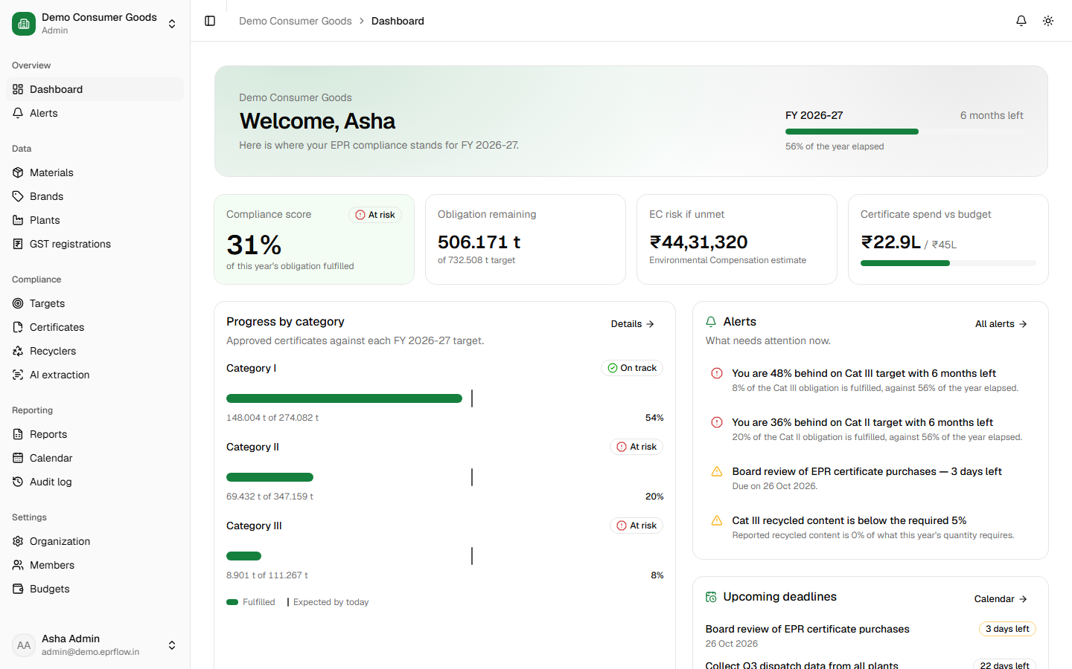
EPRFlow
PITCH DECK · 2026
Know your obligation. Trust every certificate. Never miss a deadline.
EPR compliance software for Indian producers, importers, brand owners and their consultants
Notes:
EPRFlow is software that runs Extended Producer Responsibility compliance for Indian companies — from sales data to the CPCB annual return — in one place.

Slide 2





Every brand selling in India carries an EPR obligation
THE PROBLEM
Under the Plastic, E-Waste and Battery Waste Management rules, every producer, importer and brand owner must:
Register on the CPCB centralised EPR portal
Report every tonne placed on the market, by category and state
Buy recycling certificates to meet a yearly target
File quarterly and annual returns on time
The yearly cycle a compliance team runs today
Sales data
Excel, every month
Target
Worked out by hand
Certificates
Typed in, unverified
Miss the target and pay. Any shortfall attracts Environmental Compensation — a direct financial penalty, on top of the certificates still owed.
CPCB return
Chased by email
Notes:
The rules are clear, but the obligation repeats every year and touches sales, purchase and finance data across brands, plants and states. Falling short means Environmental Compensation.

Slide 3






And it still runs on spreadsheets, PDFs and email
THE PROBLEM
Targets calculated by hand
Every document typed in
Fake and double-sold certificates
Category-wise targets from two years of sales data, in Excel. One wrong formula and the whole year is off.
Recycler certificates and invoices arrive as PDFs and photos, and are re-keyed line by line.
The same certificate can be sold to two companies, or come from an unverified recycler. Nobody checks.
Missed CPCB deadlines
No single view
Nothing to show an auditor
Filing dates live in inboxes. A missed return becomes a penalty.
No one sees the position across brands, plants, GSTINs and states — least of all consultants with many clients.
Who changed what, and why, is lost in email threads and file versions.
Notes:
Six pains we hear from compliance teams: hand-calculated targets, manual data entry, unverifiable certificates, missed deadlines, no consolidated view, and no audit trail.

Slide 4


EPRFlow fixes each of these in one workspace
THE SOLUTION
PROBLEM
HOW EPRFLOW SOLVES IT
Targets calculated by hand
Automatic targets from versioned CPCB rules, with shortfall and EC risk
Every document typed in
AI reads certificates and invoices; a person checks and approves
Fake and double-sold certificates
Fraud checks on every certificate; flagged ones cannot be approved
Missed CPCB deadlines
Compliance calendar with email reminders 30, 7 and 1 day before
No single view
Live dashboard per company, and one overview across all clients
Nothing to show an auditor
Every change logged; CPCB return and registers in one click
Notes:
Each pain maps to one part of the product. The next slides show each of them working, with screenshots from the live application.

Slide 5

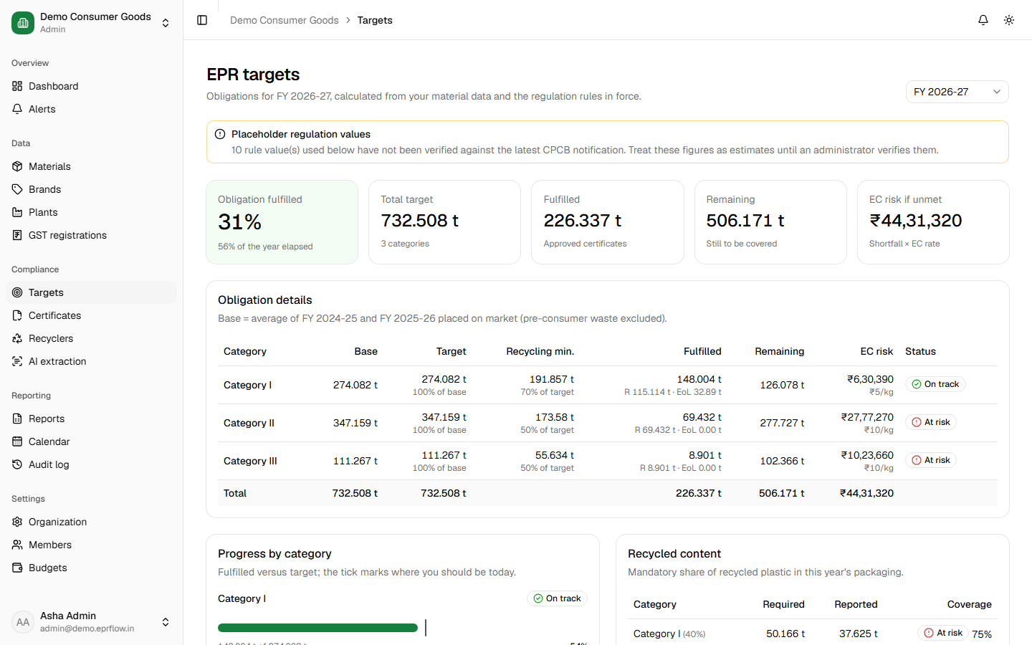


Targets and risk, calculated automatically
SOLUTION
The problem: targets are worked out by hand in Excel, and nobody knows the shortfall until it is too late.
Rule engine
Target per category from two years of sales data and the CPCB rule in force.
Live compliance score
Fulfilled, remaining, shortfall and Environmental Compensation risk in rupees.
Early alerts
“36% behind on Category II with 6 months left” — checked every day.
Notes:
Rules are stored as versioned data, not code, so when CPCB changes a target it is a data update and every customer recalculates instantly.

Slide 6
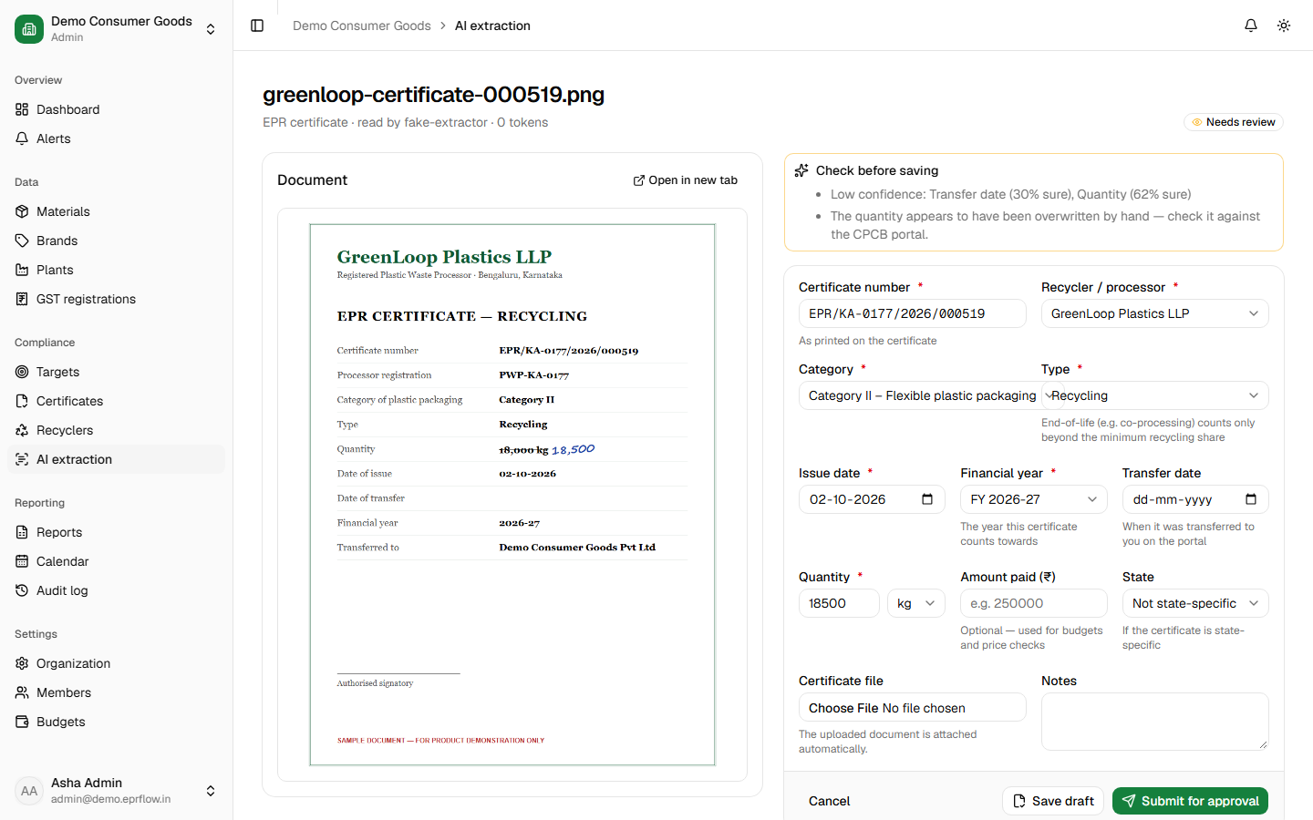



AI reads certificates and invoices
SOLUTION
The problem: every certificate and invoice is re-typed by hand — slow, and a source of errors.
Upload a PDF or photo
AI extracts certificate number, recycler, category, quantity, dates — or every invoice line.
Side-by-side review
Document on the left, values on the right. Nothing is saved until a person approves.
Flags what to check
Low-confidence fields and hand-written corrections are highlighted first.
Notes:
Works with Google Gemini (free tier) or Claude. Approved certificates become drafts with the file attached; invoice lines become material entries.

Slide 7
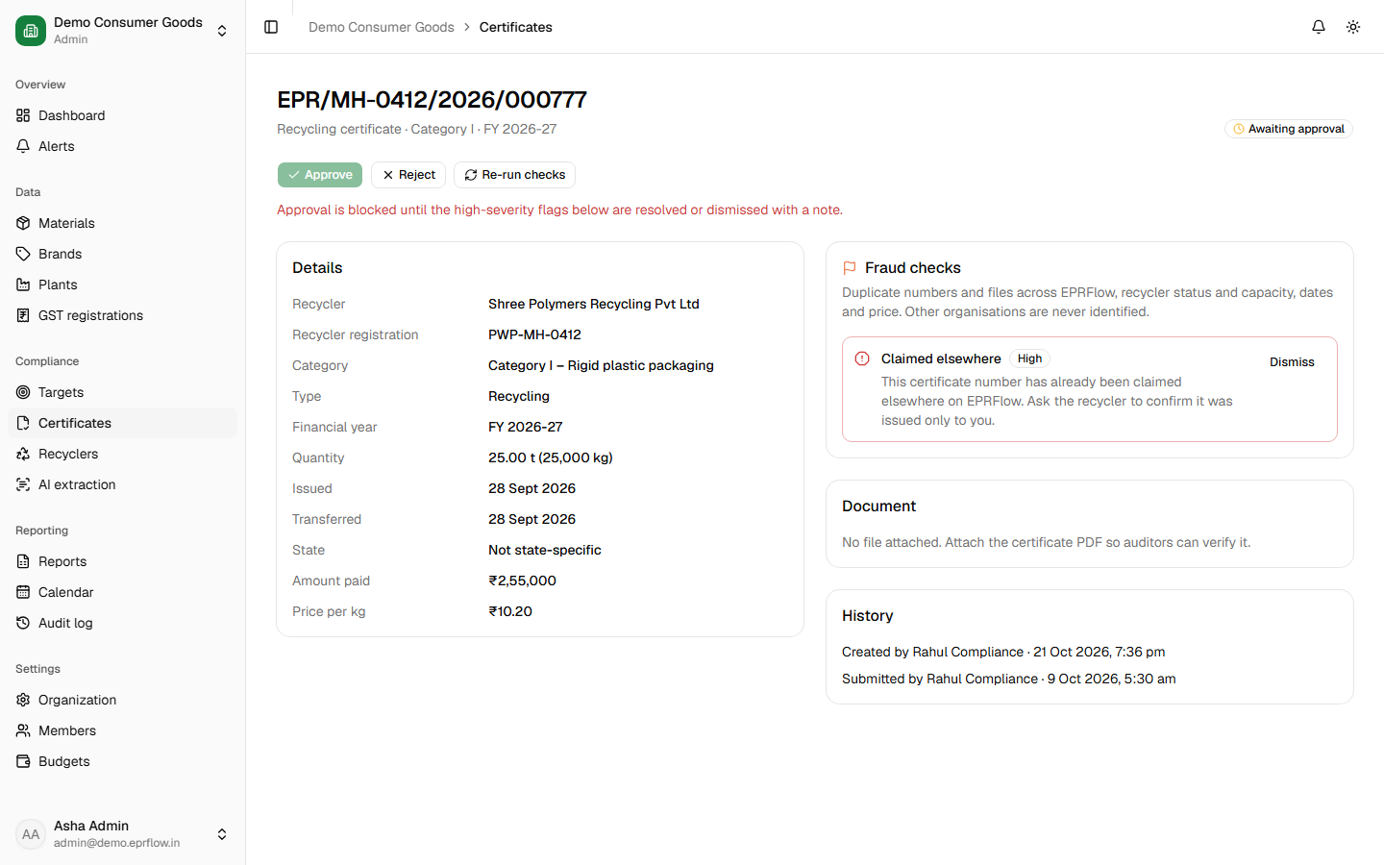



Every certificate is checked before it counts
SOLUTION
The problem: the same certificate can be sold twice, or come from an unverified recycler — and nobody checks.
Duplicate detection
Within the company and across all EPRFlow customers — without revealing who.
Recycler and capacity
Unverified or expired recyclers, and volumes beyond a recycler's capacity.
Approval blocked
High-severity flags must be resolved before a certificate counts towards targets.
Notes:
Also checks impossible dates and prices far from the market median. Admins approve purchases; every decision is in the audit log.

Slide 8
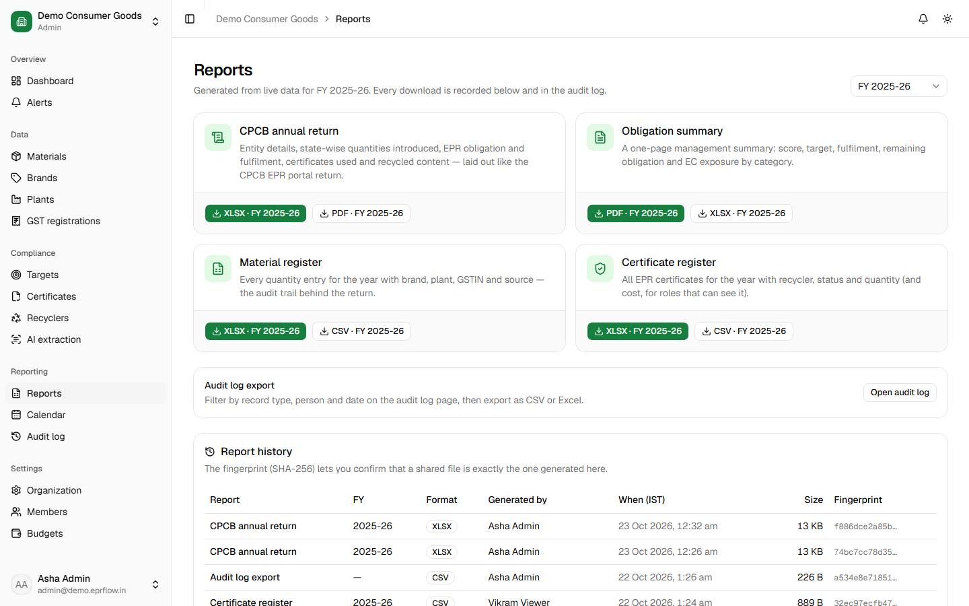
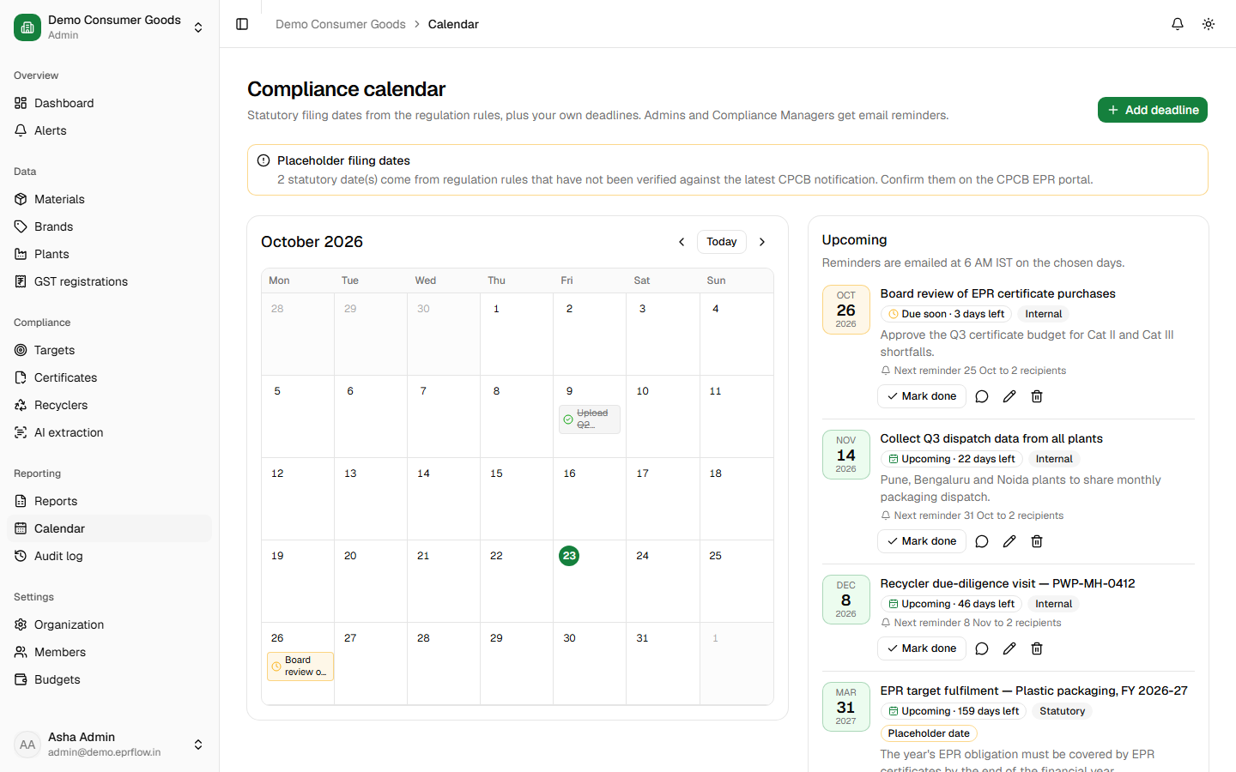
CPCB-ready reports and no missed deadlines
SOLUTION
The problem: returns are assembled by hand at the last minute, and filing dates are tracked in inboxes.
One-click reports. CPCB annual return, obligation summary and registers in Excel or PDF.
Compliance calendar. Every statutory date, with email reminders 30, 7 and 1 day before.
Notes:
Reports are generated from the same data as the dashboard, so the return always matches what the team sees. Each download is fingerprinted and kept in a history.

Slide 9
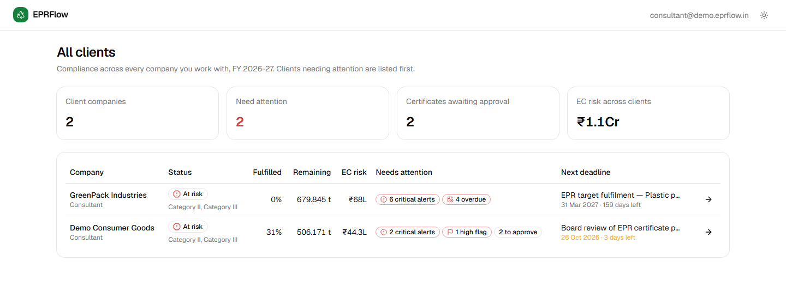



Consultants see every client on one screen
SOLUTION
The problem: EPR consultants juggle dozens of clients in separate spreadsheets and folders.
All clients overview
Score, EC risk, open alerts and the next deadline for every client — riskiest first.
One login
Switch between client companies from the sidebar.
Strict isolation
Each client's data is separated at the database layer.
Notes:
Consultants are a distribution channel: each consultant brings many client companies onto the platform.

Slide 10





How it works: the whole EPR cycle in one flow
1. Bring in data
2. See the target
3. Buy safely
4. File on time
Excel / CSV import with row-by-row validation, or AI-read invoices.
Obligation, shortfall and EC risk per category and state.
Certificates checked for fraud; admins approve; budget tracked.
Calendar reminders and a CPCB-format return in one click.
Built to be trusted with compliance data
Four enforced roles · complete audit log · tenant isolation on every query · rate-limited sign-in · encrypted sessions · hosted on Vercel + Neon Postgres
Notes:
Plastic, e-waste and battery streams are all supported. Regulation values live in versioned rules that an administrator updates when CPCB changes them.

Slide 11

Simple annual subscriptions
Starter
Growth
Enterprise
₹24,000 / year
₹72,000 / year
Custom
Single brand owner getting off spreadsheets
Multi-state producers buying certificates every quarter
Groups and EPR consultants with many companies
Plastic packaging
Automatic targets & EC risk
Calendar & CPCB return
Plastic, e-waste & battery
Fraud checks & AI extraction
Budgets, registers, audit export
Consultant multi-client view
Unlimited members & AI
Onboarding & priority support
Pays for itself: one avoided Environmental Compensation penalty or one rejected fake certificate covers years of subscription. Prices are indicative.
Notes:
Prices are indicative, per organisation per year excluding GST, with a 30-day free trial. A recycler marketplace with commission is a later revenue stream.

Slide 12
Built and working today
7 / 7
3
190+
product phases complete
waste streams: plastic, e-waste, battery
automated unit and browser tests
Company onboarding, GSTIN checks, brands and plants
Material data entry and Excel / CSV import
Target engine, dashboard and daily alerts
Certificates, recycler directory and fraud checks
AI extraction with human review
CPCB reports, calendar, reminders and audit log
Landing page, pricing and consultant overview
Next
Pilot customers and consultants
Billing and plan limits
WhatsApp reminders
Recycler certificate marketplace
Notes:
The full product is built and tested. Next comes onboarding pilot customers, connecting billing, and the recycler marketplace.

Slide 13



SEE IT IN ACTION
2-minute demo
From spreadsheets to certainty
eprflow-demo.mp4
Product
Let's make EPR compliance effortless for every Indian brand.
Landing page, pricing and free trial
Source
github.com/sanjaysaini383/EPR-Flow
Notes:
Play the 2-minute demo video, then open the discussion.

