Slide 1

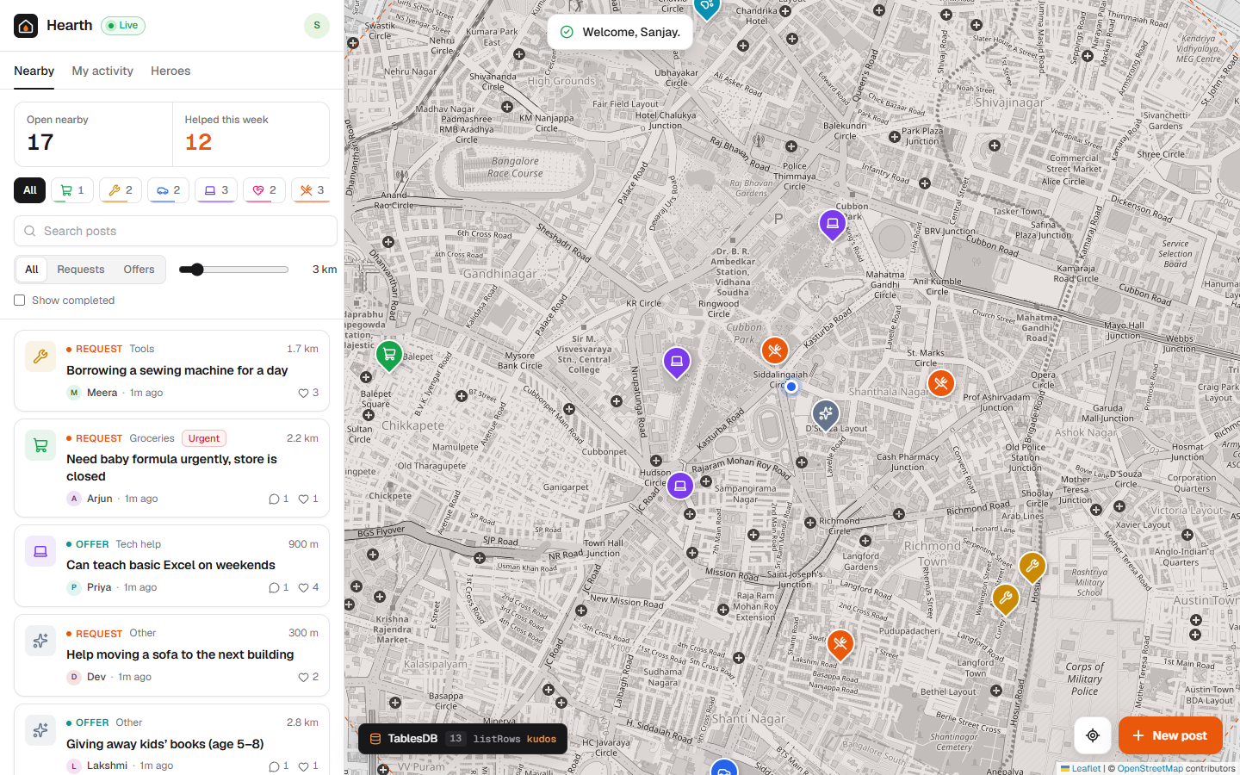
Hearth
Your neighbourhood, on a live map. Ask for a hand, or lend one.
Built on Appwrite TablesDB · Appwrite Databases Hackathon 2026
Sanjay Saini
Notes:
Hearth is a hyperlocal mutual-aid app: neighbours post small requests or offers on a live map, someone nearby claims it, they chat, and it ends with kudos. Everything runs on Appwrite TablesDB with no custom backend.

Slide 2



Most people would help a neighbour, if they knew
Small, everyday needs go unmet because there is no simple, local, low-pressure way to ask or to offer.
Group chats bury requests
Nobody can see what is nearby
Asking feels like a burden
A 400-person WhatsApp group is noisy; an ask for a ladder scrolls away in minutes.
Helpers have no view of who needs what within a few streets of them.
Without a clear, bounded ask and a way to say thanks, people simply don’t ask.
Notes:
The need is real but the channels are wrong: noisy group chats, no spatial view, and no bounded way to ask or close the loop.

Slide 3




Hearth turns small asks into neighbourly help
01
02
03
04
Post
Claim
Coordinate
Complete
Pin a request or an offer to your street. It is visible to neighbours within their search radius.
A neighbour taps “I can help”. Claims are race-safe, so nobody is double-booked.
Sort out the details in a live conversation attached to the post.
Mark it done and send kudos. Kudos roll up into a neighbourhood Heroes board.
No email or password: neighbours join with a first name (anonymous Appwrite session).
Notes:
Four steps: post, claim, coordinate, complete. The claim and completion steps are where the interesting database work happens.

Slide 4



A live map of who needs what, nearby
Radius search
The feed is every open post inside a radius you control, computed by the database.
Neighbourhood pulse
Open posts per category and help completed this week, at a glance.
Live updates
New pins, claims and messages appear for everyone instantly over Realtime.
Notes:
The main screen: map on the right, feed and filters on the left. Category pins, a radius ring, and the pulse counts at the top of the feed.

Slide 5






Every feature runs on Appwrite TablesDB
Spatial index
Full-text search
Relationships
Transactions
Point column + distanceLessThan radius search
Fulltext index on titles, Query.search
posts → messages (cascade), posts → kudos
Race-safe claiming with conflict detection
Batch operations
Atomic operators
Aggregations
Realtime
createOperations: 4 writes, 3 tables, 1 commit
incrementRowColumn and Operator.increment
groupBy + count / sum for pulse and Heroes
One socket on posts, messages and kudos rows
Row security and permissions throughout: anyone reads, signed-in neighbours write, authors own deletes.
Notes:
This is the core of the submission: Hearth uses TablesDB the way a real product would, not just CRUD. Eight distinct capabilities, each with a concrete job in the app.

Slide 6
Three tables, linked by relationships
posts
messages
1 → many · cascade
kind enum request | offer
category enum, 8 values
title / body varchar 120 / text
location point [lng, lat]
status enum open | claimed | done
urgency enum low | normal | high
author / helper id + name
hearts / replies integer counters, min 0
expiresAt datetime
post relationship → posts
authorId / authorName varchar
body varchar 1000
system boolean
kudos
1 → many · set null
post relationship → posts
from / to id + name
points integer 1 – 5
note varchar 280
Indexes spatial (location) · fulltext (title) · key (status, $createdAt) · key (category) · key (authorId) · key (helperId) · key (kudos.toId)
Notes:
Deleting a post cascades its thread; kudos survive with the link nulled. The schema is provisioned by an idempotent script (npm run setup) using the server SDK.

Slide 7

Claims are race-safe by design
createTransaction
getRow
Stage writes
Commit
Open a short-lived transaction (60 s TTL)
Read the post inside it and check it is still open
Claim the post, add a system message, bump replies
All staged writes apply together
Two neighbours tap at the same moment
Completion is one batch
The second commit is rejected with 409 transaction_conflict and rolled back. The first claimer is kept, and the UI says “someone claimed this a moment before you”.
createOperations stages four writes across three tables: post → done, a kudos row, a thank-you message and a reply counter. One commit, all or nothing.
Notes:
The conflict path is not theoretical: the smoke test forces a concurrent claim and asserts that Appwrite returns 409 transaction_conflict and keeps the first claimer.

Slide 8
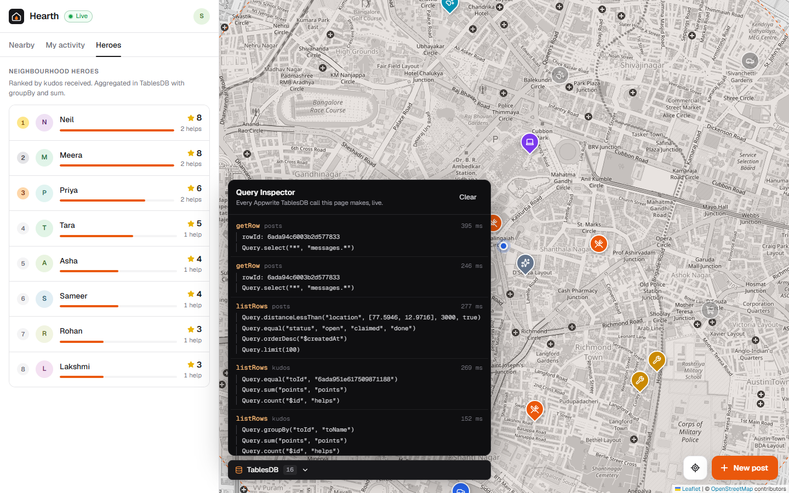
The Query Inspector makes the database visible
A live panel that logs every TablesDB call the page makes, rendered as the SDK call that built it, with timings.
Queries, transactions and batches step by step
Realtime pushes as they arrive
Rollbacks and errors highlighted
Lets judges verify every claim in this deck while using the app
Notes:
Open it from the TablesDB button on the map. It is the fastest way to see that the radius search, aggregations and transactions are real database calls.

Slide 9
Verified end to end on Appwrite Cloud
13 / 13
2
0
3 · 8 · 2
smoke checks pass
live browsers in e2e
custom servers
schema at a glance
npm run smoke exercises every TablesDB feature against a live project
Post, realtime delivery, claim, chat, completion and kudos between two real users
The browser talks to TablesDB directly; permissions are enforced by Appwrite
3 tables, 8 indexes and 2 relationships, provisioned by an idempotent setup script
Deployed on Appwrite Cloud (Singapore region). Light and dark themes, desktop and phone layouts.
Notes:
Everything shown was tested against a real Appwrite Cloud project, not mocks: a scripted smoke test plus a two-browser Playwright run.

Slide 10

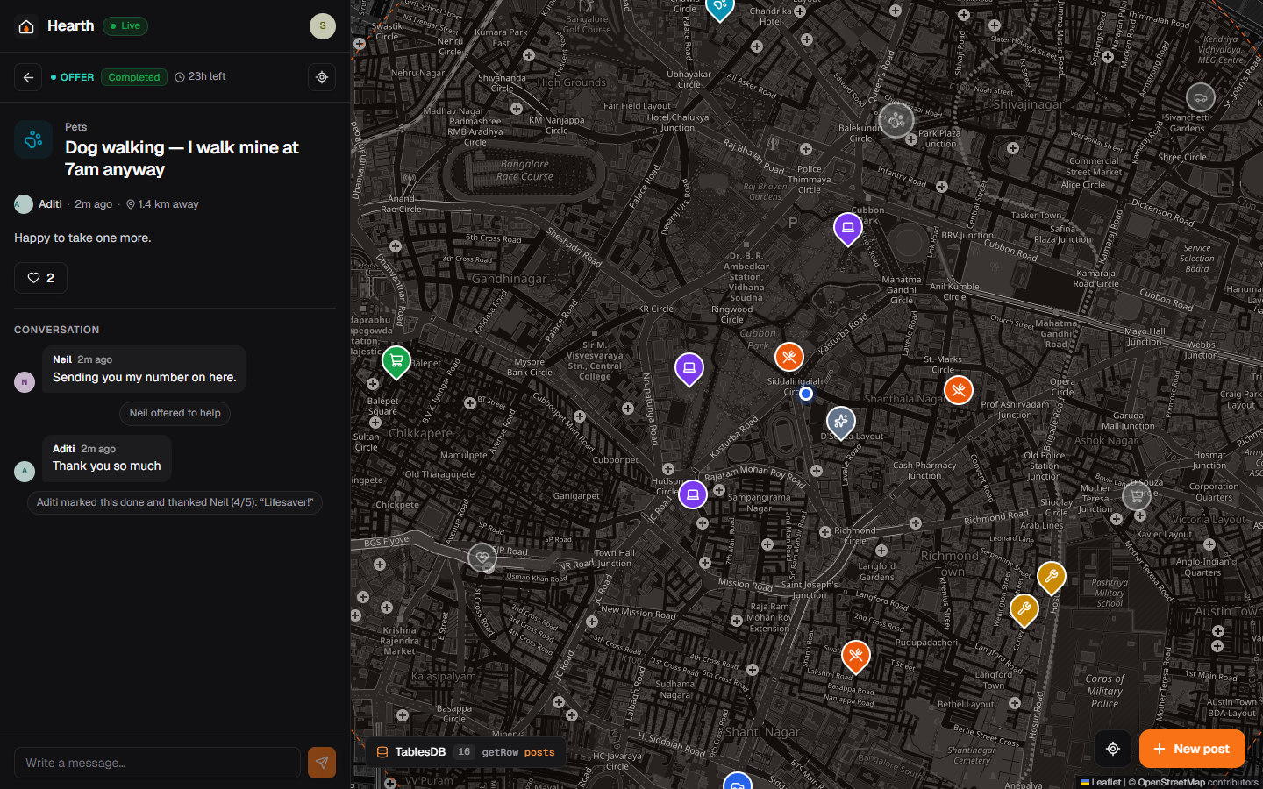



What comes next
Auto-expiry
Appwrite Functions on a schedule to close posts past their expiry.
Nearby alerts
Appwrite Messaging push when an urgent request appears within your radius.
Verified neighbourhoods
Appwrite Teams for buildings and societies, with private boards.
Trust and safety
Reporting, moderation queue and rate limits per user.
Notes:
Each next step builds on another Appwrite product, keeping the zero-custom-server architecture.

Slide 11



Help is closer
than you think
Source
github.com/sanjaysaini383/appwrite
Demo
90-second walkthrough video
Run it
npm run setup / seed / dev
Notes:
Thank you. The repository has setup instructions, the smoke test and the demo script.

