Slide 1
Final Project- Sales prediction
By-
Rishya and Sanjay

Slide 2
Problem Definition
Predicting the sales for October 2015 for every item and shop using various data mining modelling methods.

Slide 3
Dataset
The dataset consists of the following:
Structured dataset:
> str(merged_all)
'data.frame': 2935849 obs. of 10 variables:
1 $ item_id : int 0 1 1 1 1 1 1 2 2 3 ...
2 $ item_category_id : int 40 76 76 76 76 76 76 40 40 40 ...
3 $ item_name : Factor w/ 22170 levels "! Ð’Ðž Ð’Ð›Ð\220Ð¡Ð¢Ð\230 Ð\2
4 $ item_category_name: Factor w/ 84 levels "Ð¡Ð»ÑƒÐ¶ÐµÐ±Ð½Ñ‹Ðµ",..: 47 80 80
5 $ shop_id : int 54 55 55 55 55 55 55 54 54 54 ...
6 $ shop_name : Factor w/ 60 levels "!Ð¯ÐºÑƒÑ‚Ñ\201Ðº Ð¢Ð¦ \"Ð¦ÐµÐ½Ñ‚
7 $ date : Factor w/ 1034 levels "01.01.2013","01.01.2014",..: 2
8 $ date_block_num : int 20 21 15 20 18 15 19 19 22 18 ...
9 $ item_price : num 58 4490 4490 4490 4490 4490 4490 58 58 100 ...
10 $ item_cnt_day : num 1 1 1 1 1 1 1 1 1 1 ...

Slide 4
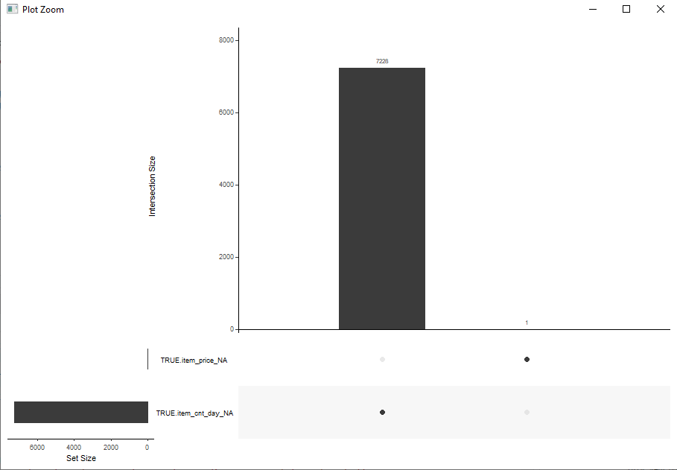
1. Cleaning the data
Looking for noise in the dataset:
It was observed that two variables(item_price and item_cnt_day) in the dataset had noisy data i.e. it had negative values.

Slide 5
Dataset Summary
> summary(merged_all)
item_id item_category_id
Min. : 0 Min. : 0
1st Qu.: 4476 1st Qu.:28
Median : 9343 Median :40
Mean :10197 Mean :40
3rd Qu.:15684 3rd Qu.:55
Max. :22169 Max. :83
item_name
Ð¤Ð¸Ñ€Ð¼ÐµÐ½Ð½Ñ‹Ð¹ Ð¿Ð°ÐºÐµÑ‚ Ð¼Ð°Ð¹ÐºÐ° 1Ð¡ Ð˜Ð½Ñ‚ÐµÑ€ÐµÑ\u0081 Ð±ÐµÐ»Ñ‹Ð¹ (34*42) 45 Ð¼ÐºÐ¼ : 31340
Playstation Store Ð¿Ð¾Ð¿Ð¾Ð»Ð½ÐµÐ½Ð¸Ðµ Ð±ÑƒÐ¼Ð°Ð¶Ð½Ð¸ÐºÐ°: ÐšÐ°Ñ€Ñ‚Ð° Ð¾Ð¿Ð»Ð°Ñ‚Ñ‹ 1000 Ñ€ÑƒÐ±. : 9408
ÐŸÑ€Ð¸ÐµÐ¼ Ð´ÐµÐ½ÐµÐ¶Ð½Ñ‹Ñ… Ñ\u0081Ñ€ÐµÐ´Ñ\u0081Ñ‚Ð² Ð´Ð»Ñ\u008f 1Ð¡-ÐžÐ½Ð»Ð°Ð¹Ð½ : 9067
Diablo III [PC, Jewel, Ñ€ÑƒÑ\u0081Ñ\u0081ÐºÐ°Ñ\u008f Ð²ÐµÑ€Ñ\u0081Ð¸Ñ\u008f] : 7479
Kaspersky Internet Security Multi-Device Russian Edition. 2-Device 1 year Renewal Box : 6853
World of Warcraft. ÐšÐ°Ñ€Ñ‚Ð° Ð¾Ð¿Ð»Ð°Ñ‚Ñ‹ Ð¸Ð³Ñ€Ð¾Ð²Ð¾Ð³Ð¾ Ð²Ñ€ÐµÐ¼ÐµÐ½Ð¸ (online) (Ñ€ÑƒÑ\u0081.Ð².) (60 Ð´Ð½ÐµÐ¹) (Jewel): 6602
(Other) :2865100
item_category_name shop_id
ÐšÐ¸Ð½Ð¾ - DVD : 564652 Min. : 0
Ð˜Ð³Ñ€Ñ‹ PC - Ð¡Ñ‚Ð°Ð½Ð´Ð°Ñ€Ñ‚Ð½Ñ‹Ðµ Ð¸Ð·Ð´Ð°Ð½Ð¸Ñ\u008f : 351591 1st Qu.:22
ÐœÑƒÐ·Ñ‹ÐºÐ° - CD Ð»Ð¾ÐºÐ°Ð»ÑŒÐ½Ð¾Ð³Ð¾ Ð¿Ñ€Ð¾Ð¸Ð·Ð²Ð¾Ð´Ñ\u0081Ñ‚Ð²Ð°: 339585 Median :31
Ð˜Ð³Ñ€Ñ‹ - PS3 : 208219 Mean :33
ÐšÐ¸Ð½Ð¾ - Blu-Ray : 192674 3rd Qu.:47
Ð˜Ð³Ñ€Ñ‹ - XBOX 360 : 146789 Max. :59
(Other) :1132339
shop_name date date_block_num
ÐœÐ¾Ñ\u0081ÐºÐ²Ð° Ð¢Ð¦ "Ð¡ÐµÐ¼ÐµÐ½Ð¾Ð²Ñ\u0081ÐºÐ¸Ð¹" : 235636 28.12.2013: 9434 Min. : 0.00
ÐœÐ¾Ñ\u0081ÐºÐ²Ð° Ð¢Ð Ðš "Ð\u0090Ñ‚Ñ€Ð¸ÑƒÐ¼" : 186104 29.12.2013: 9335 1st Qu.: 7.00
Ð¥Ð¸Ð¼ÐºÐ¸ Ð¢Ð¦ "ÐœÐµÐ³Ð°" : 143480 30.12.2014: 9324 Median :14.00
ÐœÐ¾Ñ\u0081ÐºÐ²Ð° Ð¢Ð¦ "ÐœÐ•Ð“Ð\u0090 Ð¢ÐµÐ¿Ð»Ñ‹Ð¹ Ð¡Ñ‚Ð°Ð½" II: 142234 30.12.2013: 9138 Mean :14.57
Ð¯ÐºÑƒÑ‚Ñ\u0081Ðº ÐžÑ€Ð´Ð¶Ð¾Ð½Ð¸ÐºÐ¸Ð´Ð·Ðµ, 56 : 117428 31.12.2014: 8347 3rd Qu.:23.00
Ð¡ÐŸÐ± Ð¢Ðš "Ð\u009dÐµÐ²Ñ\u0081ÐºÐ¸Ð¹ Ð¦ÐµÐ½Ñ‚Ñ€" : 109253 27.12.2014: 8041 Max. :33.00
(Other) :2001714 (Other) :2882230
item_price item_cnt_day daily_sales_value
Min. : -1.0 Min. : -22.000 Min. : -68970
1st Qu.: 249.0 1st Qu.: 1.000 1st Qu.: 249
Median : 399.0 Median : 1.000 Median : 449
Mean : 890.9 Mean : 1.243 Mean : 1158
3rd Qu.: 999.0 3rd Qu.: 1.000 3rd Qu.: 1078
Max. :307980.0 Max. :2169.000 Max. :1829990

Slide 6
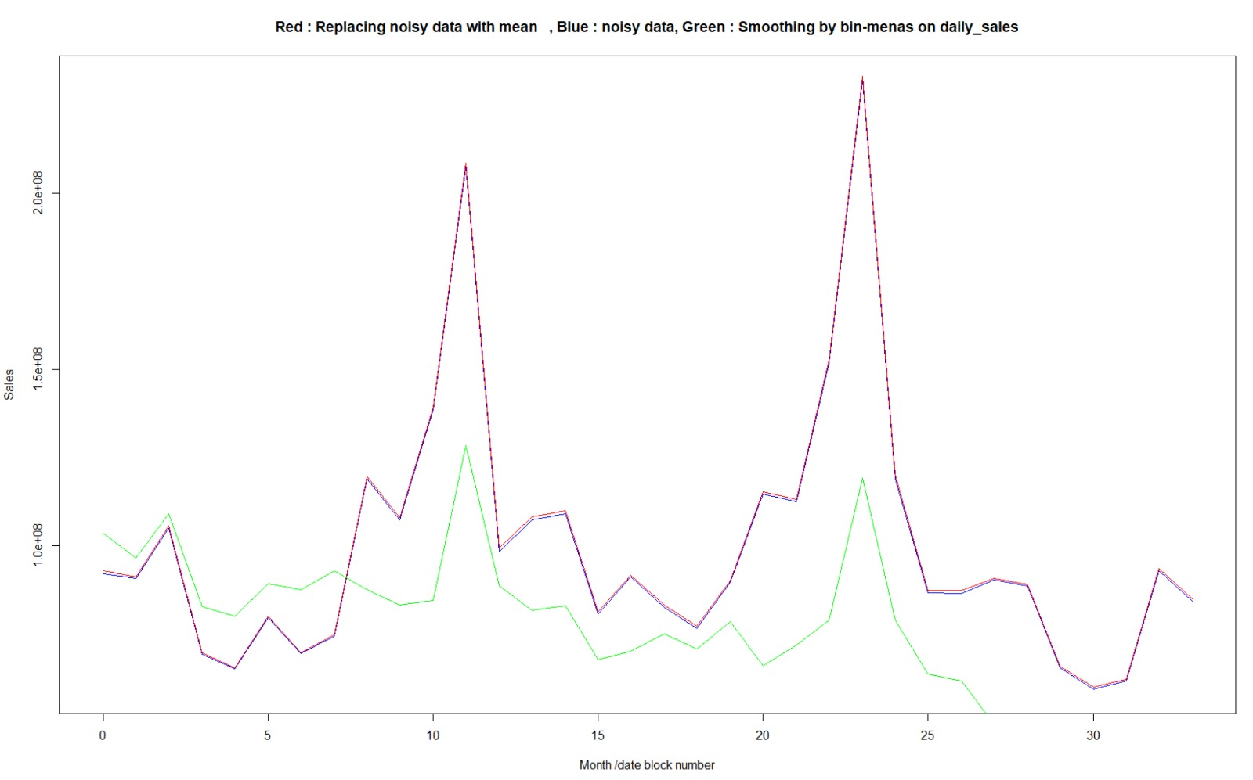
Comparing smoothed data with actual data
Notes:
Bin size : 200,000

Slide 7
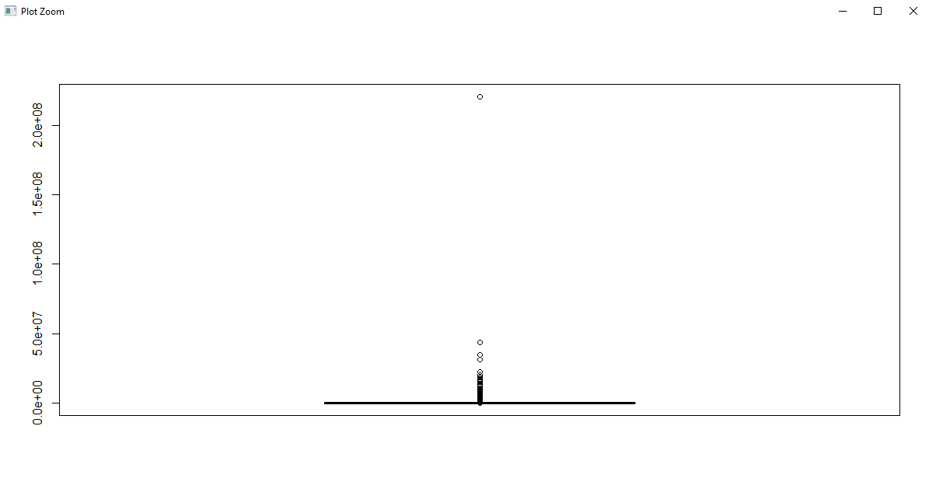
2. Outlier detection
Boxplot was used to determine the outliers in total Sales for ItemID, ShopID and Month

Slide 8
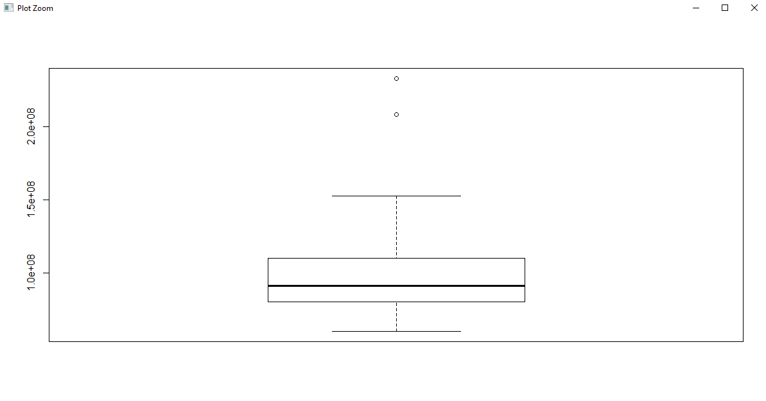
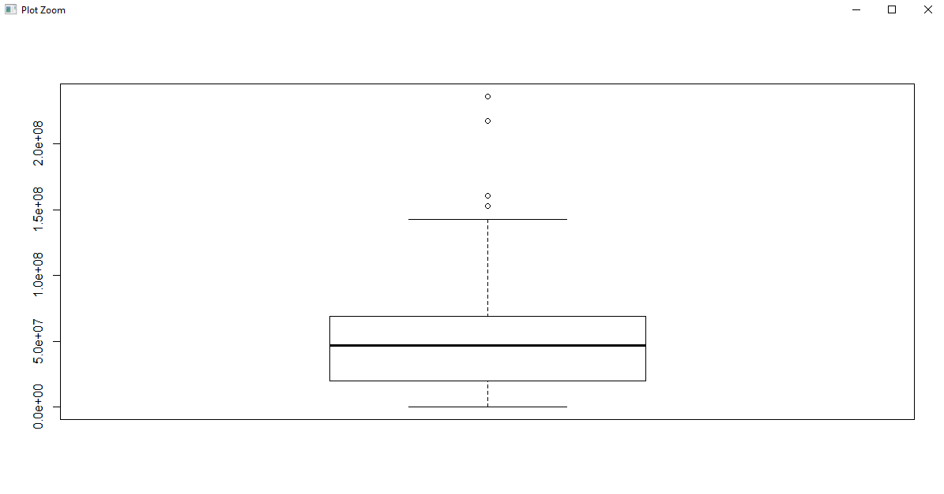
Month ShopID

Slide 9
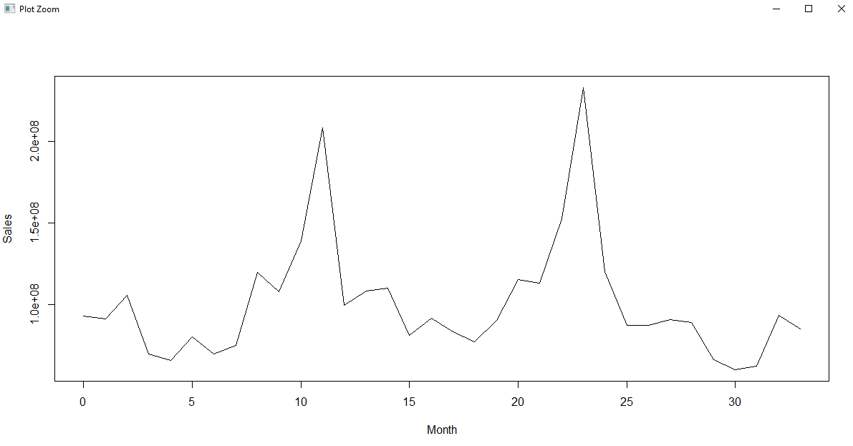
Visual analysis of the data

Slide 10
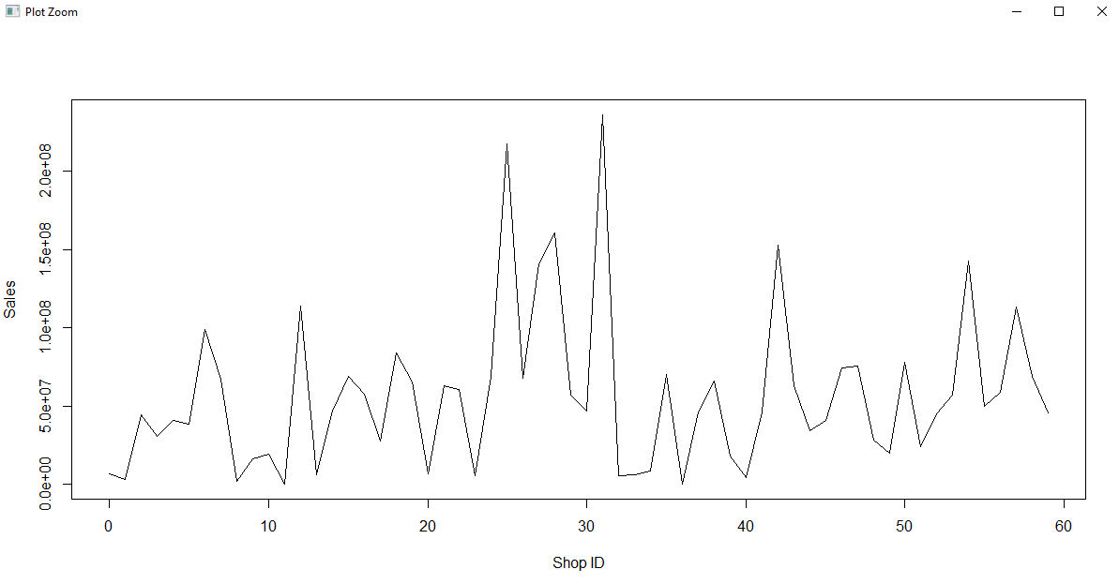
Visual analysis of the data

Slide 11
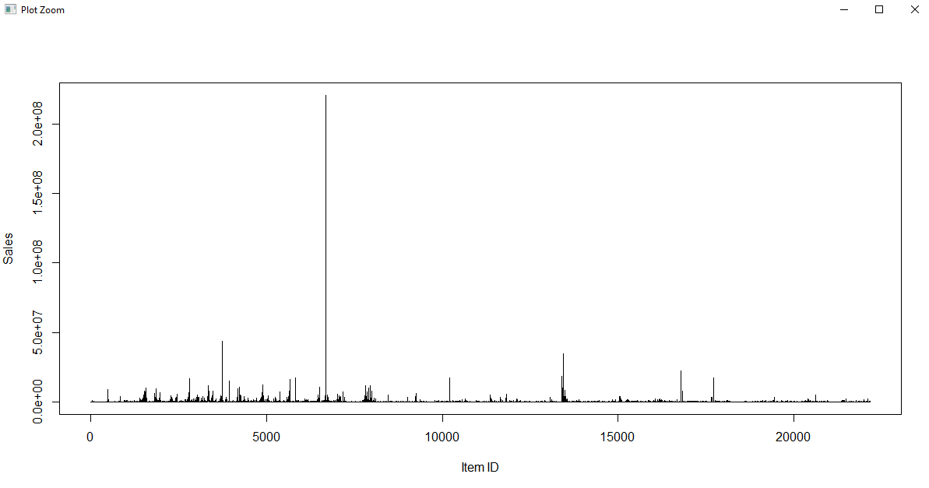
Visual analysis of the data

Slide 12
3. Feature Engineering
1. Daily sales value : Count * Item Price
2. Smoothing the daily sales value by bin-means
N = 200,000
3. Removed the columns that didn’t effect modeling

Slide 13
4. Modelling
Various data mining models that can be employed for predictive analysis are:
1. Linear Regression
2. K-nearest neighbor
3. Random Forest
4. Naïve Bayes
5. K-means

Slide 14
Linear Regression
Step 1: Split the clean data Quarter-wise for efficient modelling purpose
Step 2. Modelled the dataset for linear regression with respect to Daily Sales Value.
Step 3: Plotted the regression line
Step 4: Predicted the output for the Test set i,e; October 2015
Step 5: Plotted a comparison plot for actual values and predicted values

Slide 15
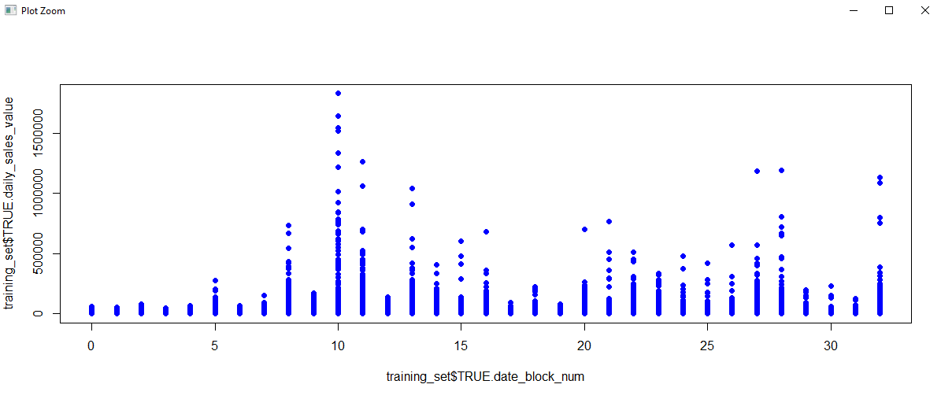
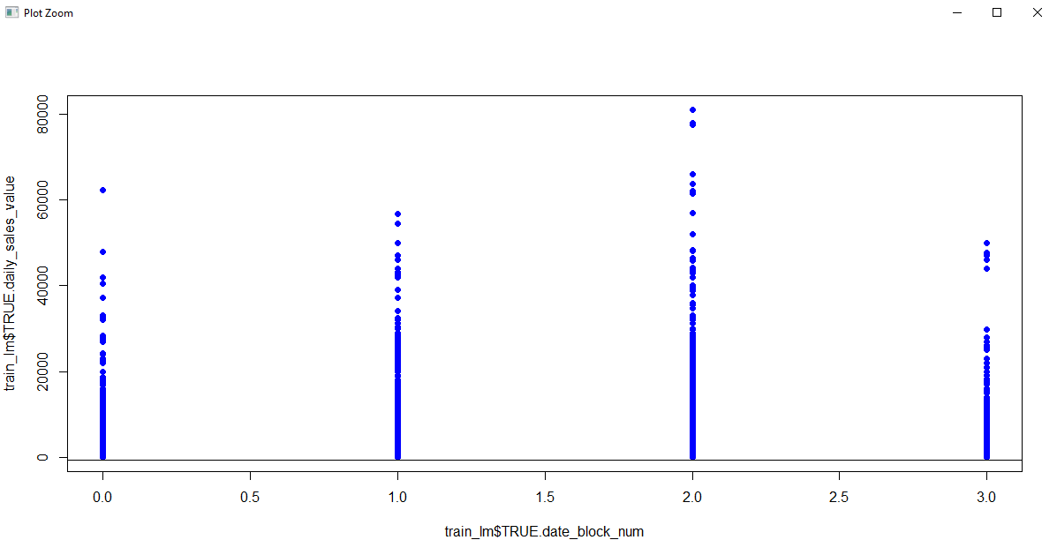

Slide 16
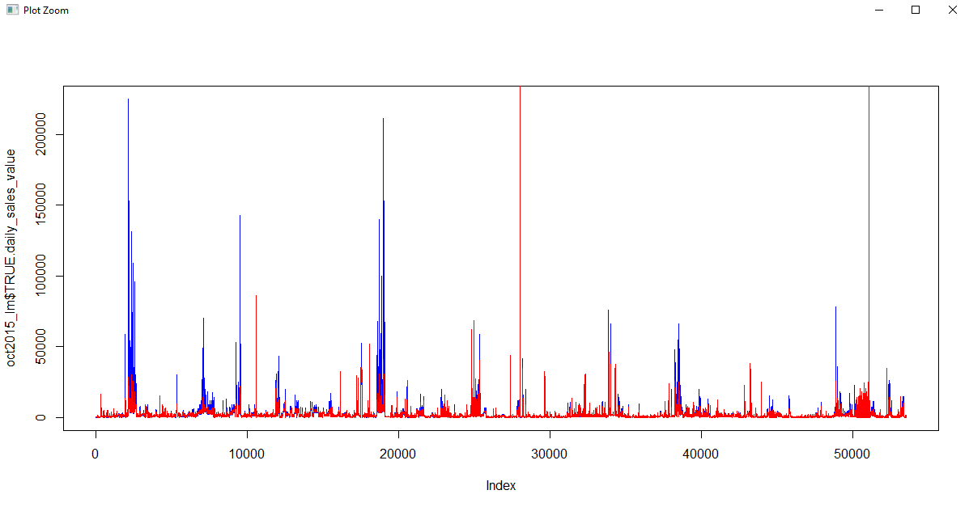

Slide 17
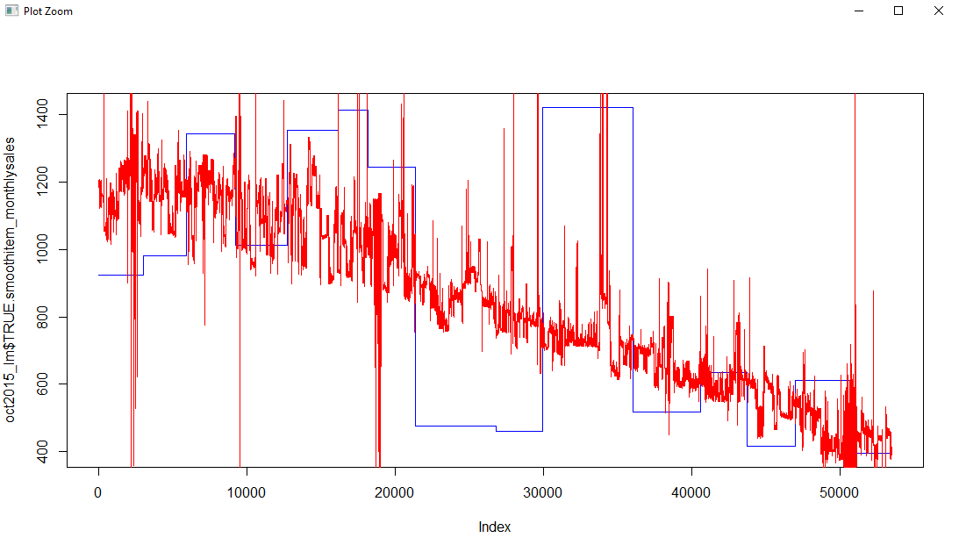

Slide 18
Error determination for Linear Regression
RMSE without bin-means smoothing
RMSE with bin-means smoothing
MSE without bin-means smoothing
MSE with bin-means smoothing

Slide 19
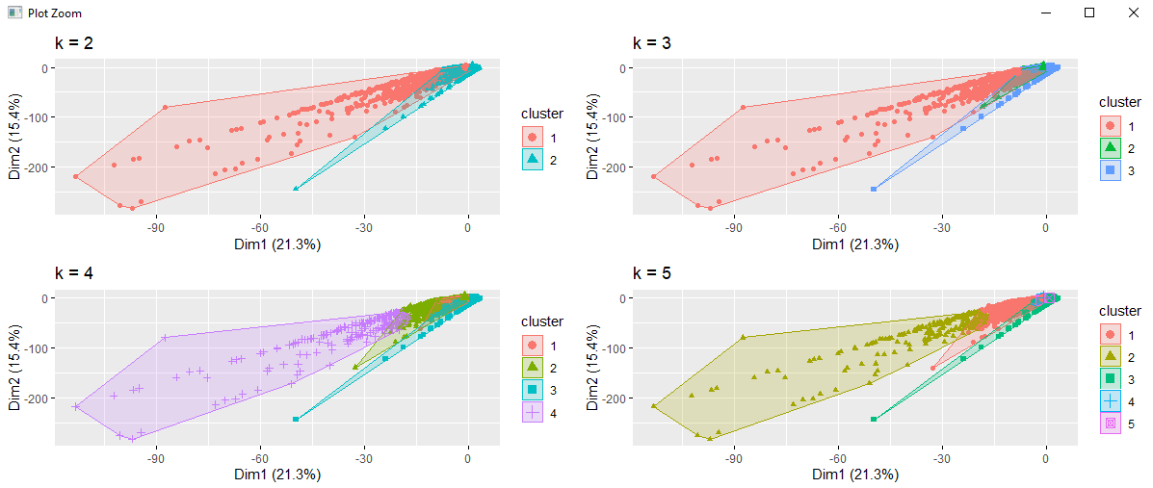
K-Means

Slide 20
K nearest neighbors
Step1: We are normalizing the entire dataset by creating a function.
normalize <-function(x) { return((x-min(x))/(max(x) - min(x))) }
norm_data <- as.data.frame(lapply(knntraindata[,c(1,2,3,4,5,6,7,8)], normalize))
Step2: Split the normalized data in train and test set on the date_block _num.
knn_split <- split(norm_data, norm_data$TRUE.date_block_num < 1)
norm_train_knn <- data.frame(knn_split["TRUE"])
norm_test_knn <- data.frame(knn_split["FALSE"])
Step3: Create a target dataset for daily_sales.
knn_split_wo <- split(knntraindata, knntraindata$date_block_num <33)
wo_norm_train_knn <- data.frame(knn_split_wo["TRUE"])
wo_norm_test_knn <- data.frame(knn_split_wo["FALSE"])
train_target <- wo_norm_train_knn[,5]
Step4: Determination of K > k <- sqrt(2935849) > print(k) > [1] 1713.432 #too many ties in knn was a major roadblock while implementing knn.

Slide 21
What still needs to be completed?
1. KNN prediction
2. Computation of confidence interval for Model 1 and Model 2
3. Efficiency in training time

Slide 22
Who did what
Sanjay
1. Cleaning data
2. Outlier detection
4. Modelling: KNN
Rishya
1. Feature engineering
2. Exploration of the data
3. Modelling: Linear regression

Slide 23
Conclusion
What did you learn?
1. Comparing various models to determine the perfect one that fits the data
2. Analytical creativity in handling noisy data, outliers and feature engineering
What were the roadblocks?
1. Dealing with huge dataset was difficult.
2. Determining the right ways for feature engineering.

Slide 24
THANK YOU

