Slide 1

Angular – 22 Demo By Mr. Sanjay
www.nareshit.com

Slide 2

Introduction
I am Sanjay Kumar
12+ years of Corporate Development Experience.
8+ years of Training Experience.
5+ years With NareshIT.
www.nareshit.com all copy rights reserved to Naresh i Technologies

Slide 3
Training Roadmap
JavaScript
Fundamentals → Modern JS → Async → ES6+
TypeScript
Types → Interfaces → OOP
Angular
Components →Directives →Pipes → Services → RxJS → Forms→ Routing → Authentication → State → Performance
www.nareshit.com all copy rights reserved to Naresh i Technologies

Slide 4
JavaScript Content
Variables
Functions
Arrow Function
Closure
String
Array
Objects
Event Loop
Module (import/export)
Promises
Async-await
ES6+ JavaScript
www.nareshit.com all copy rights reserved to Naresh i Technologies

Slide 5
Angular Content
Angular Installation
Angular CLI
Component
Data binding
View Encapsulation
Inbuilt Directives
Custom Directives
Pipes
Custom Pipes
Component Communication
LifeCycle Methods / Hooks
Services
Dependency Injection
HttpClient / AJAX
Interceptors
Observables (RxJs)
Subject, BehaviourSubject, ReplaySubject
Form
Routing
Lazy Loading
Signals
NgRx (State management)
Build & Deploy
Angular Material
Unit testing (Jasmine + Karma)
www.nareshit.com all copy rights reserved to Naresh i Technologies

Slide 6
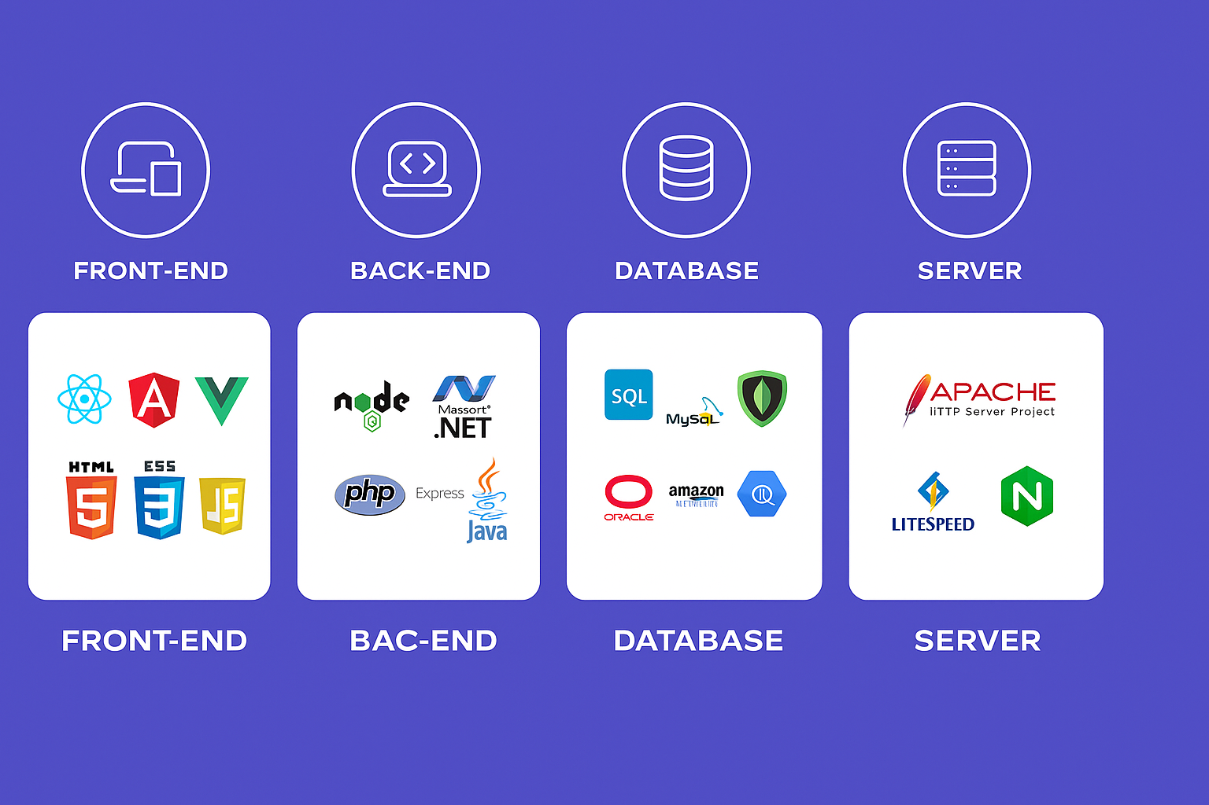
Web Development
www.nareshit.com all copy rights reserved to Naresh i Technologies

Slide 7
Web Development
HTML | Content ( paragraph,image,table,list,audio,form,video)
CSS | Styling (color,border,width,height,background-color,positioning)
Bootstrap | predefined css , Responsiveness
Javascript | Behaviour
Angular/React/Vue | JavaScript Frameworks RAD - Rapid Application Development CLI - Command Line Interface A Template System Reusable components Synchronization of state and view Routing Form Validation Better AJAX
www.nareshit.com all copy rights reserved to Naresh i Technologies

Slide 8
Angular ?
Angular is a TypeScript-based frontend framework by Google for building scalable, enterprise-level web applications.
Angular doesn't eliminate JavaScript. It gives us a structured way to build large applications using JavaScript/TypeScript.
Why Do We Need Angular?
Enterprise-ready framework
Backed by Google
High performance SPA
Built-in routing, forms & HTTP
TypeScript based
Secure & scalable
Strong job demand
www.nareshit.com all copy rights reserved to Naresh i Technologies

Slide 9
Web Development
React Angular
===========================================================
1. Library-2013 1. Framework-2009
2. Light-weight 2. Heavy
3. JSX + Javascript 3. HTML + Typescript
4. Uni-Directional 4. two-way
5. Virtual DOM 5. Regular DOM
6. Axios 6. HttpClientModule
7. No 7. Dependency Injection
8. No 8. Form Validation
9. extra libraries needed 9. No additional libraries
10. UI heavy 10. Functionality heavy
www.nareshit.com all copy rights reserved to Naresh i Technologies

Slide 10
Commonly Asked Questions
Course Duration : 2 months
Class Time : 1 hour daily 07.00 pm to 08.30 pm
Working days: Monday to Saturday (Sunday-off)
Pre-Requisite – HTML , CSS
Mode of training – online
How Many Demo Sessions – 3-4 Sessions
Free For Fullstack Students - No
Fee - NareshIT Admin/management
Course Completion Certificate - Yes
Mute: Allowed to interact anytime during the session once actual class starts
www.nareshit.com all copy rights reserved to Naresh i Technologies

Slide 11

www.nareshit.com all copy rights reserved to Naresh i Technologies

