Slide 1

Node + Express + MongoDB By Mr. Sanjay
www.nareshit.com

Slide 2

Introduction
I am Sanjay Kumar
10+ years of corporate experience as a Full-Stack developer.
7+ years of experience as a trainer.
4+ years With NareshIT.
www.nareshit.com all copy rights reserved to Naresh i Technologies

Slide 3
Training Roadmap
Course Duration : 2 months
Class Time : 1 hour daily 07.30am to 08.45am
Working days: Monday to Saturday (Sunday-off)
JavaScript - 2 weeks
Node + Express + MongoDB - 4/5 weeks
www.nareshit.com all copy rights reserved to Naresh i Technologies

Slide 4
JavaScript Content
Variables
Functions
Arrow Function
Closure
String
Array
Objects
Event Loop
Module (import/export)
Promises
Async-await
www.nareshit.com all copy rights reserved to Naresh i Technologies

Slide 5
NodeJS Content
Node.JS - Introduction
Nodejs Advantages
NPM , NPX , NVM
Modules : (OS, FS,HTTP)
Buffer & Streams
Events
Creating web server
Express Framework
Express Routing
Express Middleware
Template Engines
Error Handling
Introduction to MongoDB
NodeJS & MongoDB
Mongoose
graphQL
Redis (Caching)
ESLint
Swagger
Unit testing
JWT
PhonePe
CRON
Socket.io
Deployment
www.nareshit.com all copy rights reserved to Naresh i Technologies

Slide 6
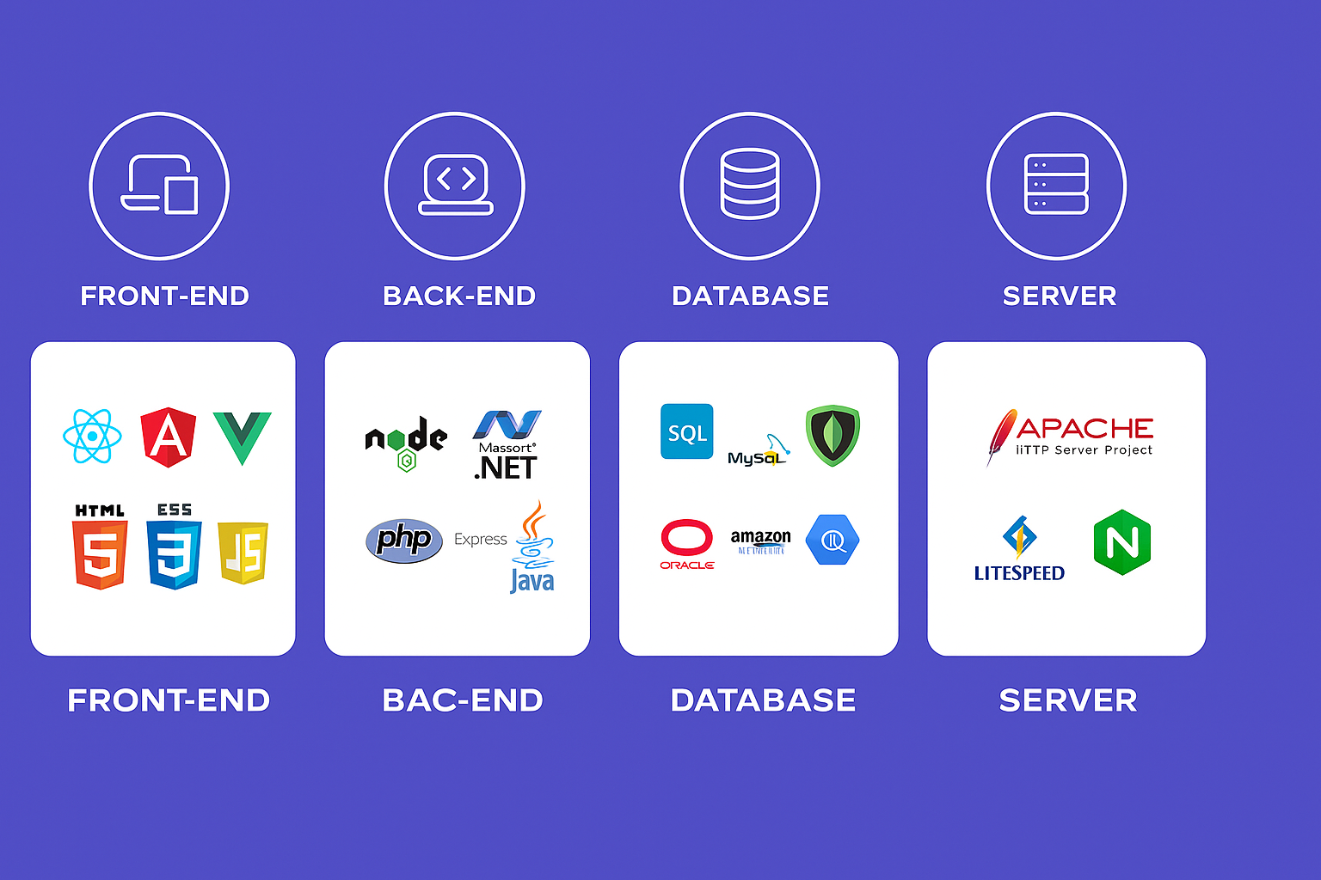
Web Development
www.nareshit.com all copy rights reserved to Naresh i Technologies

Slide 7
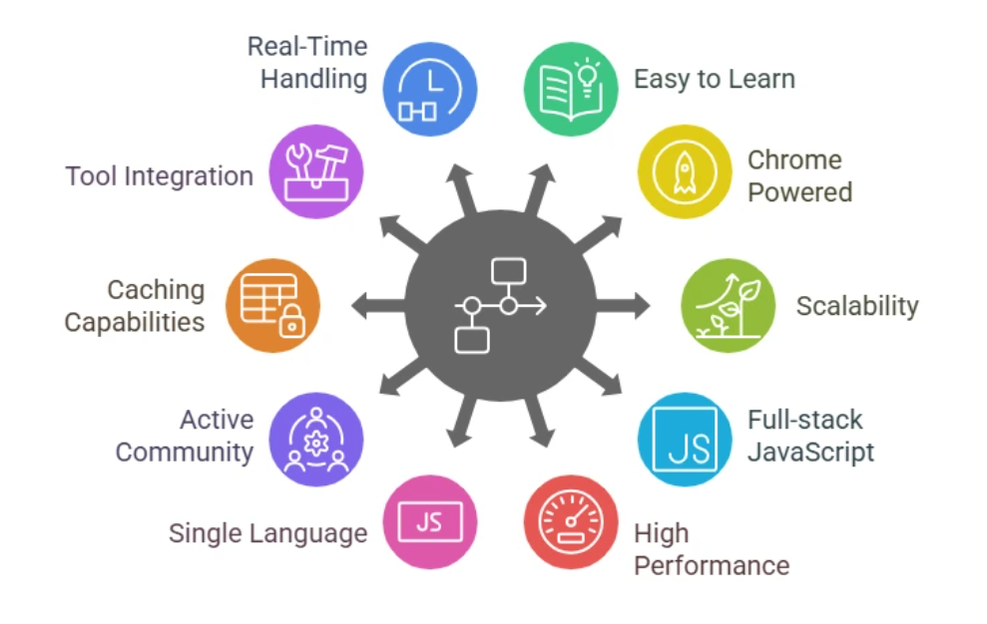
Why NodeJS
www.nareshit.com all copy rights reserved to Naresh i Technologies

Slide 8
Commonly Asked Questions
Course Duration : 2 months
Class Time : 1 hour daily 07.30am to 08.45am
Working days: Monday to Saturday (Sunday-off)
Pre-Requisite - JavaScript
Mode of training – online
How Many Demo Sessions – 3-4 Sessions
Free For Fullstack Students - No
Fee - NareshIT Admin/management
Course Completion Certificate - Yes
Mute: Allowed to interact anytime during the session once actual class starts
www.nareshit.com all copy rights reserved to Naresh i Technologies

Slide 9

www.nareshit.com all copy rights reserved to Naresh i Technologies

