Slide 1

React Demo By Mr. Sanjay
www.nareshit.com

Slide 2

Introduction
I am Sanjay Kumar
10+ years of corporate experience as a MEAN/MERN developer.
7+ years of experience as a trainer.
5+ years With NareshIT.
www.nareshit.com all copy rights reserved to Naresh i Technologies

Slide 3
Training Roadmap
Course Duration : 2 months
Class Time : 3 hours (10.00 AM - 1.00 PM)
Working days: Saturdays & Sundays
www.nareshit.com all copy rights reserved to Naresh i Technologies

Slide 4
JavaScript Content
Variables
Functions
Arrow Function
Closure
String
Array
Objects
Event Loop
Module (import/export)
Promises
Async-await
ES6+ JavaScript
www.nareshit.com all copy rights reserved to Naresh i Technologies

Slide 5
React Content
ReactJs features
Local Environemnt Setup (Create-react-app , vite)
React Project Structure
JSX , Expressions in JSX
Class Components
Functional Components
React Object
Fragment
Component Styling
Conditional rendering
Lists & keys
Props : de-structuring,requiring props, proptypes,default props
State
React Hooks (useState, useEffect, useRef, useMemo, useCallback, useReducer)
Component Lifecycle using useEffect
Pure Component
Memo Component
HigherOrder Component
Events : Synthetic Event
Form
Http - Axios
Interceptors
Routing (Nested Routes, Route Parameters, Protected Routes)
Unit Testing (JEST / vitest)
EsLint
Context API
REDUX (State Management)
www.nareshit.com all copy rights reserved to Naresh i Technologies

Slide 6
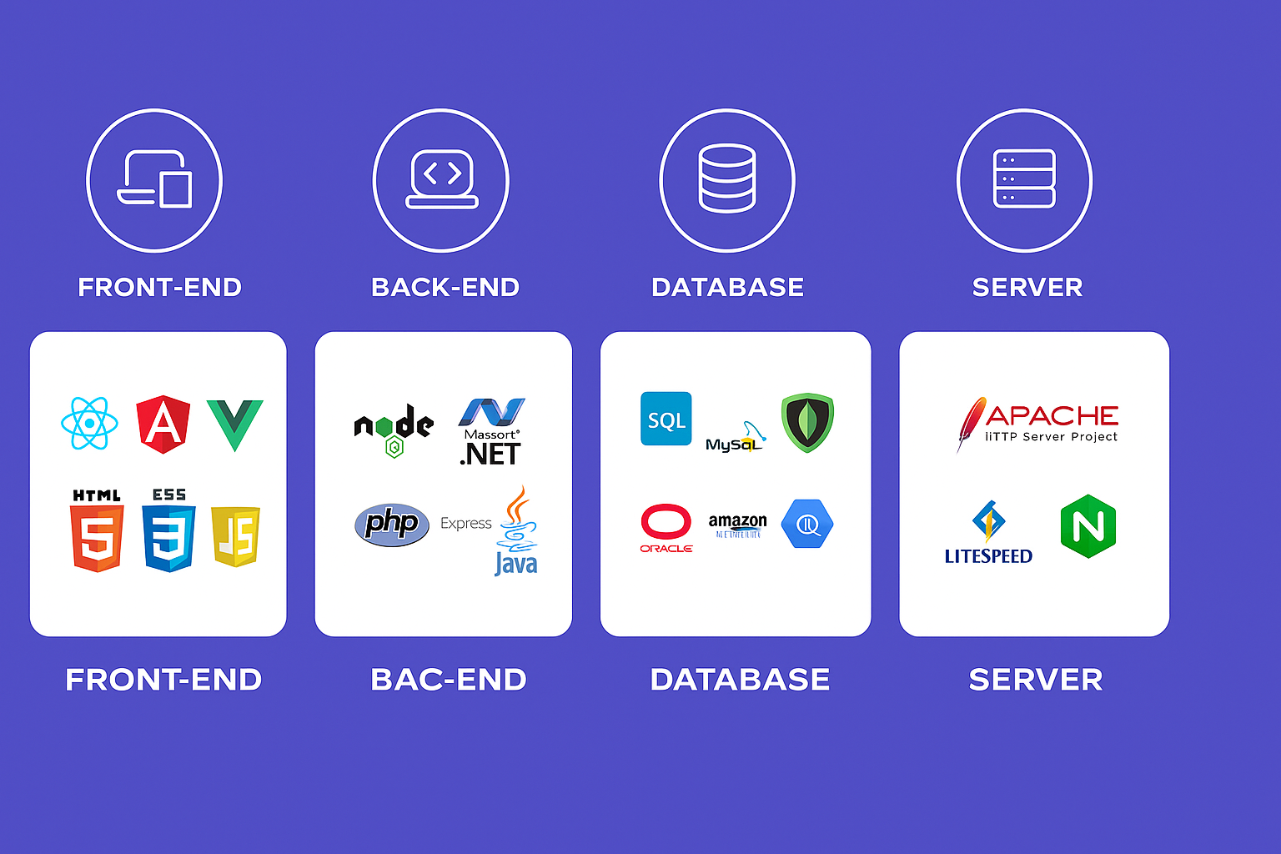
Web Development
www.nareshit.com all copy rights reserved to Naresh i Technologies

Slide 7
Web Development
HTML | Content ( paragraph,image,table,list,audio,form,video)
CSS | Styling (color,border,width,height,background-color,positioning)
Bootstrap | predefined css , Responsiveness
Javascript | Behaviour
Angular/React/Vue | JavaScript Frameworks RAD - Rapid Application Development CLI - Command Line Interface A Template System Reusable components Synchronization of state and view Routing Form Validation Better AJAX
www.nareshit.com all copy rights reserved to Naresh i Technologies

Slide 8
React ?
React is an open-source Javascript library for building fast, interactive and re-usable user interfaces.
Why React?
Re-usable components.
Fast Rendering (Virtual DOM)
One-way data flow
Form Handling
Easy API Integration
Easy State management
Industry Demand
www.nareshit.com all copy rights reserved to Naresh i Technologies

Slide 9
React vs Angular
React Angular
===========================================================
1. Library-2013 1. Framework-2009
2. Light-weight 2. Heavy
3. JSX + Javascript 3. HTML + Typescript
4. Uni-Directional 4. two-way
5. Virtual DOM 5. Regular DOM
6. Axios 6. HttpClientModule
7. No 7. Dependency Injection
8. No 8. Form Validation
9. extra libraries needed 9. No additional libraries
10. UI heavy 10. Functionality heavy
www.nareshit.com all copy rights reserved to Naresh i Technologies

Slide 10
Commonly Asked Questions
Course Duration : 2 months
Class Time : 3 hours 10.00 AM to 1.00PM
Working days: Saturday & sunday
Pre-Requisite – HTML , CSS
Mode of training – online
How Many Demo Sessions – 2 Sessions
Free For Fullstack Students - No
Fee - NareshIT Admin/management
Course Completion Certificate - Yes
Mute: Allowed to interact anytime during the session once actual class starts
www.nareshit.com all copy rights reserved to Naresh i Technologies

Slide 11

www.nareshit.com all copy rights reserved to Naresh i Technologies

