Slide 1
What this Session is for
Building Modern Frontend Applications with Angular
will understand the web stack, choose Angular, and start a working project.
Notes:
60-minute session: about 20 minutes of concepts, 30 minutes to create and run the app, and 10 minutes for questions.

Slide 2
Introduction
I am Sanjay Kumar Samantra
Lead Full-Stack Developer
Building Scalable Web Apps
Mentor & Team Lead
I specialize in software architecture for web apps, ensuring they are scalable, secure, and reliable
Notes:
Sources: https://www.freecodecamp.org/news/freecodecamps-new-responsive-web-design-certification-is-now-live ; https://developer.mozilla.org/en-US/docs/Learn_web_development ; https://angular.dev/tutorials/learn-angular . freeCodeCamp certifies web fundamentals; Angular Learn is a tutorial, not a certification.

Slide 3
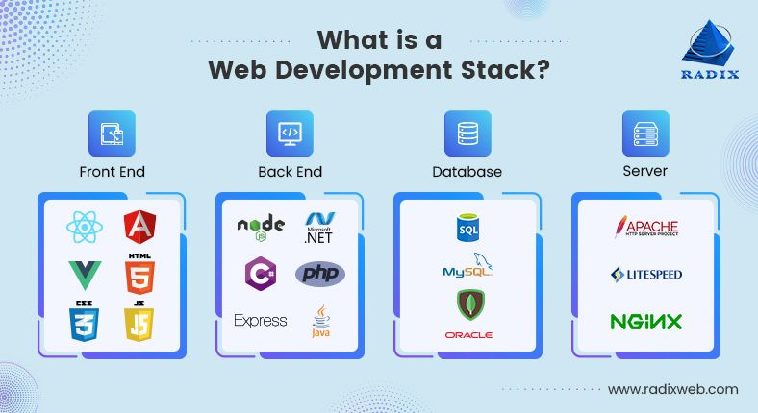
Web development stack
Notes:
Sources: https://developer.mozilla.org/en-US/docs/Learn_web_development ; https://angular.dev/overview ; https://angular.dev/cli

Slide 4
From HTML to Angular: Frontend Stack
Technology | Why it matters
HTML | Creates the structure of a web page: headings, forms, buttons, images, tables, etc.
CSS | Controls the appearance: colors, spacing, layout, responsive design, and animations.
Bootstrap | A CSS framework that provides ready-made responsive components such as navbars, cards, grids, and modals—helpful for building UIs faster.
JavaScript | Makes pages interactive: button clicks, form validation, API calls, dynamic content, and application logic.
Angular | A complete frontend framework built with TypeScript/JavaScript for creating large, maintainable single-page applications using components, routing, forms, services, and APIs.
Notes:
Sources: https://developer.mozilla.org/en-US/docs/Learn_web_development ; https://getbootstrap.com/docs/5.3/getting-started/introduction/ ; https://angular.dev/overview

Slide 5
Why Angular?
Build a large, structured, maintainable web application.
Provides developers a complete framework instead of manually combining many separate tools
Components — split the UI into reusable parts, such as Header, Login, Dashboard, or Product Card.
Routing — move between pages without reloading the browser.
Forms and validation — build login, registration, and data-entry forms reliably.
Services and dependency injection — organize API calls and shared business logic cleanly.
Two-way data binding — keep UI inputs and application data in sync.
TypeScript — catches many errors early and makes large projects easier to maintain.
Built-in structure — especially useful when multiple developers work on the same application.

Slide 6
Angular vs React
Area | Angular | React
Type | Full frontend framework | UI library
Language | TypeScript by default | JavaScript or TypeScript
Maintained by | Google | Meta
Built-in features | Routing, forms, HTTP client, dependency injection, testing support | Usually added through external libraries
Best suited for | Large enterprise applications | Fast, flexible product development and UI-focused apps
State management | Services, RxJS, Signals, NgRx | State, Context, Redux, Zustand, etc.
Mobile option | Ionic / NativeScript | React Native
Notes:
Sources: https://angular.dev/overview ; https://angular.dev/guide/routing ; https://react.dev/ ; https://react.dev/learn

Slide 7
Let's code
Prerequisite: install a supported Node.js LTS release and npm
npm install -g @angular/cli
ng new hello-angular
cd hello-angular
ng serve --open
Edit src/app/app.html, then refresh the browser
Notes:
Demo commands and current default file naming: https://angular.dev/installation ; https://angular.dev/cli/new . Follow the interactive defaults for ng new.

Slide 8
Thank You
Any Questions?
Notes:
Invite questions about the stack, Angular vs React, and the first project setup. Allow about 10 minutes for questions.

