Slide 1
WELCOME TO THE LIVE DEMO ON ANGULAR-20
By Mr. SANJAY KUMAR

Slide 2
Introduction
I am Sanjay Kumar
10+ years of corporate experience as a Full-Stack developer.
6+ years of experience as a trainer.

Slide 3
Angular Content
Angular Installation
Angular vs AngularJS
Angular CLI
Component
Module
Data binding
View Encapsulation
Inbuilt Directives
Custom Directives
Pipes
Custom Pipes
Component Communication
LifeCycle Methods / Hooks
Services
Dependency Injection
HttpClient / AJAX
Interceptors
Observables (RxJs)
Form
Routing
Lazy Loading
NgRx (State management)
Build & Deploy
Angular Material
Unit testing (Jasmine + Karma)

Slide 4
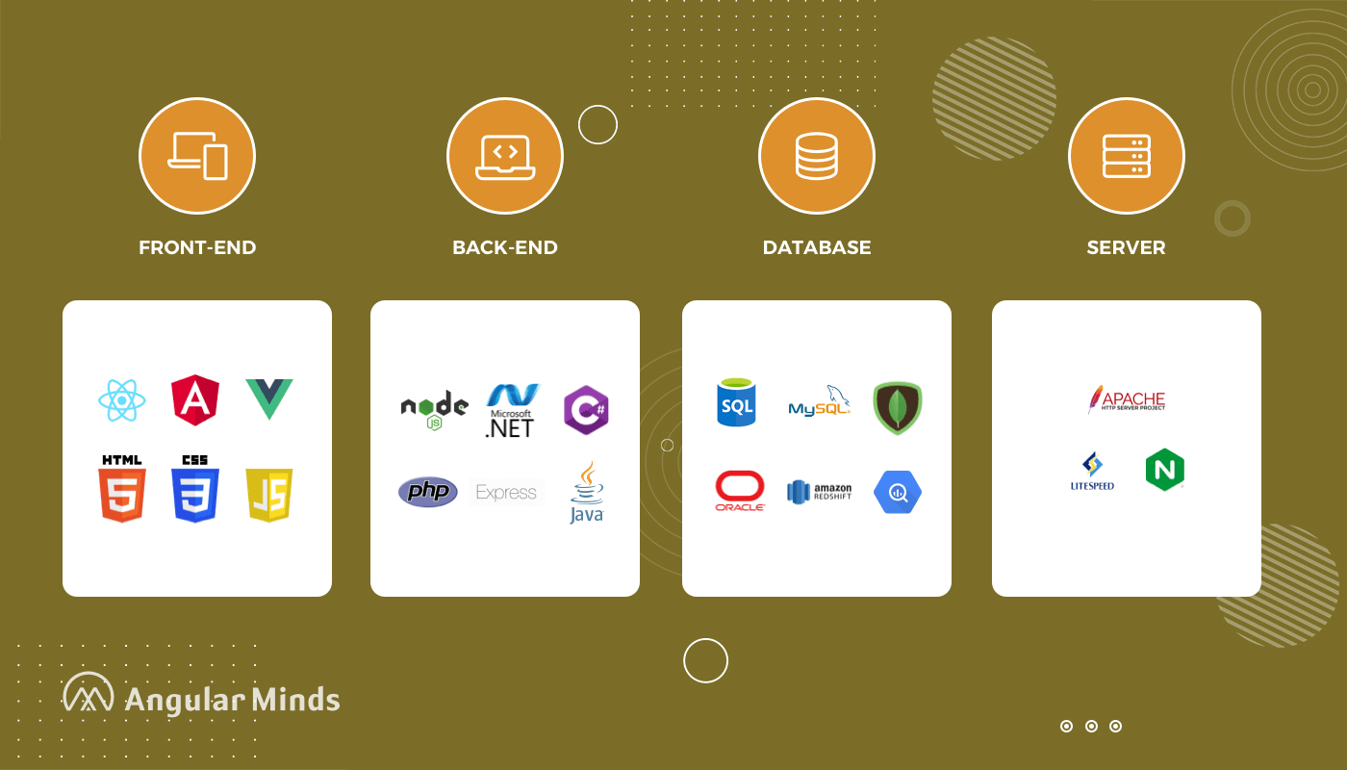
Web Development Stack

Slide 5
What is Web Development
Website Development
Front-End : User Interface (HTML, CSS, Javascript, Angular/React)
Back-End : Processing (Java, .NET, PHP, python, NodeJS)
Database : Data Storage (oracle, mysql, mongoDB)
Server : Apache Tomcat , WebLogic , Glassfish

Slide 6
Front-End Technologies
HTML | Content ( paragraph,image,table,list,audio,form,video)
CSS | Styling (color,border,width,height,background-color,positioning)
Bootstrap | predefined css , Responsiveness
Javascript | Behaviour
Angular/React/Vue | JavaScript Frameworks RAD - Rapid Application Development CLI - Command Line Interface A Template System Reusable components Synchronization of state and view Routing Form Validation Better AJAX

Slide 7
Commonly Asked Tech Questions
Why Angular?
AngularJS vs Angular

Slide 8
AngularJs vs angular
AngularJs Angular
1. Javascript 1. Typescript
2. MVC 2. Component
3. CLI-No 3. CLI
4. filters 4. Pipes
5. Controller 5. Controller-No
6. $scope,$rootscope 6. NO-(component class)
7. Unit testing 7. Unit testing - better
8. mobile devices-No 8. mobile devices-yes

Slide 9
React Vs Angular
React Angular
===========================================================
1. Library-2013 1. Framework-2009
2. Light-weight 2. Heavy
3. JSX + Javascript 3. HTML + Typescript
4. Uni-Directional 4. two-way
5. Virtual DOM 5. Regular DOM
6. Axios 6. HttpClientModule
7. No 7. Dependency Injection
8. No 8. Form Validation
9. extra libraries needed 9. No additional libraries
10. UI heavy 10. Functionality heavy

Slide 10


