Slide 1
WELCOME TO THE LIVE DEMO ON NodeJS
By Mr. SANJAY KUMAR

Slide 2
Introduction
I am Sanjay Kumar
9+ years of corporate experience as a Full-Stack developer.
5+ years of experience as a trainer.
3+ years With NareshIT.

Slide 3
Training Roadmap
Course Duration : 2 months
Class Time : 1 hour daily 08.30am to 09.30am
Working days: Monday to Saturday (Sunday-off)
JavaScript - 2 weeks
Node + Express + MongoDB - 4/5 weeks
Others - 1 week(Resume, Interview, Project, Unit Testing)

Slide 4
JavaScript Content
Variables
Variable Scopes
Functions
Arrow Function
This Operator
Array
Class
Module
Rest Parameter
Spread Operator
Promise
Async-await
Fetch()

Slide 5
NodeJS Content
Node.JS - Introduction, Advantages
Traditional Web Server Model, Node.js Process Model
Local Environment SetUp
Node.js Console - REPL
NPM , NPX , NVM
Modules: Core, Local , 3rd party
Global Objects
File System
Debugging Node JS Application
Buffer & Streams
Events (Event Loop,Event Emitter)
Creating web server & Handling http requests (HTTP)
Express Framework-routes
Express Middlewares
NodeJS & MongoDB Connection
Mongoose,graphQL
Template Engines (Jade/Pug, vash, EJS, handlebars)
Redis (Caching)
ESLint
Swagger (API Documentation)
Unit testing (Mocha, Jasmine)
JWT
PhonePe Payment Integration

Slide 6
Training Highlights
Designed for both beginners & experienced candidates.
Hands on exercises
Realtime examples on every topic.
Assignments
Mock Interview
Resume preparation
Placement Assistance
Class recordings (1 year)
Notes (google classroom / GitHub)

Slide 7
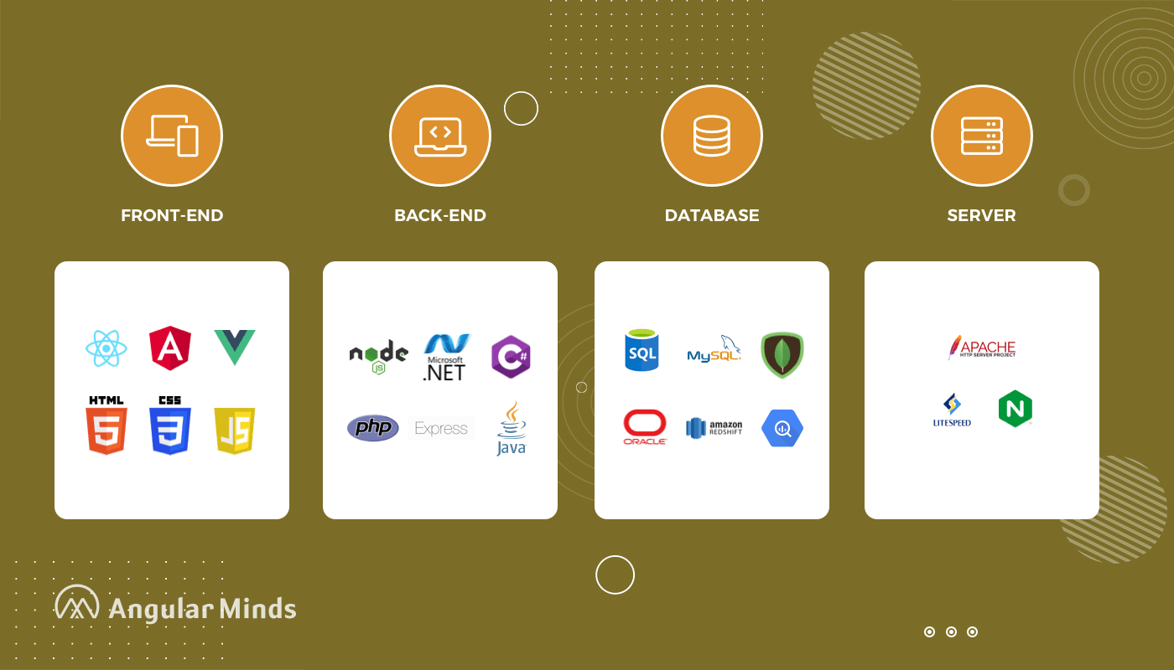
Web Development Stack

Slide 8
What is Web Development
Website Development
Front-End : User Interface (HTML, CSS, Javascript, Angular/React)
Back-End : Processing (Java, .NET, PHP, python, NodeJS)
Database : Data Storage (oracle, mysql, mongoDB)
Server : Apache Tomcat , WebLogic , Glassfish

Slide 9
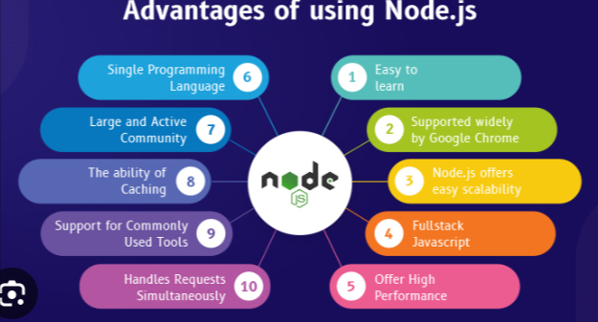
Why NodeJS

Slide 10
Commonly Asked Questions
Course Duration : 2 months
Class Time : 1 hour daily 08.30am to 09.30am
Working days: Monday to Saturday (Sunday-off)
Pre-Requisite - javascript
Laptop configuration - any
Mode of training – online
How Many Demo Sessions – 3-4 Sessions
Free For Fullstack Students - No
Fee – 5000 (only live session) , 8000 (live session + class recordings)
Notes - Google Drive, GitHub
Recording - google Classroom
Admin - 8179191999(office)
Mute: you are allowed to interact anytime during the session once actual class starts

Slide 11


