Slide 1

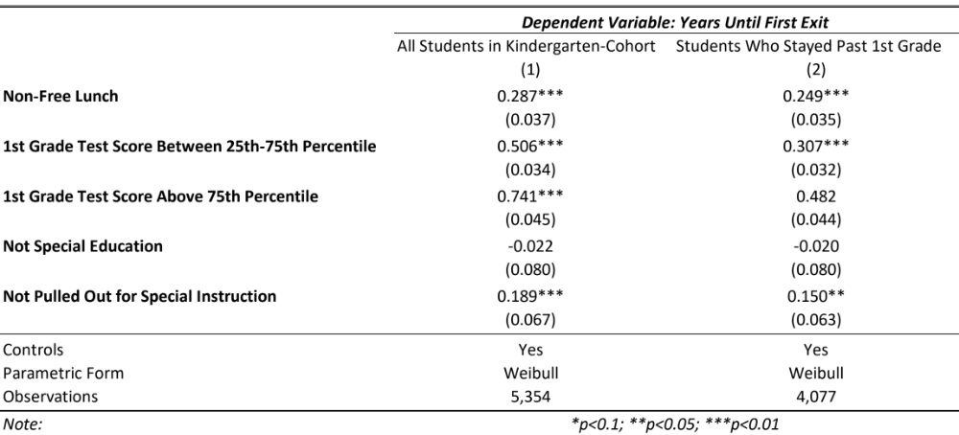
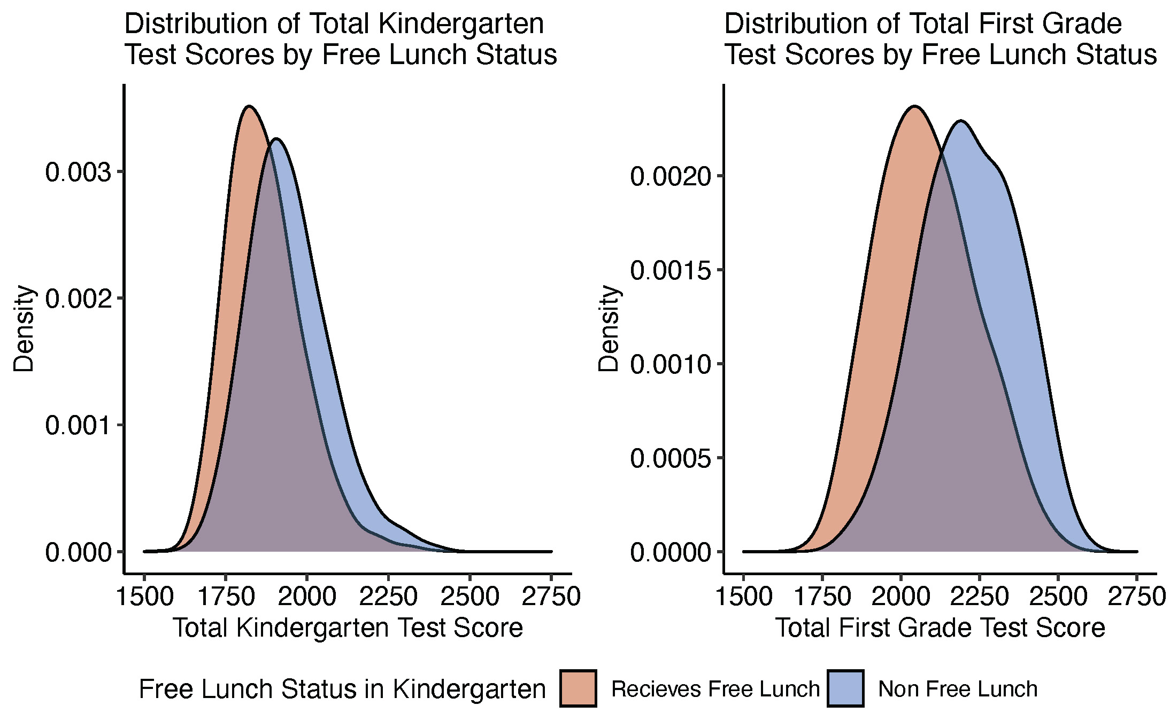

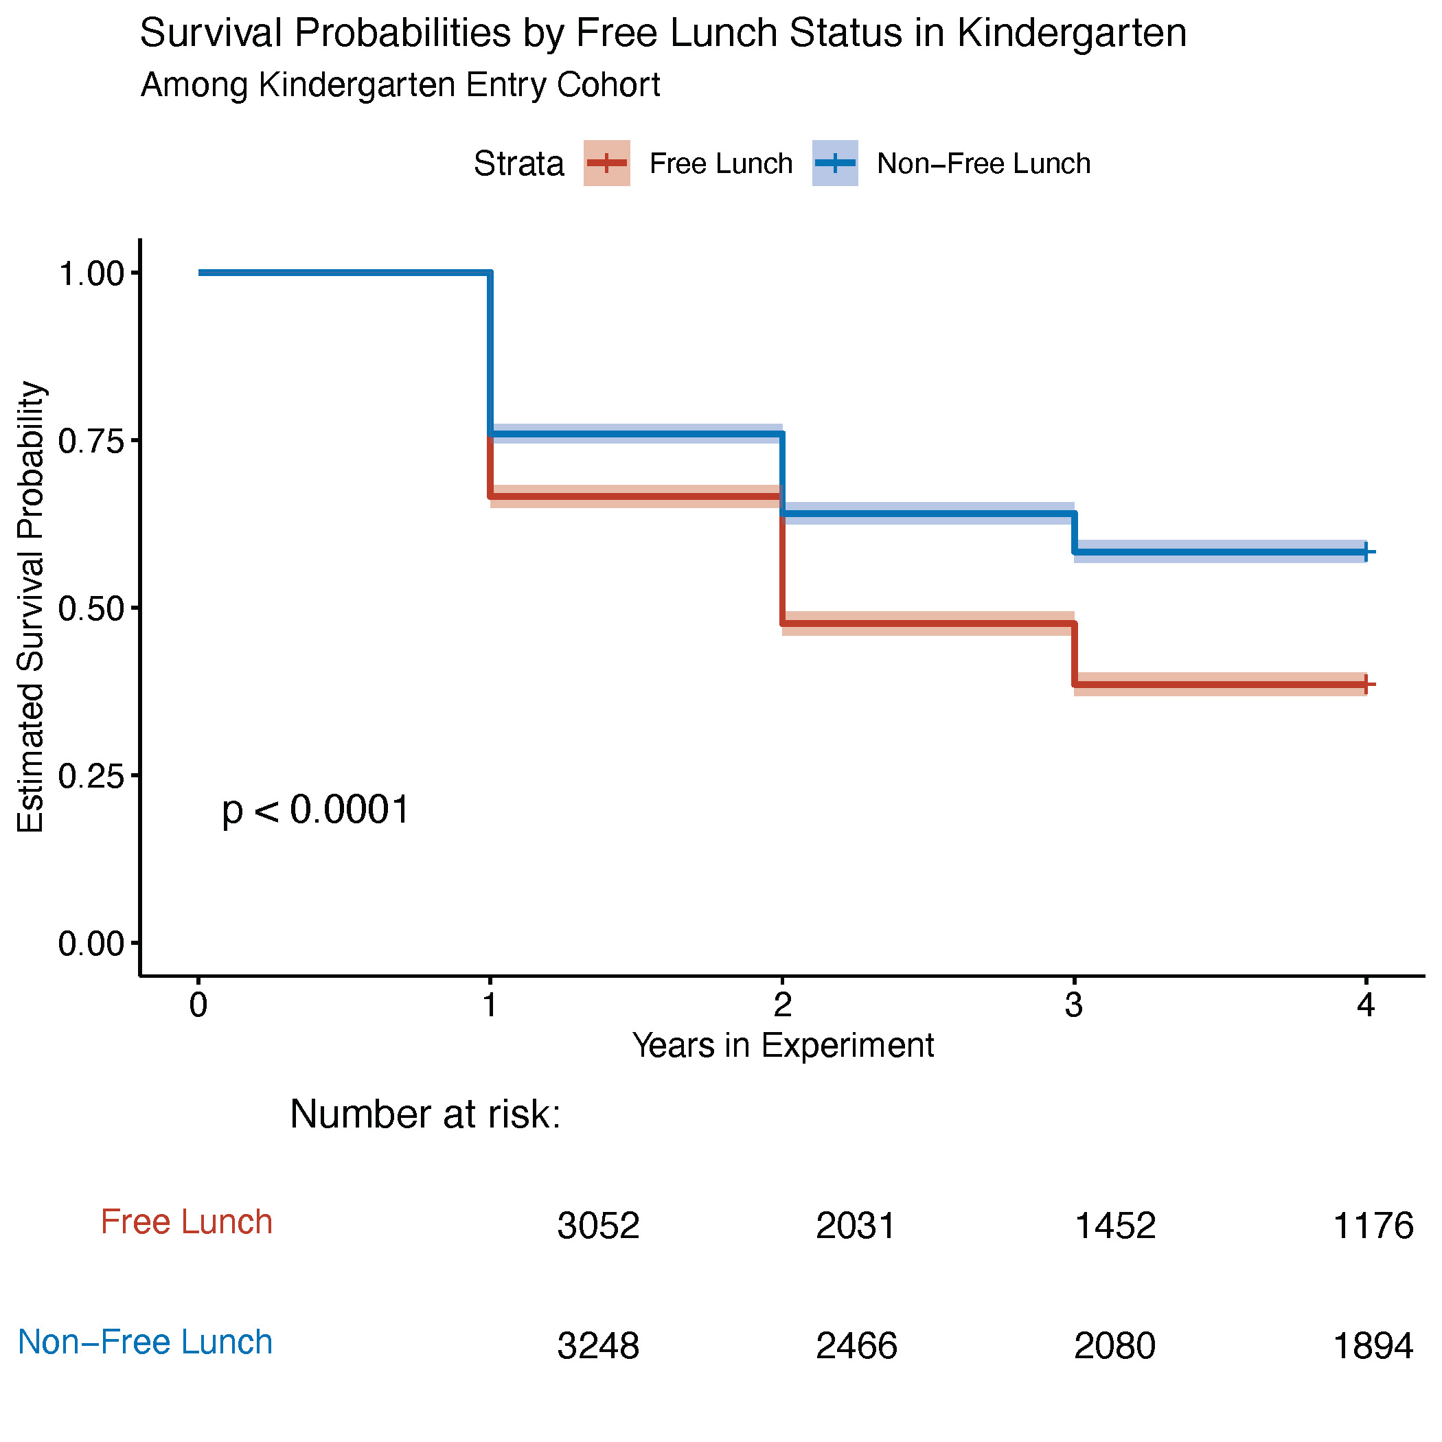
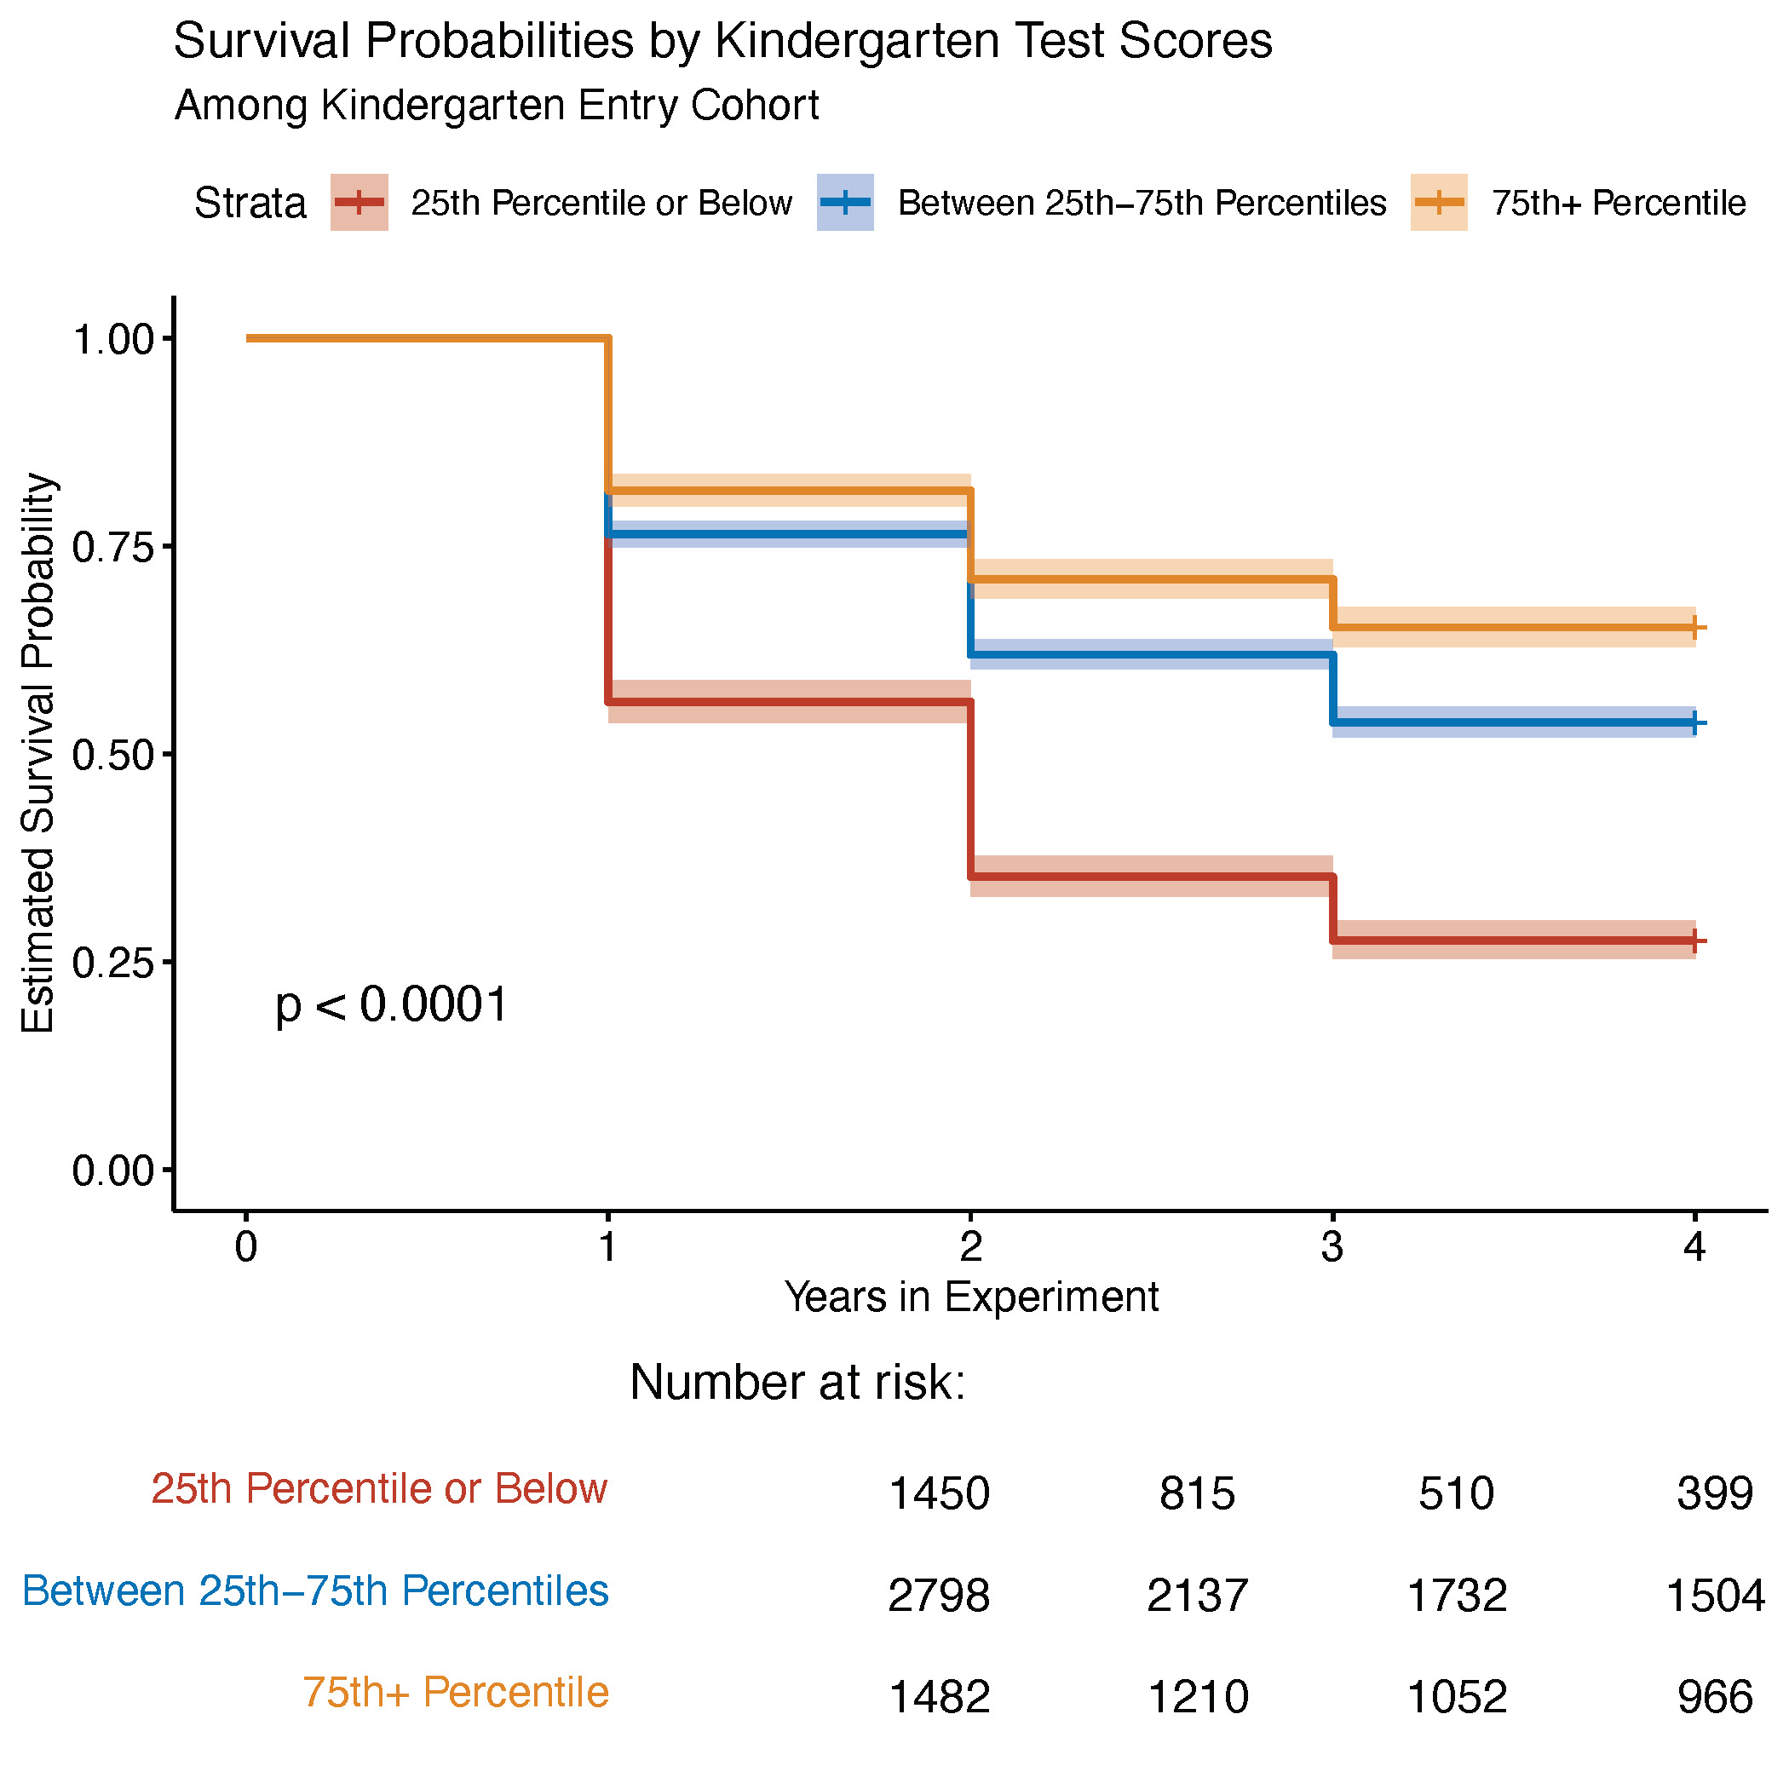

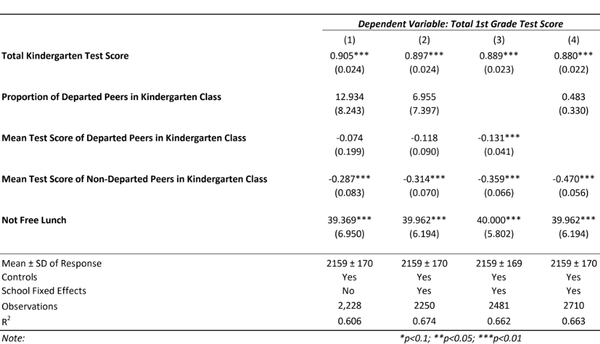
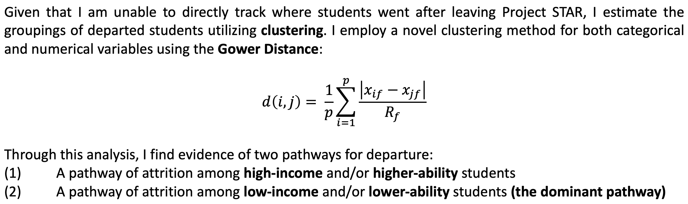

Peer Effects & Differential Attrition: Evidence from Tennessee's Project STAR
Sanjay Satish*,†
Introduction
Who Leaves?
The presence of a highly engaged peer in early education may have a lasting impact on a student’s achievement, even if said peer were to move or leave after just one year of school. If certain peers are provided a channel to depart the public school system, it may have an adverse effect on the students they leave behind. An understanding of which students are likely to leave public schools in addition to measuring the potential effects of such students' departures may provide researchers with a better understanding of the drivers of educational attainment.
To quantify the effect of student ability on attrition, I turn to survival analysis. Survival analysis allows for the identification of factors which may be correlated with the amount of time a student stayed in the experiment. The following AFT model estimates survival time as a function of test scores, income, class-size, and controls:
Low-income/Low-ability students leave due to familial instability, financial trouble, truancy, etc.
Higher-income/High-ability students leave to private or charter schools though cream-skimming or tuition-rationing
Project STAR
Project STAR was a class-size randomization experiment across grades K-3 in Tennessee between 1985-1989. 11,600 students across 79 schools voluntarily participated in the study. Students and teachers were randomized into one of the three following class types at the beginning of the 1985 school year:
In general, low-income and low-ability students are more likely to exit the public school system than their counterparts. The presence of this channel begins to diminish as the experiment went on. Differential attrition based on class size seems to not be significant after controlling for income. There exists strong evidence that attrition of low-income and often low-ability students was the dominant channel of attrition in Project STAR, though attrition of high-income and often high-ability students was also present.
Small Classes (13—17 students)
Regular Classes (22—25 students)
Regular Classes w/ Aide
There exists a positive relationship between a student’s income and ability in STAR and this relationship persists throughout the experiment.
The Effects of Attrition
Utilizing a peer-effects model, I estimate own 1st grade test scores as a function of own kindergarten test scores, the proportion of departed peers, the leave-one-out mean test score of non-departed peers, the mean test score of departed peers, and controls at the kindergarten-class level. Although I find potential evidence of bias in these estimates, I identify a positive relationship between own and peer outcomes. It seems that the total effect of peer background on own achievement is a combination of the effect of lagged own achievement, lagged peer achievement, and departed peer achievement.
* Author’s email: sanjay.satish@duke.edu
† Advisors: Professor Robert Garlick & Professor Michelle Connolly

