Slide 1
Multi-core Processor on FPGA
Lasya Balachandran and Sanjay Seshan
6.1920[6.175] Final Project

Slide 2
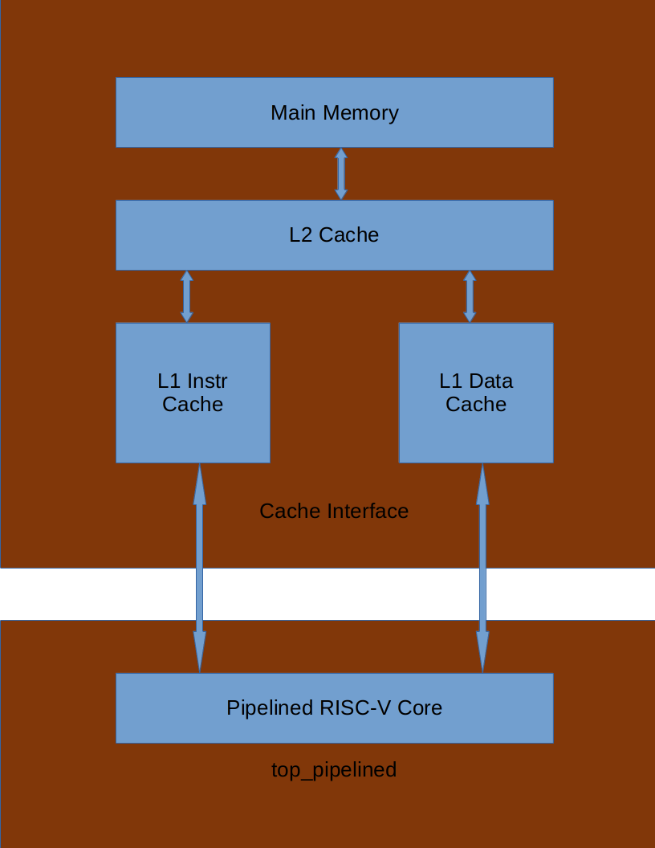
Connecting Cache to the Processor
Converted cache to store words
Used 4 offset bits to correspond to 16 words per line
Used two BRAMs for the cache
One with tag and valid
One byte enabled for data
Created two caches (data and instruction)
Requests for instructions and data are tagged in a queue when sending to L2 to return to the cache in FIFO order
2 level cache hierarchy connects to main memory
Built an interface between processor and cache
Main memory and L2 cache store lines
Evaluated using modified Beveren tests

Slide 3
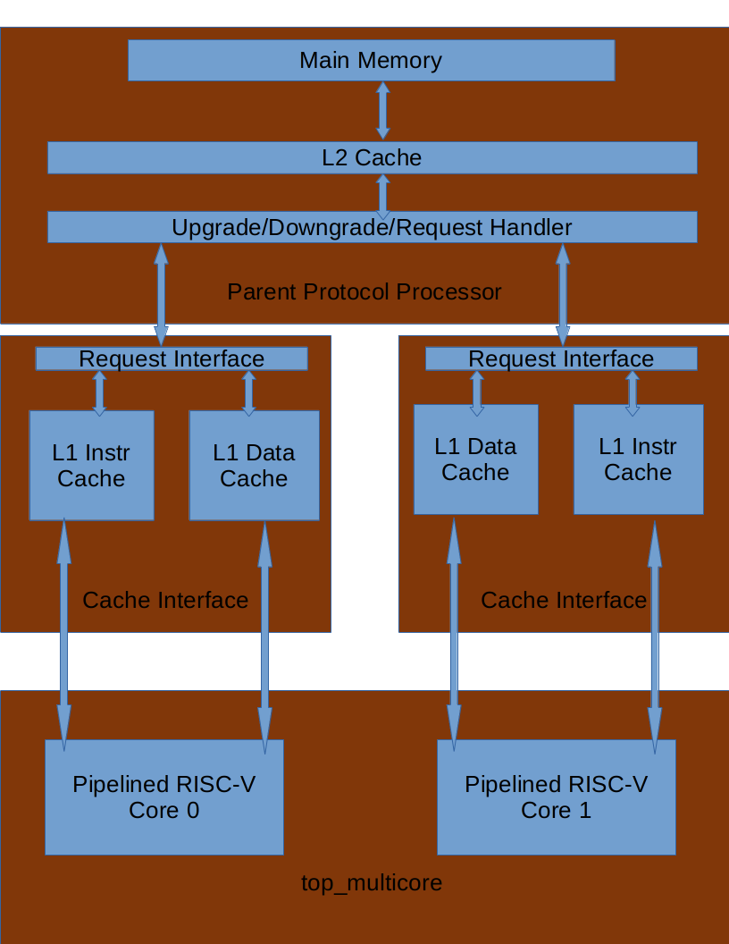
Implementing Multi-Core Processor
Created a Parent Protocol Processor
Routes upgrades and downgrades between cores
Abstracted the L2 cache and main memory into the PPP
PPP handles requests for evictions and loads into higher cache levels
Shared L2 cache stores writes for accessing by other cores
Tag core requests to memory to return FIFO order
System is modular
Two cores are instantiated
First starts at pc=0
Second starts at pc=4096
Each core gets its own set of data and instruction caches

Slide 4
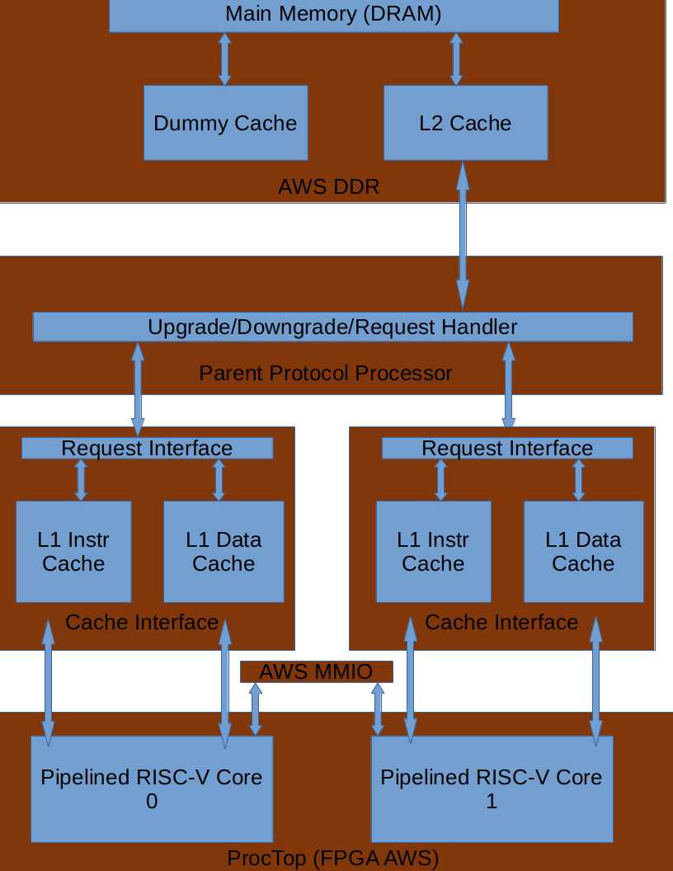
Running on FPGA
We modified our code to run within the AWS DDR system
Restructured the cache hierarchy a bit to match
Had to use a dummy cache to use a single L2 cache with no separate instruction L2 cache
MMIO was also abstracted into the AWS module and was shared by the cores by using a FIFO tag on requests
Only managed to get a few tests working in time but results are promising

Slide 5
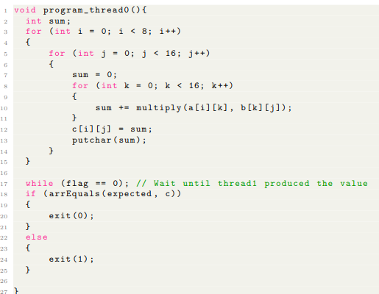
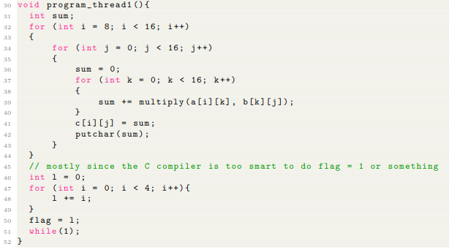
Results – Multicore
Standard tests run same code on both cores which all work
New tests ensures coherence between core’s caches
Created a distributed matrix multiply to display working shared data and speed up from two threads
Each core produced half of the rows
Thread1 notifies Thread0 when it finishes
Single core ran with 5.47 million cycles (simulator 2m 43s)
Dual core ran with 2.67 million cycles (simulator 2m 22s)
Roughly 2x cycle speed up
Simulator has overhead and does not really utilize multi core processing on the host

Slide 6
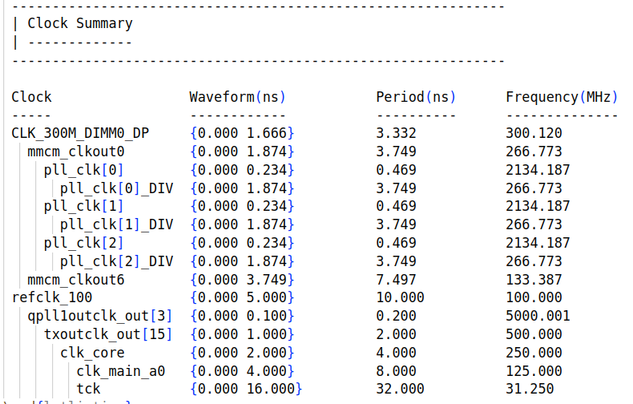
Results – FPGA
Many of the single core tests worked on the FPGA
Remaining tests are a work in progress
Clock speeds are shown at the right and are promising

Slide 7
Challenges
Handling half words and bytes took some restructuring
Many revisions and debugging to ensure PPP handles correct cache coherency
Some issues turning words to lines in mem.vmh – needed padding of zeroes
Unexpected loading values in the cache – had to zero out the valid/dirty bits

Slide 8
Thanks for listening!

