Slide 1
Blockchain: A Panacea for
Healthcare Cloud-Based
Data Security and
Privacy?
Madhusudhan K(1NT17IS090)
R Ajay(1NT17IS131)

Slide 2
Abstract
The potential to use the Blockchain
technology to protect healthcare data
hosted within the cloud.
Also describe the practical challenges
of such a proposition and further
research that is required.

Slide 3
HEALTH RECORDS IN ELECTRONIC FORMS AND
HEALTH INFORMATION SYSTEMS(HIS)
Electronic Medical Records (EMRs) contain medical and clinical data related to a given patient and stored by the responsible healthcare provider. This facilitates the retrieval and analysis of healthcare data.
With patient mobility increasing,there is a need for EMR’s to formalize their data structure and the design of HIS for data sharing and patient data portability.
Electronic Health Records (EHRs) are designed to allow patient medical history to move with the patient or be made available to multiple healthcare providers.

Slide 4
Fascicolo Sanitario Elettronico (FSE) project in Italy, the epSOS project in Europe are the ongoing project to standardize sharing of EHRs.
Personal Health Records (PHR), where patients are more involved in their data collection, monitoring of their health conditions, etc, using their smart phones or wearable devices (e.g. smart shirts and smart socks).

Slide 5
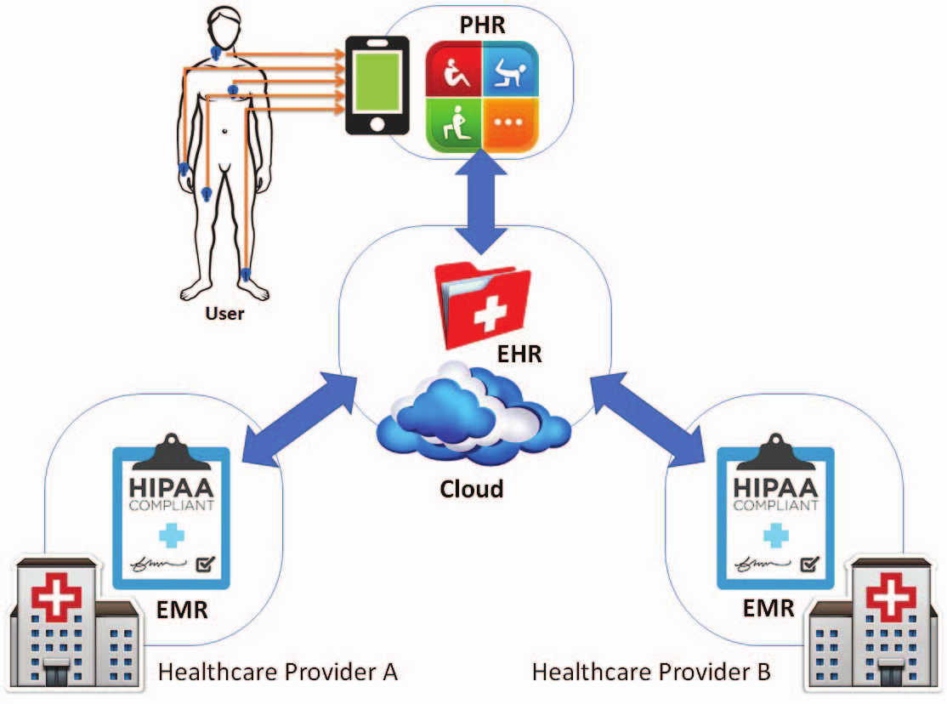
A conceptual cloud-based EMR/EHR/PHR ecosystem.
Cloud computing is a potential solution,as it can be used to interconnect the different healthcare providers and their PHR solutions, used by the providers to deal with any sudden or seasonal changes, and so on.

Slide 6
SECURITY AND PRIVACY
Healthcare data contain personal and sensitive information that may be attractive to cybercriminals.
Ensuring the security of the EMR/EHR/PHR ecosystem and the underlying systems and components that form the ecosystem is crucial.
The privacy and integrity of healthcare data must be protected not only from external attackers, but also from unauthorized access attempts from inside the network or ecosystem

Slide 7
SECURITY AND PRIVACY(Contd.)
How to secure EMR/EHR/PHR ecosystem and ensure privacy and integrity of the data is an active research area.
Approaches include using cryptographic primitives, such as those based on public key infrastructure and public clouds to ensure data confidentiality and privacy.
This limits the searchability of the data, in the sense that healthcare providers have to decrypt the (potentially big) data prior to searching , resulting in increases in time and costs for the data retrieval and diagnosis (e.g. download, decrypt, and search).

Slide 8
BLOCKCHAIN TO THE RESCUE?
Blockchain is a technology able to build an open and distributed online database, which consists a list of blocks that are linked with each other.
These blocks are distributed among multiple nodes of an infrastructure, and are not centrally stored.
Each block contains a timestamp of its production,the hash of the previous block and the transaction data( a patient’s healthcare data and the healthcare provider information).

Slide 9
Blockchain is secure by design that provides the capability to achieve decentralized consensus and consistency, and resilience to intentional and/or unintentional attacks.

Slide 10
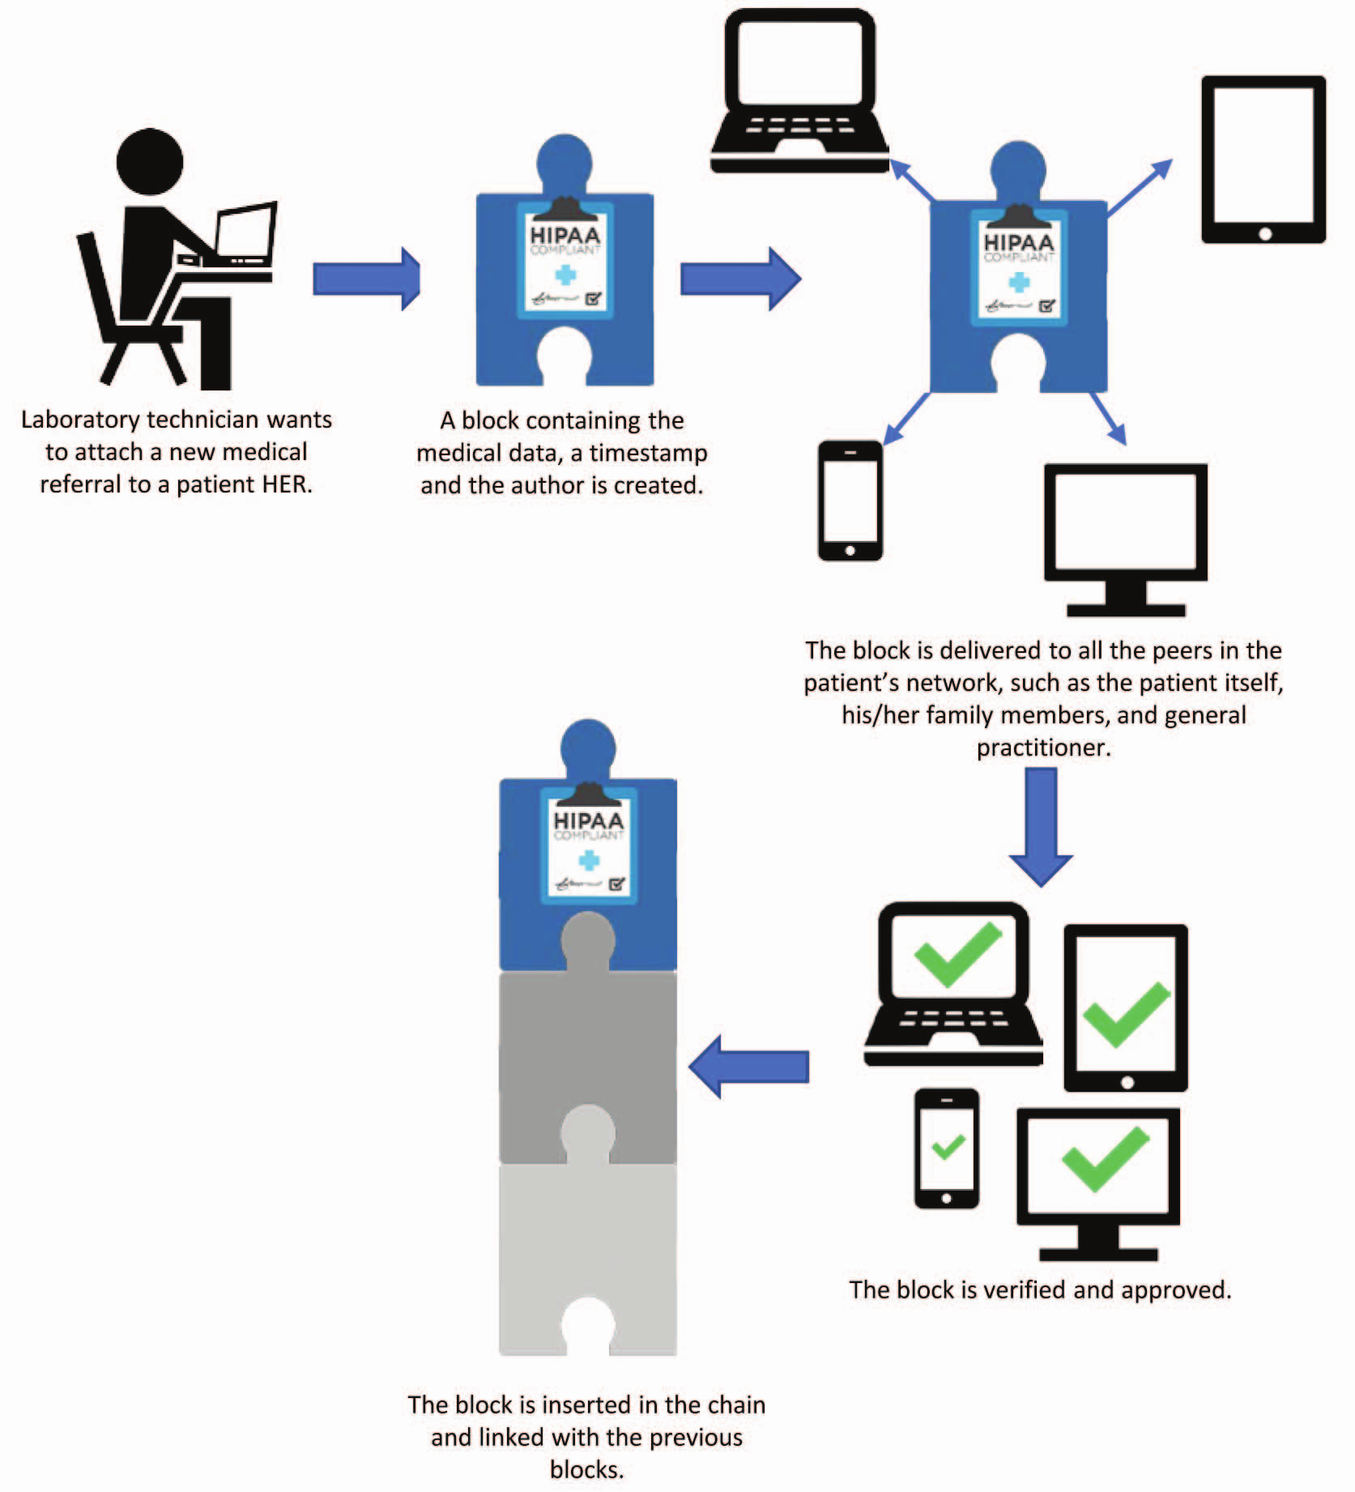
A conceptual blockchain-based EMR/EHR/PHR ecosystem

Slide 11
Key Benefits of deploying a Blockchain
1.Agreement can be reached without the involvement of a trusted mediator; thus, avoiding a performance bottleneck and a single point of failure.
2.Patients have control over their data.
3.Medical history as a blockchain data is complete, consistent, timely, accurate, and easily distributed.
4.Changes to the blockchain are visible to all members of the patient network, and all data insertions are immutable. Also, any unauthorized modifications can be trivially detected.

Slide 12
CHALLENGES
The strong data integrity feature of blockchain results in immutability that any data, once stored in blockchain, cannot be altered or deleted.
As healthcare records are personal data which comes under the protection of privacy laws,states individuals have rights to request personal data to be erased.
Anyone planning to use blockchain to store
them cannot ignore this legal obligation to erase personal data if warranted.

Slide 13
CHALLENGES...
Another practical issue is on how fit it is for blockchain to store healthcare data.
Blockchain was originally designed to record transaction data, which is relatively small in size and linear.
Healthcare data, such as imaging and treatment plans, however, can be large and relational that requires searching. How well blockchain storage can cope with both requirements is currently unclear.

Slide 14
Solution to the Challenges.
Healthcare data is stored off-chain and may be secured, corrected, and erased as appropriate.
At the same time, immutable hashes of the healthcare data are stored on-chain for checking the authenticity and accuracy of the off-chain medical records.

