Slide 1
Hyperledger

Slide 5
Hyperledger
Hyperledger is not a blockchain, but it is a project that was initiated by Linux foundation in December 2015 to advance blockchain technology.
This project is a collaborative effort by its members to build an open source distributed ledger framework
Used to develop and implement cross-industry blockchain applications and systems.
The key focus is to build and run platforms that support global business transactions.
The project also focuses on improving the reliability and performance of blockchain systems.

Slide 6
Hyperledger
Projects under Hyperledger undergo various stages of development,
starting from proposal to incubation and graduating to an active state.
Projects can also be deprecated or in End of Life state where they are no longer actively developed.
In order for a project to be able to move into incubation stage
it must have a fully working code base along with an active community of developers.

Slide 7
Project Goals
Create an enterprise grade, open source distributed ledger framework and code base,
upon which users can build and run robust, industry-specific applications, platforms and hardware systems to support business transactions.
Create an open source, technical community to benefit the ecosystem of Hyperledger solution providers and users,
focused on blockchain and shared ledger use cases that will work across a variety of industry solutions.

Slide 8
Project Goals
Promote participation of leading members of the ecosystem, including developers, service and solution providers and end users.
Host the infrastructure for Hyperledger, establishing a neutral home for community infrastructure, meetings, events and collaborative discussions and providing structure around the business and technical governance of Hyperledger.

Slide 9
Projects
Currently, there are six projects under the Hyperledger umbrella:
Fabric, Iroha, Sawtooth lake, blockchain explorer, Fabric chaintool, and Fabric SDK Py.
Corda is the most recent addition to the Hyperledger project.
The Hyperledger project has 100 members and is very active with more than 120 contributors, with regular meet-ups and talks being organized around the globe.

Slide 13
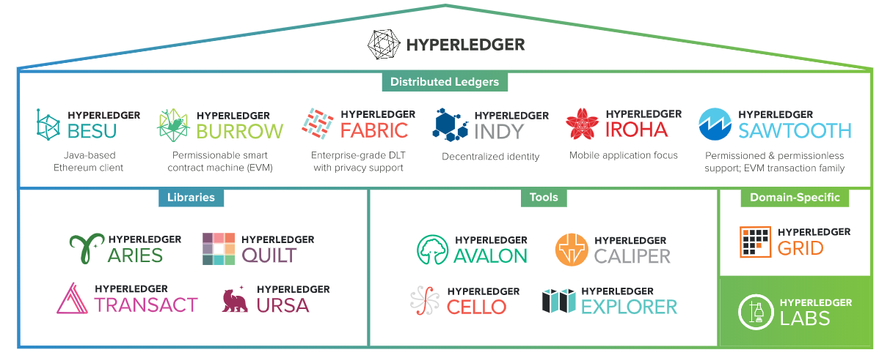

Slide 14
Hyperledger Business Blockchain Frameworks
Hyperledger Fabric:
Intended as a foundation for developing applications or solutions with a modular architecture
Hyperledger Fabric allows components, such as consensus and membership services, to be plug-and-play.
Fabric is a blockchain project that was proposed by IBM and DAH (Digital Asset Holdings)

Slide 15
Hyperledger Business Blockchain Frameworks
Hyperledger Iroha:
Business blockchain framework designed to be simple and easy to incorporate into infrastructural projects requiring distributed ledger technology.
Iroha was proposed by Soramitsu, Hitachi, NTT Data, and Colu in September 2016.
Iroha is aiming to build a library of reusable components that users can choose to run on their Hyperledger-based distributed ledgers.
Iroha's main goal is to complement other Hyperledger projects by providing reusable components written in C++ with an emphasis on mobile development.
This project has also proposed a novel consensus algorithm called Sumeragi, which is a chain based Byzantine fault tolerant consensus algorithm

Slide 16
Hyperledger Sawtooth:
A modular platform for building, deploying, and running distributed ledgers.
Sawtooth lake is a blockchain project proposed by Intel in April 2016 with some key innovations focusing on decoupling of ledgers from transactions, flexible usage across multiple business areas using transaction families, and pluggable consensus
Transactions are decoupled from the consensus layer by making use of a new concept called Transaction families. Instead of transactions being individually coupled with the ledger,
Transaction families are used, which allows for more flexibility, rich semantics and unrestricted design of business logic.
Transactions follow the patterns and structures defined in the transaction families.
Hyperledger Sawtooth includes a novel consensus algorithm, Proof of Elapsed Time (PoET), which targets large distributed validator populations with minimal resource consumption.
It also supports permissioned and permission-less setups

Slide 17
Hyperledger Sawtooth Cont..
Transaction Family
Sawtooth separates the application level from the core system level with transaction families, which allows application developers to write in the languages of their choice.
Each application defines the custom transaction families for its unique requirements.
Transaction family includes these components:
Transaction processor to define the business logic for your application
Data model to record and store data
Client to handle the client logic for your application

Slide 18
Hyperledger Business Blockchain Frameworks
Hyperledger Burrow:
Permissionable smart contract machine.
The first of its kind when released in December, 2014
Burrow provides a modular blockchain client with a permissioned smart contract interpreter built in part to the specification of the Ethereum Virtual Machine (EVM).
Hyperledger Indy:
Tools, libraries, and reusable components for providing digital identities rooted on blockchains or other distributed ledgers
so that they are interoperable across administrative domains, applications, and any other silo.

Slide 19
Blockchain explorer
This project aims to build a blockchain explorer for Hyperledger
that can be used to view and query the transactions, blocks, and associated data from the blockchain.
It also provides network information and the ability to interact with chain code.

Slide 20
Fabric chaintool
Hyperledger chaincode compiler is being developed to support Fabric chaincode development.
The aim is to build a tool that reads in a high-level Google protocol buffer structure and produces a chaincode.
Additionally, it packages the chaincode so that it can be deployed directly.
It is envisaged that this tool will help developers in various stages of development, such as compiling, testing, packaging, and deployment

Slide 21
Fabric SDK Py
The aim of this project is to build a python based SDK library that can be used to interact with the blockchain (Fabric).

Slide 22
Corda
Corda is the latest project that has been contributed by R3 to the Hyperledger project.
It was open sourced on November 30, 2016.
Corda is heavily oriented towards the financial services industry and has been developed in collaboration with major banks and organizations in the financial industry.
Technically, Corda is not a blockchain but has key features similar to those of a blockchain, such as consensus, validity, uniqueness, immutability, and authentication.
October 2017 Corda 1 brings API stability
November 2017 Corda 2 is launched
February 2019 Corda 4 releases with 1800+ commits!

Slide 23
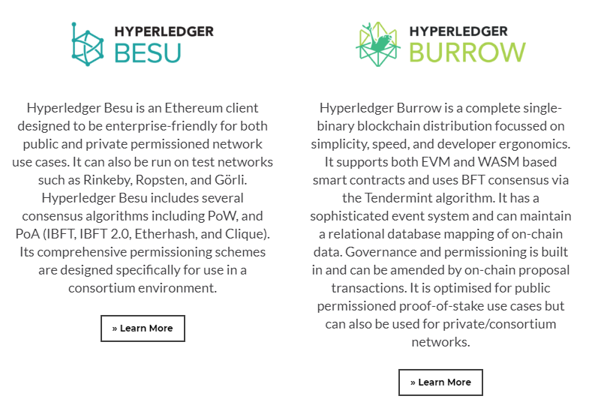
Distributed Ledgers

Slide 24
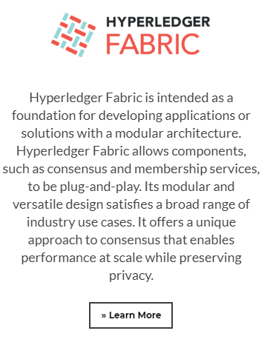
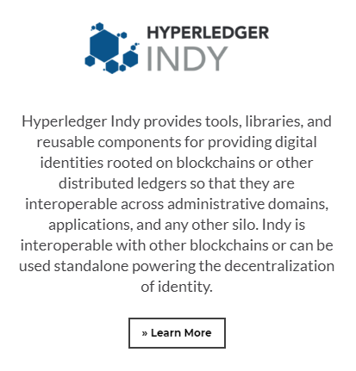

Slide 25
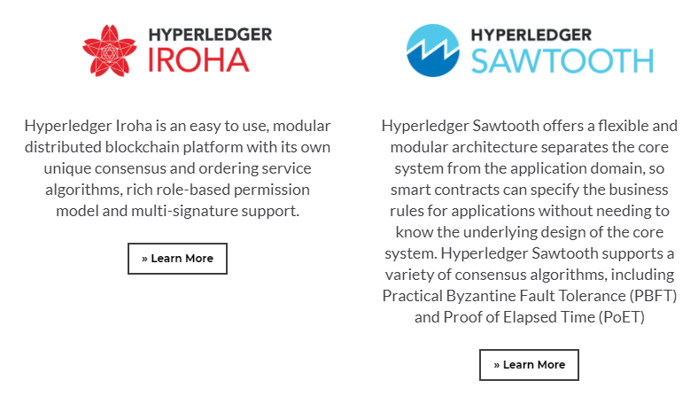

Slide 26
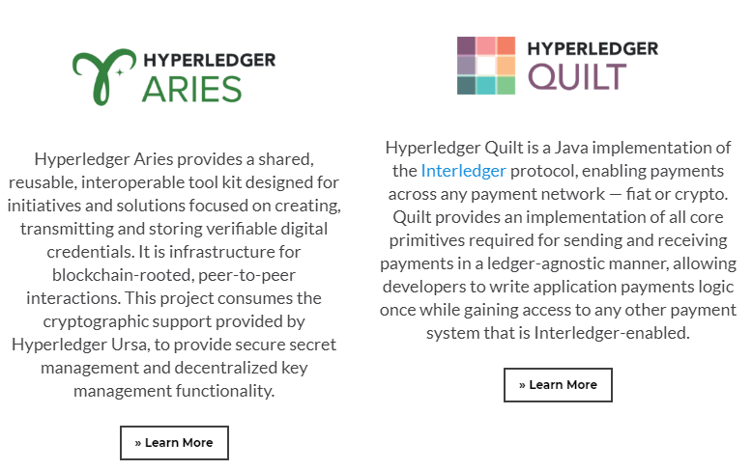
Libraries

Slide 27
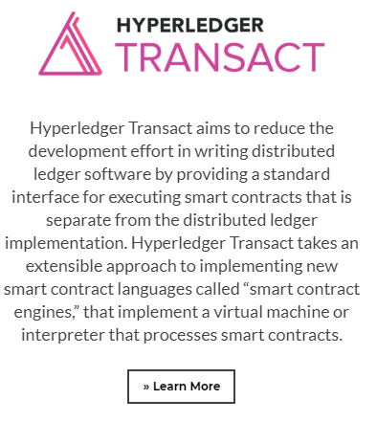
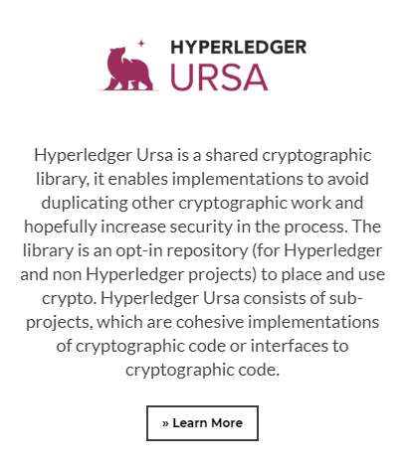

Slide 28
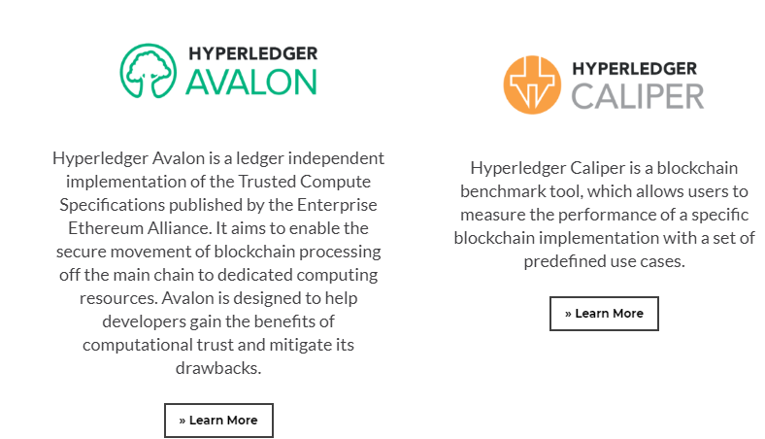
Tools

Slide 29
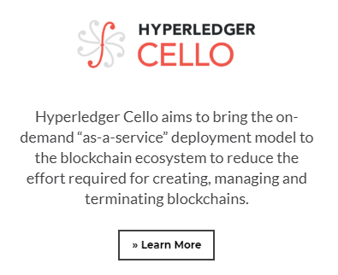
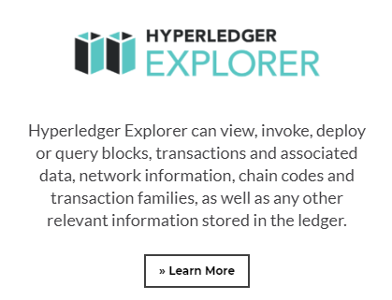

Slide 30
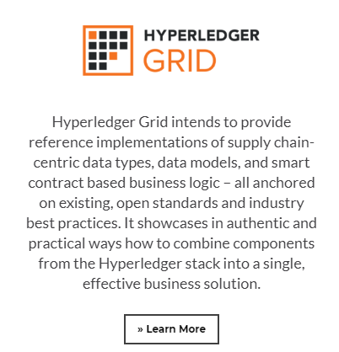
Domain-Specific

Slide 31
Hyperledger as a protocol
Hyperledger is aiming to build a new blockchain platform that is driven by industry use cases.
As there have been number of contributions made to the Hyperledger project by the community
Hyperledger blockchain platform is evolving into a protocol for business transactions.
Hyperledger is also evolving into a specification that can be used as a reference to build blockchain platforms
as compared to earlier blockchain solutions that address only a specific type of industry or requirement.

Slide 32
Reference architecture
Hyperledger has published a white paper with reference architecture that can serve as a guideline to build permissioned distributed ledgers.
Reference architecture consists of two main components:
Hyperledger services
Hyperledger APIs, SDKs, and CLI (Command Line Interface)
Hyperledger services provide various services such as
Identity services
Policy services
Blockchain services
Smart contract services.

Slide 33
Reference architecture
Hyperledger APIs, SDKs, and CLIs provide an interface into blockchain services via appropriate application programming interfaces, software development kits, or command line interfaces.
Event stream, which is basically a gRPC channel, runs across all services.
It can receive and send events.
Events are either pre-defined or custom.
Validating peers or chaincode can emit events to which external application can respond or listen to.

Slide 34
The reference architecture that has been published in the Hyperledger white paper

Slide 36
Requirements
There are certain requirements of a blockchain service.
Reference architecture is driven by the needs and requirements
Raised by the participants of the Hyperledger project
After studying the industry use cases.
There are several categories of requirements that have been deduced from the study of industrial use cases

Slide 37
Requirements- Modular approach
Main requirement of Hyperledger is a modular structure.
Cross industry fabric (blockchain) will be used in many business scenarios.
Functions related to storage, policy, chaincode, access control, consensus and many other blockchain services should be pluggable.
Modules should be plug and play
Users should be able to easily remove and add a different module that meets the requirements of the business.

Slide 38
Requirements- Modular approach
For example
if a business blockchain needs to be run only between already trusted parties and performs very basic business operations,
No need to have advanced cryptographic support for confidentiality and privacy,
Users should be able to remove that functionality (module) or replace that with a more appropriate module that suits their needs.
if users need to run a cross-industry blockchain, then confidentiality and privacy can be of paramount importance.
Users should be able to plug an advanced cryptographic and access control mechanism (module) into the blockchain (fabric).

Slide 39
Requirements- Privacy and confidentiality
Privacy and confidentiality of transactions and contracts is of utmost importance in a business blockchain.
Hyperledger's vision is to provide a wide range of cryptographic protocols and algorithms
Users will be able to choose appropriate modules according to their business requirements.
Fabric should be able to handle complex cryptographic algorithms without compromising performance.

Slide 40
Requirements- Identity
To provide privacy and confidentiality services, a flexible PKI model that can be used to handle the access control functionality
Strength and Type of cryptographic mechanisms is also expected to vary according to the needs and requirements of the users.
In certain scenarios it might be required for a user to hide their identity
Hyperledger is expected to provide this functionality.

Slide 41
Requirements- Auditability
Auditability is another requirement of a Hyperledger Fabric.
Immutable audit trail of all identities, related operations and any changes is kept.

Slide 42
Requirements- Interoperability
Currently , Many blockchain solutions available, but they cannot communicate with each other
This can be a limiting factor in the growth of a blockchain based global business ecosystem.
It is envisaged that many blockchain networks will operate in the business world for specific needs,
It is important that they are able to communicate with each other.
There should be a common set of standards that all blockchains can follow in order to allow communication between different ledgers.
Protocol will be developed that will allow the exchange of information between many Fabrics.

Slide 43
Requirements- Portability
Portability requirement is concerned with the ability to run across multiple platforms
Environments without the need to change anything at code level.
Hyperledger is envisaged to be portable, not only at infrastructure level but also at code, libraries, and API levels
It can support uniform development across various implementations of Hyperledger.

Slide 44
Fabric
Fabric can be defined as a collection of components providing a foundation layer that can be used to deliver a blockchain network.
There are various types and capabilities of a fabric network
all fabrics share common attributes such as immutability and are consensus driven.
Some fabrics can provide modular approach towards building blockchain networks.
Blockchain network can have multiple pluggable modules to perform various function on the network.
For example, consensus algorithms can be a pluggable module in a blockchain network
Depending on the requirements of the network, an appropriate consensus algorithm can be chosen and plugged into the network

Slide 45
Fabric
Modules can be based on some particular specification of the fabric and can include APIs, access control, and various other components.
Fabrics can also be designed either to be private or public and can allow the creation of multiple business networks.
As an example, bitcoin is an application that runs on top of its fabric (blockchain network).,
Blockchain can either be permissioned or permission-less and the same is true for fabric in Hyperledger terminology.
Fabric is the name given to the code contribution made by IBM to the Hyperledger foundation and is formally called Hyperledger Fabric.
IBM also offers blockchain as a service (IBM Blockchain) via its Bluemix cloud service.

Slide 46
Hyperledger Fabric
Fabric is the contribution originally made by IBM to the Hyperledger project.
Aim is to enable a modular, open and flexible approach towards building blockchain networks.
Various functions in the fabric are pluggable, and it also allows use of any language to develop smart contracts.
This is possible because it is based on container technology which can host any language.
Chaincode (smart contract) is sandboxed into a secure container which includes a secure operating system, chaincode language, runtime environment and SDKs for Go, Java, and Node.js.
Other languages can be supported too if required.
Smart contracts are called chaincode in the Fabric.
This is a very powerful feature compared to domain specific languages in Ethereum, or the very limited scripted language in bitcoin.

Slide 47
Hyperledger Fabric
It is a permissioned network that aims to address issues such as scalability, privacy, and confidentiality.
key idea behind this is modular technology, which would allow for flexibility in design and implementation.
This can then result in achieving scalability, privacy and other desired attributes.
Transactions in fabric are private, confidential and anonymous for general users, but they can still be traced and linked to the users by authorized auditors.
As a permissioned network, all participants are required to be registered with the membership services in order to access the blockchain network.
Ledger also provided auditability functionality in order to meet the regulatory and compliance needs.

Slide 48
Fabric architecture
The Fabric is logically organized into three main categories based on the type of service provided.
membership services
blockchain services
chaincode services.
The current stable version of Hyperledger Fabric is v1.4,

Slide 49
Membership services
These services are used to provide access control capability for the users of the fabric network.
Functions that membership services perform:
User identity validation.
User registration.
Assign appropriate permissions to the users depending on their roles.
Membership services makes use of Public Key Infrastructure (PKI) in order to support identity management and authorization operations.

Slide 50
Membership services
Membership services are made up of various components:
Registration authority (RA):
Service that authenticates the users and assesses the identity of the fabric participants for issuance of certificates.
Enrolment certificate authority:
Enrolment certificates (Ecerts) are long term certificates issued by ECA to registered participants in order to provide identification to the entities participating on the network.

Slide 51
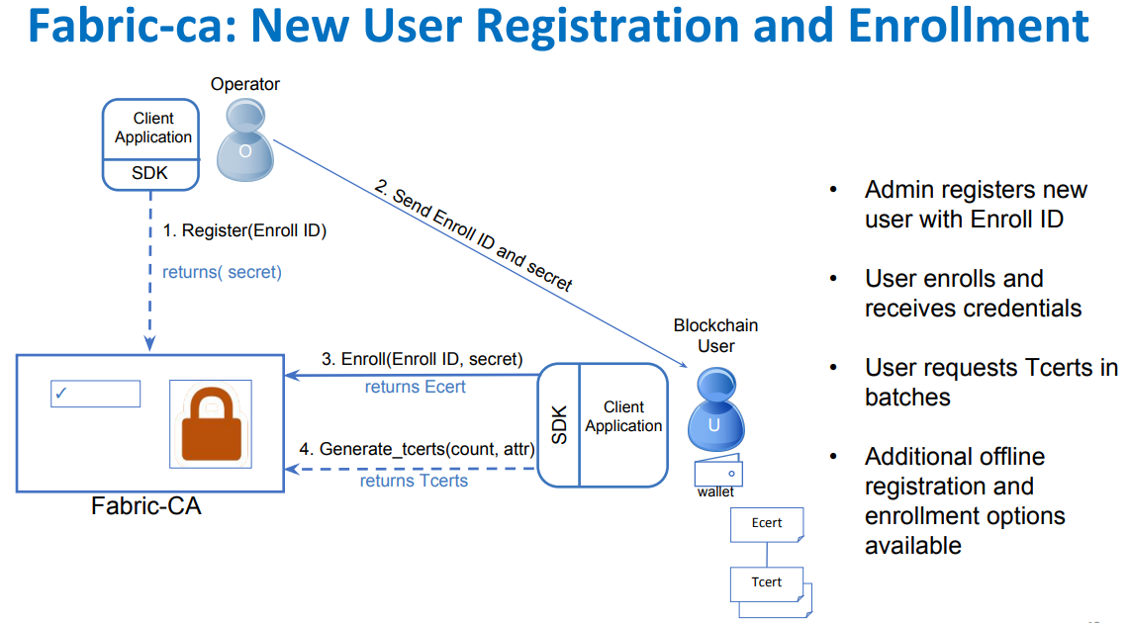

Slide 52
Membership services
Transaction certificate authority:
In order to send transactions on the networks, participants are required to hold a transaction certificate.
TCA is responsible for issuing transaction certificates to holders of Enrolment certificates and is derived from Ecerts.
TLS certificate authority:
In order to secure the network level communication between nodes on the Fabric, TLS certificates are used.
TLS certificate authority issues TLS certificates in order to ensure security of the messages being passed between various systems on the blockchain network.

Slide 53
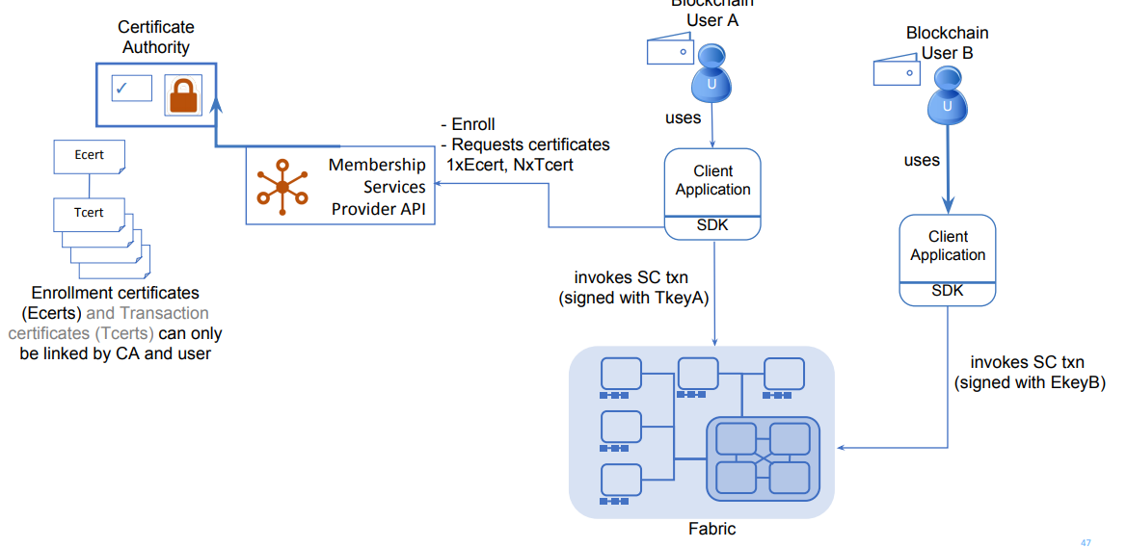

Slide 54
Blockchain services
Blockchain services are at the core of the Hyperledger Fabric.
Components of Blockchain Services are
Consensus manager
Consensus manager is responsible for providing the interface to the consensus algorithm.
This serves as an adapter that receives the transaction from other Hyperledger entities and executes them under criteria according to the type of algorithm chosen.
Consensus is pluggable
Three types of consensus algorithm available in Fabric,
Batch PBFT protocol
SIEVE algorithm
NOOPS.

Slide 55
Blockchain services
Distributed ledger
Blockchain and world state are two main elements of the distributed ledger.
Blockchain is simply a linked list of blocks
World ledger is a key value database.
This database is used by smart contracts to store relevant states during execution by the transactions.
Blockchain consists of blocks that contain transactions.
These transactions contain chaincode, which runs transactions that can result in updating the world state.
Each node saves the world state on disk in RocksDB.

Slide 56
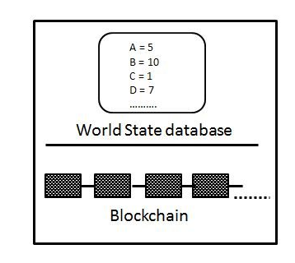

Slide 58
Block Structure fields
Version: Used for keeping track of changes in the protocol.
Timestamp: Timestamp in UTC epoch time, updated by block proposer.
Transaction hash: This field contains the Merkle root hash of the transactions in the block.
State hash: This is the Merkle root hash of the world state.
Previous hash: This is the previous block's hash, which is calculated after serializing the block message and then creating the message digest by applying the SHA3 SHAKE256 algorithm.
Consensus metadata: This is an optional field that can be used by the consensus protocol to provide some relevant information about the consensus.
Non-Hash data: This is some metadata that is stored with the block but is not hashed.
This feature makes it possible to have different data on different peers.
It also provides the ability to discard data without any impact on the blockchain.

Slide 59
Blockchain services
Peer to Peer protocol
P2P protocol in the Hyperledger Fabric is built using google RPC (gRPC).
It uses protocol buffers to define the structure of the messages.
Messages are passed between nodes in order to perform various functions.
There are four main types of messages in Hyperledger Fabric:
Discovery, transaction, synchronization and consensus.
Discovery messages are exchanged between nodes when starting up in order to discover other peers on the network.

Slide 60
Blockchain services
Transaction messages
Transaction messages can be divided into two types:
Deployment transactions
used to deploy new chaincode to the ledger
Invocation transactions.
used to call functions from the smart contract.
Transactions can be public, confidential, and confidential chaincode transactions.
Public transactions are open and available to all participants.
Confidential transactions are allowed to be queried only by transaction owners and participants.
Confidential chaincode transactions have encrypted chaincode and can only be decrypted by validating nodes.

Slide 61
Blockchain services
Transaction messages
Validating nodes run consensus, validate the transactions and maintain the blockchain.
Non-validating nodes provide transaction verification, stream server, and REST services.
They also act as a proxy between the transactors and the validating nodes.
Synchronization messages are used by peers to keep the blockchain updated and in synch with other nodes.
Consensus messages are used in consensus management and broadcasting payloads to validating peers.
These are generated internally by the consensus framework.

Slide 62
Blockchain services
Ledger storage
In order to save the state of the ledger, RocksDB is used, and it is stored at each peer.
RocksDB is a high performance database available at h t t p ://r o c k s d b . o r g /.

Slide 63
Chaincode services
These services allow the creation of secure containers that are used to execute the chaincode.
Components in this category are as follows:
Secure container:
Chaincode is deployed in Docker containers that provide a locked down sandboxed environment for smart contract execution.
Currently Golang is supported as the main smart contract language, but any other main stream language can be added and enabled if required.
Secure registry:
This provides a record of all images containing smart contracts.

Slide 64
Events
Events on the blockchain can be triggered by validator nodes and smart contracts.
External applications can listen to these events and react to them if required via event adapters.
Similar to the concept of events in solidity

Slide 65
APIs and CLIs
Application programming interface provides an interface into the fabric by exposing various REST APIs.
REST API defines a set of functions which developers can perform requests and receive responses via HTTP protocol such as GET and POST.
Command line interfaces that provide a subset of REST APIs
Allow for quick testing and limited interaction with the blockchain are also available.

Slide 66
Components of the Fabric
There are various components that can be part of the blockchain.
These components include but are not limited to the
Ledger
Chaincode
Consensus mechanism
Access control
Events
System monitoring and management
Wallets
System integration components.

Slide 67
Peers or nodes
There are two main types of peers that can be run on a fabric network:
Validating
Non-validating.
Validating node runs consensus, creates and validates a transaction, and contributes towards updating the ledger and maintaining the chaincode.
Non-validating peer does not execute transactions and only constructs transactions that are then forwarded to validating nodes.
Both nodes manage and maintain user certificates that have been issued by membership services.

Slide 68
Applications on blockchain
Typical application on Fabric is simply composed of a user interface, usually written in JavaScript/HTML,
That interacts with the backend chaincode (smart contract) stored on the ledger via an API layer.
Hyperledger provides various APIs and command line interfaces to enable interaction with the ledger.
These APIs include interfaces for identity, transactions, chaincode, ledger, network, storage, and events.

Slide 70
Chaincode implementation
Chaincode is usually written in Golang or Java.
Chaincode can be public, confidential or access controlled.
These codes serve as a smart contract that users can interact with via APIs.
Users can call functions in the chaincode that result in a state change, and consequently updates the ledger.
There are also functions that are only used to query the ledger and do not result in any state change.

Slide 71
Chaincode implementation
Chaincode implementation is performed by first creating the chaincode shim interface in the code.
Package shim provides APIs for the chaincode to access its state variables, transaction context and call other chaincodes.
It can either be in Java or Golang code.
The following four functions are required in order to implement the chaincode:
Init():
This function is invoked when chaincode is deployed onto the ledger.
This initializes the chaincode and results in making a state change, which accordingly updates the ledger.

Slide 72
Invoke():
This function is used when contracts are executed.
It takes a function name as parameters along with an array of arguments.
This function results in a state change and writes to the ledger.
Query():
This function is used to query the current state of a deployed chaincode.
This function does not make any changes to the ledger.
Main():
This function is executed when a peer deploys its own copy of the chaincode.
Chaincode is registered with the peer using this function.

Slide 74
Application model
Any blockchain application for Hyperledger Fabric follows MVC-B architecture.
This is based on the popular MVC design pattern.
Components in this model are Model, View, Control, and Blockchain:

Slide 75
Application model
View logic:
This is concerned with the user interface. It can be a desktop, web application or mobile frontend.
Control logic:
This is the orchestrator between user interface, data model, and APIs.
Data model:
This model is used to manage the off-chain data.
Blockchain logic:
This is used to manage the blockchain via the controller and the data model via transactions.

Slide 76
Sawtooth lake
Sawtooth lake can run in both permissioned and non-permissioned modes.
It is a distributed ledger that proposes two novel concepts:
New consensus algorithm called Proof of Elapsed Time (PoET);
Idea of transaction families.

Slide 77
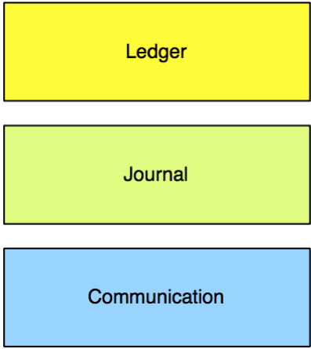
Core Architecture
The Sawtooth Lake Distributed Ledger consists of three major architectural layers:
Ledger layer
Journal layer,
Communication Layer.

Slide 78
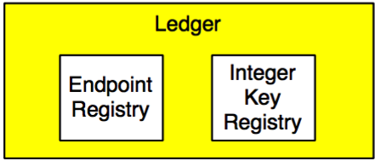
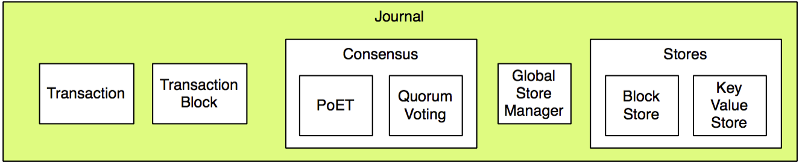
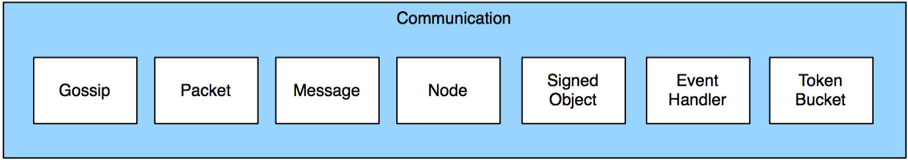

Slide 79
Ledgers
Ledgers are a conceptual semantic and data model layer for transaction types.
Ledgers are described as a ‘conceptual’ layer because they are implemented as a specialization of existing base classes already present in the Communication and Journal layers.

Slide 80
PoET
PoET is a novel consensus algorithm that allows a node to be selected randomly based on the time that the node has waited before proposing a block.
This is in contrast to other leader election and lottery based proof of work algorithms
where an enormous amount of electricity and computer resources are used in order be elected as a block proposer,
For example in the case of bitcoin.
PoET is a type of Proof of Work algorithm but, instead of spending computer resources, it uses a trusted computing model to provide a mechanism to fulfill Proof of Work requirements.

Slide 81
Transaction families
Traditional smart contract paradigm provides a solution that is based on a general purpose instruction set for all domains.
For example, in the case of Ethereum, a set of opcodes has been developed for the Ethereum virtual machine (EVM) that can be used to build smart contracts to address any type of requirements for any industry.
Though this model has its merits, it is becoming clear that this approach is not very secure as it provides a single interface into the ledger with a powerful and expressive language
which potentially offers a larger attack surface for malicious code.

Slide 82
Transaction families
This complexity and generic virtual machine paradigm has resulted in several vulnerabilities that were found and exploited recently by hackers.
A recent example is the DAO hack and further Denial of Services (DoS) attacks that exploited limitations in some EVM opcodes.

Slide 83
Figure describes the traditional smart contract model, where a generic virtual machine has been used to provide the interface into the blockchain for all domains:

Slide 84
Transaction families
In order to address this issue, Sawtooth lake has proposed the idea of transaction families.
A transaction family is created by decomposing the logic layer into a set of rules and a composition layer for a specific domain.
The key idea is that business logic is composed within transaction families, which provides a more secure and powerful way to build smart contracts.
Transaction families contain the domain-specific rules and another layer that allows for creating transactions for that domain.

Slide 85
Transaction families
Sawtooth separates the application level from the core system level with transaction families,
which allows application developers to write in the languages of their choice.
Each application defines the custom transaction families for its unique requirements.
A transaction family includes these components:
A transaction processor to define the business logic for your application
A data model to record and store data
A client to handle the client logic for your application

Slide 86
Transaction families
Another way of looking at it is that transaction families are a combination of a data model and a transaction language that implements a logic layer for a specific domain.
The data model represents the current state of the blockchain (ledger)
Transaction language modifies the state of the ledger.
It is expected that users will build their own transaction families according to their business requirements.

Slide 88
Transaction families
In the diagram,each specific domain, like financial services, digital rights management (DRM), supply chain, and the health industry, has its own logic layer comprised of operations and services specific to that domain.
This makes the logic layer both restrictive and powerful at the same time.
Transaction families ensure that operations related to only the required domain are present in the control logic,
thus removing the possibility of executing needless, arbitrary and potentially harmful operations.

Slide 89
Transaction families
Intel has provided three transaction families with Sawtooth:
Endpoint registry is used for registering ledger services.
Integerkey is used for testing deployed ledgers.
MarketPlace is used for selling, buying and trading operations and services.

Slide 90
Consensus in Sawtooth
Sawtooth has two types of consensus mechanisms based on the choice of network.
PoET is a trusted executed environment based lottery function that elects a leader randomly based on the time a node has waited for block proposal.
Another consensus type called quorum voting, which is an adaptation of consensus protocols built by Ripple and Stellar.
This consensus algorithm allows instant transaction finality, which is usually desirable in permissioned networks.

Slide 91
Corda
Corda is not a blockchain.
Traditional blockchain solutions have the
Concept of transactions that are bundled together in a block
Each block is linked back cryptographically to its parent block, which provides an immutable record of transactions.
Corda has been designed entirely from scratch with a new model for providing all blockchain benefits, but without a traditional blockchain.

Slide 92
Corda
Corda has been developed purely for the financial industry to solve issues arising from the fact that
Each organization manages their own ledgers and thus have their own view of truth, which leads to contradictions and operational risk.
Data is also duplicated at each organization which results in an increased cost of managing individual infrastructures and complexity.
These are the types of problems within the financial industry that Corda aims to resolve by building a decentralized database platform.

Slide 93
Corda
Corda source code is available at
h t t p s ://g i t h u b . c o m /c o r d a /c o r d a .
It is written in a language called Kotlin, which is a statically typed language targeting the Java Virtual Machine (JVM).

Slide 94
Architecture
The main components of the Corda platform include
State objects
Contract code
Legal prose
Transactions
Consensus
Flows.

Slide 95
State objects
State objects represent the smallest unit of data that represent a financial agreement.
They are created or deleted as a result of a transaction execution.
They refer to contract code and legal prose.
Legal prose is optional and provides legal binding to the contract.
Contract code is mandatory in order to manage the state of the object.
It is required in order to provide a state transition mechanism for the node according to the business logic defined in the contract code.
State objects contain a data structure that represent the current state of the object

Slide 97
State objects
For example
In the diagram, a state object represents the current state of the object.
In this case, it is a simple mock agreement between Party A and Party B where Party ABC has paid Party XYZ 1,000 GBP.
This represents the current state of the object;
Referred contract code can change the state via transactions.
State objects can be thought of as a state machine, which are consumed by transactions in order to create updated state objects.

Slide 98
Transactions
Transactions are used to perform transitions between different states.
For example, the state object shown in the preceding diagram is created as a result of a transaction.
Corda uses a bitcoin-style UTXO based model for its transaction processing.
The concept of state transition by transactions is same as in bitcoin.
Similar to bitcoin, transactions can have none, single or multiple inputs, and single or multiple outputs.

Slide 99
Transactions
All transactions are digitally signed.
Corda has no concept of mining because it does not use blocks to arrange transactions in a blockchain.
Instead, notary services are used in order to provide temporal ordering of transactions.
In Corda, new transaction types can be developed using JVM bytecode, which makes it very flexible and powerful.

Slide 100
Consensus
The consensus model in Corda is quite simple and is based on notary services.
The general idea is that the transactions are evaluated for their uniqueness by the notary service
if they are unique, they are signed as valid.
There can be single or multiple clustered notary services running on a Corda network.
Various consensus algorithms like PBFT or Raft can be used by notaries to reach consensus.

Slide 101
Consensus
There are two main concepts regarding consensus in Corda:
Consensus over state validity,
consensus over state uniqueness.
The first concept is concerned with the validation of the transaction, ensuring that all required signatures are available and states are appropriate.
The second concept is a means to detect double–spend attack and ensures that a transaction has not been already been spent and is unique.

Slide 102
Flows
Flows in Corda are a novel idea that allow the development of decentralized workflows.
All communication on the Corda network is handled by these flows.
These are transaction building protocols that can be used to define any financial flow of any complexity using code.
Flows run as an asynchronous state machine and they interact with other nodes and users.
During the execution, they can be suspended or resumed as required.

Slide 103
Corda network -Components
The Corda network has multiple components
Nodes
Nodes in a Corda network operated under a trust-less model and run by different organizations.
Nodes run as part of an authenticated peer-to-peer network.
Nodes communicate directly with each other using the Advanced Message Queuing Protocol (AMQP),
which is an approved international standard (ISO/IEC 19464) and ensures that messages across different nodes are transferred safely and securely.
AMQP works over Transport Layer Security (TLS) in Corda, thus ensuring privacy and integrity of data communicated between nodes.

Slide 104
Nodes
Nodes also make use of a local relational database for storage.
Messages on the network are encoded in a compact binary format.
Messages are delivered and managed by using the Apache Artemis message broker (Active MQ).
A node can serve as a
network map service
Notary
Oracle,
regular node.

Slide 106
Permissioning service
Permissioning service is used to provision TLS certificates for security.
In order to participate on the network, participants are required to have a signed identity issued by a root certificate authority.
Identities are required to be unique on the network and the Permissioning service is used to sign these identities.
The naming convention used to recognize participants is based on the X.500 standard.
This ensures the uniqueness of the name.

Slide 107
Network map service
Network map service is used to provide a network map in the form of a document of all nodes on the network.
This service publishes IP addresses, identity certificates and a list of services offered by nodes.
All nodes announce their presence by registering to this service when they first start up
When a connection request is received by a node, the presence of the requesting node is checked on the network map first.
Network map service resolves the identities of the participants to physical nodes.

Slide 108
Notary service
In a traditional blockchain, mining is used to ascertain the order of blocks that contain transactions.
In Corda, notary services are used to provide transaction ordering and timestamping services.
There can be multiple notaries in a network and they are identified by composite public keys.
Notaries can use different consensus algorithms like BFT or Raft depending on the requirements of the applications.
Notary services sign the transactions to indicate validity and finality of the transaction which is then persisted to the database.

Slide 109
Notary service
Notaries can be run in a load-balanced configuration in order to spread the load across the nodes for performance reasons;
In order to reduce latency, the nodes are recommended to be run physically closer to the transaction participants.

Slide 110
Oracle service
Oracle services either sign a transaction containing a fact, if it is true, or can themselves provide factual data.
They allow real world feed into the distributed ledgers.

Slide 111
Transactions
Transactions in a Corda network are never transmitted globally, but in a semi-private network.
They are shared only between a subset of participants who are related to the transaction.
This is in contrast to traditional blockchain solutions like Ethereum and bitcoin,
where all transactions are broadcasted to the entire network globally.
Transactions are digitally signed and either consume state(s) or create new state(s).

Slide 112
Transactions
Transactions on a Corda network are composed of the following elements:
Input references:
Reference to the states the transaction is going to consume and use as an input.
Output states:
New states created by the transaction.
Attachments:
List of hashes of attached zip files.
`Zip files can contain code and other relevant documentation related to the transaction.
Files themselves are not made part of the transaction, instead, they are transferred and stored separately.

Slide 113
Transactions
Commands:
Command represents the information about the intended operation of the transaction as a parameter to the contract.
Each command has a list of public keys which represents all parties that are required to sign a transaction.
Signatures:
Signature required by the transaction.
Total number of signatures required is directly proportional to the number of public keys for commands.

Slide 114
Transactions
Type:
There are two types of transactions namely, Normal or Notary changing.
Notary changing transactions are used for reassigning a notary for a state.
Timestamp:
This field represents a bracket of time during which the transaction has taken place.
These are verified and enforced by notary services.
Also, it is expected that if strict timings are required, which is desirable in many financial services scenarios, notaries should be synched with an atomic clock.
Summaries:
This is a text description that describes the operations of the transaction.

Slide 115
Vaults
Vaults run on a node and are akin to the concept of wallets in bitcoin.
As the transactions are not globally broadcast, each node will have only that part of data in their vaults that is considered relevant to them.
Vaults store their data in a standard relational database and as such can be queried by using standard SQL.
Vaults can contain both on ledger and off ledger data, meaning that it can also have some part of data that is not on ledger.

Slide 116
CorDapp
Core model of Corda consists of state objects, transactions and transaction protocols, which when combined with contract code, APIs, wallet plugins, and user interface components results in constructing a Corda distributed application (CorDapp).
Smart contracts in Corda are written using Kotlin or Java.
The code is targeted for JVM.
JVM has been modified slightly in order to achieve deterministic results of execution of JVM bytecode.

Slide 117
CorDapp
There are three main components in a Corda smart contract as follows:
Executable code that defines the validation logic to validate changes to the state objects.
State objects represent the current state of a contract and either can be consumed by a transaction or produced (created) by a transaction.
Commands are used to describe the operational and verification data that defines how a transaction can be verified.

Slide 118
References
Imran Bashir. “Mastring BlockChain”, Packt
Web Materials

