Slide 1

Bitcoin

Slide 2
Introduction
Bitcoin has started a revolution with the introduction of the very first fully decentralized digital currency, and one that has proven to be extremely secure and stable.
sparked a great interest in academic and industrial research
introduced many new research areas.
Since introduction in 2008, bitcoin has gained much popularity
Most successful digital currency in the world with billions of dollars invested in it.
Bitcoin is built on decades of research in the field of cryptography, digital cash, and distributed computing.

Slide 3
Introduction
Early proposals to create digital cash go as far back as the early 1980s.
In 1982, David Chaum proposed a scheme that used blind signatures to build untraceable digital currency.
Bank would issue digital money by signing a blind and random serial number presented to it by the user.
The user could then use the digital token signed by the bank as currency.
The limitation in this scheme was that the bank had to keep track of all used serial numbers.
This was a central system by design and required to be trusted by the users.

Slide 4
Introduction
Later on in 1990, David Chaum proposed a refined version named e-cash that not only used blinded signature, but also some private identification data to craft a message that was then sent to the bank.
This scheme allowed the detection of double spending but did not prevent it.
If the same token was used at two different locations, then the identity of the double spender would be revealed.
e-cash could only represent a fixed amount of money.
Adam Back's hashcash, introduced in 1997, was originally proposed to thwart e-mail spam.
Solve a computational puzzle that was easy to verify but comparatively difficult to compute.

Slide 5
Introduction
B-money was proposed by Wei Dai in 1998, which introduced the idea of using Proof of Work to create money.
A major weakness in the system was that an adversary with higher computational power could generate unsolicited money without allowing the network to adjust to an appropriate difficulty level.
The system lacked details on the consensus mechanism between nodes and some security issues such as Sybil attacks were also not addressed.
At the same time, Nick Szabo introduced the concept of BitGold,
Based on the Proof of Work mechanism but had the same problems as b-money with the exception that the network difficulty level was adjustable

Slide 6
Introduction
Tomas Sander and Ammon TaShama introduced an e-cash scheme in 1999
For the first time, used Merkle trees to represent coins and zero knowledge proofs to prove the possession of coins.
Central bank was required that kept a record of all used serial numbers.
Scheme allowed users to be fully anonymous albeit at a computational cost.
RPOW (Reusable Proof of Work) was introduced by Hal Finney in 2004 and used the hashcash scheme by Adam Back as a proof of computational resources spent to create the money.
This was also a central system that kept a central database to keep track of all used POW tokens.
This was an online system that used remote attestation made possible by a trusted computing platform (TPM hardware).

Slide 7
Bitcoin
In 2008, a paper on bitcoin, Bitcoin: A Peer-to-Peer Electronic Cash System was written by Satoshi Nakamoto.
The first key idea introduced was that purely peer-to-peer electronic cash that does need an intermediary bank to transfer payments between peers.
Bitcoin is built on cryptographic research in Merkle trees, hash functions, public key cryptography, and digital signatures.
BitGold, b-money, hashcash, and cryptographic time stamping provided the foundations for bitcoin invention.
All these technologies are cleverly combined in bitcoin to create the world's first decentralized currency.
The key issue that has been addressed in bitcoin is an elegant solution to the Byzantine Generals problem along with a practical solution of the double-spend problem.

Slide 8
Milestones
“Satoshi Nakamoto” created the reference implementation that began with a Genesis Block of 50 coins
2008
August 18 Domain name "bitcoin.org" registered^{[1]}.
October 31 Bitcoin design paper published
November 09 Bitcoin project registered at SourceForge.net
2009
January 3 Genesis block established at 18:15:05 GMT
January 9 Bitcoin v0.1 released and announced on the cryptography mailing list
January 12 First Bitcoin transaction, in block 170 from Satoshi to Hal Finney
https://en.bitcoin.it/wiki/History

Slide 9
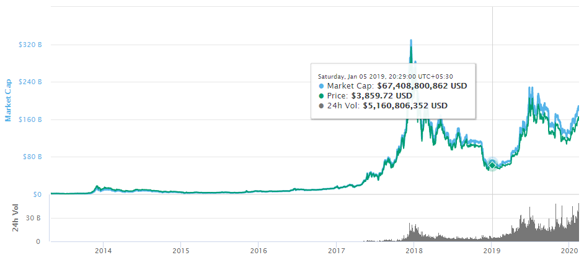

Slide 10
Bitcoin
The regulation of bitcoin is a controversial subject
it is a libertarian's dream, law enforcement agencies and governments are proposing various regulations to control it
BitLicense issued by New York's state department of financial services.
This is a license issued to businesses that perform activities related to virtual currencies.
The growth of Bitcoin is also due to so-called Network Effect.
Also called demand-side economies of scale, it is a concept that basically means more users who use the network, the more valuable it becomes.
Over time, an exponential increase has been seen in the Bitcoin network growth.
1 Bitcoin = 7,33,918.79 Indian Rupee
1 Bitcoin= 10,258.30 United States Dollar

Slide 11
Bitcoin definition
Bitcoin can be defined in various ways;
it's a protocol, a digital currency, and a platform.
It is a combination of peer-to-peer network, protocols, and software that facilitate the creation and usage of the digital currency named bitcoin.
Bitcoin with a capital B is used to refer to the Bitcoin protocol
bitcoin with a lowercase b is used to refer to bitcoin, the currency.
Nodes in this peer-to-peer network talk to each other using the Bitcoin protocol.

Slide 12


Bitcoin vs. bitcoins
Bitcoin is the system
bitcoins are the units

Slide 13
Bitcoin definition
Decentralization of currency was made possible for the first time with the invention of bitcoin
Double spending problem was solved in an elegant and ingenious way in bitcoin.

Slide 14
Keys and addresses
Elliptic curve cryptography is used to generate public and private key pairs in the Bitcoin network.
The bitcoin address is created by taking the corresponding public key of a private key and hashing it twice,
First with the SHA256 algorithm
Then with RIPEMD160.

Slide 15
Keys and addresses
The resultant 160-bit hash is then prefixed with a version number and finally encoded with a Base58Check encoding scheme.
Base58 is a group of binary-to-text encoding schemes used to represent large integers as alphanumeric text, introduced by Satoshi Nakamoto for use with Bitcoin.
It is similar to Base64 but has been modified to avoid both non-alphanumeric characters and letters which might look ambiguous when printed.
The bitcoin addresses are 26-35 characters long and begin with digit 1 or 3.

Slide 16
Keys and addresses
Typical bitcoin address looks like
This is also commonly encoded in a QR code for easy sharing
1ANAguGG8bikEv2fYsTBnRUmx7QUcK58wt

Slide 17
Keys and addresses
Currently, there are two types of addresses, the commonly used
Pay-to-PubKey-Hash (Pay-to-Public-Key-Hash, P2PKH)
Pay to script hash (P2SH)
In the early days, bitcoin used direct Pay-to- Pubkey, which is now superseded by P2PKH.
However, direct Pay-to-Pubkey is still used in bitcoin for coinbase addresses.
Addresses should not be used more than once; otherwise, privacy and security issues can arise.
Avoiding address reuse circumvents
anonymity issues to an extent,
bitcoin has some other security issues as well, such as transaction malleability, which requires different approaches to resolve.

Slide 18
Pay-to-PubKey-Hash (Pay-to-Public-Key-Hash, P2PKH)
P2PKH is the basic form of making a transaction and is the most common form of transaction on the Bitcoin network.
Transactions that pay to a Bitcoin address contain P2PKH scripts that are resolved by sending the public key and a digital signature created by the corresponding private key.
A Bitcoin payment address comprising a hashed public key, allowing the spender to create a standard pubkey script that Pays To PubKey Hash (P2PKH).

Slide 19
Pay to script hash (P2SH)
Pay to script hash (P2SH) transactions were standardised in BIP 16.
They allow transactions to be sent to a script hash (address starting with 3) instead of a public key hash (addresses starting with 1).
To spend bitcoins sent via P2SH, the recipient must provide a script matching the script hash and data which makes the script evaluate to true.
Using P2SH, you can send bitcoins to an address that is secured in various unusual ways without knowing anything about the details of how the security is set up.
You just send bitcoins to the ~34-character P2SH address.
The recipient might need the signatures of several people to spend these bitcoins, or a password might be required, or the requirements could be completely unique.

Slide 20
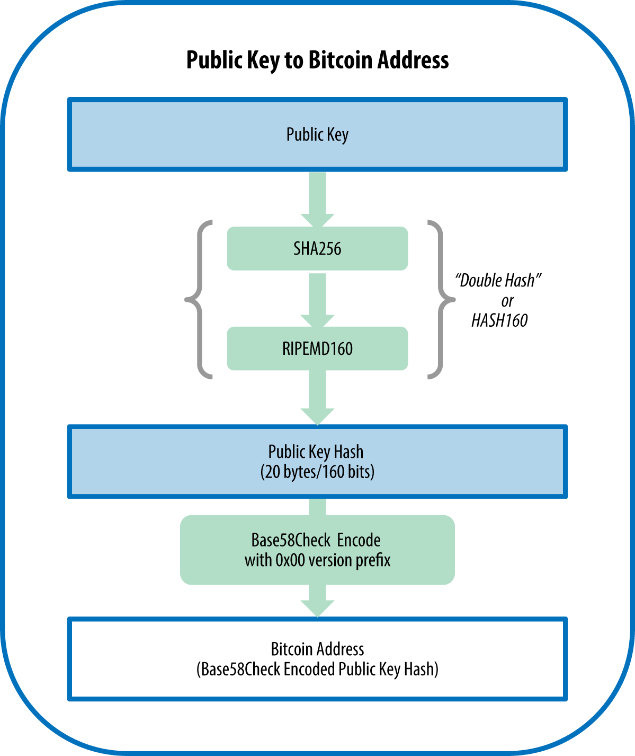

Slide 21
Private key
Private key is simply a number, picked at random.
Ownership and control over the private key is the root of user control over all funds associated with the corresponding bitcoin address.
Private key is used to create signatures that are required to spend bitcoin by proving ownership of funds used in a transaction.
Private key must remain secret at all times, because revealing it to third parties is equivalent to giving them control over the bitcoin
Private key must also be backed up and protected from accidental loss
because if it’s lost it cannot be recovered

Slide 22
Generating a private key from a random number
Important step in generating keys is to find a secure source of entropy, or randomness.
Creating a bitcoin key is essentially the same as "Pick a number between 1 and 2²⁵⁶."
The exact method you use to pick that number does not matter as long as it is not predictable or repeatable.
Bitcoin software uses the underlying operating system’s random number generators to produce 256 bits of entropy
More precisely, the private key can be any number between 0 and n - 1 inclusive, where n is a constant (n = 1.1578 * 10⁷⁷, slightly less than 2²⁵⁶) defined as the order of the elliptic curve used in bitcoin

Slide 23
Generating a private key from a random number
To create such a key, we randomly pick a 256-bit number and check that it is less than n.
In programming terms, this is usually achieved by feeding a larger string of random bits, collected from a cryptographically secure source of randomness, into the SHA256 hash algorithm, which will conveniently produce a 256-bit number.
If the result is less than n, we have a suitable private key. Otherwise, we simply try again with another random number.

Slide 24
Private keys in bitcoin
Private keys are basically 256-bit numbers chosen in the range specified by the SECP256K1 ECDSA recommendation.
Any randomly chosen 256-bit number from 0x1 to 0xFFFF FFFF
FFFF FFFF FFFF FFFF FFFF FFFE BAAE DCE6 AF48 A03B BFD2 5E8C D036 4140 is a valid private key.
Private keys are usually encoded using Wallet Import Format (WIF) in order to make them easier to copy and use.
WIF can be converted into private key and vice versa.
Mini Private Key Format is sometimes used to encode the key in under 30 characters in order to allow storage where physical space is limited,
Bitcoin core client also allows the encryption of the wallet that contains the private keys.

Slide 25
Public keys in bitcoin
The public key is calculated from the private key using elliptic curve multiplication, which is irreversible:
K = k * G, where k is the private key, G is a constant point called the generator point, and K is the resulting public key.
The reverse operation, known as "finding the discrete logarithm"—calculating k if you know K—is as difficult as trying all possible values of k, i.e., a brute-force search.

Slide 26
Public keys in bitcoin
A private key is randomly selected and is 256-bit in length.
Public keys can be presented in an uncompressed or compressed format.
Public keys are basically x and y coordinates on an elliptic curve and in an uncompressed format and are presented with a prefix of 04 in a hexadecimal format.
Public key K is defined as a point K = (x,y):
X and Y coordinates are both 32- bit in length.
In total, the compressed public key is 33 bytes long as compared to 65 bytes in the uncompressed format.
The compressed version of public keys basically includes only the X part, since the Y part can be derived from it.

Slide 27
secp256k1
Bitcoin uses ECC based on the SECP256K1 standard.
secp256k1 refers to the parameters of the elliptic curve used in Bitcoin's public-key cryptography, and is defined in Standards for Efficient Cryptography (SEC)
secp256k1 is now gaining in popularity due to its several nice properties.
Secp256k1 was constructed in a special non-random way which allows for especially efficient computation.
As a result, it is often more than 30% faster than other curves if the implementation is sufficiently optimized.
Secp256k1's constants were selected in a predictable way, which significantly reduces the possibility that the curve's creator inserted any sort of backdoor into the curve.

Slide 28
Public keys in bitcoin
Keys are identified by various prefixes, described as follows:
Uncompressed public keys used 0x04 as the prefix
Compressed public key starts with 0x03 if the y 32-bit part of the public key is odd
Compressed public key starts with 0x02 if the y 32-bit part of the public key is even

Slide 29
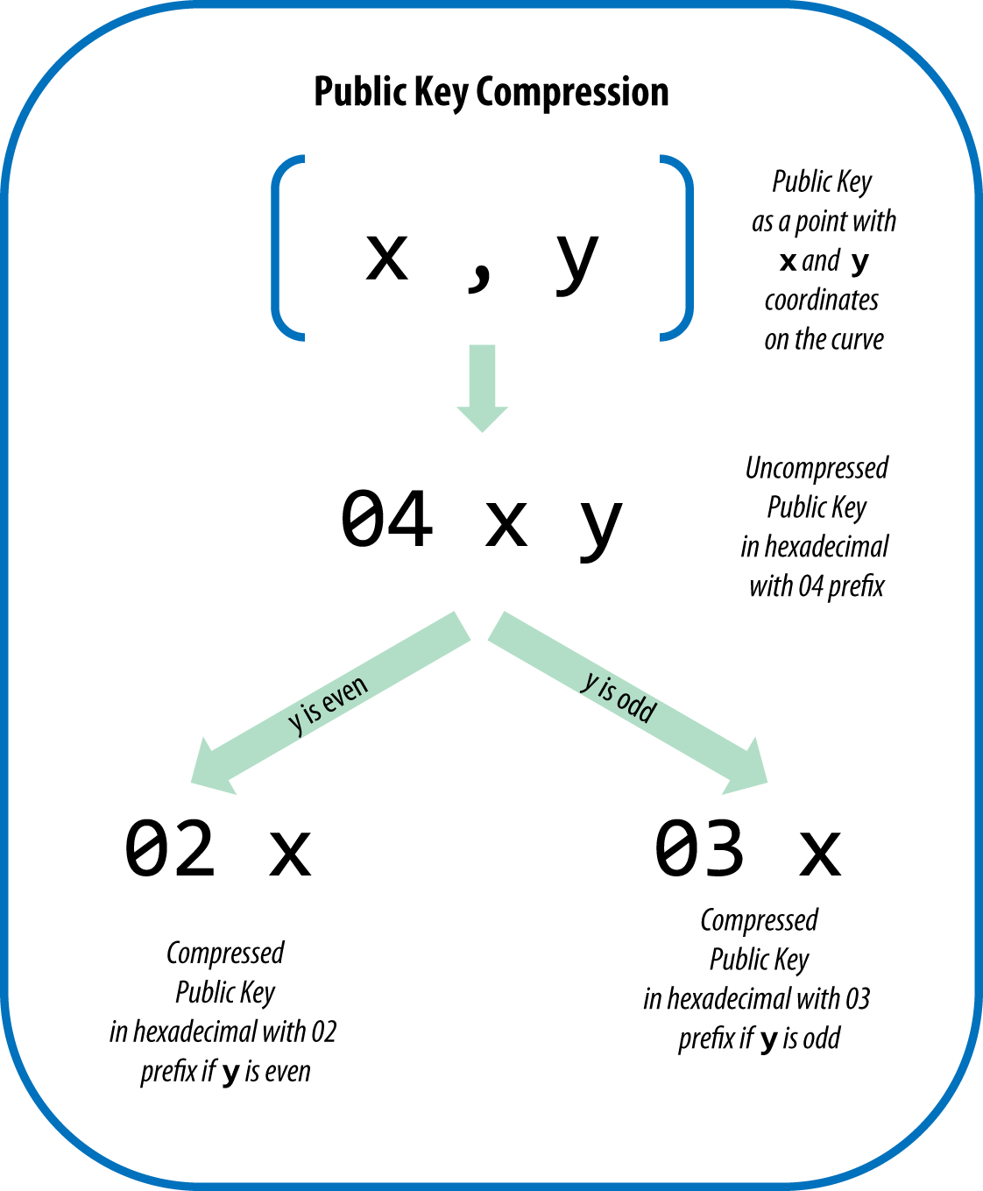

Slide 30
Public keys in bitcoin
Compressed public keys are gradually becoming the default across bitcoin clients, which is having a significant impact on reducing the size of transactions and therefore the blockchain.
However, not all clients support compressed public keys yet.
Newer clients that support compressed public keys have to account for transactions from older clients that do not support compressed public keys.
This is especially important when a wallet application is importing private keys from another bitcoin wallet application,
because the new wallet needs to scan the blockchain to find transactions corresponding to these imported keys.

Slide 31
Bitcoin currency units

Slide 32
Base58Check encoding
In order to represent long numbers in a compact way, using fewer symbols, many computer systems use mixed-alphanumeric representations with a base (or radix) higher than 10.
For example, whereas the traditional decimal system uses the 10 numerals 0 through 9, the hexadecimal system uses 16, with the letters A through F as the six additional symbols.
A number represented in hexadecimal format is shorter than the equivalent decimal representation.
Base64 representation uses 26 lowercase letters, 26 capital letters, 10 numerals, and 2 more characters such as “``&#x201d; and "/" to transmit binary data over text-based media such as email.
Base64 is most commonly used to add binary attachments to email.
Base58 is a text-based binary-encoding format developed for use in bitcoin and used in many other cryptocurrencies

Slide 33
Base58Check encoding
Base58 offers a balance between compact representation, readability, and error detection and prevention.
Base58 is a subset of Base64, using upper- and lowercase letters and numbers, but omitting some characters that are frequently mistaken for one another and can appear identical when displayed in certain fonts.
Specifically, Base58 is Base64 without the 0 (number zero), O (capital o), l (lower L), I (capital i), and the symbols &#x201c;``” and "/". Or, more simply, it is a set of lowercase and capital letters and numbers without the four (0, O, l, I) just mentioned.
Bitcoin’s Base58 alphabet shows the full Base58 alphabet.

Slide 34
Vanity addresses
As bitcoin addresses are based on base 58 encoding, it is possible to generate addresses that contain human-readable messages.

Slide 35
Vanity addresses are generated using a purely brute-force method.
Example

Slide 36
Vanity Addresses
Vanity addresses are valid bitcoin addresses that contain human-readable messages.
For example, 1LoveBPzzD72PUXLzCkYAtGFYmK5vYNR33 is a valid address that contains the letters forming the word "Love" as the first four Base-58 letters.
Vanity addresses require generating and testing billions of candidate private keys, until a bitcoin address with the desired pattern is found.
Vanity generation algorithm,
the process essentially involves picking a private key at random,
deriving the public key,
deriving the bitcoin address
checking to see if it matches the desired vanity pattern,
repeating billions of times until a match is found.

Slide 37
Vanity Addresses
Once a vanity address matching the desired pattern is found,
Private key from which it was derived can be used by the owner to spend bitcoin in exactly the same way as any other address.
Vanity addresses are no less or more secure than any other address.
They depend on the same Elliptic Curve Cryptography (ECC) and SHA as any other address.
You can no more easily find the private key of an address starting with a vanity pattern than you can any other address.

Slide 38
Paper Wallets
Paper wallets are bitcoin private keys printed on paper.
Paper wallet also includes the corresponding bitcoin address for convenience
but this is not necessary because it can be derived from the private key.
Paper wallets are a very effective way to create backups or offline bitcoin storage, also known as "cold storage.“
As a backup mechanism, a paper wallet can provide security against the loss of key due to a computer mishap such as a hard-drive failure, theft, or accidental deletion.
If the paper wallet keys are generated offline and never stored on a computer system, they are much more secure against hackers, keyloggers, and other online computer threats.

Slide 39
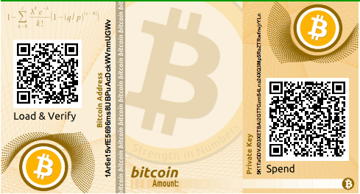

Slide 40
Transactions
Transactions are the most important part of the bitcoin system.
Everything else in bitcoin is designed to ensure that transactions can be
created
propagated on the network,
validated,
Finally added to the global ledger of transactions (the blockchain).
Transactions are data structures that encode the transfer of value between participants in the bitcoin system.
Each transaction is a public entry in bitcoin’s blockchain, the global double-entry bookkeeping ledger.

Slide 41
Transactions
Transactions are at the core of the bitcoin ecosystem.
Transactions can be as simple as just sending some bitcoins to a bitcoin address, or it can be quite complex depending on the requirements.
Each transaction is composed of at least one input and output.
Inputs can be thought of as coins being spent that have been created in a previous transaction and outputs as coins being created.
If a transaction is minting new coins, then there is no input and therefore no signature is needed.
If a transaction is to sends coins to some other user (a bitcoin address), then it needs to be signed by the sender with their private key and a reference is also required to the previous transaction in order to show the origin of the coins.
Coins are, in fact, unspent transaction outputs represented in Satoshis.

Slide 42
The transaction life cycle
A user/sender sends a transaction using wallet software or some other interface.
The wallet software signs the transaction using the sender's private key.
The transaction is broadcasted to the Bitcoin network using a flooding algorithm.
Mining nodes include this transaction in the next block to be mined.
Mining starts once a miner who solves the Proof of Work problem broadcasts the newly mined block to the network.
The nodes verify the block and propagate the block further, and confirmation starts to generate.
Finally, the confirmations start to appear in the receiver's wallet and after approximately six confirmations, the transaction is considered finalized and confirmed.

Slide 43
The transaction structure
A transaction at a high level contains metadata, inputs, and outputs.
Transactions are combined to create a block

Slide 44
The transaction structure
MetaData:
This part of the transaction contains some values such as the size of the transaction, the number of inputs and outputs, the hash of the transaction, and a lock_time field.
Every transaction has a prefix specifying the version number.
Inputs:
Generally, each input spends a previous output.
Each output is considered an Unspent Transaction Output (UTXO) until an input consumes it.

Slide 45
The transaction structure
Outputs:
Outputs have only two fields, and they contain instructions for the sending of bitcoins.
The first field contains the amount of Satoshis,
Second field is a locking script that contains the conditions that need to be met in order for the output to be spent.
Verification:
Verification is performed using bitcoin's scripting language.

Slide 46
sample transaction

Slide 47
Bitcoin Scripts
In Bitcoin transactions, there is necessary use of digital signatures and validation with the help private and public key pairs.
This is implemented through Bitcoin scripts.
The crux is that the input of transaction consists of scripts instead of signatures.
To validate that a transaction is in sync with the previous blocks of the chain correctly,
we combine the new transaction’s input script and the earlier transaction’s output script by concatenating them.

Slide 48
Bitcoin Scripting Language
It is based on an old, simple, stack-based programming language called Forth.
The main goals of designing such a script for Bitcoins was simple, compact and yet supporting key cryptographic operations.
key features of this language are:
Stack based:
This results that every instruction specified in the Bitcoin script is executed exactly once and in a linear fashion.
Hence, there can be no implementation of loops in the Bitcoin scripting language.

Slide 49
key features of this language
Not Turing-complete
This results to the language’s inability to execute arbitrarily powerful methods based on recursion and loops.
Miners of the Bitcoin network run these scripts appended by the sender of a transaction and this is the reason for dis-allowance of infinite loops in Bitcoin scripts.
Finite Size
The Bitcoin scripting language is finitely small in size.
It can only accommodate 256 instructions as each instruction is represented by one byte.

Slide 50
Script Instructions
A large part of the instruction set in Bitcoin scripts is same as any of those in common programming languages.
For examples: arithmetic operations, logic blocks such as if-else, throwing and not throwing of errors and function returns
There are two types of instructions:
Data instructions:
If a data instructions is encountered in a script, the data corresponding to the instruction is simply pushed onto the top of the stack data structure.
Opcodes:
Whenever an opcode is encountered in a script, it executes some particular function which is mostly taken as input data residing on the top of the stack.

Slide 51
Most common instructions
OP DUP: Duplicates the top item of the stack
OP HASH160: Hashes twice, first using SHA-256 and then RIPEMD-160
OP EQUALVERIFY: Returns true if the inputs are equal. Returns false and marks the transaction as invalid if they are unequal
OP CHECKSIG: Checks that the input signature is a valid signature using the input public key for the hash of the current transaction
OP CHECKMULTISIG: Checks that the k signatures on the transaction are valid signatures from k of the specified public keys

Slide 52
Commonly used Opcodes

Slide 53
Execution of the script
All that we will need to execute is a stack data structures which supports push and pop methods.
Any other form of memory or variables are not required for the script’s execution
example of a Bitcoin script:
<sig>
<pubKey>
OP DUP
OP HASH160
<pubKeyHash?>
OP EQUALVERIFY
OP CHECKSIG

Slide 54
Execution of the script
Data instructions are denoted with surrounding angle brackets, whereas opcodes begin with ”OP ”
In this example, the first two instructions of the script are the signature and public key used to verify that signature.
Then we duplicate the instruction with OP DUP where we simply push a copy of the public key onto the stack data structure.
This instructions is followed by OP HASH160 which basically pops the top value and computes the cryptographic hash and then pushes the result onto the stack.

Slide 55
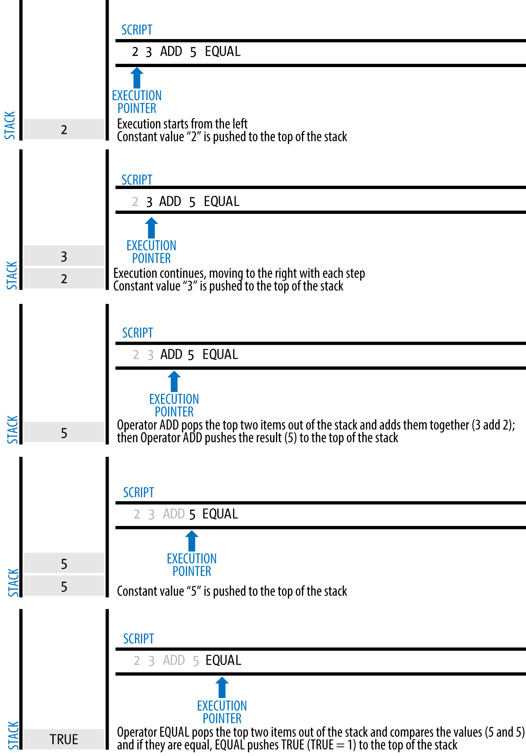

Slide 56
Stateless Verification
Bitcoin transaction script language is stateless, in that there is no state prior to execution of the script, or state saved after execution of the script.
All the information needed to execute a script is contained within the script.
If your system verifies a script, you can be sure that every other system in the bitcoin network will also verify the script
Valid transaction is valid for everyone and everyone knows this.

Slide 57
Script Construction (Lock + Unlock)
Bitcoin’s transaction validation engine relies on two types of scripts to validate transactions:
locking script
unlocking script.

Slide 58
A locking script
Locking script is a spending condition placed on an output
It specifies the conditions that must be met to spend the output in the future.
Locking script was called a scriptPubKey, because it usually contained a public key or bitcoin address (public key hash).
locking script also referred as a witness script or more generally as a cryptographic puzzle.

Slide 59
unlocking script
An unlocking script is a script that "solves," or satisfies, the conditions placed on an output by a locking script and allows the output to be spent.
Unlocking scripts are part of every transaction input.
It contain a digital signature produced by the user’s wallet from his or her private key.
Unlocking script was called scriptSig, because it usually contained a digital signature.

Slide 60
Script Construction (Lock + Unlock)
Every bitcoin validating node will validate transactions by executing the locking and unlocking scripts together.
Each input contains an unlocking script and refers to a previously existing UTXO.
The validation software will
Copy the unlocking script
Retrieve the UTXO referenced by the input,
Copy the locking script from that UTXO.
The unlocking and locking script are then executed in sequence.
The input is valid if the unlocking script satisfies the locking script conditions
All the inputs are validated independently, as part of the overall validation of the transaction.

Slide 61
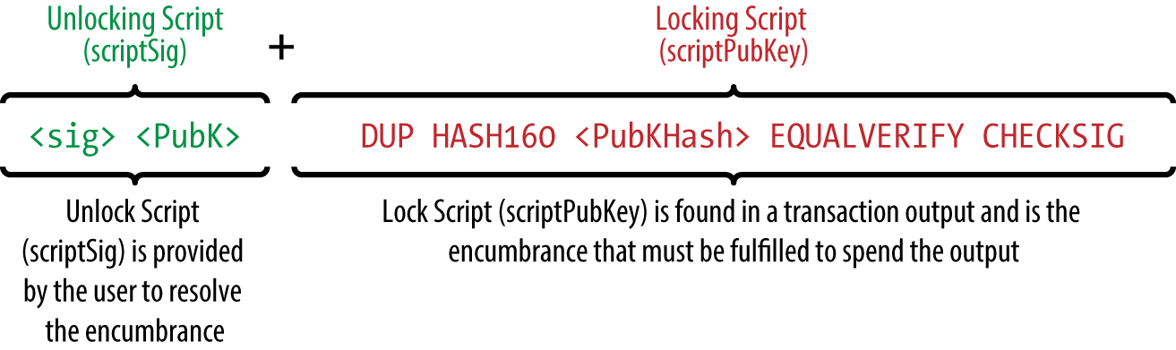

Slide 62
Types of transaction
There are various scripts available in bitcoin to handle the value transfer from the source to the destination
These scripts range from very simple to quite complex depending upon the requirements of the transaction.
Standard transactions are evaluated using IsStandard() and IsStandardTx() tests
Only standard transactions that pass the test are generally allowed to be mined or broadcasted on the bitcoin network.
However, Nonstandard transactions are valid and allowed on the network.

Slide 63
Types of transaction
Pay to Public Key Hash (P2PKH):
P2PKH is the most commonly used transaction type and is used to send transactions to the bitcoin addresses.
The format of the transaction is shown as folows:
ScriptPubKey: OP_DUP OP_HASH160 <pubKeyHash> OP_EQUALVERIFY OP_CHECKSIG
ScriptSig: <sig> <pubKey>
The ScriptPubKey and ScriptSig parameters are concatenated together and executed.

Slide 64
Types of transaction
Pay to Script Hash (P2SH):
P2SH is used in order to send transactions to a script hash and was standardized in BIP16.
In addition to passing the script, the redeem script is also evaluated and must be valid.
The template is shown as follows:
ScriptPubKey: OP_HASH160 <redeemScriptHash> OP_EQUAL
ScriptSig: [<sig>…<sign>] <redeemScript>

Slide 65
Types of transaction
MultiSig (Pay to MultiSig):
M of n multisignature transaction script is a complex type of script where it is possible to construct a script that required multiple signatures to be valid in order to redeem a transaction.
Various complex transactions such as escrow and deposits can be built using this script.
The template is shown here:
ScriptPubKey: <m> <pubKey> [<pubKey> . . . ] <n> OP_CHECKMULTISIG
ScriptSig: 0 [<sig > . . . <sign>]
Raw multisig is obsolete, and multisig is usually part of the P2SH redeem script

Slide 66
Types of transaction
Pay to Pubkey:
This script is a very simple script that is commonly used in coinbase transactions.
It is now obsolete and was used in an old version of bitcoin.
The public key is stored within the script in this case, and the unlocking script is required to sign the transaction with the private key.
The template is shown as follows:
<PubKey> OP_CHECKSIG

Slide 67
Types of transaction
Null data/OP_RETURN:
This script is used to store arbitrary data on the blockchain for a fee.
The limit of the message is 40 bytes.
The output of this script is unredeemable because OP_RETURN will fail the validation in any case.
ScriptSig is not required in this case.
The template is very simple and is shown as follows:
OP_RETURN <data>

Slide 68
A P2PKH script execution

Slide 69
Coinbase transactions
Coinbase transaction or generation transaction is always created by a miner and is the first transaction in a block.
It is used to create new coins.
It includes a special field, also called coinbase, which acts as an input to the coinbase transaction.
This transaction also allows up to 100 bytes of arbitrary data that can be used to store arbitrary data.
In the genesis block, this included the most famous comment taken from The Times newspaper:
“The Times 03/Jan/2009 Chancellor on brink of second bailout for banks”
This message is proof that the genesis block was not mined earlier than January 3, 2009.

Slide 70
What is UTXO?
Unspent Transaction Output (UTXO) is an unspent transaction output that can be spent as an input to a new transaction

Slide 71
Transaction fee
Transaction fees are charged by the miners.
The fee charged is dependent upon the size of the transaction.
Transaction fees are calculated by subtracting the sum of the inputs and the sum of the outputs.
The fees are used as an incentive for miners to encourage them to include a user transaction in the block the miners are creating.
All transactions end up in the memory pool, from where miners pick up transactions based on their priority to include them in the proposed block.

Slide 72
Transaction fee
From a transaction fee point of view, a transaction with a higher fee will be picked up sooner by the miners.
There are different rules based on which fee is calculated for various types of actions, such as
Sending transactions
Inclusion in blocks
Relaying by nodes.
Fees are not fixed by the Bitcoin protocol and are not mandatory;
Even a transaction with no fee will be processed in due course but may take a very long time.

Slide 73
Contracts
Contracts are basically transactions that use the bitcoin system to enforce a financial agreement.
Allows users to design complex contracts that can be used in many real-world scenarios.
Contracts allow the development of a completely decentralized, independent, and reduced risk platform.
Various contracts, such as escrow, arbitration, and micropayment channels, can be built using the bitcoin scripting language

Slide 74
Contracts
The current implementation of a script is very limited, but various types of contracts are still possible to develop.
For example
the release of funds only if multiple parties sign the transaction
the release of funds only after a certain time has elapsed.
Both of these scenarios can be realized using multiSig and transaction lock time options.

Slide 75
Transaction malleability
Transaction malleability in bitcoin was introduced due to a bug in the bitcoin implementation.
Due to this bug, it becomes possible for an adversary to change the Transaction ID of a transaction
If the ID is changed before confirmation, it would seem that the transaction did not happen at all,
which allow double deposits or withdrawal attacks.
In other words, this bug allows the changing of the unique ID of a bitcoin transaction before it is confirmed.

Slide 76
Transaction pools
Also known as memory pools
These pools are basically created in local memory by nodes in order to maintain a temporary list of transactions that are not yet confirmed in a block.
Transactions are included in a block after passing verification and based on their priority.

Slide 77
Transaction verification
Check the syntax and ensure that the syntax of the transaction is correct.
Verify that inputs and outputs are not empty.
Check whether the size in bytes is less than the maximum block size
Bitcoin blocks now have a theoretical maximum size of 4 megabytes and a more realistic maximum size of 2 megabytes.
Exact size depends on the types of transactions included.
The output value must be in the allowed money range (0 to 21 million BTC).
All inputs must have a specified previous output, except for coinbase transactions, which should not be relayed.

Slide 78
Transaction verification
Verify that nLockTime must not exceed 31-bits.
nLockTime is a parameter of a transaction, mandates a minimal time (specified in either unix time or block height), before which the transaction cannot be accepted into a block.
For a transaction to be valid, it should not be less than 100 bytes.
Number of signature operands in a standard signature should be less than or not more than 2.
Reject nonstandard transactions;
for example, ScriptSig is allowed to only push numbers on the stack.
ScriptPubkey not passing the isStandard() checks.
A transaction is rejected if there is already a matching transaction in the pool or in a block in the main branch.
The transaction will be rejected if the referenced output for each input exists in any other transaction in the pool.

Slide 79
Transaction verification
For each input, there must exist a referenced output transaction.
This is searched in the main branch and the transaction pool to find whether the output transaction is missing for any input, and this will be considered an orphan transaction.
It will be added to the orphan transactions pool if a matching transaction is not in the pool already.
For each input, if the referenced output transaction is the coinbase, it must have at least 100 confirmations; otherwise, the transaction will be rejected.
For each input, if the referenced output does not exist or has been spent already, the transaction will be rejected.

Slide 80
Transaction verification
Using the referenced output transactions to get input values, verify that each input value, as well as the sum, is in the allowed range of 0-21 million BTC.
Reject the transaction if the sum of input values is less than the sum of output values.
Reject the transaction if the transaction fee would be too low to get into an empty block.

Slide 81
Blockchain
Blockchain is a public ledger of a timestamped, ordered, and immutable list of all transactions on the bitcoin network.
Each block is identified by a hash in the chain and is linked to its previous block by referencing the previous block's hash.

Slide 82
The structure of a block

Slide 83
The structure of a block header

Slide 84
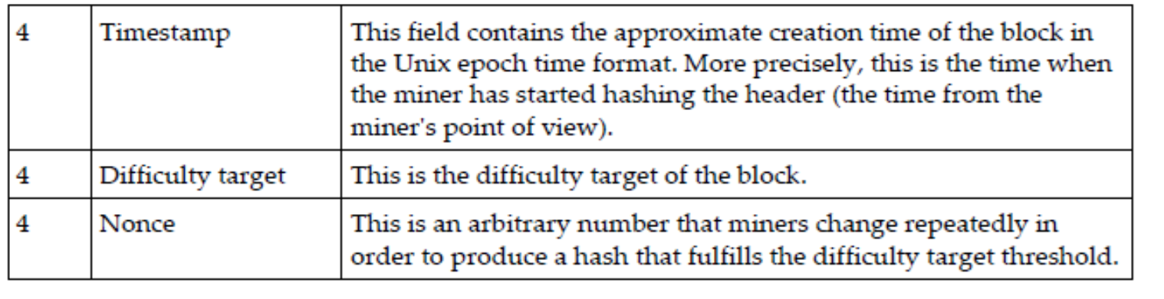

Slide 86
Blockchain is a chain of blocks where each block is linked to its previous block by referencing the previous block header's hash.
This linking makes sure that no transaction can be modified unless the block that records it and all blocks that follow it are also modified.
The first block is not linked to any previous block and is known as the genesis block.

Slide 87
The genesis block
This is the first block in the bitcoin blockchain.
The genesis block was hardcoded in the bitcoin core software.
It is in the chainparams.cpp file
Every node always starts with a blockchain of at least one block because
the genesis block is statically encoded within the bitcoin client software, such that it cannot be altered.
Every node always "knows" the genesis block’s hash and structure, the fixed time it was created, and even the single transaction within.
Every node has the starting point for the blockchain, a secure "root" from which to build a trusted blockchain.

Slide 88
Bitcoin provides protection against double spending by enforcing strict rules on transaction verification and via mining.
Blocks are added in the blockchain only after strict rule checking and successful Proof of Work solution.
Block height is the number of blocks before a particular block in the blockchain.
The current height (at the time of writing this) of the blockchain is 434755 blocks.
Proof of Work is used to secure the blockchain.
Each block contains one or more transactions, out of which the first transaction is a coinbase transaction.
There is a special condition for coinbase transactions that prevent them to be spent until at least 100 blocks in order to avoid a situation where the block may be declared stale later on

Slide 89
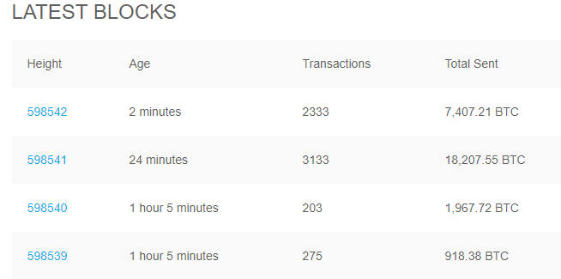

Slide 90
Stale blocks
Stale blocks are created when a block is solved and every other miner who is still working to find a solution to the hash puzzle is working on that block
As the block is no longer required to be worked on, this is considered a stale block.
Orphan blocks are also called detached blocks and were accepted at one point in time by the network as valid blocks
but were rejected when a proven longer chain was created that did not include this initially accepted block.
They are not part of the main chain and can occur at times when two miners manage to produce the blocks at the same time.

Slide 91
Network difficulty
New blocks are added to the blockchain approximately every 10 minutes
Network difficulty is adjusted dynamically every 2016 blocks in order to maintain a steady addition of new blocks to the network.
Network difficulty is calculated using the following equation:
Target = Previous target * Time/2016 * 10 minutes
Difficulty and target are interchangeable and represent the same thing.
Previous target represents the old target value,
Time is the time spent to generate previous 2016 blocks.
Network difficulty basically means how hard it is for miners to find a new block,
how difficult the hashing puzzle is now.

Slide 92
Mining
Mining is a resource-intensive process by which new blocks are added to the blockchain
Blocks contain transactions that are validated via the mining process by mining nodes and are added to the blockchain.
Process is resource-intensive in order to ensure that the required resources have been spent by miners in order for a block to be accepted.
New coins are minted by the miners by spending the required computing resources.
Secures the system against frauds and double spending attacks while adding more virtual currency to the bitcoin ecosystem.

Slide 93
Mining
Roughly one new block is created (mined) every 10 minute.
Miners are rewarded with new coins if and when they create new blocks and are paid transaction fees in return of including transactions in their blocks.
New blocks are created at an approximate fixed rate.
Also, the rate of creation of new bitcoins decreases by 50%, every 210,000 blocks, roughly every 4 years.
When bitcoin was initially introduced, the block reward was 50 bitcoins;
Then in 2012, this was reduced to 25 bitcoins. In July 2016, this was further reduced to 12.5 coins (12 coins)
next reduction is estimated to be on July 4, 2020, further down to approximately six coins.

Slide 94
Mining
Approximately 144 blocks, that is, 1,728 bitcoins are generated per day.
The number of actual coins can vary per day; however, the number of blocks remains at 144 per day.
Bitcoin supply is also limited and in 2140, almost 21 million bitcoins will be finally created and no new bitcoins can be created after that.
Bitcoin miners, however, will still be able to profit from the ecosystem by charging transaction fees.

Slide 95
Task of miners- Synching up with the network
Once a new node joins the bitcoin network,
It downloads the blockchain by requesting historical blocks from other nodes.
Transaction validation:
Transactions broadcasted on the network are validated by full nodes by verifying and validating signatures and outputs.
Block validation:
Miners and full nodes can start validating blocks received by them by evaluating them against certain rules.
This includes the verification of each transaction in the block along with verification of the nonce value.

Slide 96
Task of miners- Synching up with the network
Create a new block:
Miners propose a new block by combining transactions broadcasted on the network after validating them.
Perform Proof of Work:
This task is the core of the mining process
miners find a valid block by solving a computational puzzle.
The block header contains a 32-bit nonce field
miners are required to repeatedly vary the nonce until the resultant hash is less than a predetermined target.

Slide 97
Task of miners- Synching up with the network
Fetch reward:
Once a node solves the hash puzzle,
it immediately broadcasts the results, and other nodes verify it and accept the block.
There is a slight chance that the newly minted block will not be accepted by other miners due to a clash with another block found at roughly the same time,
Once accepted, the miner is rewarded with 12.5 bitcoins (as of 2016) and any associated transaction fees.

Slide 98
Proof of Work
This is a proof that enough computational resources have been spent in order to build a valid block.
Proof of Work (PoW) is based on the idea that a random node is selected every time to create a new block.
In this model, nodes compete with each other in order to be selected in proportion to their computing capacity.
The following equation sums up the Proof of Work requirement in bitcoin:
H ( N || P_hash || Tx || Tx || . . . Tx) < Target
Where N is a nonce,
P_hash is a hash of the previous block
Tx represents transactions in the block,
Target is the target network difficulty value.
The only way to find this nonce is the brute force method.

Slide 99
The mining algorithm
The previous hash block is retrieved from the bitcoin network.
Assemble a set of potential transactions broadcasted on the network into a block.
Compute the double hash of the block header with a nonce and the previous hash using the SHA256 algorithm.
If the resultant hash is lower than the current difficulty level (target), then stop the process.
If the resultant hash is greater than the current difficulty level (target), then repeat the process by incrementing the nonce
Mining difficulty increased over time and bitcoins that could be mined by single CPU laptop computers now require dedicated mining centers to solve the hash puzzle.

Slide 100
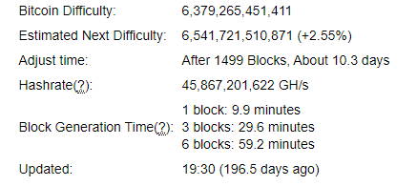
The current difficulty level can be queried using the bitcoin command line interface using the following command:
$ bitcoin-cli getdifficulty
258522748404.5154

Slide 101
The hashing rate
Hashing rate basically represents the rate of calculating hashes per second.
In early days of bitcoin, it used to be quite small as CPUs were used
With dedicated mining pools and ASICs now, this has gone up exponentially in the last few years.
Application-Specific Integrated Circuit (ASIC)
This has resulted in increased difficulty.
Hash rate increase over time and is currently measured in Exa hashes.
This means that in 1 second, bitcoin network miners are computing more than 1 000 000 000 000 000 000 hashes per second.

Slide 102
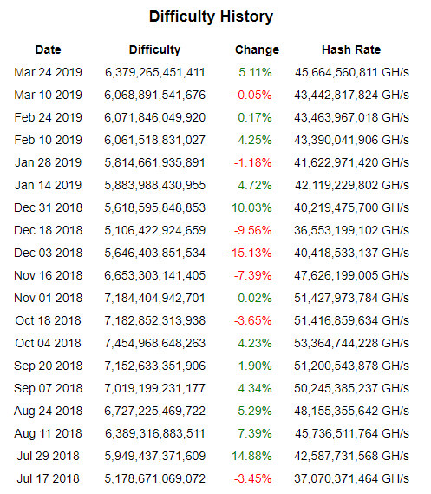

Slide 103
Mining systems
CPU
GPU
Field Programmable Gate Array (FPGA) is basically an integrated circuit that can be programmed to perform specific operations
FPGA offered much better performance as compared to GPUs;
However, issues such as accessibility, programming difficulty, and the requirement for specialized knowledge to program and configure FPGAs resulted in a short life of the FPGA era for bitcoin mining.
Application Specific Integrated Circuit (ASIC) was designed to perform the SHA-256 operation
Currently, professional mining centers using thousands of ASIC units in parallel are offering mining contracts to users to perform mining on their behalf.

Slide 104
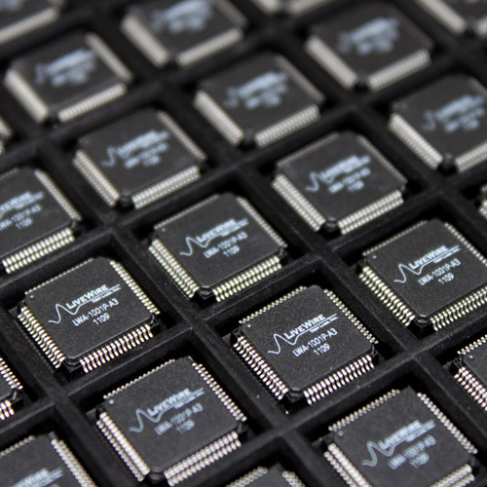

Slide 105
Mining pools
Mining pool forms when group miners work together to mine a block.
The Pool manager receives the coinbase transaction if the block is successfully mined
which is then responsible for distributing the reward to the group of miners who invested resources to mine the block.
Profitable as compared to solo mining,
where only one sole miner is trying to solve the partial hash inversion function.

Slide 106
The bitcoin network
The bitcoin network is a P2P network where nodes exchange transactions and blocks.
There are two main types of nodes- full nodes and SPV nodes.
Full nodes, as the name implies, are implementations of bitcoin core clients performing the wallet, miner, full blockchain storage, and network routing functions.
it is not necessary to perform all these functions.
SPV nodes or lightweight clients perform only wallet and network routing functionality.
Simplified Payment Verification(SPV)

Slide 107
The bitcoin network
Some nodes prefer to be full blockchain nodes only
contain complete blockchain
perform network routing functions
but do not perform mining or store private keys (the wallet function).
Another type is solo miner nodes
that can perform mining
store full blockchain
act as a bitcoin network routing node.

Slide 108
The bitcoin network
Few nonstandard but heavily used nodes that are called pool protocol servers.
These nodes make use of alternative protocols, such as the stratum protocol.
Some nodes perform only mining functions and are called mining nodes.
Nodes that only compute hashes use the stratum protocol to submit their solutions to the mining pool.
It is possible to run an SPV client runs a wallet and network routing function without a blockchain.
Most protocols on the Internet are line-based, which means that each line is delimited by a carriage return and newline \r \n character.

Slide 109
The bitcoin network
Stratum is also a line-based protocol that makes use of plain TCP sockets and human-readable JSON-RPC to operate and communicate between nodes.
When a bitcoin core node starts up, first, it initiates the discovery of all peers.
This is achieved by querying DNS seeds that are hardcoded into the bitcoin core client and are maintained by bitcoin community members.
This lookup returns a number of DNS A records.
The bitcoin protocol works on TCP port 8333 by default for the main network and TCP 18333 for testnet.

Slide 110
The bitcoin network
First, the client sends a protocol message Version that contains various fields, such as version, services, timestamp, network address, nonce, and some other fields.
The remote node responds with its own version message followed by verack message exchange between both nodes, indicating that the connection has been established.
Getaddr and addr messages are exchanged to find the peers.
Either of the nodes can send a ping message to see whether the connection is still live.

Slide 111
The bitcoin network
Now the block download can begin.
If the node already has all blocks fully synchronized, then it listens for new blocks using the Inv protocol message;
otherwise, it first checks whether it has a response to inv messages and have inventories already.
If yes, then it requests the blocks using the Getdata protocol message;
if not, then it requests inventories using the GetBlocks message

Slide 112
Types of protocol messages
There are 27 types of protocol messages in total, but they're likely to increase over time as the protocol grows
Version:
This is the first message that a node sends out to the network, advertising its version and block count.
The remote node then replies with the same information and the connection is then established.
Verack :
This is the response of the version message accepting the connection request.
Inv:
This is used by nodes to advertise their knowledge of blocks and transactions.

Slide 113
Getdata :
This is a response to inv, requesting a single block or transaction identified by its hash.
Getblocks:
This returns an inv packet containing the list of all blocks starting after the last known hash or 500 blocks.
Getheaders :
This is used to request block headers in a specified range.
Tx :
This is used to send a transaction as a response to the getdata protocol message.
Block:
This sends a block in response to the getdata protocol message.

Slide 114
Headers:
This packet returns up to 2,000 block headers as a reply to the getheaders request.
Getaddr:
This is sent as a request to get information about known peers.
Addr:
This provides information about nodes on the network.
It contains the number of addresses and address list in the form of IP address and port number.

Slide 115
Full client and SPV client:
Full clients are thick clients or full nodes that download the entire blockchain;
This is the most secure method of validating the blockchain as a client.
Bitcoin network nodes can operate in two fundamental modes:
full client or lightweight SPV client.
SPV clients are used to verify payments without requiring the download of a full blockchain.
SPV nodes only keep a copy of block headers of the current valid longest blockchain

Slide 116
Bloom filters:
Bloom filter is basically a data structure (a bit vector with indexes) that is used to test the membership of an element in a probabilistic manner.
These filters are mainly used by simple payment verification SPV clients to request transactions and the merkle blocks they are interested in
BIP 37 proposed the bitcoin implementation of bloom filters and introduced three new messages to the Bitcoin protocol.
Filterload: This is used to set the bloom filter on the connection.
Filteradd: This adds a new data element to the current filter.
FilterClear: This deletes the currently loaded filter.

Slide 117
Wallets
The wallet software is used to store private or public keys and bitcoin address.
It performs various functions, such as receiving and sending bitcoins.
On the disk, the bitcoin core client wallets are stored as the Berkeley DB file
Private keys can be generated in different ways and are used by different types of wallets.
Wallets do not store any coins, and there is no concept of wallets storing balance or coins for a user.
In fact, in the bitcoin network, only transaction information is stored on the blockchain (UTXO, unspent outputs),
which are then used to calculate the amount of bitcoins.

Slide 118
Wallet types
Non-deterministic wallets
These wallets contain randomly generated private keys and are also called Just a Bunch of Key wallets.
The bitcoin core client generates some keys when first started and generates keys as and when required.
Managing a large number of keys is very difficult and an errorprone process can lead to theft and loss of coins.
Moreover, there is a need to create regular backups of the keys and protect them appropriately in order to prevent theft or loss.

Slide 119
Wallet types
Deterministic wallets
In this type of wallet, keys are derived out of a seed value via hash functions.
seed number is generated randomly and is commonly represented by human-readable mnemonic code words.
Mnemonic code words are defined in BIP39.
This phrase can be used to recover all keys and makes private key management comparatively easier.

Slide 120
Wallet types
Hierarchical deterministic wallets
Defined in BIP32 and BIP44
HD wallets store keys in a tree structure derived from a seed.
The seed generates the parent key (master key), which is used to generate child keys and, subsequently, grandchild keys.
Key generation in HD wallets does not generate keys directly;
instead, it produces some information (private key generation information) that can be used to generate a sequence of private keys.
The complete hierarchy of private keys in an HD wallet is easily recoverable if the master private key is known.
It is because of this property that HD wallets are very easy to maintain and are highly portable.

Slide 121
Wallet types
Brain wallets
The master private key can also be derived from the hash of passwords that are memorized.
The key idea is that this passphrase is used to derive the private key and if used in HD wallets, this can result in a full HD wallet that is derived from a single memorized password.
This method is prone to password guessing and brute force attacks
but techniques such as key stretching can be used to slow down the progress made by the attacker.

Slide 122
Wallet types
Paper wallets
As the name implies, this is a paper-based wallet with the required key material printed on it.
It requires physical security to be stored.
Paper wallets can be generated online from various service providers
Hardware wallets
Another method is to use a tamper-resistant device to store keys.
This tamper-resistant device can be custom-built or with the advent of NFC-enabled phones, this can also be a secure element (SE) in NFC phones.
Trezor and Ledger walletsare the most commonly used bitcoin hardware wallets.

Slide 123
Wallet types
Online wallets
Online wallets, as the name implies, are stored entirely online and are provided as a service usually via cloud.
They provide a web interface to the users to manage their wallets and perform various functions such as making and receiving payments.
They are easy to use but imply that the user trust the online wallet service provider.
Mobile wallets
Mobile wallets, as the name suggests, are installed on mobile devices.
They can provide various methods to make payments, most notably the ability to use smart phone cameras to scan QR codes quickly and make payments.
Mobile wallets are available for the Android platform and iOS, for example, breadwallet, copay, and Jaxx.

