Slide 1


DL Model Optimization
DL Model Optimization
for Embedded Systems Deployment in Leather Applications
for Embedded Systems Deployment (leather image analysis)

Slide 2


Chapter 1.1: Introduction
Automatic Surface Inspection Background
Automatic surface inspection acts as a backbone for modern quality control systems, especially for manufacturing sectors like leather. Accurate classification of leather into defective (hole, cut, scratch, insect bite) and non defective is an essential first step in leather processing.
Traditional methods rely on manual inspection of leather by trained professionals, but this is highly time consuming, prone to human error due to overworking. With the emergence of deep learning techniques for image classification, it is possible to automate this process with the help of high resolution images.
This project aims to optimize Convolutional Neural Networks to be able to deploy them onto resource constrained systems such as Jetson TX2.
Report: DL Optimization for Embedded System Applications
Slide 1 of 14

Slide 3
Chapter 1.2: Objectives
Literature Survey: Conduct a review of the available research papers on optimization of deep learning models to be deployed on a resource constrained system.
Determine the architectures to train and optimize and determine the optimization techniques to use from the literature review.
Create and train the models with different optimization techniques.
Make a script to train the base models and perform different optimization techniques, fine tune after optimization and finally store the optimized techniques.
Configure Jetson TX2 board to run the models on the board.
Implement and evaluate the models and optimization techniques on the boards.
Perform the comparative study of the results.
Slide 2 of 14

Slide 4


Chapter 2: Literature Review
Survey Overview & Architectures
Optimization Techniques
We reviewed 50 Research papers on the topic of optimizing DL models to deploy them on resource constrained systems like mobile, IOT, embedded devices. From those research papers we documented the architectures, optimization techniques used, boards used, classification or segmentation.
Pruning, Quantization were popular optimization techniques used in the majority of the papers.
So, channel pruning, layer pruning, neuron pruning were selected for pruning, INT16 and INT8 PTQ were selected for quantization and dropout was selected.
From the papers it was observed that VGG models, ResNet models were popular and MobileNet was deemed suitable for resource constrained systems. So, VGG16, ResNet50 and MobileNetV2 were selected for a wide range of parameter count and footprint size.
Slide 3 of 14

Slide 5



Chapter 3: Architectures
3.1 VGG16 Overview: VGG16 is a fundamental Convolution Neural Network(CNN), it consists of 16 total layers - 13 convolution layers and 3 fully connected layers.
Input Layer
Convolution Layers
Classification Head
It takes 224x244 RGB images as input.
It consists of 5 blocks, each with 2 or 3 convolution layers (3x3 convolution filter, stride 1, same padding) followed by a 2x2 max-pooling layer (stride 2).
The model ends with 2 fully connected (Dense) layers, each with 4096 neurons and is followed by the final output fully connected layer.
Slide 4 of 14

Slide 6



Chapter 3: MobileNetV2
3.2 MobileNetV2 Overview: MobilleNetV2 is a light weight Convolutional Neural Network that was designed for resource constrained devices.
Input / Initial Conv
Inverted Residual Layer
Classification Head
Input layer: It takes 224x224 RGB images as input.
Each Block consists of a 1x1 expansion layer that expands the no of channels, followed by a filtering layer with a 3x3 depthwise convolution layer and then a 1x1 projection layer that shrinks the tensor.
It contains a 1x1 convolution layer followed by a Global Average Pooling then a final dense layer.
Initial Convolution layer: It begins with a 3x3 convolution, followed by 17 Inverted Residual Blocks.
It also contains a skip connection between the input and the out of the Inverted Residual Block.
Slide 6 of 14

Slide 7



Chapter 3: ResNet50 Architecture
3.3 ResNet50 Overview: ResNet50 is a 50 layer Convolutional Neural Network(CNN) that uses residual skip connections.
Input & Initial Conv
Residual Blocks
Classification Head
Input layer: It takes 224x224 RGB images as input.
Residual Block: Consists of a 1x1 convolution layer that reduces the no of channels, then a 3x3 convolution layer for feature extraction, then a 1x1 convolution layer that expands the channels.
Contains a Global Average pooling followed by a dense layer.
Initial Convolution layer: Contains a 7x7 convolution layer, followed by 16 Residual blocks.
Convolution layers: Consists of 4 stages: Stage 1 (3 Residual blocks, 256 output channels), Stage 2 (4 blocks, 512 channels), Stage 3 (6 blocks, 1024 channels), Stage 4 (3 blocks, 2048 channels).
Slide 5 of 14

Slide 8
Chapter 4: Datasets & Development
4.1 Datasets:
4.2 Model Architecture and Development:
We used 2 different datasets to build and test the optimization techniques:
We took the VGG16, MobileNetV2 and ResNet50 bases from keras.applications with pre-trained weights from ImageNet. We added our own classification head with 0.3 dropout to avoid overfitting for our use case of binary classification. The pre-trained weights were frozen and the classification head was allowed to train, then to increase the accuracy even more with the whole model trainable for fine tuning. The base models were trained with Adam optimizer and cosine scheduling from 1e-4 to 1e-6 learning rate, with a max of 100 epochs. Early stop was implemented with the patience of 10 monitoring validation loss. The training and validation data was recorded using TensorBoard and the Test sta was recorded manually.
1. Kaggle Cats Vs Dogs dataset: A standard publicly available dataset to test and validate the results of the models and the techniques.
2. Proprietary CEERI leather dataset: Dataset developed from high quality 224x224 RGB images of leather samples with 3992 defect free images and 3992 images with various defects such as holes, cuts, scratches, insect bites, etc.
For the various optimization techniques the base model of the architectures were loaded and the optimization techniques were performed, then for the various pruning techniques and dropout, fine tuning was performed to regain some of the lost accuracy and quantization was evaluated as such.
Slide 7 of 14

Slide 9



Chapter 4: Automation Pipeline
4.3 Automation pipeline: Instead of changing the optimization technique ratios by hand and running and training the model one by one manually, we decided to write an automation script that will open the files , update the specific variables, train the models and store the data automatically. This code was implemented for ResNet50 and MobileNetV2.
Pipeline Sequence:
Base Training
Optimization Techniques
Quantization
Trains the unoptimised base model of each architecture.
Load the Base model, change name of the model to save the tensorboard files, perform the technique at the particular ratio, store the optimized model on the updated file name, save the test results. This is done for Channel pruning, Layer Pruning, Neuron Pruning, Dropout.
Then run the scripts for all the Quantization levels.
All training and validation results were stored using tensorboard files and the test results were noted on a csv file. To keep the script running smoothly, exception handling was built in the code to skip models in case of any issues and start running the next model.
Slide 8 of 14

Slide 10

Chapter 4: Targeted Techniques
4.4 Targeted Optimization Techniques: The ratios and level of optimization used for all the techniques are mentioned below,
Optimization Technique | Ratios and Levels of Optimization Used
Channel pruning | 0.2, 0.3, 0.4, 0.5, 0.6, 0.7, 0.8
Neuron pruning | 0.3, 0.4, 0.5, 0.6, 0.7, 0.8
Layer pruning | 1, 2, 3, 4, 5, 6, 7
Dropout | 0.1, 0.2, 0.3, 0.4, 0.5, 0.6
Quantization | INT16, INT8
Slide 9 of 14

Slide 11


Chapter 5: Embedded Setup
The implementation of the trained models were conducted on Jetson TX2 and will be conducted on Jetson Orin Nano.
5.1 Jetson TX2 Setup
Setup Configuration Steps
The Jetson TX2 board serves as one of the primary hardware testbed for obtaining the inference time of the models.
Installation of SDK manager on a pc with ubuntu 18.04
Flash the board with the os
After the proper setup, the inference time of all the models were evaluated and documented.
Install jetpack4.6.6
Install all the required modules.
Slide 10 of 14

Slide 12

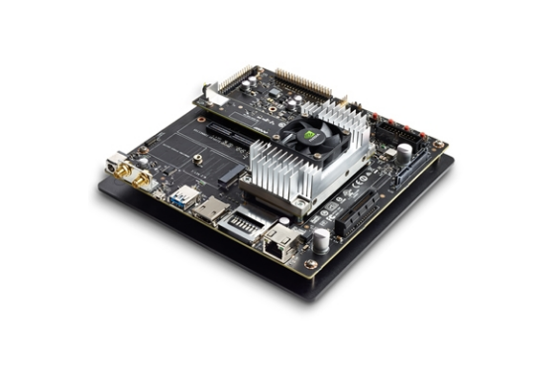
Chapter 5: Jetson TX2 Hardware
5.2 Jetson TX2 Platform Specifications
Jetson TX2 is a high performance AI computing device, it contains a 256-core NVIDIA Pascal architecture GPU with a max frequency of 1.3GHz capable of 1.33 TFLOPS of performance, along with a Dual-core NVIDIA Denver 2 64-bit CPU and quad-core Arm Cortex-A57 MPCore processor, with max frequency of 2GHz for both of them.
The system contains 8GB 128-bit LPDDR4 with bandwidth of 59.7GB/s and a 32GB eMMC 5.1 for storage.
Slide 11 of 14

Slide 13
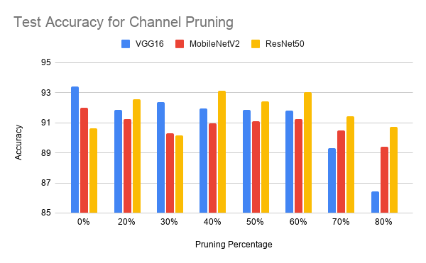
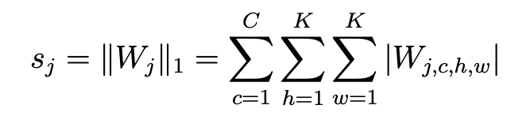
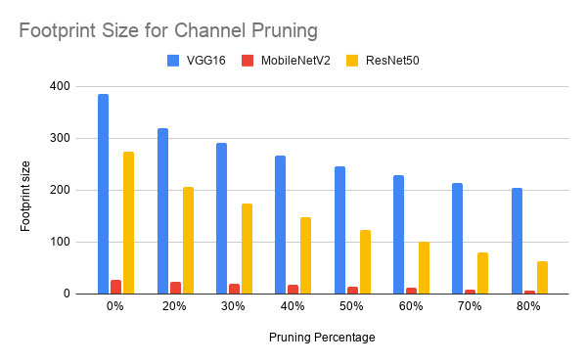
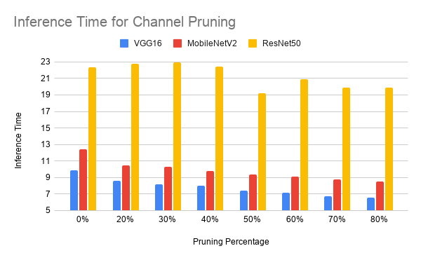
Chapter 6: System Results
System Evaluation Results
6.1 Channel pruning results for the System:
The Results of evaluating the trained models of Channel pruning across VGG16, ResNet50 and MobileNetV2 are shown below.
Slide 12 of 14

Slide 14
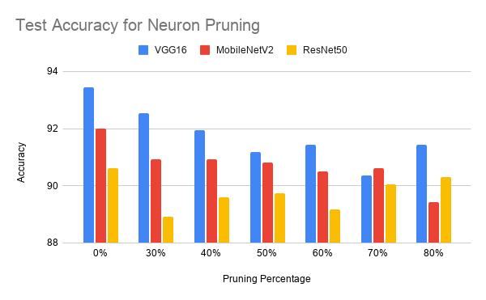
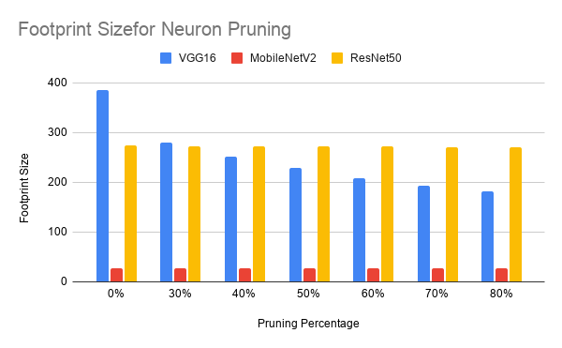
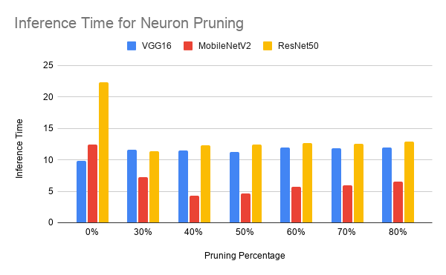
Chapter 6: System Results
System Evaluation Results
6.2 Neuron pruning results for the System:
The Results of evaluating the trained models of neuron pruning across VGG16, ResNet50 and MobileNetV2 are shown below.
Slide 12 of 14

Slide 15
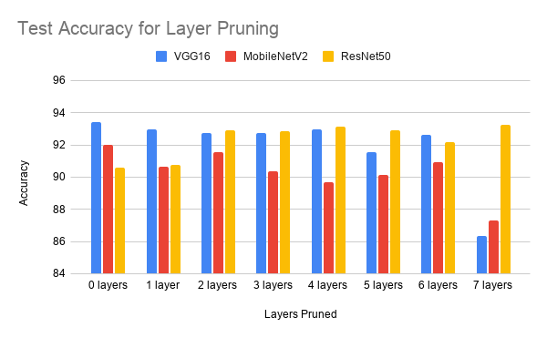
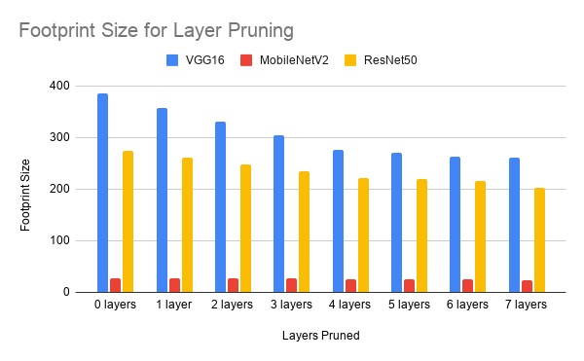
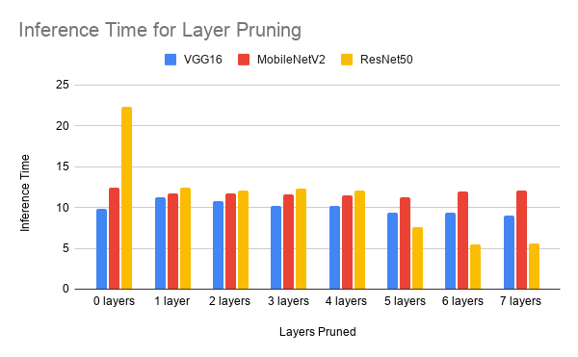
Chapter 6: System Results
System Evaluation Results
6.3 Layer pruning results for the System:
The Results of evaluating the trained models of layer pruning across VGG16, ResNet50 and MobileNetV2 are shown below,
Slide 12 of 14

Slide 16
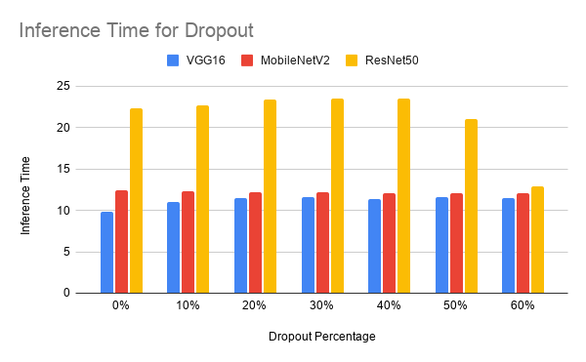
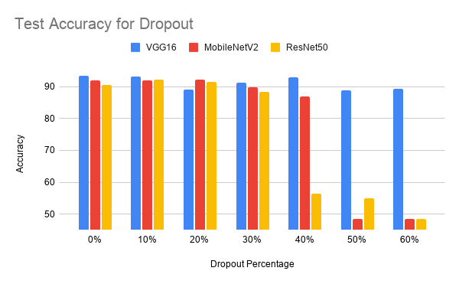
Chapter 6: System Results
System Evaluation Results
d^{[l]}∼Bernoulli(p)
100*(1-keep_prob)% of entries are zeroed out in the product step
a^{[l]} = a^{[l]}⊙d^{[l]}
6.4 Dropout results for the System:
The Results of evaluating the trained models of dropouts across VGG16, ResNet50 and MobileNetV2 are shown below,
a^{[l]} = (a^{[l]}⊙d^{[l]})/p.
Slide 12 of 14

Slide 17
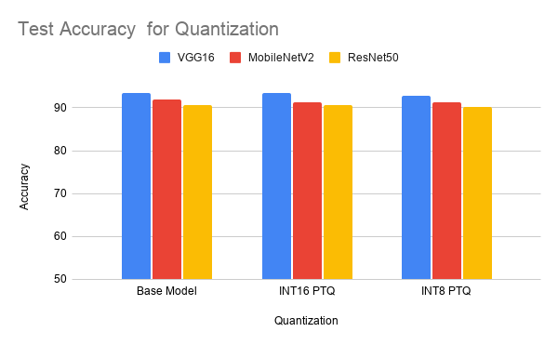
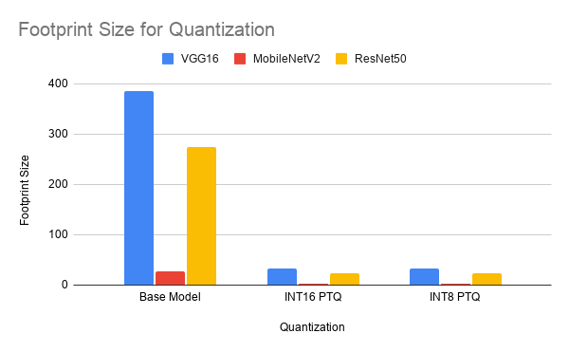
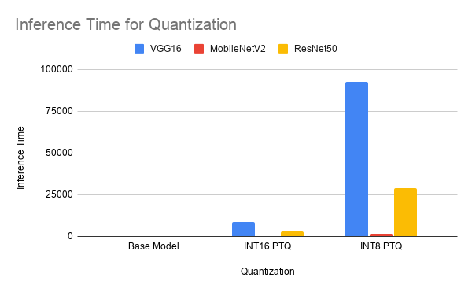
Chapter 6: System Results
System Evaluation Results
6.5 Quantization results for the System:
The Results of evaluating the trained models of quantization across VGG16, ResNet50 and MobileNetV2 are shown below,
Slide 12 of 14

Slide 18
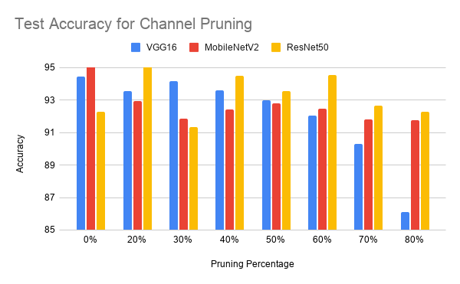
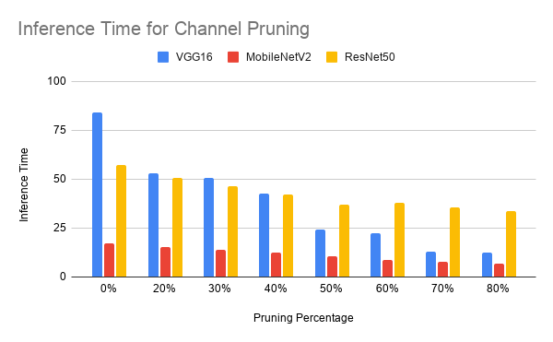
Chapter 6: TX2 Evaluation
Jetson TX2 Platform Evaluation
6.6 Channel pruning results for TX2:
The Results of evaluating the trained models of Channel pruning across VGG16, ResNet50 and MobileNetV2 are shown below.
Slide 13 of 14

Slide 19
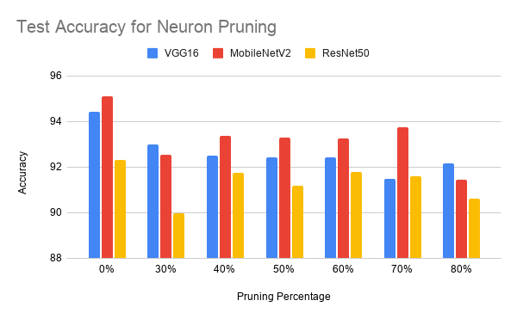
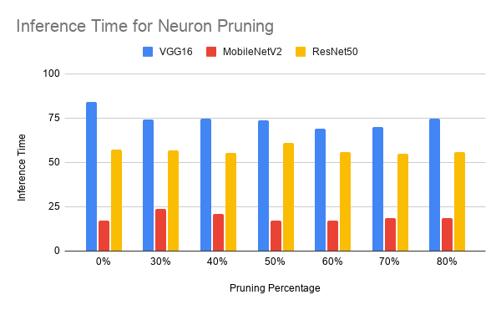
Chapter 6: TX2 Evaluation
Jetson TX2 Platform Evaluation
6.7 Neuron pruning results for TX2:
The Results of evaluating the trained models of neuron pruning across VGG16, ResNet50 and MobileNetV2 are shown below.
Slide 13 of 14

Slide 20
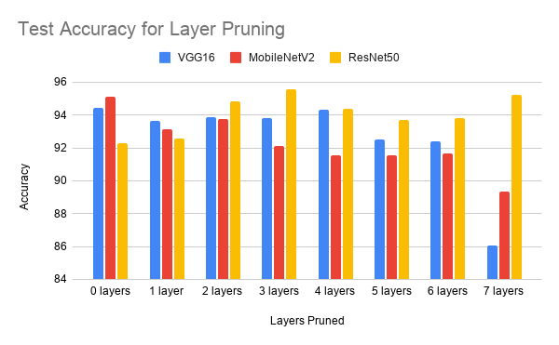
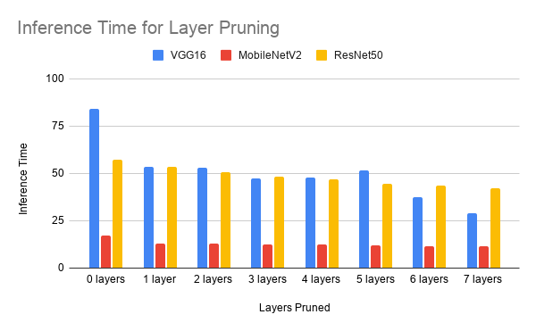
Chapter 6: TX2 Evaluation
Jetson TX2 Platform Evaluation
6.8 Layer pruning results for TX2:
The Results of evaluating the trained models of layer pruning across VGG16, ResNet50 and MobileNetV2 are shown below,
Slide 13 of 14

Slide 21
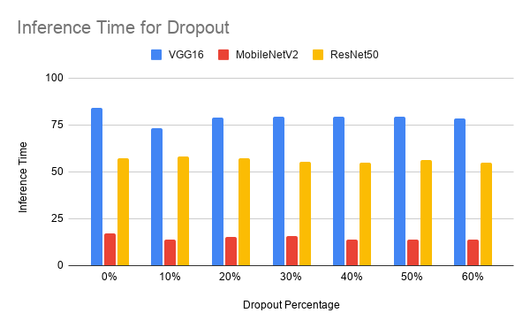
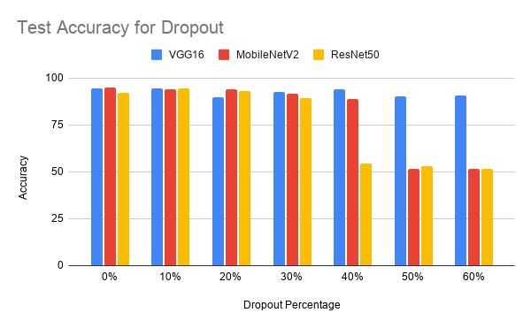
Chapter 6: TX2 Evaluation
Jetson TX2 Platform Evaluation
6.9 Dropout results for TX2:
The Results of evaluating the trained models of dropouts across VGG16, ResNet50 and MobileNetV2 are shown below,
Slide 13 of 14

Slide 22
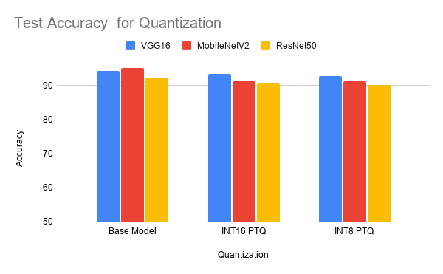
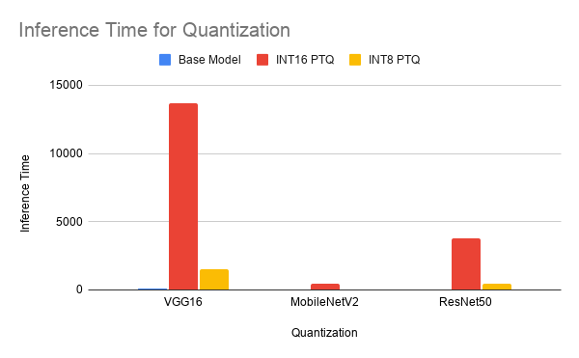
Chapter 6: TX2 Evaluation
Jetson TX2 Platform Evaluation
6.10 Quantization results for TX2:
The Results of evaluating the trained models of quantization across VGG16, ResNet50 and MobileNetV2 are shown below,
Slide 13 of 14

Slide 23

Chapter 7:
Conclusions
This project successfully developed and optimized three deep learning architectures—VGG16, ResNet50, and MobileNetV2—for binary image classification on both a standard benchmark dataset (Cats vs Dogs) and a proprietary leather defect dataset. Based on an extensive literature review, optimization techniques including channel pruning, layer pruning, neuron pruning, dropout, and post-training quantization (INT16 and INT8) were implemented and evaluated.
An automated training and optimization pipeline was developed to efficiently generate, fine-tune, and evaluate multiple optimized models. The optimized models were deployed and tested on the NVIDIA Jetson TX2 embedded platform, where their inference performance and classification accuracy were analyzed. The study demonstrates that model optimization techniques can significantly reduce computational requirements while maintaining competitive classification performance, making deep learning models more suitable for deployment on resource-constrained embedded AI systems.
Slide 14 of 14

Slide 24
Chapter 8: Recommendations
Based on the experimental findings, the following engineering guidelines are recommended for deploying lightweight deep learning models on resource-constrained platforms:
Prioritize Structured Methods: Use structured channel pruning over unstructured variants to ensure direct compatibility with standard execution hardware without requiring specialized sparse execution libraries.
Target Internal Expansion Spaces: Focus pruning operations on the internal expansion layers of inverted residual structures. These regions contain high channel redundancy and can be modified without altering residual block boundaries.
Incorporate Post-Pruning Fine-Tuning: Always integrate a targeted fine-tuning phase with a reduced learning rate following structural compression to recover accuracy lost during filter excision.
Optimize for Moderate Compression: Target compression ratios between 30% and 40% to maximize hardware efficiency while leveraging the regularization effects that improve model generalization.
Slide 14 of 14

