Slide 1
Infrastructure automation with Terraform
https://tinyurl.com/terraformclum

Slide 2
What is Infrastructure as Code?
Infrastructure as Code (IaC) is the practice of managing and provisioning infrastructure through machine-readable configuration files, rather than through manual processes.
Think of it as executable documentation.

Slide 3
IaC allows us to...
Provide a codified workflow to create infrastructure.
Change and update existing infrastructure.
Safely test changes in a dry run mode.
Integrate with application code workflows (CI/CD tools).
Provide reusable modules for easy sharing and collaboration.
Enforce security policy and organizational standards.
Enable collaboration between different teams.

Slide 4
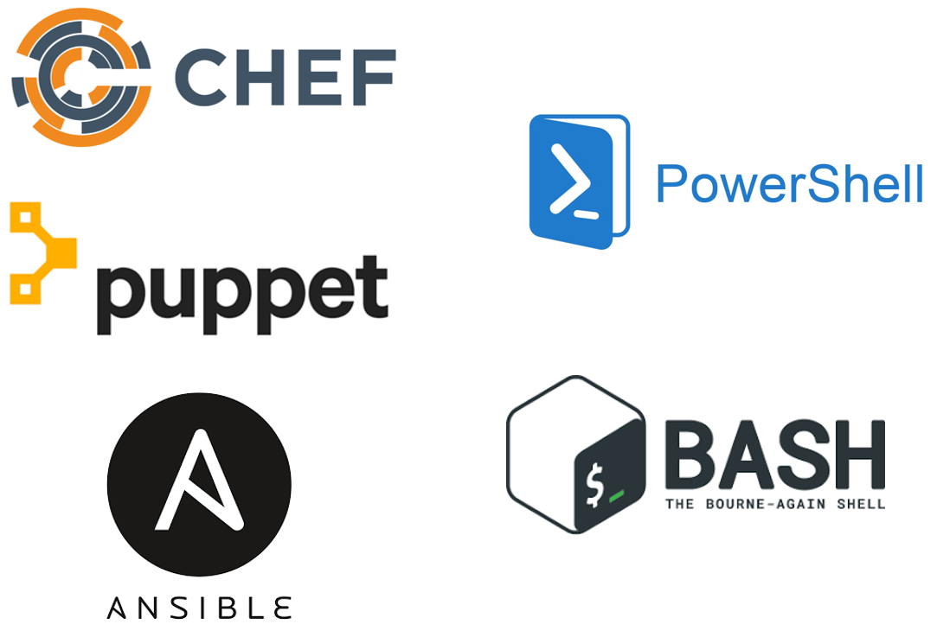
IaC Tools
These tools work well for configuring the operating system and application. However, they are not purpose-built for provisioning cloud infrastructure and platform services.

Slide 5
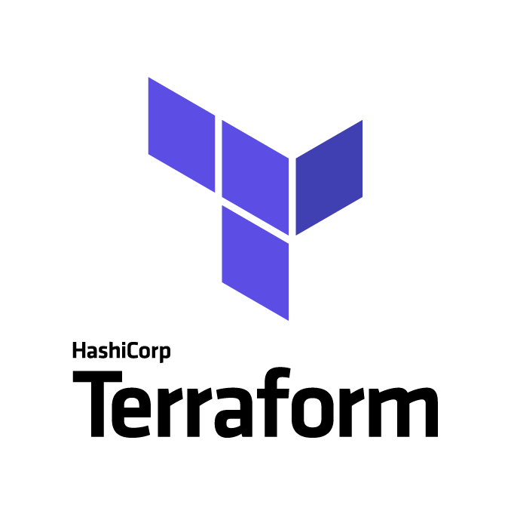
What is Terraform
Terraform is an infrastructure provisioning tool.
It ships as a single binary, which is written in Go.
Terraform is cross-platform.
Human and machine-readable.
Easy to learn, test, share, re-use, automate.
Works on all major cloud providers.
Is declarative and idempotent.
https://developer.hashicorp.com/terraform/docs

Slide 6
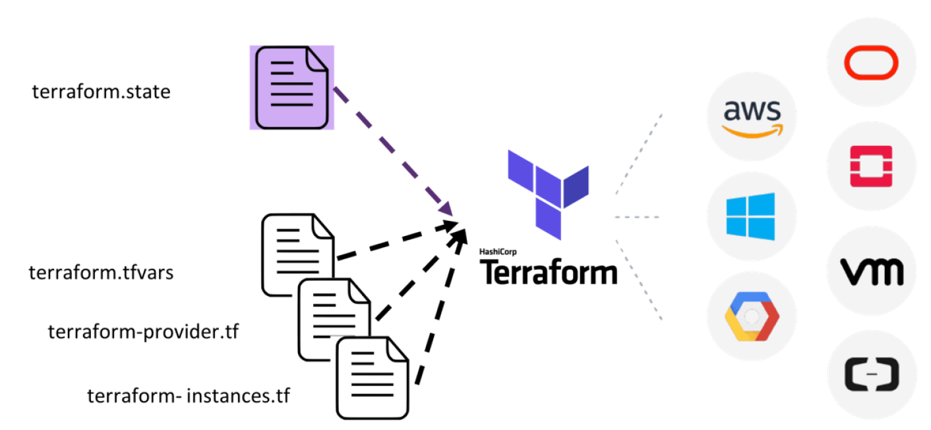
Terraform architecture

Slide 7
Terraform Configuration Language
Terraform code is based on the HCL2 toolkit. HCL stands for HashiCorp Configuration Language.
Terraform code, or simply terraform is a declarative language that is specifically designed for provisioning infrastructure on any cloud or platform.
resource "openstack_compute_instance_v2" "test" {
name = “test-vm”
image_name = “denbi-centos7-j10-2e08aa4bfa33-master”
flavor_name = “m1.tiny”
key_pair = “${openstack_compute_keypair_v2.my-cloud-key.name}”
security_groups = [“default”]
network {
name = “public”
}
}
Notes:
Declarative, meaning that they describe the end state of your infrastructure. You do not need to write step-by-step instructions to create resources because Terraform handles the underlying logic.
Declarative tools like Terraform maintain a state file that records the current state of infrastructure. This allows them to adjust only what's needed to reach the desired state. On the other hand, imperative tools like Ansible do not maintain state, leading to possible redundancy in operations.

Slide 8
Terraform Workspaces
Terraform workspace is simply a folder or directory that contains terraform code.
Terraform files always end in either a *.tf, *.tfvars, or *.tf.json extension.
Most Terraform workspaces contain a minimum of three to four files:
main.tf - Most of your functional code will go here.
variables.tf - This file is for storing variables.
outputs.tf - Define what is shown at the end of a Terraform run.
providers.tf – Cloud plugin configuration.
Notes:
A tfvars file in Terraform is used to define variable values for a Terraform configuration. It allows you to assign specific values to variables instead of hardcoding them directly in your Terraform code. The tfvars file typically has a ".tfvars" extension (e.g., "variables.tfvars").

Slide 9
Terraform Workspaces
Modules: are reusable, self-contained units of infrastructure code that define a set of resources with well-defined inputs and outputs.
Root module: is the top-level directory in a Terraform configuration, serving as the entry point that coordinates the usage of various modules to create and manage the entire infrastructure.
https://developer.hashicorp.com/terraform/language/modules

Slide 10


Terraform - Providers
A plugin to interact with the APIs of the service and access its related resources.
The Terraform core program requires at least one provider to build anything.
You can manually configure which version(s) of a provider you would like to use.
# Define required providers
terraform {
required_version = ">= 0.14.0"
required_providers {
openstack = {
source = "terraform-provider-openstack/openstack"
version = "~> 3.3.2"
}
aws = {
source = "hashicorp/aws"
version = "~> 3.0"
}
}
}
https://registry.terraform.io/providers/terraform-provider-openstack/openstack/latest/docs

Slide 11
Terraform Version Constraints
Anywhere that Terraform lets you specify a range of acceptable versions for something, it expects a specially formatted string known as a version constraint.
Version constraints are used when configuring:
Modules.
Provider requirements.
=: Match exact version number e.g., “1.0.0”, “=1.0.0”
!=: Excludes an exact version number e.g., “!= 1.0.0”
>, >=, <, <=: Compare against a specific version e.g., “>= 1.0.0”
~>: Allow only for the rightmost version (last number) to increment e.g., “~> 1.0.0” will allow “1.0.5” but not “1.1.0”
https://developer.hashicorp.com/terraform/language/expressions/version-constraints

Slide 12
Terraform - Resource
It refers to a block of one or more infrastructure objects (compute instances, virtual networks, etc.), which are used in configuring and managing the infrastructure.
Type
Name
resource "openstack_compute_instance_v2" "test" {
name = “test-vm”
image_name = “denbi-centos7-j10-2e08aa4bfa33-master”
flavor_name = “m1.tiny”
key_pair = “${openstack_compute_keypair_v2.my-cloud-key.name}”
security_groups = [“default”]
network {
name = “public”
}
}
resource: Top-level keyword type: Type of resource, e.g., openstack_compute_instance_v2 name: Arbitrary name to refer to this resource. Used internally by Terraform.
https://developer.hashicorp.com/terraform/language/resources

Slide 13
Terraform – Meta-arguments
Meta-Aguments
depends_on
count
for_each
resource "openstack_compute_instance_v2" "basic" {
name = "compute_node_${count.index}"
image_id = data.openstack_images_image_v2.ubuntu.id
flavor_name = "m1.tiny"
count = 10
}
resource "openstack_compute_instance_v2" "basic" {
for_each = {
manager = "m1.large"
worker = "m1.xxlarge"
}
name = each.key
image_id = data.openstack_images_image_v2.ubuntu.id
flavor_name = each.value
}
https://developer.hashicorp.com/terraform/language/meta-arguments
Notes:
If your instances are almost identical, count is appropriate. If some of their arguments need distinct values that can't be directly derived from an integer, it's safer to use for_each. You can’t use both count and for_each together.

Slide 14
Terraform – Meta-arguments
Meta-Aguments
depends_on
count
for_each
provider
# default configuration
provider "google" {
region = "us-central1"
}
# alternate configuration, whose alias is "europe"
provider "google" {
alias = "europe"
region = "europe-west1"
}
resource "google_compute_instance" "example" {
# This "provider" meta-argument selects the google provider
# configuration whose alias is "europe", rather than the
# default configuration.
provider = google.europe
# ...
}
https://developer.hashicorp.com/terraform/language/meta-arguments
Notes:
The provider meta-argument specifies which provider configuration to use for a resource, overriding Terraform's default behavior of selecting one based on the resource type name. Its value should be an unquoted <PROVIDER>.<ALIAS> reference.
As described in Provider Configuration, you can optionally create multiple configurations for a single provider (usually to manage resources in different regions of multi-region services). Each provider can have one default configuration, and any number of alternate configurations that include an extra name segment (or "alias").

Slide 15
Terraform – Data Source
Implemented by providers to return information on external objects to terraform.
All data sources are “read-only” and have a list of returned attributes.
Each data instance will export one or more attributes, which can be used in other resources as data.<TYPE>.<NAME>.<ATTRIBUTE>.
data "openstack_images_image_v2" "ubuntu" {
name = "Ubuntu 16.04"
most_recent = true
}
resource "openstack_compute_instance_v2" "basic" {
name = "basic"
image_id = data.openstack_images_image_v2.ubuntu.id
...
...
}
https://developer.hashicorp.com/terraform/language/data-sources
Notes:
To fetch data from a range of data sources. Dynamically fetching data makes your configuration more flexible.

Slide 16

Terraform - State
Terraform is a stateful application.
It keeps track of everything that was created.
The state file is Terraform's source of record for everything it knows about.
State files also contain sensitive information.
It’s a JSON-formatted file.
Local / Remote.
To store and retrieve state files remotely, Terraform uses the concept of a backend module to specify a bucket, key, and region to store the state information.
There is also a backup of the previous state.
terraform.tfstate
https://developer.hashicorp.com/terraform/language/state

Slide 17
Terraform – Input variable
Input Variables serve as parameters for a Terraform module, so users can customize behavior without editing the source.
Variables are placed in a file called variables.tf. Variables can have default settings.
Variable block has 5 optional arguments.
default: A default value which then makes the variable optional.
type: The argument specifies what value types are accepted for the variable.
description: Specifies the input variables documentation.
validation: A block to define validation rules, usually in addition to type constraints.
sensitive: Limits Terraform UI output when the variable is configured.
If you omit the default, the user will be prompted to enter a value.
https://developer.hashicorp.com/terraform/language/block/variable
Notes:
A variables.tf file is used to define the variables type and optionally set a default value.
A terraform.tfvars file is used to set the actual values of the variables.
You could set default values for all your variables and not use tfvars files at all.

Slide 18
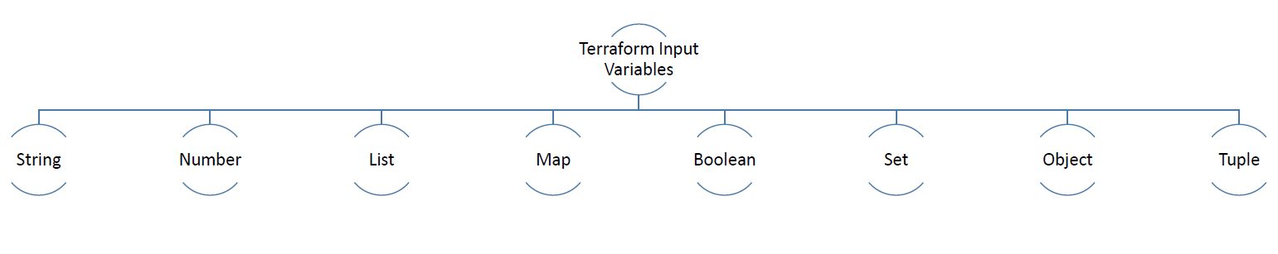
Terraform – Input variable types
variable "flavors" {
type = map
default = {
"central-manager" = m1.medium
"worker1" = m1.medium
"worker2" = m1.xlarge
"worker3" = m1.small
}
}
variable "cidr_block" {
type = string
description = "CIDR block for the network"
default = "10.0.0.0/24"
}
variable "number_of_vms" {
type = number
description = "Demo for the number"
default = 5
}
resource "openstack_compute_instance_v2" "basic" {
name = "basic"
image_id = data.openstack_images_image_v2.ubuntu.id
flavor_name = var.flavors["central-manager"]
...
...
}
https://developer.hashicorp.com/terraform/language/block/variable

Slide 19
Terraform – Output Values
Output Values are like return values for a Terraform module.
It let’s you expose information about your infrastructure.
resource "openstack_compute_instance_v2" "basic" {
name = "basic"
image_id = data.openstack_images_image_v2.ubuntu.id
flavor_name = var.flavors["central-manager"]
...
...
}
output "basic_instance_ip" {
value = openstack_compute_instance_v2.basic.access_ip_v4
}
https://developer.hashicorp.com/terraform/language/block/output

Slide 20
Terraform – Conditionals
Two methods:
Conditional expression (CONDITION ? TRUEVALUE:FALSEVALUE).
Depends on (depends_on).
resource "openstack_compute_volume_attach_v2" "attach_1" {
instance_id = openstack_compute_instance_v2.instance_1.id
volume_id = openstack_blockstorage_volume_v3.volumes.0.id
}
resource "openstack_compute_volume_attach_v2" "attach_2" {
instance_id = openstack_compute_instance_v2.instance_1.id
volume_id = openstack_blockstorage_volume_v3.volumes.1.id
depends_on = ["openstack_compute_volume_attach_v2.attach_1"]
}
resource "openstack_compute_instance_v2" "basic" {
….
count = “${var.environment == ‘prod’ ? 2:1}”
...
...
}
https://developer.hashicorp.com/terraform/language/expressions/conditionals
Notes:
Use the depends_on meta-argument to handle hidden resource or module dependencies that Terraform can't automatically infer.
Explicitly specifying a dependency is only necessary when a resource or module relies on some other resource's behavior but doesn't access any of that resource's data in its arguments.

Slide 21
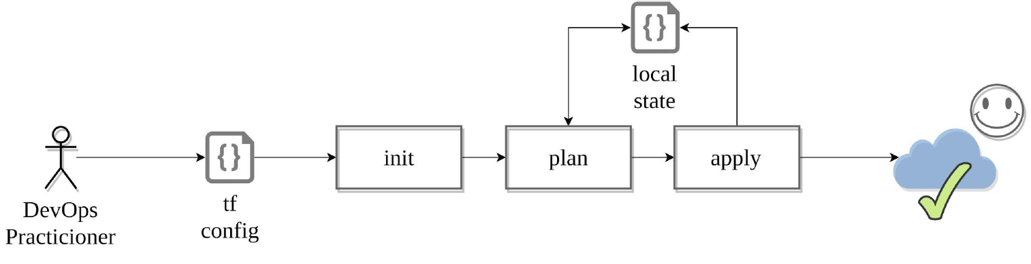
Terraform Workflow
https://developer.hashicorp.com/terraform/intro/core-workflow

Slide 22
Terraform Command Line
The commands are the same whether you are on Linux or Windows or MacOS.
Terraform has subcommands that perform different actions.
# Basic Terraform Commands
terraform version
terraform help
terraform init
terraform plan
terraform apply
terraform destroy
https://developer.hashicorp.com/terraform/cli/commands

Slide 23
Terraform CLI: init
Initialization Process:
terraform init initializes a new or existing Terraform configuration.
Downloads the necessary providers and modules.
Set up the working directory for Terraform operations.
First command you typically run when starting a new project or working with an existing one.
Backend Configuration:
terraform init is where you define and configure the backend, specifying where Terraform should store its state file. Proper backend configuration is vital for collaboration and state management.
Lock file generation:
To coordinate access to the state file if multiple users are working on the same infrastructure.
https://developer.hashicorp.com/terraform/cli/commands

Slide 24
Terraform CLI: init
$ terraform init
Initializing the backend...
Initializing provider plugins...
- Reusing previous version of terraform-provider-openstack/openstack from the dependency lock file
- Installing terraform-provider-openstack/openstack v1.48.0...
- Installed terraform-provider-openstack/openstack v1.48.0 (self-signed, key ID 4F80527A391BEFD2)
Partner and community providers are signed by their developers.
If you'd like to know more about provider signing, you can read about it here:
https://www.terraform.io/docs/cli/plugins/signing.html
Terraform has been successfully initialized!
Terraform fetches all required providers and modules, storing them in the .terraform directory.
If you add, change, or update your modules or providers, you will need to rerun the init command.
https://developer.hashicorp.com/terraform/cli/commands

Slide 25
Terraform CLI: plan & apply
The terraform plan examines the Terraform configuration, detailing the changes it will make to infrastructure (preview changes).
The terraform apply then executes those planned changes, applying them to create, modify, or destroy resources as needed.
$ terraform plan
Terraform used the selected providers to generate the following execution plan. Resource actions are indicated with the following symbols:
+ create
Terraform will perform the following actions:
# openstack_compute_keypair_v2.my-cloud-key will be created
+ resource "openstack_compute_keypair_v2" "my-cloud-key" {
+ fingerprint = (known after apply)
+ id = (known after apply)
+ name = "clum_key"
+ private_key = (known after apply)
+ public_key = "XXXX"
+ region = (known after apply)
+ user_id = (known after apply)
}
Plan: 1 to add, 0 to change, 0 to destroy.
https://developer.hashicorp.com/terraform/cli/commands

Slide 26
Terraform CLI: destroy
terraform destroy dismantles all resources defined in the Terraform configuration, effectively tearing down the infrastructure.
It prompts for confirmation before initiating the removal process and provides a summary of the destroyed resources upon completion.
$ terraform destroy
Terraform will perform the following actions:
# openstack_compute_instance_v2.example_instance will be destroyed
…
…
…
…
Plan: 0 to add, 0 to change, 1 to destroy.
https://developer.hashicorp.com/terraform/cli/commands

Slide 27
Terraform CLI: others
terraform fmt: automatically formats Terraform configuration files to adhere to a consistent style, promoting clean and readable code by standardizing indentation, spacing, and syntax.
Terraform graph: generates a visual representation of the Terraform resource dependency graph, aiding in understanding and troubleshooting complex infrastructures by illustrating how resources are connected and dependent on each other.
terraform outputs: displays the output values defined in a Terraform configuration, providing a quick way to retrieve and view important information about the deployed infrastructure, such as IP addresses or endpoint URLs.
https://developer.hashicorp.com/terraform/cli/commands

Slide 28
Terraform CLI: others
terraform taint: marks a resource for recreation during the next terraform apply, forcing Terraform to destroy and recreate the specified resource, useful for triggering updates or troubleshooting specific components.
terraform untaint: removes the taint mark from a resource, allowing it to be managed normally in subsequent terraform apply operations, useful for reverting the forced recreation status applied by terraform taint.
terraform refresh: Sometimes infrastructure may be changed outside of Terraform's control. The state file represents the last known state of the infrastructure. If you'd like to check and see if the state file still matches what you built, you can use the terraform refresh command. Note that this does not update your infrastructure, it simply updates the state file.
https://developer.hashicorp.com/terraform/cli/commands

Slide 29
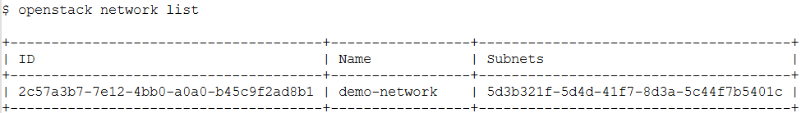
Terraform CLI: others
terraform import: imports existing resources into Terraform.
resource "openstack_networking_network_v2" "demo_network" {
name = "demo-network"
}
terraform import openstack_networking_network_v2.demo_network 2c57a3b7-7e12-4bb0-a0a0-b45c9f2ad8b1
terraform plan
https://developer.hashicorp.com/terraform/cli/commands

Slide 30
Demo

Slide 31
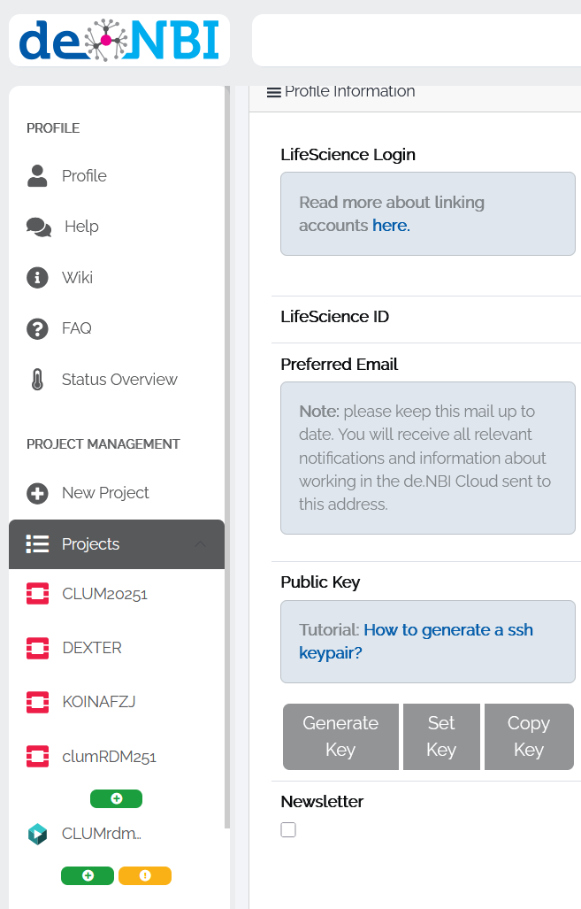
Generate SSH keys
Log in to https://cloud.denbi.de.
Go to Profile (left panel).
Click on Generate Key.
Tick the checkbox and click Set.
Download the private key and keep it safe (Not on GitHub or other public sites ;-) ).

Slide 32
Create OpenStack application credentials
Log in to https://cloud.denbi.de.
Select the CLUM20251 project on the left panel under Projects.
Click on the Login to OpenStack.
In the left panel of the OpenStack dashboard
Click on the Identity.
Click on the Application Credentials.
Click on the Create Application Credentials.
Add a Name and a Description.
Click on the Create Application Credential and download the openrc file.

