Slide 1
ReactJS - JSX

Slide 2
Overview
React uses JSX for templating instead of regular JavaScript
It is not necessary to use it, however, following are some pros that come with it.
  It is faster because it performs optimization while compiling code to JavaScript
  It is also type-safe and most of the errors can be caught during compilation.
  It makes it easier and faster to write templates, if you are familiar with HTML.

Slide 3
Using JSX
JSX looks like a regular HTML in most cases. App.jsx file: -
import React from 'react';
class App extends React.Component {
render() { return (
<div>
Hello World!!!
</div>
);
}
}export default App;

Slide 4
Nested Elements
If we want to return more elements, we need to wrap it with one container element.
Notice how we are using div as a wrapper for h1, h2 and p elements.
import React from 'react';
class App extends React.Component {
render() {
return (
<div>

Slide 5
Nested Elements
<h1>Header</h1>
<h2>Content</h2>
<p>This is the content!!!</p>
</div>
);
}
}
export default App;

Slide 6
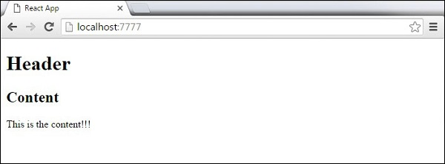

Slide 7
Attributes
We can use our own custom attributes in addition to regular HTML properties and attributes.
When we want to add custom attribute, we need to use data- prefix.
In the following example, we added data-myattribute as an attribute of p element.

Slide 8
Attributes
import React from 'react';
class App extends React.Component {
render() {
return (
<div>
<h1>Header</h1>
<h2>Content</h2>
<p data-myattribute = "somevalue">This is the content!!!</p>
</div>
);
}
}export default App;

Slide 9
JavaScript Expressions
Recommend one or several strategies
Give a summary of the expected results
Name the next steps to be taken
Delegate the various tasks

