Slide 1
Student Grade Management System
By Sanjay S Sathyabama Institute of Science and
Technology

Slide 2
Introduction
The Student Grade Management System is a software project designed to simplify the process of managing student academic performance. It enables easy grade calculation, record management, and performance tracking through both a console- based Java application and a web-based interface.

Slide 3
Objectives
- Automate the management of student grades.
- Eliminate manual calculation errors.
- Provide both console and web-based interfaces.
- Improve efficiency and accessibility for teachers and students.

Slide 4
System Versions
1. Java Terminal-Based Version:
• Operates through the command line.
• Handles student data input and grade
calculation.
2. HTML + Java Web Version:
• User-friendly interface for entering student details.
• Displays results dynamically on the

Slide 5
Features of Terminal Version
- Add, edit, and delete student records.
- Calculate total, average, and grade.
- Display all student data neatly in tabular format.
- Simple console interface with quick navigation.

Slide 6
Features of Web Version
- HTML and CSS for frontend design.
- Java Servlets for backend logic.
- Calculates and displays grades instantly.
- Simple, accessible, and responsive interface.

Slide 7
System Design
The project follows a modular structure:
Input → Processing → Output
For the terminal version, data flows through Java classes handling logic.
For the web version, client-side input is processed by server-side scripts (Servlets), and the result is rendered on the webpage.

Slide 8
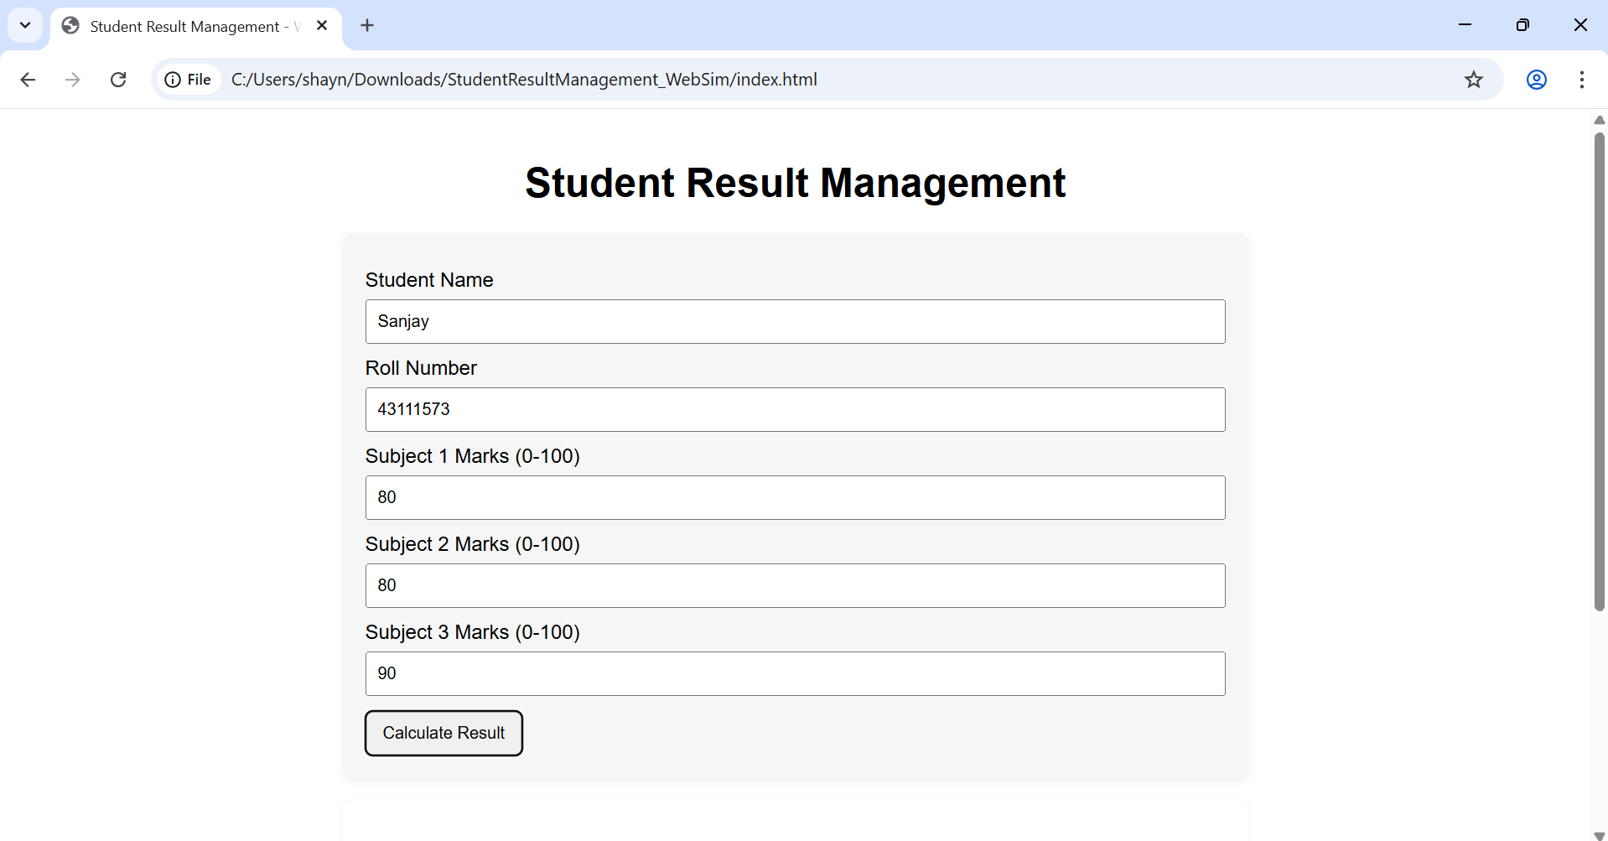
Implementation (Screenshots)

Slide 9
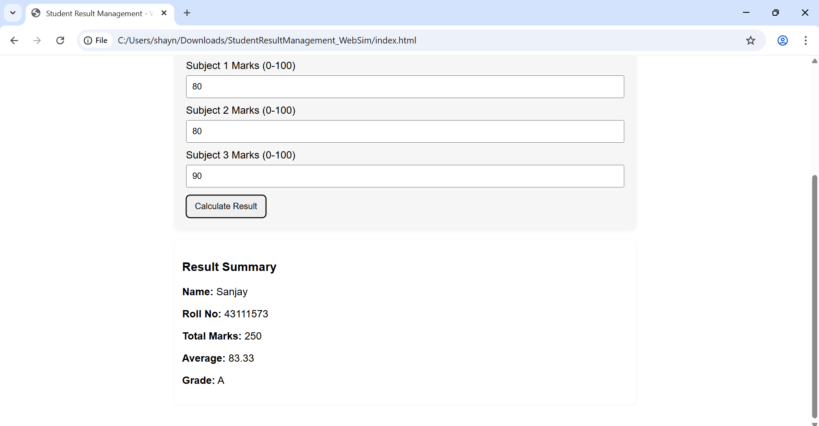

Slide 10
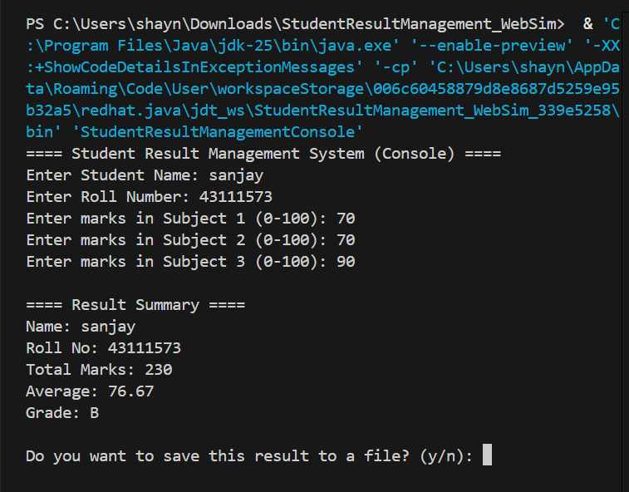

Slide 11
Results and Advantages
- Simplifies student grade tracking.
- Reduces time and manual effort.
- Improves data accuracy.
- Provides flexibility through dual modes of operation (console and web).

Slide 12
Conclusion & Future Scope
The Student Grade Management System successfully demonstrates how technology can improve academic record management.
Future enhancements:
- Integrate with a database for persistent storage.
- Add authentication and role-based access.
- Include data visualization and analytics for performance trends.

