Slide 1

SMART INDIA HACKATHON 2026
Problem Statement ID – SIH26262
Problem Statement Title - Integrated AICTE Approval Workflow Automation, Compliance Monitoring and Alert Management System
Theme - Smart Automation
PS Category - Software
Team ID - 197385
Team Name: GeoLogics

Slide 2






AICTE APPROVAL AND OPERATIONS COMPLIANCE PLATFORM
GeoLogics
PROPOSED SOLUTION
HOW IT ADDRESSES THE PROBLEM
NOVELTY OF SOLUTION
1. Auto-routing and fair assignment across APH stages by role, region and workload.
2. One deadline engine for stages, EVC, undertakings and leases; compliance evidence tracked.
3. Reminders at 30, 15, 7 days, then 3-level escalation (below).
4. Advisory entry check: flags inconsistent form values; never blocks submission.
5. Versioned rules: changes apply to new applications; in-flight cases keep the version they started with.
1. No silent pendency; every case has an owner, a clock and a reason
2. EVC never missed; queue, committee proposal, escalation
3. Undertakings and leases linked to due dates and a verifier
4. Automatic alerts and reports for every officer level
5. Human oversight; only the competent authority decides, never the scrutiny officer
1. Action Center: why, who and by when, for every role
2. Fair clock: pauses while the college holds the case
3. Explainable assignment: each task shows why that officer
4. Tamper-evident audit: enforced by the database, hash-chained
5. Self-hosted; ML check: Isolation Forest, advisory only, never blocks submissions (0.97 precision, 0.89 recall on 2,000 synthetic forms)
ESCALATION LADDER
day offsets are configurable
Level 1 · Day +3 overdue
Senior officer notified
Level 2 · Day +7 overdue
Super senior officer notified
Level 3 · Day +14 overdue
HoD notified, copy to competent authority
Submit
Scrutiny
EVC
SAC/SHC
Decision
Compliance
Closed

Slide 3
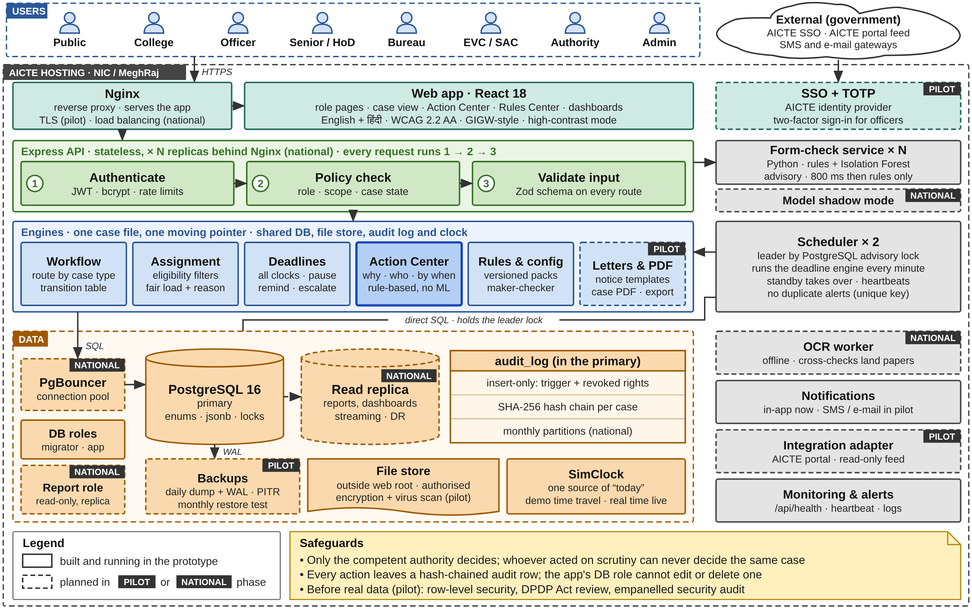








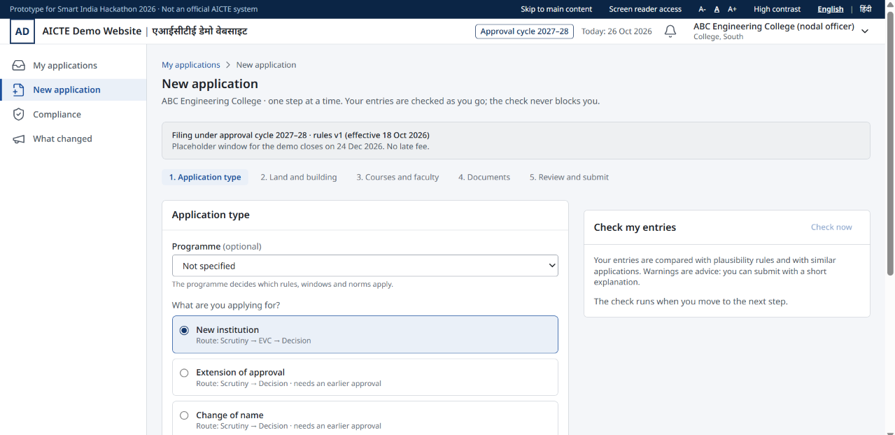
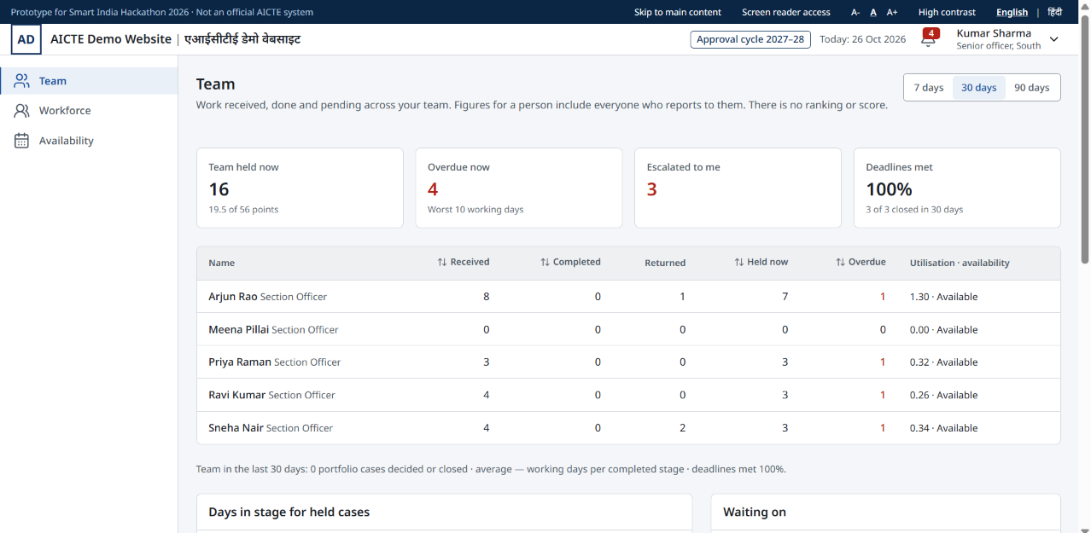

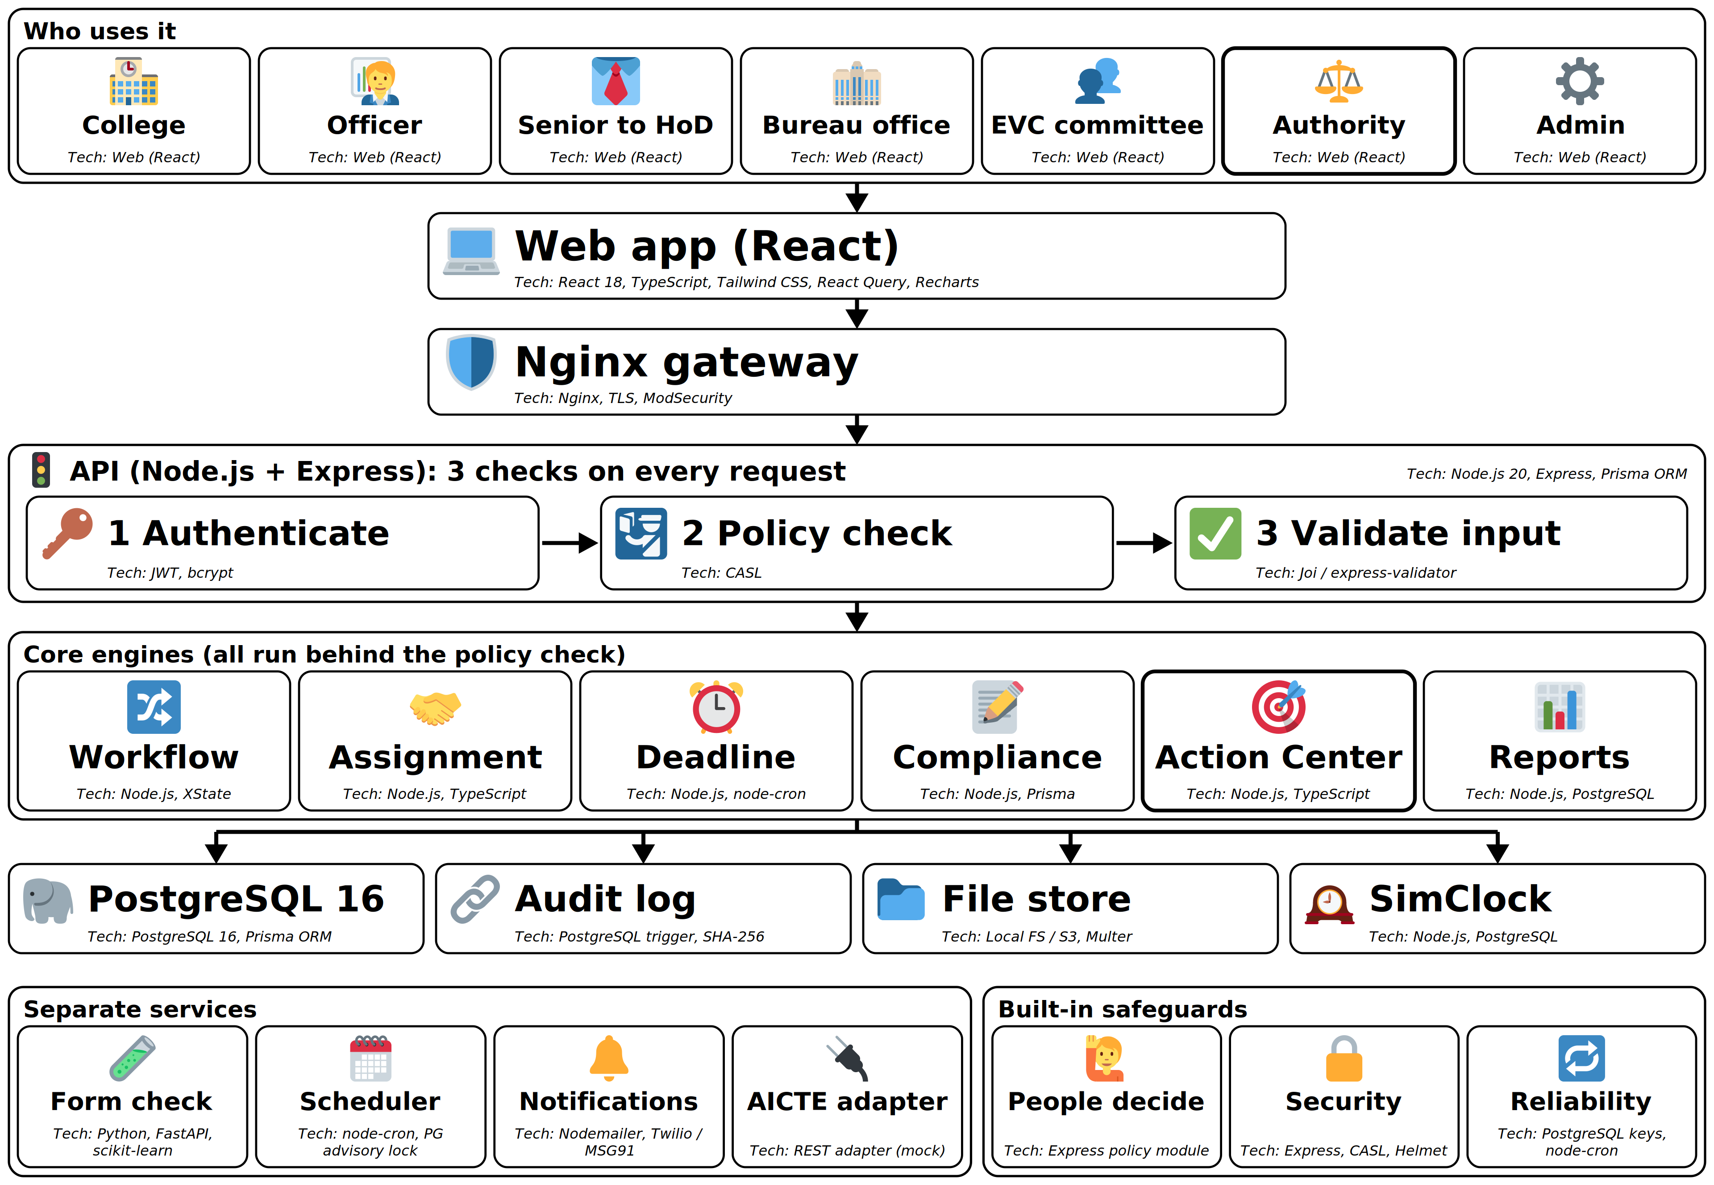
TECHNICAL APPROACH
GeoLogics
SYSTEM ARCHITECTURE: TECH STACK:
PostgreSQL 16 Prisma ORM React 18 Express.js
Tailwind.css Nginx Node.js 22 TypeScript
Demo: prototype, ~40% implemented
Prototype link:
Click here!
Demo Video link:
Click here!

Slide 4
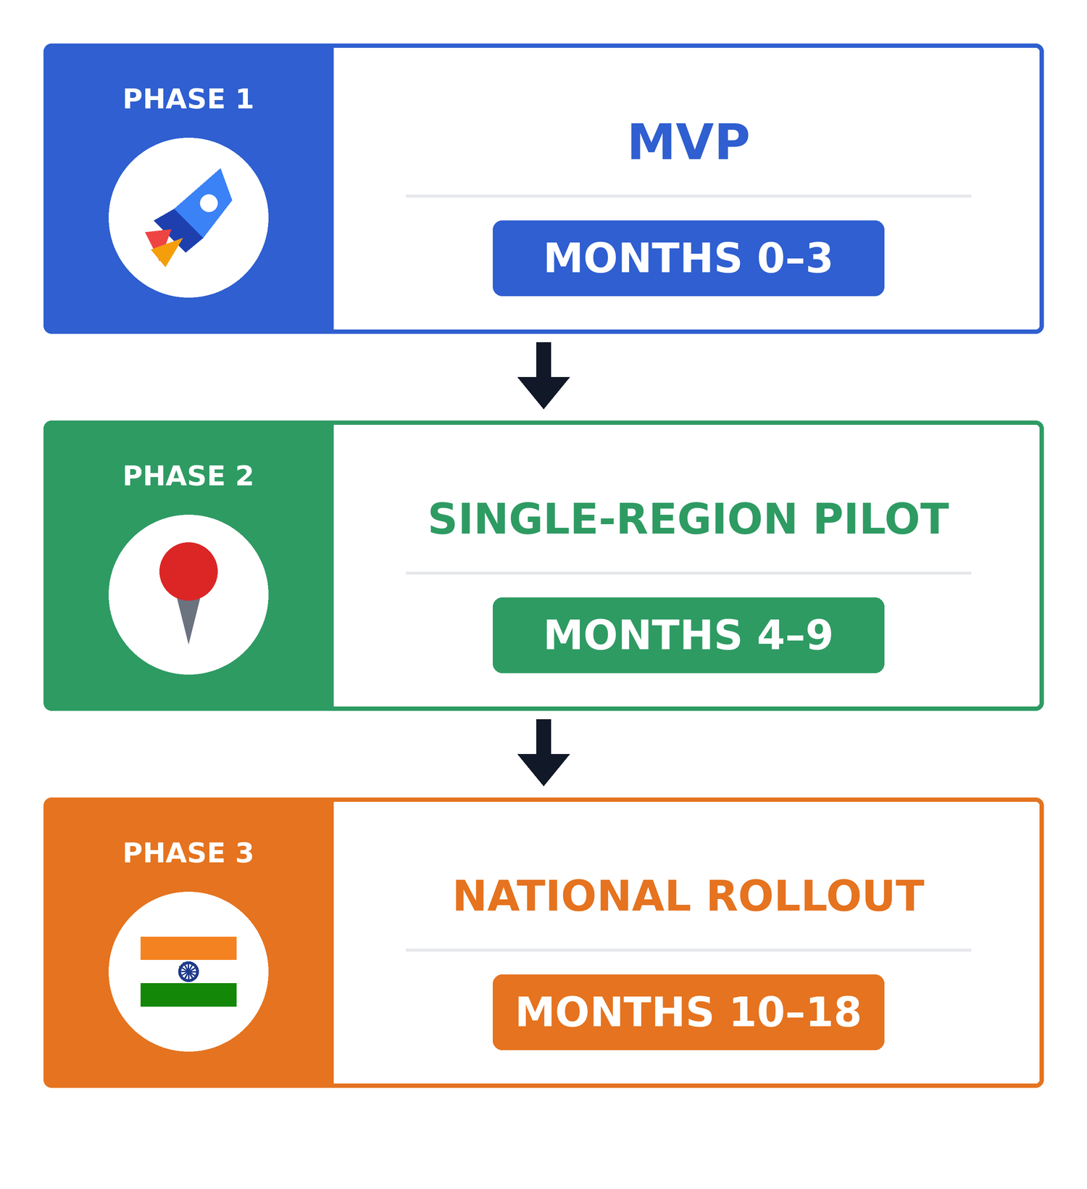






FEASIBILITY AND VIABILITY
GeoLogics
FEASIBILITY-PHASED ROADMAP AND INDICATIVE COST
VIABILITY
Hardened prototype: stage routing, deadline engine, in-app Action Center, SimClock demo, mock AICTE adapter.
Users
Colleges, scrutiny officers, senior officials, EVC committees and competent authorities.
Operational value
Clearer pendency, fewer manual follow-ups and traceable decisions. In simulation, peak officer load 0.98 vs 1.59 for random assignment.
One AICTE regional office on real cases via CSV / read-only feed; email + SMS alerts; baseline for impact metrics.
Scalability
Sized for (assumed) 15,000 applications/cycle and 50,000 alerts/day on primary + replica DB, 2 app nodes; scale by adding nodes.
Cost approach
Open-source stack, no licence fees. Hosting, upkeep and integration costs are estimated at left.
All regional offices on NIC/MeitY cloud; live API integration if offered; high availability, DR and officer training.
CHALLENGES AND MITIGATION
CHALLENGES | MITIGATION STRATEGIES
Changing AICTE rules | Configurable rule engine with versioned updates
Portal integration | Modular adapter layer; mock adapter for demo
Data accuracy | Validation, mandatory fields and audit trail
Missed deadline alerts | Idempotent scheduler, retries and monitoring
Unauthorized access | Role-based access, strong auth and audit logs
ML data availability | Synthetic data, unsupervised model; advisory only
INDICATIVE COST (to be validated with NIC/AICTE)
Hosting: ₹3–6 lakh/yr pilot; ₹12–20 lakh/yr national (HA + backups)
Maintenance: ₹10–18 lakh/yr (small support team, patches)
Integration: ₹5–10 lakh one-time (AICTE adapter, SMS/email gateway)
SECURITY AND DATA RESIDENCY: self-hosted on Indian government cloud (NIC / MeitY-empanelled), data stays in India; encryption at rest (AES-256) and in transit (TLS 1.2+); role-based access and audit logs. Before real data: officer 2FA, AICTE SSO, row-level security, DPDP Act review and a security audit.

Slide 5




IMPACT AND BENEFITS
GeoLogics
1
1
Colleges
See status, deficiencies and deadlines in one place and submit evidence online, in English or Hindi.
IMPACT
BENEFITS
Social
Timely approvals before the academic year; clearer status and deadlines for colleges. Paperless: fewer couriered files.
2
2
Officers
Start from a prioritised queue with visible ageing, standard letters and one workspace.
Economic
Target: manual follow-up effort cut ~50% (about 3 officer-hours saved per case, ~45,000 hours per cycle). Assumes 15,000 applications/cycle and ~6 hours of manual follow-up per case today. (demo load tested)
3
3
Committees (EVC, SAC, SHC)
Assigned cases, checklists, schedules and recommendation forms in one workspace.
Governance
Target: median pendency 60 → 40 days (−33%) and 100% of overdue cases escalated within 3 days. Assumes a 60-day baseline, to be confirmed in the pilot. Every action is audit-logged.
4
4
Authority and admin
Pendency, workload and escalation views; rules edited without code.
Measurement
Owner: AICTE Authority, quarterly, from Action Center reports vs pilot baseline. Criteria: pendency days, follow-ups per case, overdue cases escalated.
LOAD TESTED
15,000 applications · 0 errors
0 duplicate alerts · median 0.3–3 s

Slide 6








RESEARCH AND REFERENCES
GeoLogics
AICTE Approval Process Handbook
Regulatory Stages • EVC • SAC/SHC • Compliance
MARKET BENCHMARKING: VS EXISTING AICTE PORTAL
Workflow Area | Existing AICTE Portal | Our Proposed Solution
Application routing | Online filing; email/CSS follow-ups | Configurable stage-based routing
Deadline monitoring | No per-case SLA clock | Per-case SLA clock, reminders, escalation
Overdue cases | Manual review of reports | Action Center with owner and next action
Post-approval compliance | Tracked outside the portal | Undertaking and document-expiry tracking
Accountability | No tamper-evident trail | Hash-chained, timestamped audit trail
Final approval decision | Authorised human | Authorised human — retained
Workflow Automation
Application Routing • Scrutiny • Returns • Re-scrutiny
Deadline & Escalation Engine
Reminders • SLA Monitoring • Overdue Alerts
Auditability & Human Oversight
Traceable Actions • Evidence Verification • Human Decisions
REFERENCES
LINKS
1. AICTE, Approval Process Handbook 2024–25 to 2026–27.
2. PIB, Govt. of India, AICTE releases Approval Process Handbook (6 Dec 2023).
3. AICTE, Public Notice for Approval Process 2026–27, No. AICTE/Regulation Bureau/AP/2026-27 (26 Nov 2025).
4. AICTE, Corrigendum to the Approval Process 2026–27 (2 Dec 2025).
5. MeitY, Guidelines for Indian Government Websites and Apps (GIGW 3.0), 2023.
6. Govt. of India, Digital Personal Data Protection Act, 2023 (No. 22 of 2023).
7. W3C, Web Content Accessibility Guidelines (WCAG) 2.2, 2023.
8. Liu, Ting and Zhou, Isolation Forest, IEEE ICDM 2008.
1) AICTE Approval Handbook
Official · AICTE
4) 2026–27 Corrigendum
Official · AICTE (aicte.gov.in)
2) PIB Announcement
Official · Govt. of India (PIB)
5) GitHub Repository of Prototype:
Click here!
3) 2026–27 Public Notice
Official · AICTE (aicte.gov.in)
6) Video Demo of the Prototype:
Click here!
@GeoLogics
6

