Slide 1
NAME :SANJAYVIGNESH.A.S III RD YEAR B.E COMPUTER SCIENCE REG NO.-211521104140

Slide 2
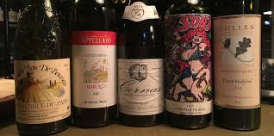
TNSDC-GENERATIVE AI
LIQUOR Quality Prediction

Slide 3
AGENDA
PROBLEM STATEMENT
PROJECT OVERVIEW
WHO ARE END USERS?
SOLUTION AND ITS VALUR PROPORTIONS
OBJECTIVE
DATA DESCRIPTION
MODELLING
RESULTS
REFRENCES

Slide 4
PROBLEM STATEMENT
In industries, understanding the demands of liquor safety testing can be a complex task for the laboratory with numerous analytes and residues to monitor.
But, our application's prediction, provide ideal solutions for the analysis of wine, which will make this whole process efficient and cheaper with less human interaction.

Slide 5
WHO ARE THE END USERS?
liquor makers: liquor makers can use quality prediction models to optimize their production processes, improve the quality of their wines, and make informed decisions about harvesting, fermentation, aging, and blending.
liquor consumers: liquor enthusiasts and consumers may use quality prediction tools to make informed purchasing decisions, select wines that match their preferences, and explore new varieties or regions.
liquor retailers: Retailers can utilize quality prediction models to recommend wines to customers, manage inventory effectively, and ensure the quality of the wines they sell.
Restaurants and sommeliers: Restaurants and sommeliers can benefit liquor quality prediction models to curate wine lists, offer personalized recommendations to patrons, and ensure consistency in the liquor they serve.

Slide 6
PROJECT OVERVIEW
About liquor :
Wine is a beverage made from fermented grape and other fruit juices with lower amount of alcohol content.
Quality of wine is graded based on the taste of wine and vintage. This process is time taking, costly and not efficient.
A wine itself includes different parameters like fixed acidity, volatile acidity, citric acid, residual sugar, chlorides, free sulphur dioxide, total sulphur dioxide, density, pH,sulphates, alcohol and quality.

Slide 7
YOUR SOLUTION AND ITS VALUE PROPOSITION
Precision and Accuracy: Our prediction model utilizes advanced machine learning algorithms trained on comprehensive datasets encompassing various wine characteristics and quality ratings. This ensures that the predictions are precise and reliable, empowering users to make informed decisions with confidence.
Optimized Production Processes: Winemakers can leverage our solution to optimize their production processes at every stage, from grape cultivation to bottling. By predicting wine quality early in the production cycle, winemakers can adjust factors such as harvesting time, fermentation techniques, and blending strategies to enhance overall quality and consistency.
Enhanced Consumer Experience: Wine consumers benefit from our solution by gaining access to personalized recommendations tailored to their preferences and taste profiles. Whether selecting wines for a special occasion or exploring new varieties, consumers can rely on our predictions to discover high-quality wines that match their palate.

Slide 8
OBJECTIVE
Our main objective is to predict the wine quality using machine learning through Python programming language.
A large dataset is considered and wine quality is modelled to analyse the quality of wine through different parameters like fixed acidity, volatile acidity etc.
All these parameters will be analysed through Machine Learning algorithms like random forest classifier algorithm which will helps to rate the wine on scale 110 or bad good.
Output obtained would further be checked for correctness and model will be optimized accordingly.
It can support the wine expert evaluations and ultimately improve the production.

Slide 9
DATA DESCRIPTION
The dataset contains chemical descriptions of 6499
Portuguese "Vinho Verde" wines.
There are 4899 entries for white wine, and 1600 entries for red wines.
The source of the data is taken from the UCI Machine Learning Repository, provided by Paulo Cortez, from the University of Minho, Portugal.

Slide 10
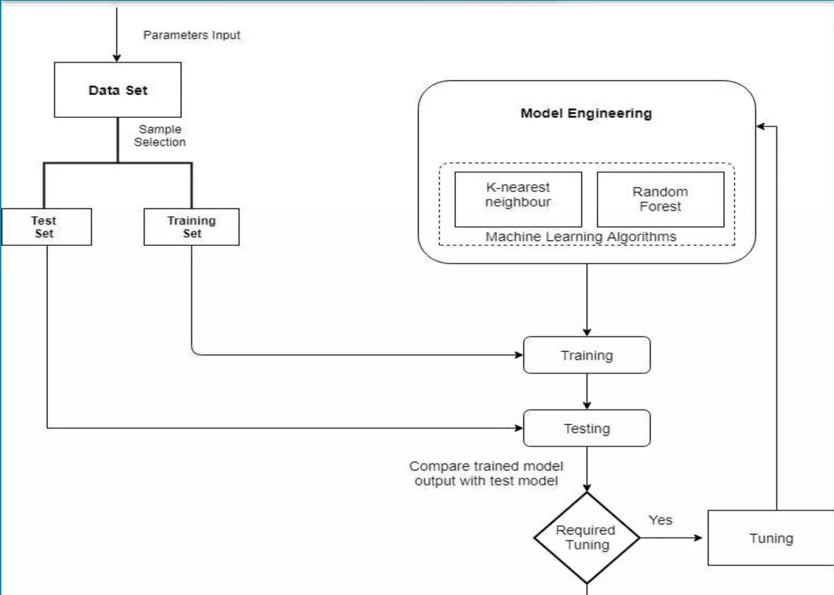
MODELLING

Slide 11
APPLICATION
Results will be used by the wine manufacturers to improve the quality of the future wines.
Certification bodies can also use the result for quality control.
Results can be used to make wine selection guides for wine magazines.
Results can be used by consumers for wine selection

Slide 12
RESULT
Data Collection: Gather a dataset containing various attributes of wines such as acidity, residual sugar, pH level, alcohol content, and more. Additionally, include the quality rating of each wine, which can be subjective (e.g., rated by experts) or objective (e.g., based on chemical analysis).
Data Preprocessing: Clean the dataset by handling missing values, outliers, and inconsistencies. Normalize or scale the features to ensure they're on a similar scale, which can improve the performance of the prediction model.
Feature Selection/Engineering: Identify the most relevant features that contribute to wine quality prediction. This may involve techniques such as correlation analysis, principal component analysis (PCA), or domain knowledge-based feature engineering.
Model Selection: Choose an appropriate machine learning algorithm for wine quality prediction. Commonly used algorithms include linear regression, decision trees, random forests, support vector machines (SVM), or more advanced techniques like gradient boosting and neural networks.

Slide 13
REFRENCES
[1] Y. Er, "The Classification of White Wine and Red Wine According to Their Physicochemical Qualities," Int. J. Intell. Syst. Appl. Eng., vol. 4, no. Speciallssue-1, pp. 23-26, 2016.
[2] E. Summary, W. P. Monitoring, W. Quality, W. Safety, and W. Complexity, "Wine Analysis: from 'Grape to Glass' An analytical testing digest of the wine manufacturing process," 2016.
[3] A. Ghosh, "Project Report: -Red Wine Quality Analysis Final 3. An empirical Red Wine
Quality Analysis of the Portuguese Vinho Verde' wine," no. December 2017, 2018.
[4] Y. Gupta, "Selection of important features and predicting wine quality using machine learning techniques," Procedia Comput. Sci., vol. 125, pp. 305-312, 2018.
[5] P. Model, L. Regression, and R. Studio, "Building and Evaluating a Predictive Model w/ Linear Regression in RapidMiner Studio," 2018.
[6] B. Tajini and O. C. Paris, "Badr Tajini - On Campus Paris - DSTI 2017," vol. 47, no. 4, pp. 547-553, 2017.

