Slide 1

SQL SERVER TO DATABRICKS AI MIGRATION FACTORY
What is the Application?
AI-Enhanced SQL Server to Databricks Lakehouse Migration • Automating Medallion Data Pipelines
• Overview: A high-efficiency enterprise migration factory designed to parse SQL Server schema objects, translate T-SQL constructs, and generate production-grade Databricks Medallion lakehouse pipelines.
• The Problem It Solves:
– Legacy T-SQL Incompatibilities: SQL Server relies heavily on proprietary features (IDENTITY columns, T-SQL stored procedures, triggers, custom scalar functions) that fail directly on Spark/Delta Lake.
– Manual Medallion Engineering Overhead: Manually creating Bronze ingestion DDLs, Silver cleansing joins, and Gold star-schema dimensions takes weeks of error-prone, repetitive SQL drafting.
• How AI Simplifies the Process:
✓ Zero-Hallucination Grounding: Every table, column, and foreign key reference is validated against immutable source discovery snapshots — no invented identifiers.
✓ Intelligent Medallion Synthesis: Automatically synthesizes Bronze Delta tables, Silver clean & joined views, Databricks SQL scalar functions, and idempotent MERGE workflows.
✓ Governed Clarification Gates: Identifies business ambiguities (e.g. completed status values, fact grain, SCD Type 1 vs. Type 2) and prompts for architect approval before execution.
AI DATABRICKS TRANSLATION ENGINE
Automated conversion flow: Converts SQL Server tables, stored procedures, multi-table joins, and complex scalar functions into production-ready Databricks Delta tables, clean views, and idempotent MERGE workflows.
SQL Server to Databricks Migration Factory | AI-Enhanced Lakehouse Modernization Platform | Slide 1 of 3

Slide 2
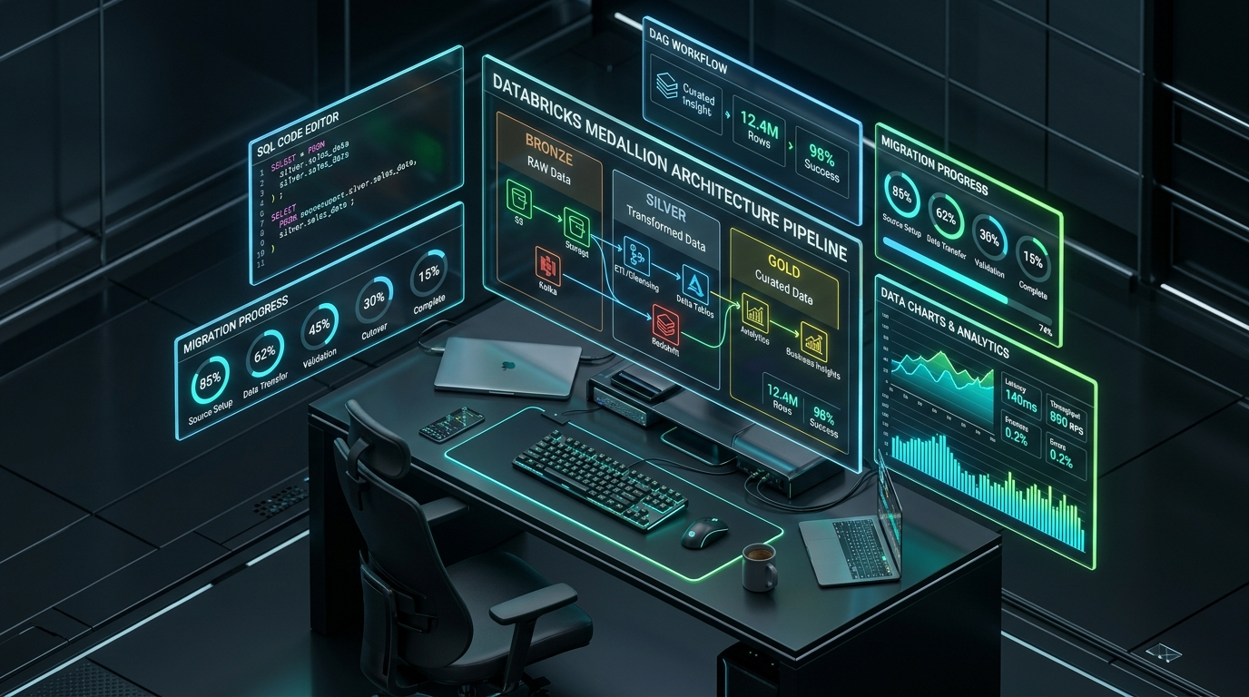
SQL SERVER TO DATABRICKS AI MIGRATION FACTORY
Application Features
Core Features & Governed Migration Workflow • Vite Studio, Syntax Mapping & Lakehouse Customization
• Vite-Powered Migration Studio: Interactive developer console featuring visual 6-stage lifecycle stepper, topological DAG dependency ordering, and real-time schema lineage mapping.
• Automated SQL Server Features Mapped:
– Data Type Normalization: Converts SQL Server data types (datetime2 → TIMESTAMP, bit → BOOLEAN, nvarchar → STRING) and enforces snake_case column standards.
– Procedural & MERGE Logic Synthesis: Re-engineers manual batch loaders into idempotent Databricks MERGE INTO Delta operations keyed on source primary and business keys.
• Key Governed Modules:
– Plan Approval Gate & Impact Audit: Lets architects review the full Medallion DAG, column mappings, and clarification answers before committing code to Databricks.
– One-Click Target Deployment: Direct automated execution into Databricks Unity Catalog schemas (bronze, silver, gold) with compile-time verification.
VITE MIGRATION STUDIO & SANDBOX
Next-generation developer studio: Real-time visual DAG pipeline viewer, interactive clarification modals, destructive operation guardrails, and 1-click Databricks target deployment.
SQL Server to Databricks Migration Factory | AI-Enhanced Lakehouse Modernization Platform | Slide 2 of 3

Slide 3

SQL SERVER TO DATABRICKS AI MIGRATION FACTORY
Time & Cost Savings
ROI: Manual vs. Automated Migration • Slashing Developer Effort by 70% (88h to 26h)
Metric / Phase | Traditional Manual | Migration-AI-Studio
Schema & Dependency Analysis | 16 Hours | 2 Hours (Auto-Discovery)
Bronze Ingestion & Delta DDLs | 14 Hours | 3 Hours (Automated DDL)
Silver Data Cleansing & Join Views | 24 Hours | 7 Hours (Graph JOIN Synthesis)
Gold Dimension & Fact Modeling | 20 Hours | 8 Hours (Semantic Modeling)
Testing, Verification & Deploy | 14 Hours | 6 Hours (1-Click Deployment)
Total Migration Time: 88 Hours 26 Hours (62h Saved - 70% Reduction)
• Total Time Saved: 70% Reduction in developer effort (saving 62 hours per application database).
• Financial Impact:
– Developer Cost Reduction: Estimated cost saving of ₹93,000 per migrated database (calculated at standard engineering billing rate).
– Accelerated Timelines: Removes weeks of manual schema re-engineering, allowing enterprise teams to modernize entire portfolio databases at high velocity.
QUANTIFIABLE ROI & VELOCITY
Measurable financial return: Slashes migration effort from 88 hours down to 26 hours (62h saved), delivering ₹93,000 in immediate cost reduction per database at enterprise speed.
SQL Server to Databricks Migration Factory | AI-Enhanced Lakehouse Modernization Platform | Slide 3 of 3

