Slide 1
DATABASE SYSTEMS LAB • BCSE302P
InfraTrace
Service Dependency & Impact Intelligence Platform
Sanjay J (24BCE2593) • Jani Rose Lawwellman (24BCE2603)
Under the guidance of Dr Sridevi S
MySQL 8.0 • FastAPI • Vanilla JS Dashboard

Slide 2
THE PROBLEM
A Service Outage Raises Three Urgent Questions
What does this failing component depend on? — where is the fault likely to be?
What depends on this component? — who is affected, and how far does it spread?
Who owns it? — which team must be paged?
If Payment DB fails…
Payment DB
FAILED
Payment Service
hop 1
Order Service
hop 2
In most organisations this knowledge lives in spreadsheets, stale architecture diagrams, and the memory of whichever engineer has been there longest — none of it queryable.
API Gateway
hop 3
Reverse traversal of the dependency graph — the basis of blast-radius analysis (Slide 10).
2

Slide 3
WHY THIS PROJECT
Motivation
Service dependency tracking is a naturally relational problem with genuine database-design difficulty — a single coherent domain that exercises core DBMS concepts end to end, rather than as disconnected textbook exercises.
Self-referencing graph
Recursive queries
Integrity beyond CHECK
Optimisation with evidence
A component depends on components, and is depended upon by others — true graph modelling inside one table.
The dependency chain must be walked to arbitrary depth — a direct application of WITH RECURSIVE.
Cycle prevention needs to read other rows, which motivates triggers and stored functions.
Traversal and filtering patterns give a genuine, measurable reason to design indexes.
3

Slide 4
GOALS
Objectives — All Met
Normalised (BCNF) schema covering the full estate
Dependency graph as a self-referencing M:N relationship
Realistic dataset with deliberate edge cases
SQL that answers real operational questions
Multi-level blast-radius analysis via recursive CTEs
Core DBMS features: views, functions, procedures, triggers, indexes
Transactions, isolation and concurrency control, demonstrated
Query optimisation with measured before/after evidence
Database-level prevention of circular dependencies
Analysis exposed through a read-only API and dashboard
4

Slide 5
GAP ANALYSIS
Limitations of the Status Quo
Area | Problem Today
Dependency knowledge | Undocumented or stale; diagrams drift from reality
Ownership | Implicit — components quietly become unowned during reorganisation
Impact analysis | Manual — engineers reconstruct dependency chains by hand, under time pressure
Deployment & incident history | Live in separate tools; "what changed before this broke?" is hard to answer
Aggregation | Unstructured data cannot answer "which component would hurt us most?"
InfraTrace does not attempt to replace GitHub, Jira, or commercial observability platforms — it is a focused database-modelling exercise for this specific problem.
5

Slide 6
THE APPROACH
Proposed System
Model dependencies as rows, not duplicated attributes.
component (component_id) ──┐
├──► dependency (component_id FK, depends_on_id FK)
component (component_id) ──┘
Traversable
The graph can be walked with recursive SQL (WITH RECURSIVE) to any depth — blast-radius analysis.
Connected
Ownership, deployment and incident data all attach to the same component key — one join answers "what broke, what it affects, who to call".
Self-validating
Triggers reject any write that would create a cycle — the database enforces its own integrity, not application discipline.
6

Slide 7
ARCHITECTURE
System Architecture — Three Thin Layers Over One Database
Frontend
Vanilla HTML / CSS / JS
6-view dashboard + SVG graph
Backend (FastAPI)
27 read-only GET endpoints
PyMySQL — no ORM, no write paths
Database (MySQL 8.0)
10 tables · views · functions · procedures · triggers
All business logic and analysis lives here
The database is the single source of truth. The backend performs no independent business logic; the frontend performs no independent calculation — every number on screen is exactly what a view, function or procedure returned.
7

Slide 8
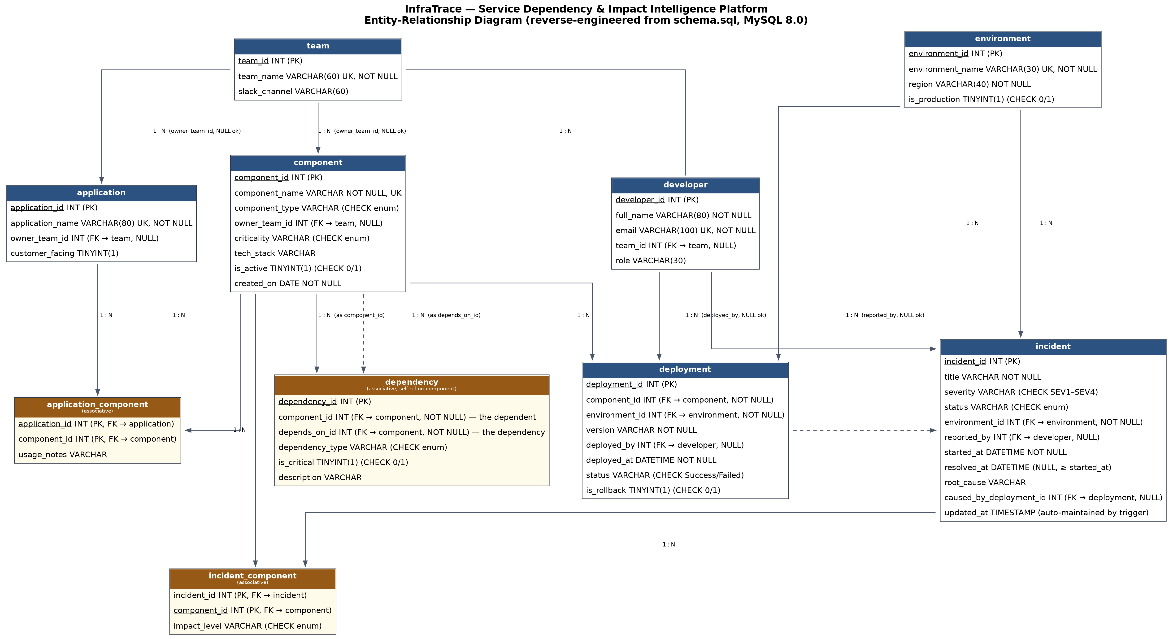
DATABASE DESIGN
Entity-Relationship Diagram
Reverse-engineered directly from schema.sql and verified table-by-table, key-by-key against the deployed DDL.
8

Slide 9
DATABASE DESIGN
Database Schema at a Glance
10
15
14
8
Tables
Foreign Keys
CHECK Constraints
UNIQUE Constraints
Ten tables, two of them pure bridges
Nullable FKs are deliberate
team, developer, application, component — core organisational and asset entities
application_component — bridge: which components an application uses (M:N)
dependency — bridge, self-referencing on component: the dependency graph itself
environment, deployment, incident, incident_component — operational history
owner_team_id — unowned is a real state
deployed_by — engineer not always recorded
caused_by_deployment_id — only a confirmed cause, never a guess
9

Slide 10
SQL IMPLEMENTATION
41 Analytical Queries, 7 of Them Recursive
Joins
Full relationship-graph traversal — component → dependency → component
Correlated subqueries
Deliberately used instead of multi-table joins to avoid row-multiplication in aggregates
Aggregates & grouping
COUNT, SUM(CASE…), GROUP BY / HAVING for ownership and incident reporting
Window functions
Incident-trend analysis (period-over-period aggregation)
Recursive CTEs
WITH RECURSIVE — 7 queries (R1–R7) walking the dependency graph up and down
WITH RECURSIVE impact (component_id, depth) AS (
SELECT d.component_id, 1 FROM dependency d WHERE d.depends_on_id = :failed_id
UNION SELECT d.component_id, impact.depth+1 FROM dependency d
JOIN impact ON d.depends_on_id = impact.component_id ) SELECT * FROM impact;
10

Slide 11
DBMS OBJECTS
Views, Functions, Procedures & Triggers
4
6
5
5
Views
Functions
Procedures
Triggers
Key stored function
Key trigger — cycle prevention
fn_would_create_cycle(p_component_id, p_depends_on_id)
Would this new edge close a dependency cycle of ANY length?
Called by both dependency triggers before every write.
trg_dependency_validate_insert / _update
BEFORE INSERT/UPDATE on dependency — SIGNALs an error and rejects
self-dependencies and any cycle. Genuine prevention, not after-the-fact detection.
Why triggers, not CHECK constraints?
A CHECK constraint may only inspect the row it is defined on — the cycle rule and the retired-component-in-production rule both need to read other rows/tables.
A column used in a CHECK may not also carry a foreign-key referential action in MySQL — ruling out even the simple self-dependency check as a CHECK.
11

Slide 12
CONCURRENCY
Transactions & Concurrency — 6 Runnable Demonstrations
01
02
03
ACID Basics
Isolation Levels
Lost Update
BEGIN, SAVEPOINT, partial ROLLBACK, COMMIT
READ COMMITTED vs REPEATABLE READ across sessions
Two sessions overwrite each other's change
04
05
00/99
Row-Level Locking
Deadlock
Setup / Teardown
SELECT … FOR UPDATE blocks a competing session
Opposite lock order → MySQL detects & aborts one transaction (error 1213)
Dedicated demo rows (id ≥ 9001) — main dataset untouched
Run manually (or via run_concurrency_demos.sh) against two live MySQL sessions — inherently timing-sensitive, so kept separate from the automated pytest/SQL suites (Slide 16).
12

Slide 13
PERFORMANCE
Indexing & Query Optimisation — Measured, Not Assumed
6 explicit indexes, each justified by a measured access pattern on a 2,000-component generated dataset (EXPLAIN ANALYZE).
Pattern | Without Index | With Index
Reverse dependency lookup | ~0.9 ms | ~0.013 ms
Recursive blast radius (rows examined) | 772,038 rows / 8.0 ms | 244 rows / 3.5 ms
Ownership audit | ~0.96 ms | ~0.04 ms
Deployment timeline MAX(deployed_at) | full scan, ~4.7 ms | optimised away — 0 rows examined
An honest negative result
An "obvious" extra composite index on incident_component made one query slower — roughly 39–46 ms → 108–111 ms across repeated runs on two platforms. Documented as evidence that plan-level reasoning is necessary but not sufficient; measurement settles the question.
13

Slide 14
APPLICATION LAYER
Backend — FastAPI, 27 Read-Only Endpoints
27
0
45
6
GET Endpoints
Write Endpoints
pytest Tests
Endpoint Groups
FastAPI + Uvicorn (ASGI) + PyMySQL — no ORM; SQL and CALLs run directly against MySQL
queries.py isolates SQL/CALL statements from route-handling code in main.py
Credentials from environment variables (.env.example checked in, no real secrets committed)
meta (1)
components (8)
organisation (5)
operations (3)
analytics (8)
graph (2)
Every route is a GET. The backend performs no independent business logic — it calls a view, function or procedure and serialises the result.
14

Slide 15
PRESENTATION LAYER
Frontend — 6-View Dashboard, No Framework
Single static HTML file · vanilla HTML/CSS/JS · hand-written SVG graph rendering · no build step
Dashboard
Components
Dependency Explorer
Platform-wide summary — component counts, ownership gaps, open incidents
Browsable, filterable list — type, criticality, ownership
Direct dependencies & dependents of a selected component
Dependency Graph
Incidents
Deployments
Rendered SVG visualisation of the full dependency graph
Incident list with severity / status
Deployment history & production infrastructure view
15

Slide 16
VERIFICATION
Testing — 211 Automated Tests
166
45
SQL Test Assertions
(6 suites — schema, constraints,
integrity, stored programs,
analytics, cycle regression)
pytest API Tests
(3 written directly in
response to real bugs
found during development)
Suite | Tests | Checks
01 schema | 37 | Every table/view/routine/trigger/index actually exists
02 constraints | 25 | CHECK/UNIQUE/NOT NULL fire on INSERT and UPDATE
03 integrity | 28 | Referential integrity & cross-table business rules
04 stored programs | 34 | Every function/procedure returns correct values
05 analytics | 22 | Analytical results are internally consistent
06 cycle regression | 20 | Cycle prevention rejects invalid edges, allows valid ones
16

Slide 17
OUTCOMES
Results — What the System Demonstrably Achieves
10-table BCNF schema deployed and internally consistent — 15 FKs, 14 CHECKs, 8 UNIQUEs, independently verified against the DDL
Dependency graph enforces its own acyclicity at write time — verified by a 20-test cycle-regression suite
41 analytical queries (7 recursive) answer real operational questions directly in SQL
Measured, order-of-magnitude index performance gains, including one honestly-reported negative result
211 automated tests exist and, per the project's own test suite structure, pass against the implementation
27-endpoint read-only API and 6-view dashboard demonstrate the analysis end to end
No screenshots were available inside the submitted project archive at audit time — none are fabricated here. A live demo of the dashboard accompanies this presentation.
17

Slide 18
WRAP-UP
Conclusion
InfraTrace is a complete, working relational model of a software organisation's infrastructure estate — where dependency and impact analysis is a query, not a manual reconstruction.
DBMS concepts demonstrated
BCNF schema design incl. self-referencing M:N
Views, procedures & functions as reusable objects
Referential integrity — FKs, CHECKs, UNIQUEs
Transactions, isolation, locking & deadlocks
Triggers & functions for rules CHECK cannot express
Evidence-based index design
Recursive SQL for graph traversal
Automated database & API testing
Honest limitations
Blast radius is an upper bound (no redundancy/failover modelling); risk score is a heuristic ranking, not a probability; correlation and confirmed cause are deliberately kept separate.
18

Slide 19
WHAT'S NEXT
Future Scope
Every item below extends the existing database — it remains fully functional without any of them.
Near-term
Later
Explicitly optional
Weight blast radius by dependency_type (async vs sync)
Model redundancy & failover
Write endpoints with authentication
Historical versioning of the dependency graph
CI pipeline running both test suites automatically
Import dependencies from service meshes / CI-CD metadata
AI-assisted natural-language querying
Automated incident correlation / anomaly detection
— layered on top of the database, not a replacement
19

Slide 20
Thank You
Questions?
InfraTrace — Service Dependency & Impact Intelligence Platform
Sanjay J (24BCE2593) • Jani Rose Lawwellman (24BCE2603) • Guide: Dr Sridevi S

