Slide 1
FusionSense
Cross-Modal Attention-Based Fusion for Real-Time Human Activity Understanding
Embedded Programming Project — Zeroth Review
24CS0836 Sanjay E • 24CS0899 Shirdithan Pon
Department of Computer Science and Engineering

Slide 2
•
Contents
1. Introduction & Problem
2. Literature Review
3. Technical Background
4. Methodology
5. Logical Design
6. Physical Design & Circuit
7. Simulation Results
8. Hardware Implementation
Goal: a working tri-modal edge HAR prototype — demonstrated on elderly fall detection.

Slide 3
1
Introduction & Problem
Real-time human activity recognition (HAR) is critical for healthcare, elderly monitoring, industrial safety and smart homes.
Single-sensor systems have blind spots: cameras fail in darkness, occlusion and raise privacy concerns; radar/IMU alone miss posture detail.
Naively averaging mismatched sensors yields conflicting signals and dangerous false fall-alarms.
Need: a dynamic, edge-computed fusion that trusts the most reliable sensor per moment — privacy-preserving, zero cloud latency.
3
sensor modalities
<300ms
target latency
0
cloud / raw video out

Slide 4
2
Literature Review
Work | Contribution | Gap FusionSense addresses
Aguileta et al. (2019) | Multi-sensor fusion beats single-sensor HAR | Traditional averaging fails when a sensor drops out
Koupai et al. (2022) | Transformer attention fuses RF + inertial data | Heavy; runs on cloud/desktop — we bring it to the edge
Cao & Wang (2023) | Lightweight Transformer for IMU HAR | Single modality — we go cross-modal (vision+IMU+radar)
Nakabayashi & Saito (2024) | Camera+IMU attention fusion on edge | Camera-dependent — we add radar for dark/private settings
Research gap: no integrated camera + mmWave + wearable-IMU edge system with reliability-aware fusion.

Slide 5
3
Technical Background
Sensing modalities
Cross-modal attention
IMU (MPU-6050): 6-DoF motion/impact. mmWave radar (LD2410): distance + micro-motion, works in the dark. Camera: posture, reduced to embeddings (no raw pixels).
Each modality → one token; a Transformer encoder lets the 3 tokens attend and re-weight each other. Cheap (attention over 3 tokens).
Sensor-health conditioning
Edge computing
Each sensor reports its own reliability (radar energy, image quality, IMU clipping); these bias the fusion's trust weights — our differentiator.
All inference local on ESP32 + Raspberry Pi; quantized model, MQTT to dashboard. Privacy + zero cloud latency.

Slide 6
4
Methodology
Acquire
IMU+radar+camera
▶
Sync into
FusionWindow (2s)
▶
Per-modality
encoders
▶
Cross-modal
attention + health
▶
Classify
activity / fall
▶
MQTT →
dashboard
Software-first: the simulator generates FusionWindows so the full model is built and validated with no hardware.
Modality-dropout during training teaches the attention to reweight; masking makes a dropped sensor contribute zero.
Same FusionWindow contract for simulated and real sensors — hardware swaps in without changing the model.

Slide 7
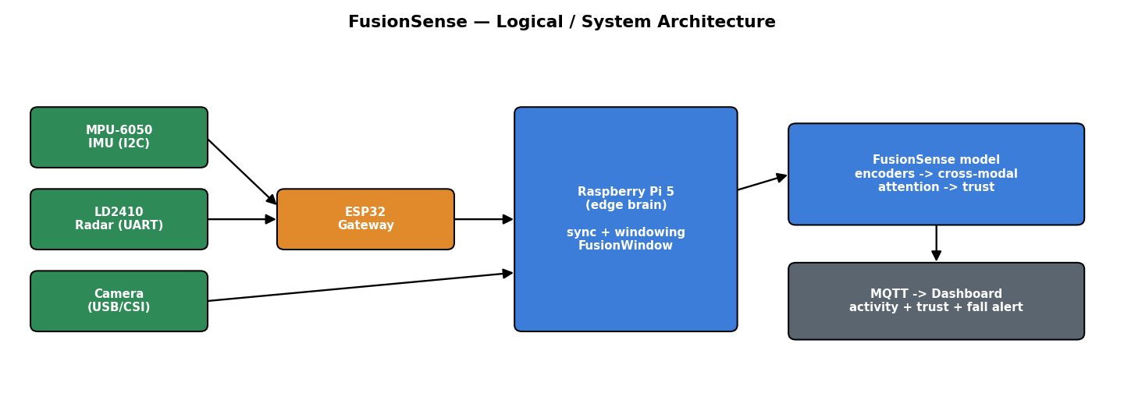
5
Logical Design
Three-tier edge pipeline: ESP32 gateway → Raspberry Pi brain (sync + fusion model) → MQTT dashboard.

Slide 8
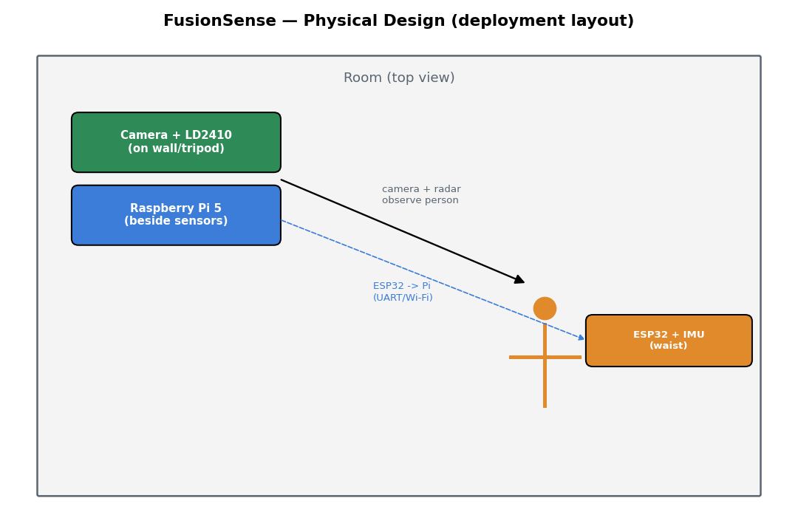
6
Physical Design
Camera + LD2410 radar fixed on a wall/tripod, both viewing the room.
Raspberry Pi beside the sensors — runs the model, hosts MQTT.
ESP32 + IMU worn at the waist (moves with the person → captures falls).
Radar is fixed, not worn — it must observe the person from a distance.

Slide 9
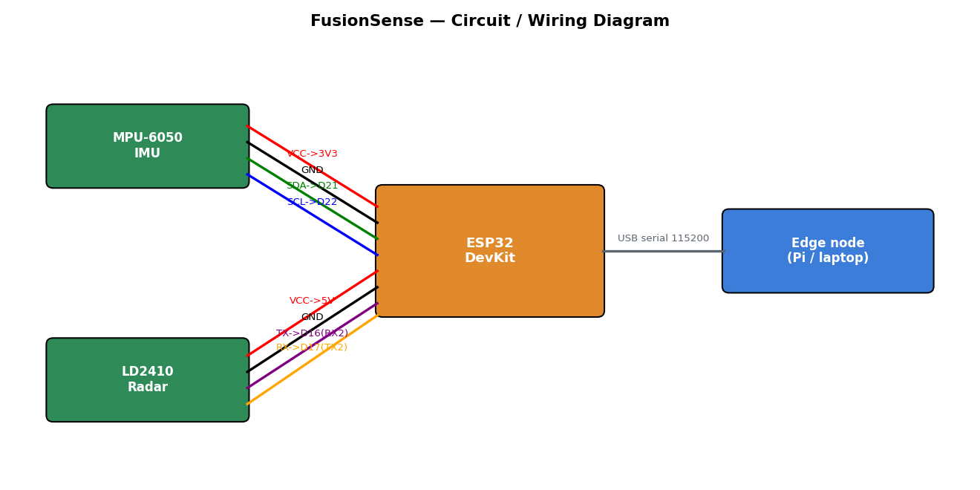
6
Circuit / Wiring Diagram
MPU-6050 over I²C (SDA→D21, SCL→D22); LD2410 over UART (TX→D16, RX→D17); ESP32 streams CSV over USB serial.

Slide 10
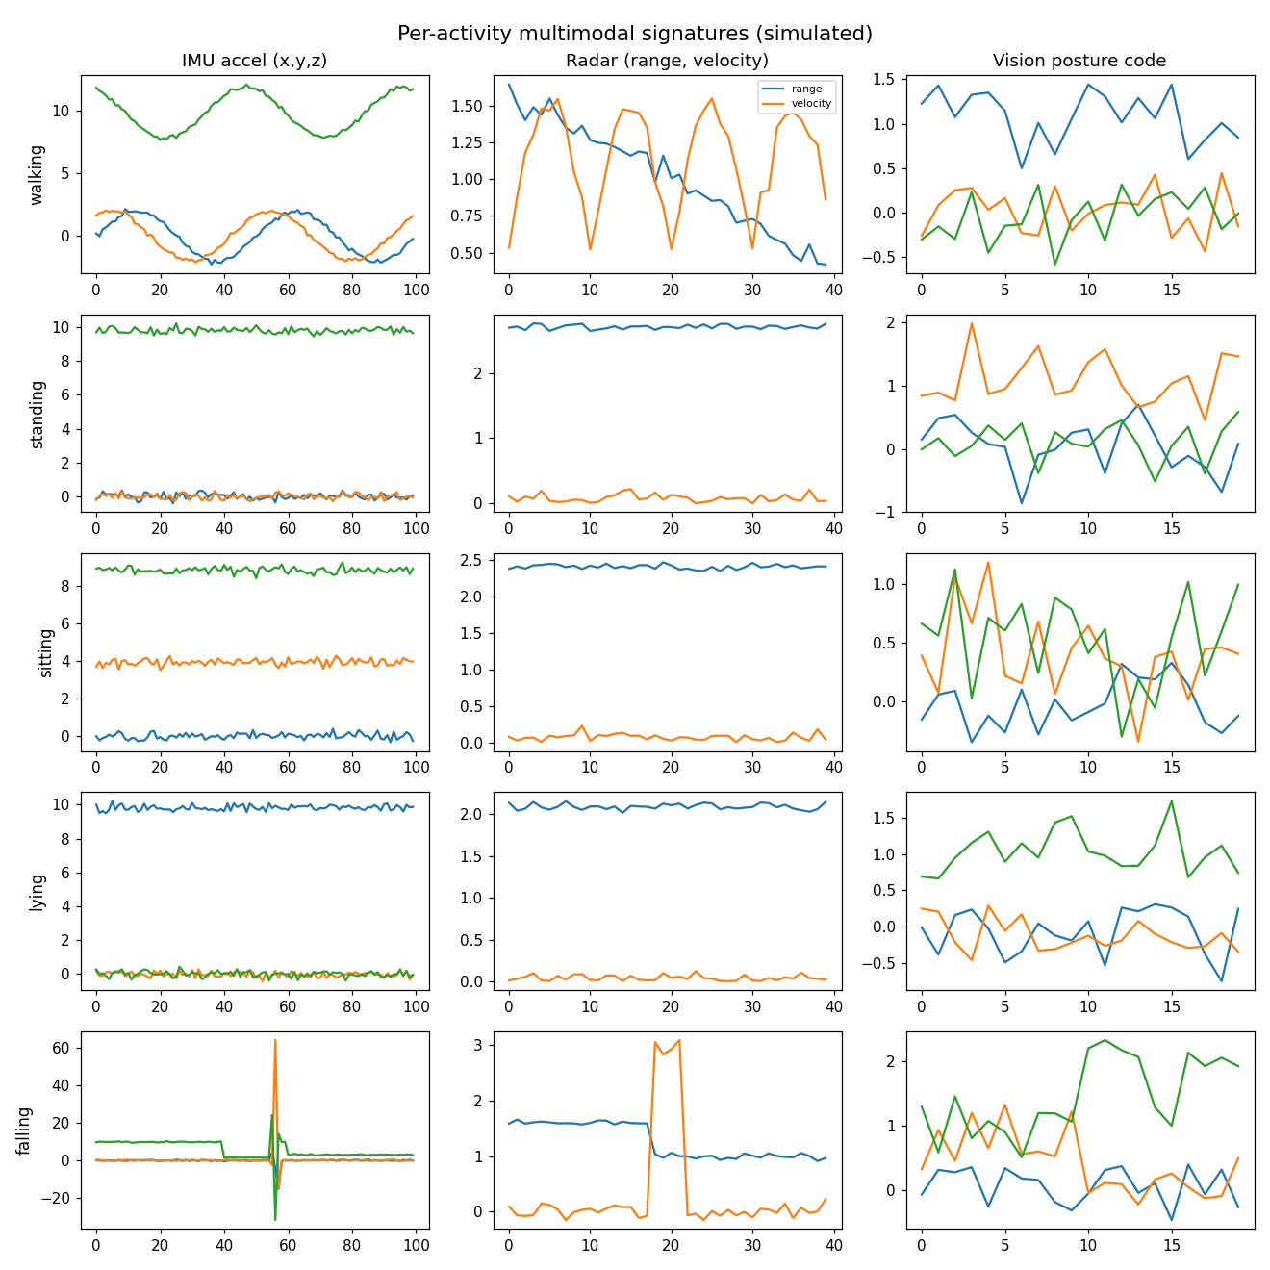
7
Simulation Results — Data
Simulator generates physically-motivated signatures per activity across all three modalities.
Falling shows an IMU impact spike + radar height drop — clearly separable from walking's periodicity.
Sensor-health signals injected (darkness, radar noise, IMU clipping) to train reliability-aware fusion.

Slide 11
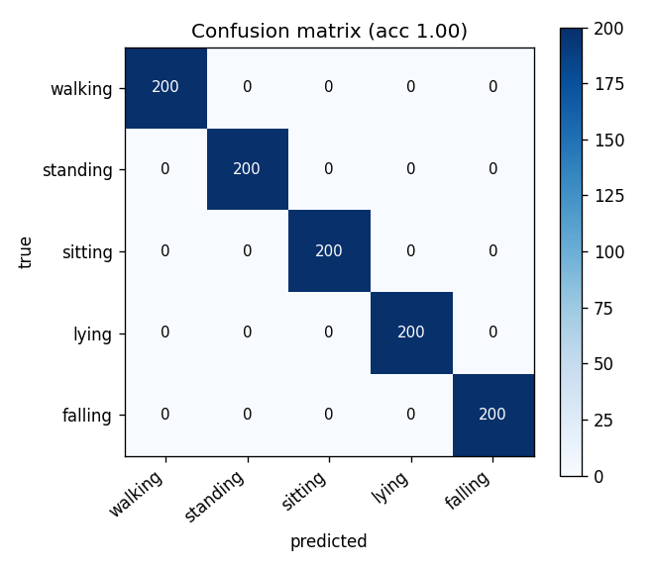
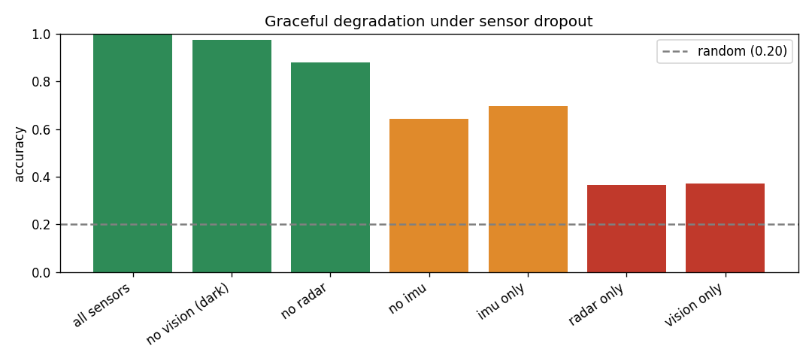
7
Simulation Results — Robustness
Graceful degradation (baseline classifier, simulated data):
All sensors 1.00 → no vision / dark 0.97 → no radar 0.88. Single-modality collapses to ~0.36.
Full PyTorch cross-modal attention model trains on GPU (RTX 4060); numbers above are the NumPy baseline sanity-check.

Slide 12
8
Hardware Implementation (in progress)
ESP32 gateway firmware written & compiles: reads MPU-6050 over I²C at 50 Hz, streams the exact CSV the pipeline expects.
Validated in Wokwi simulation (ESP32 + MPU-6050) — runs in-browser with no physical parts.
LD2410 radar path coded and guarded (RADAR_PRESENT) — enabled once the sensor is wired.
Software pipeline (simulator + model + training + robustness) fully working on laptop.
Implementation status
Firmware (IMU)
✓ done
Wokwi circuit sim
✓ done
Software model + results
✓ done
Radar firmware
coded, pending part
Physical build + Pi
pending
≈ 50%+ of hardware implementation demonstrated via firmware + Wokwi simulation.

Slide 13
Summary & Next Steps
Delivered: working software pipeline, cross-modal attention model with sensor-health conditioning, real simulation + robustness results, ESP32 firmware validated in Wokwi.
Next: pretrain encoders on public IMU datasets → acquire ESP32 + sensors → collect real data → quantize & deploy to Raspberry Pi 5 → live dashboard.
FusionSense — reliability-aware multimodal HAR for the edge.

