Slide 1
Group 1
Credit Default Risk Prediction
Group Members:
Chaitanya Moregaonkar
Siddhant More
Sumit Gorkhe
Sanjeel Bhosale
Yuyu Ndiema
Metri Sonani

Slide 2
Project Goal
To predict the likelihood of clients defaulting on loans issued by Home Credit, helping financial institutions reduce risk and improve lending accuracy.
Objective and Impact
Enable more accurate lending decisions, reducing risk and promoting financial inclusion.
Build a predictive model using machine learning to identify high-risk borrowers, gaining hands-on experience in data science techniques like feature engineering and model evaluation.

Slide 3
Motivation
Our group is working on predicting credit default risk for loans issued by Home Credit.
Our topic is critical because loan defaults represent significant financial risk for lenders, impacting their ability to offer credit effectively.
By accurately predicting the likelihood of a client defaulting, financial institutions can make more informed lending decisions, minimizing risk and potentially expanding credit access to a wider range of borrowers.
This not only helps institutions improve their bottom line but also supports financial inclusion by responsibly extending credit to individuals who may need it most.

Slide 4
Data Cleaning & Preprocessing
Initial Setup:
Import libraries: pandas, numpy, seaborn, and matplotlib.pyplot.
Configure display options to show all rows and columns and apply a Seaborn theme.
Identify Missing Data:
Calculate the percentage of missing values per column in data_train.
Identify columns with missing data and display them in descending order.
Drop Columns with High Missingness:
List columns to be dropped, likely due to a high percentage of missing values.
Drop these columns from data_train and confirm the new shape.

Slide 5
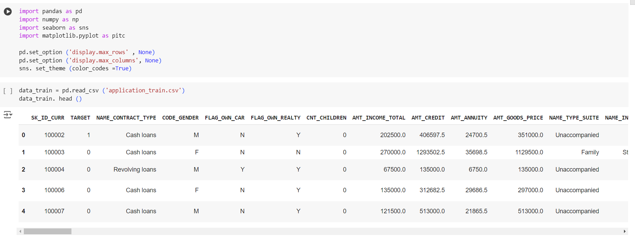

Slide 6
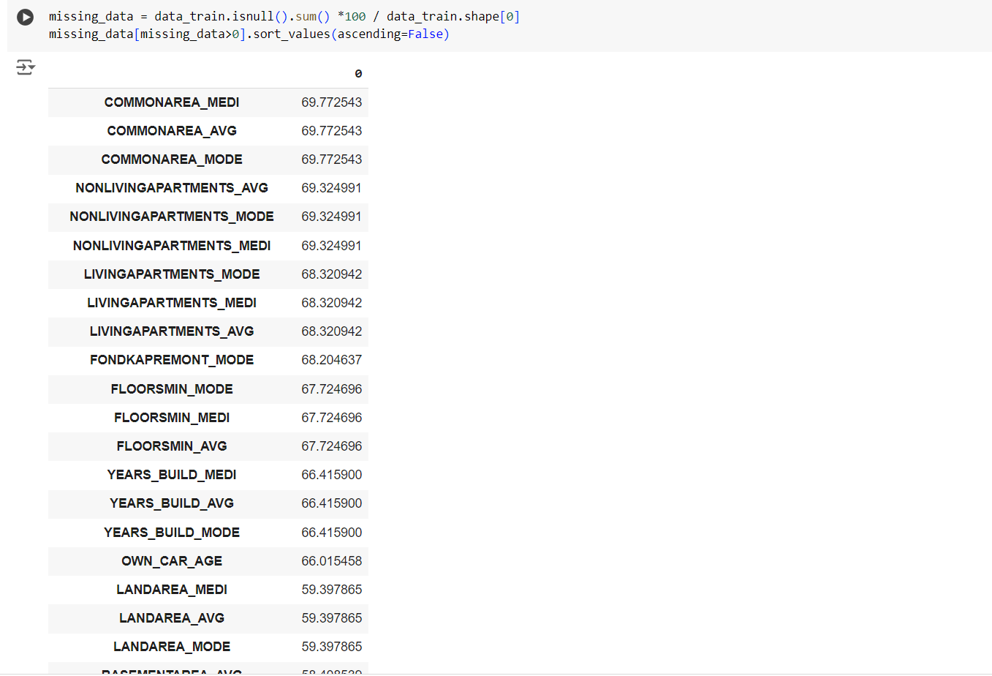

Slide 7
Process Categorical Columns:
Display the unique values of each categorical column.
Convert specified categorical columns to numerical values by mapping unique values to integers.
Convert Categorical Data to Numerical:
Define a function to map categorical values to unique integer identifiers.
Apply this mapping to relevant categorical columns in data_train.
Handling Correlated Features:
Compute the absolute correlation matrix and identify pairs with correlations above a threshold (0.7).
Drop highly correlated columns to reduce multicollinearity.

Slide 8
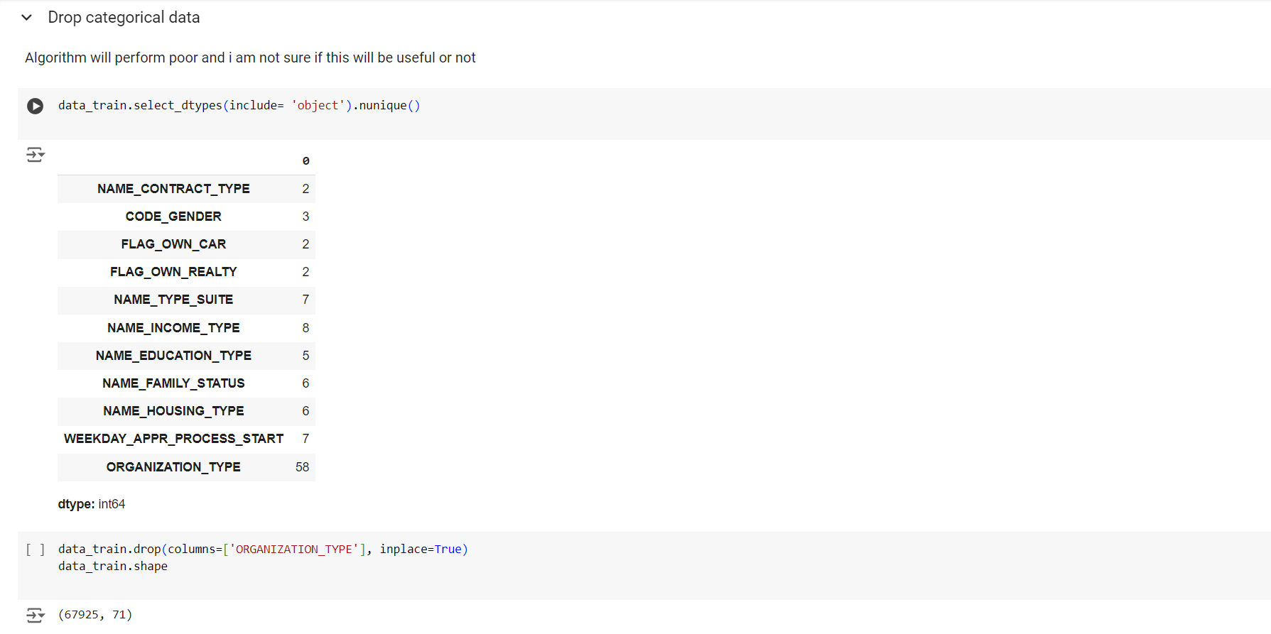

Slide 9
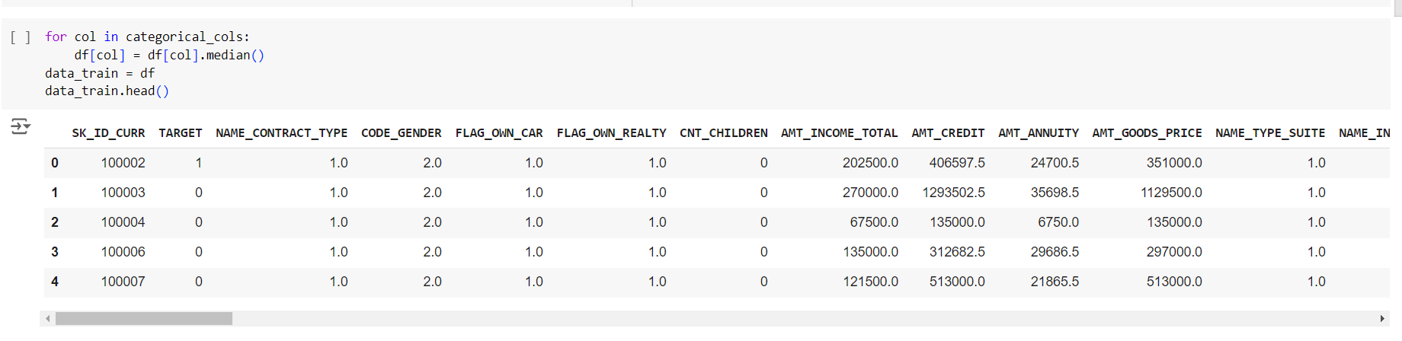

Slide 10
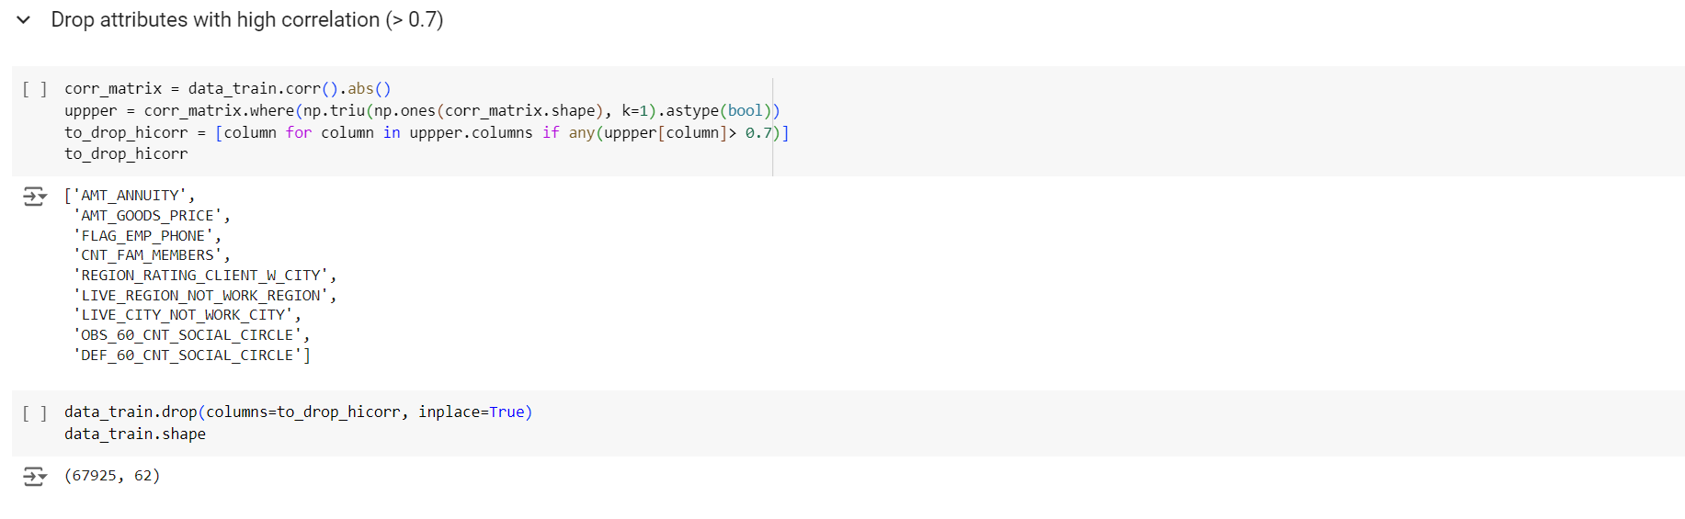

Slide 11
Fill Missing Values in flag_docs Columns:
For columns like flag_docs, fill missing values with 0.
Convert DAYS_* Columns to Positive Values:
Make the DAYS_* columns positive, as they might represent the number of days since an event occurred.
Convert Data Types to Float:
Convert all columns to float type for consistency.
Impute Missing Values:
Define a function to impute missing values using the mean if the data is symmetric, or the median if skewed.
Apply this function to each column with missing values in data_train.

Slide 12
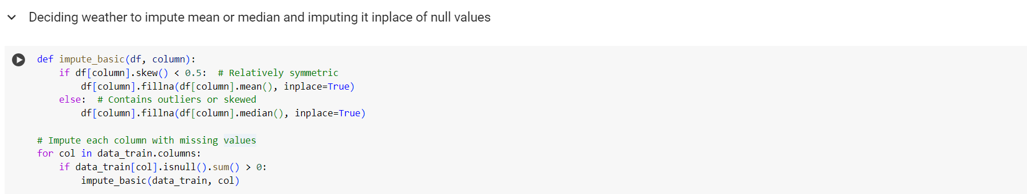
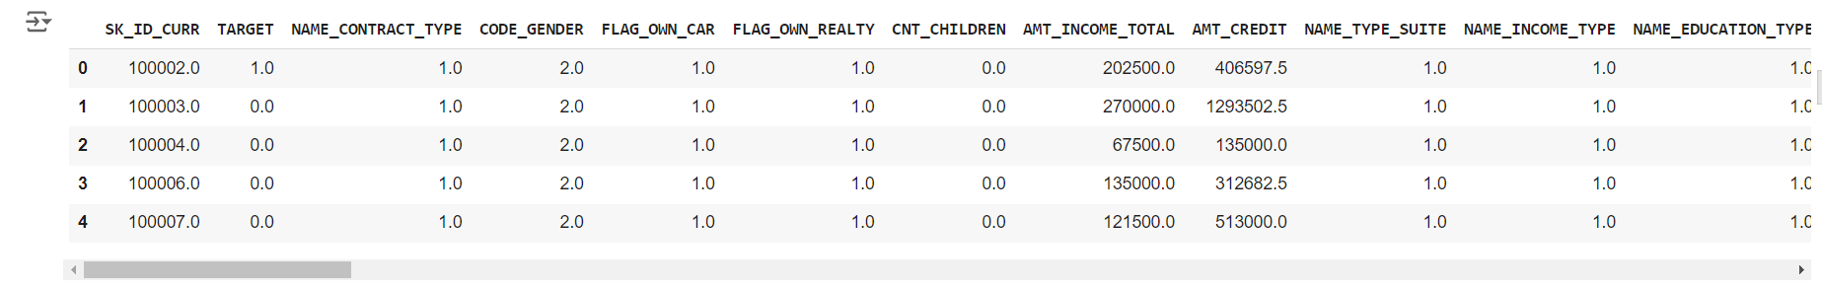

Slide 13
Train-Test Split and Oversampling with SMOTE
Separate the features (X) and target variable (y).
Split the dataset into training and testing sets (using 70% for training, 30% for testing, and stratifying by the target variable).
Apply SMOTE (Synthetic Minority Over-sampling Technique) to the training set to balance the target classes.
Print the shape and class distribution of the original and resampled training sets to confirm the effect of SMOTE.

Slide 14
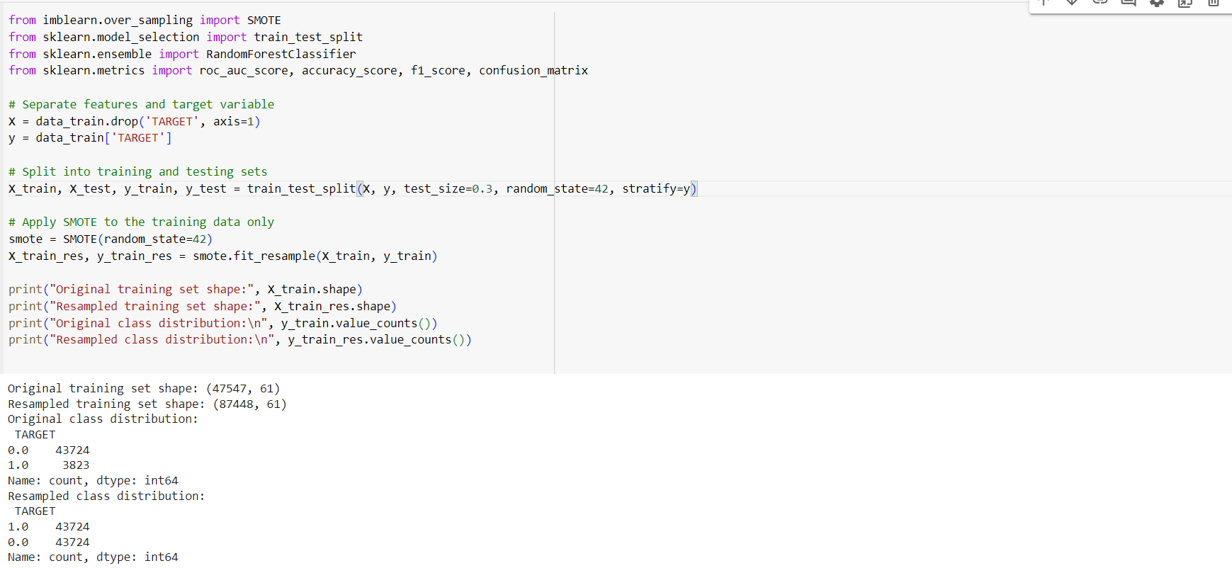

Slide 15
Logistic Regression
Hyperparameter Tuning:
Regularization (C): Tested values [0.01, 0.1, 1, 10] for balance between fitting and regularization.
Solver: Compared liblinear (good for small datasets) and lbfgs (handles larger datasets).
Cross-Validation: Used 5-fold to find the best parameters for generalizability.
Evaluation Metrics:
Training/Test Accuracy: Checks performance on both resampled training and test sets.
F1, Precision, Recall: Balances predictive quality in the imbalanced dataset.
ROC-AUC: Measures overall ranking ability between classes.
Confusion Matrix: Visualizes true/false positives and negatives.

Slide 16
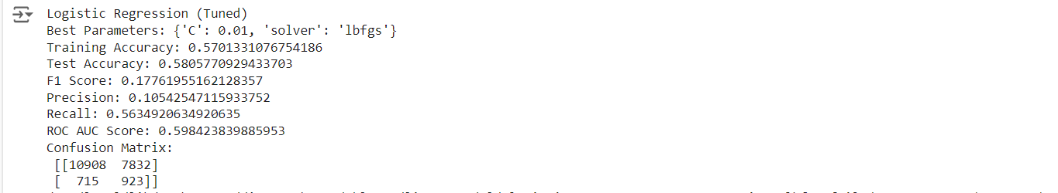
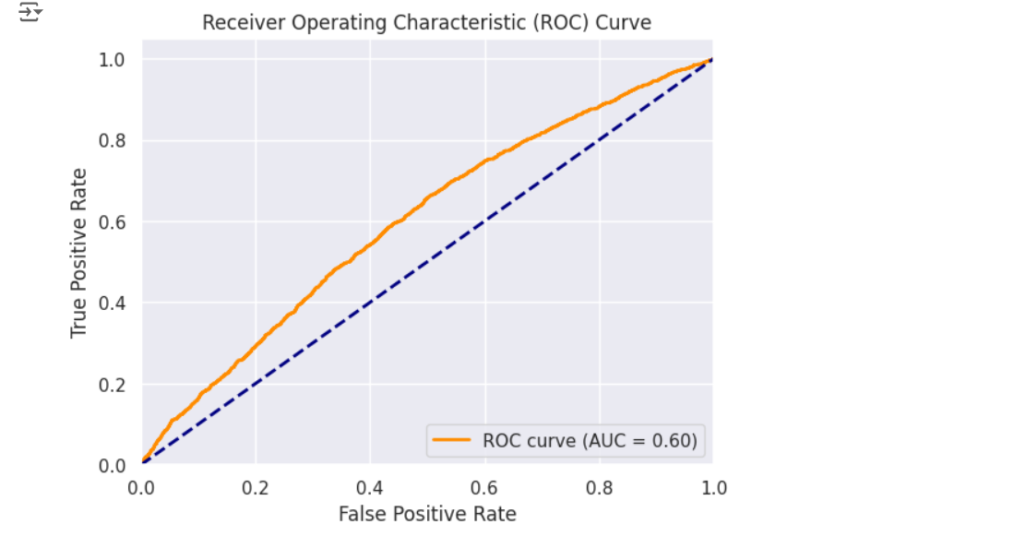

Slide 17
Random Forest Model (Tuned)
Hyperparameter Tuning:
Grid Search for optimal n_estimators, max_depth, min_samples_split, and min_samples_leaf using ROC AUC as the scoring metric.
Model:
RandomForestClassifier with best parameters from GridSearchCV: 750 estimators, max depth of 20, min samples per split 2, and min leaf size 10.
Training:
Fitted on resampled training data (X_train_res, y_train_res).
Metrics:
Evaluated on test set with F1 score, ROC AUC, accuracy, precision, recall, and confusion matrix.
Performance:
Optimized Random Forest achieved robust performance across metrics, focusing on balancing precision and recall.

Slide 18
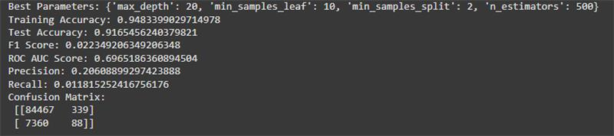
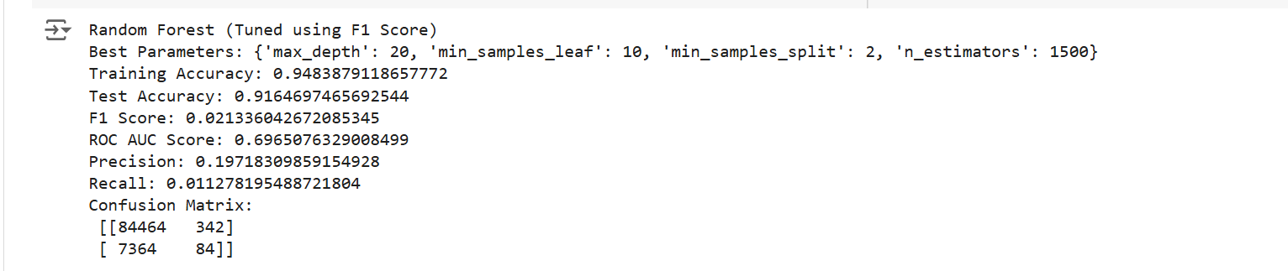
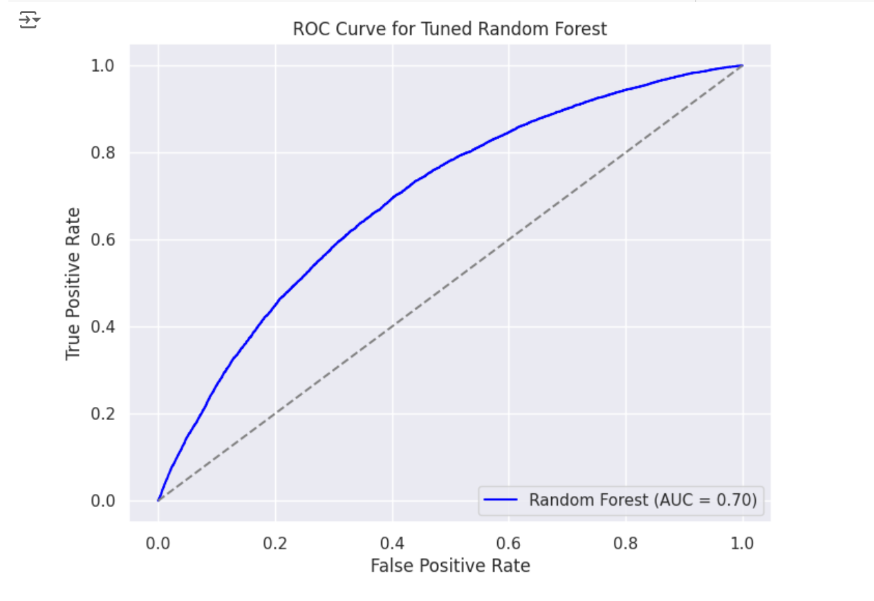
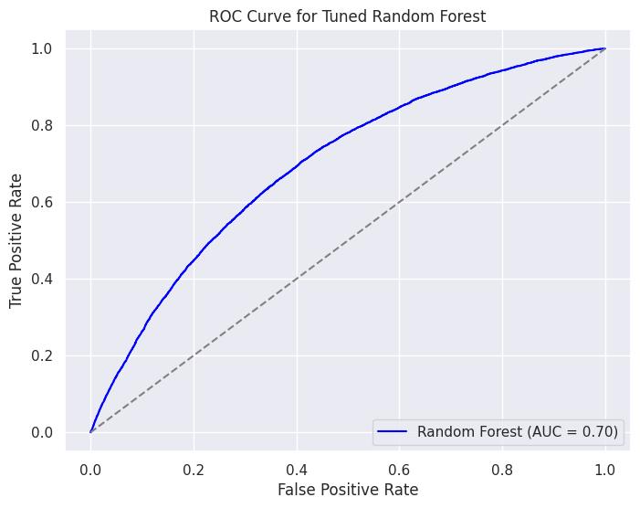
Random Forest with 500 trees and tuned using roc_auc :
Random Forest with 1500 trees and tuned using roc_auc :

Slide 19
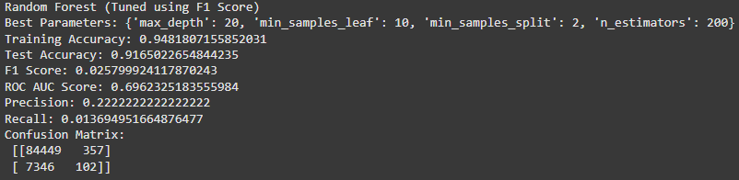
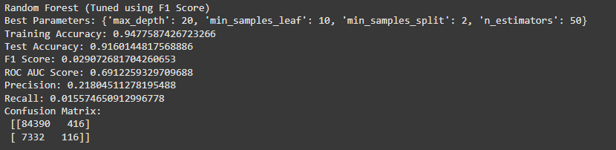
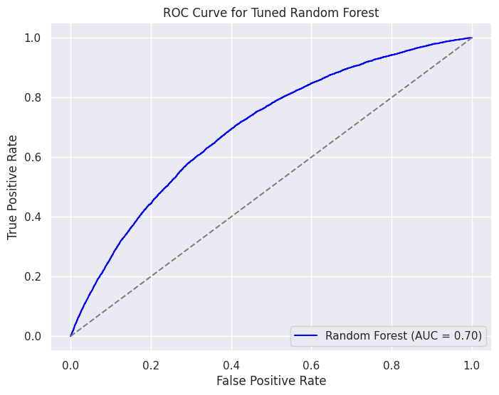
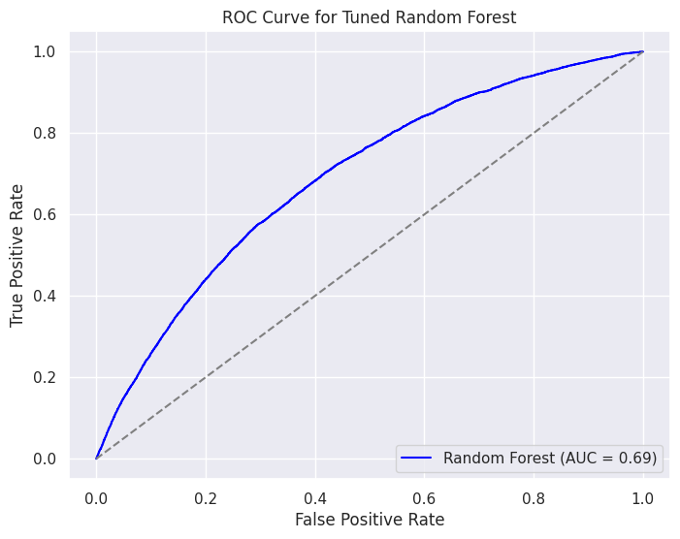
Random Forest 200 trees and tuned using f1:
Random Forest 50 trees and tuned using f1:

Slide 20
XGBoost Model (Tuned)
Hyperparameter Tuning:
Grid Search for optimal parameters: n_estimators=500, max_depth=6, learning_rate=0.1, subsample=0.8, colsample_bytree=0.8, and gamma=1.
Model:
XGBoost classifier optimized using ROC AUC as the scoring metric.
Training:
Trained on resampled training data (X_train_res, y_train_res).
Metrics:
Evaluated on test set using F1 score, ROC AUC, accuracy, precision, recall, and confusion matrix.
Performance:
XGBoost model exhibited strong generalization with high performance in terms of F1 score and ROC AUC.

Slide 21
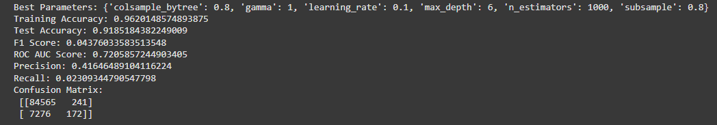
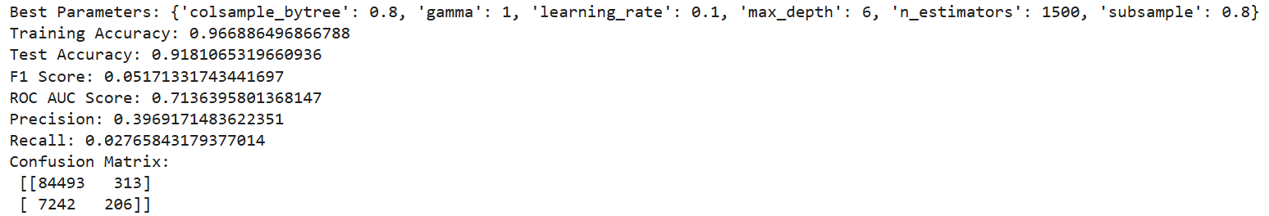
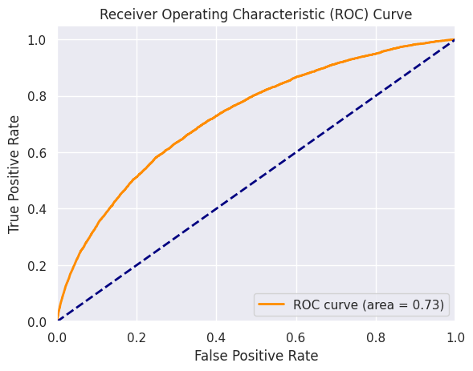
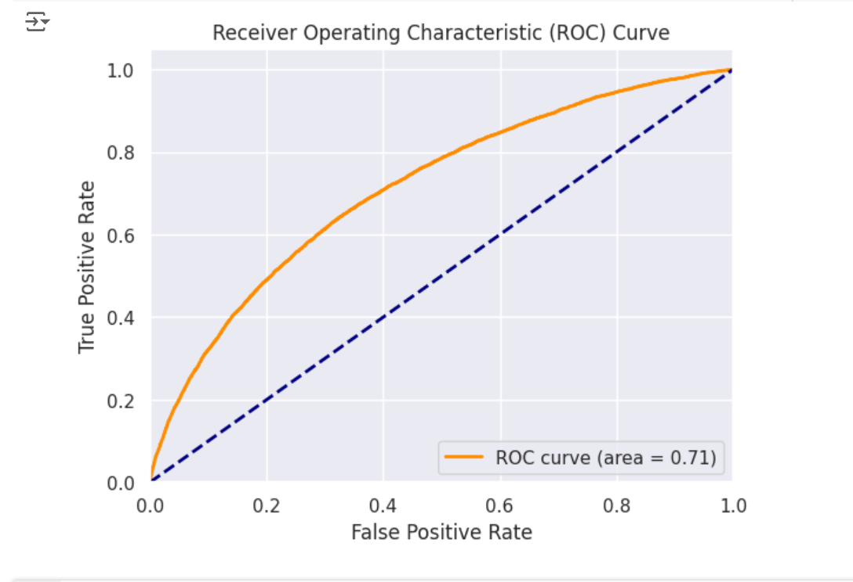
XGBoost tuned using roc_auc:

Slide 22
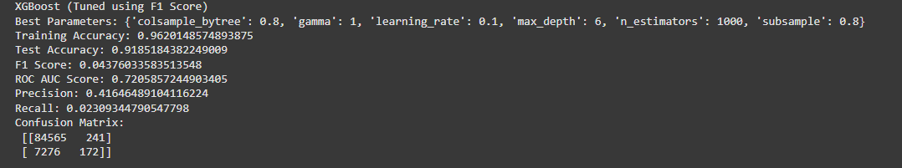
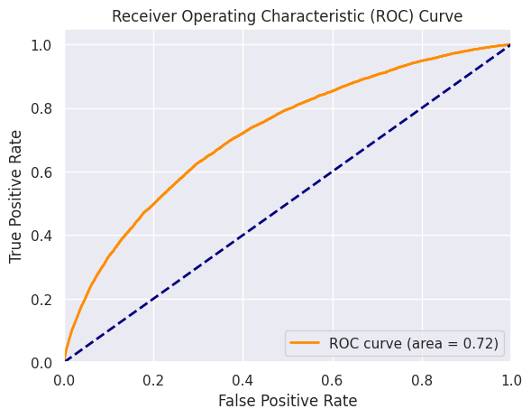
XGBoost tuned using F1:

Slide 23
Vanilla Decision Tree Model
Model Training:
  A basic Decision Tree Classifier is used with random_state=42, trained on SMOTE-resampled data to handle class imbalance.
Evaluation Metrics:
  Training Accuracy: High training accuracy may indicate overfitting, as Decision Trees often capture specific patterns too well.
  Test Metrics: Calculated on unseen data:
    Accuracy, F1 Score, Precision, Recall: Provides insight into overall correctness and balance between false positives and false negatives, especially useful for imbalanced data.
    ROC-AUC: Measures how well the model distinguishes between classes.
    Confusion Matrix: Shows true/false positives and negatives for clarity on errors.
ROC Curve:
  The ROC curve and its AUC score provide a visual and single metric summarizing the model's separation ability between classes.

Slide 24
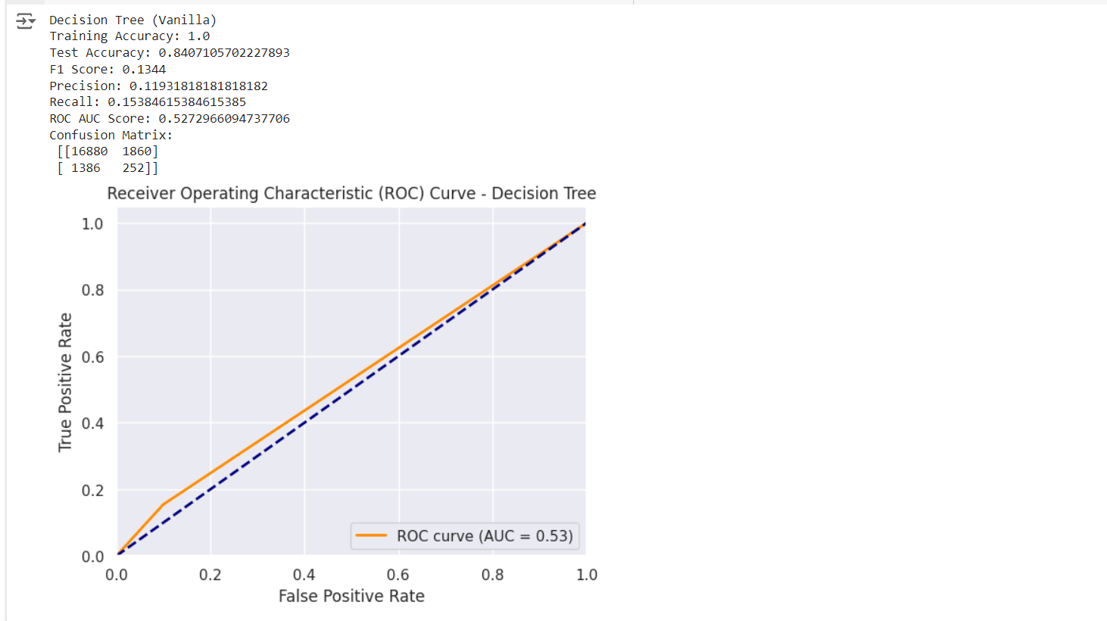

Slide 25
Tuned Decision Tree Model
GridSearchCV Tuning:
Tested max_depth, min_samples_split, min_samples_leaf, and criterion (gini/entropy) to improve model performance while reducing overfitting.
5-fold cross-validation optimized ROC-AUC to find the best parameter set.
Model Evaluation:
Training/Test Accuracy: Confirms the model’s fit.
F1, Precision, Recall: Ensures balanced performance for imbalanced data.
ROC-AUC and Confusion Matrix: Evaluates class separation and error breakdown.
ROC Curve:
Visualizes the model's ability to balance true/false positives, with AUC indicating strong classification.

Slide 26
Low-Confidence Prediction Identification
Identify Uncertain Predictions:
Extract probabilities from Logistic Regression, Tuned, and Vanilla Decision Trees.
Select cases where all models show uncertainty (probabilities between 0.1 and 0.9).
Filter Low-Confidence Cases:
Filter the dataset based on low-confidence predictions across all models.
Expand Confidence Range:
Adjust the range (e.g.:0.2 to 0.8) to capture more moderate confidence cases.
Combine indices of uncertain cases from all models.
Display Results:
Print the number of low-confidence cases and example probabilities from each model.

Slide 27
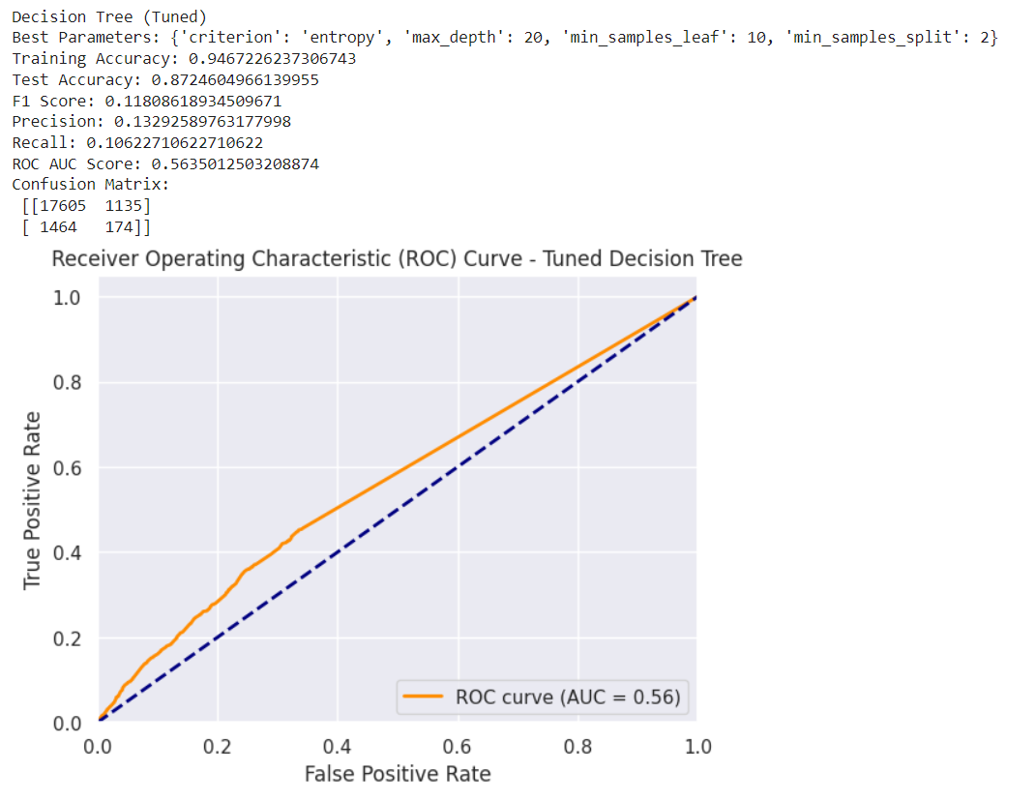

Slide 28
Deep Learning Model on Low-Confidence Cases
1. Model Structure
4 Layers: Three hidden layers with ReLU activation and dropout to prevent overfitting.
Output Layer: Sigmoid activation, outputs probability for Category A or B.
2. Training Process
20 Epochs with 32 examples per batch (batch size).
Validation Split: 20% of training data for validation to avoid overfitting.

Slide 29
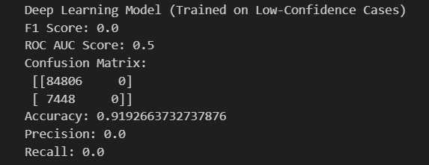
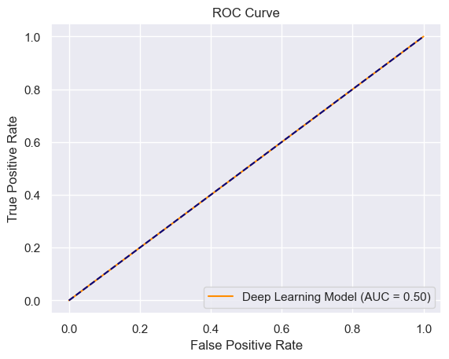

Slide 30
Future Scope
Deep Learning Integration: We plan to incorporate deep learning models alongside Random Forest for better precision, especially on complex patterns.
Improved Predictive Power: Neural networks with multiple layers may increase ROC AUC scores by 5-10% on complex data.
Target ROC AUC: Aiming for a 0.95+ ROC AUC by combining Random Forest and deep learning models.
Enhanced Edge Case Handling: Deep learning will improve predictions for moderate-confidence cases, reducing misclassifications.
Flexible Performance Thresholds: This dual approach will adapt well to varied data types, improving prediction quality overall.

