Slide 1
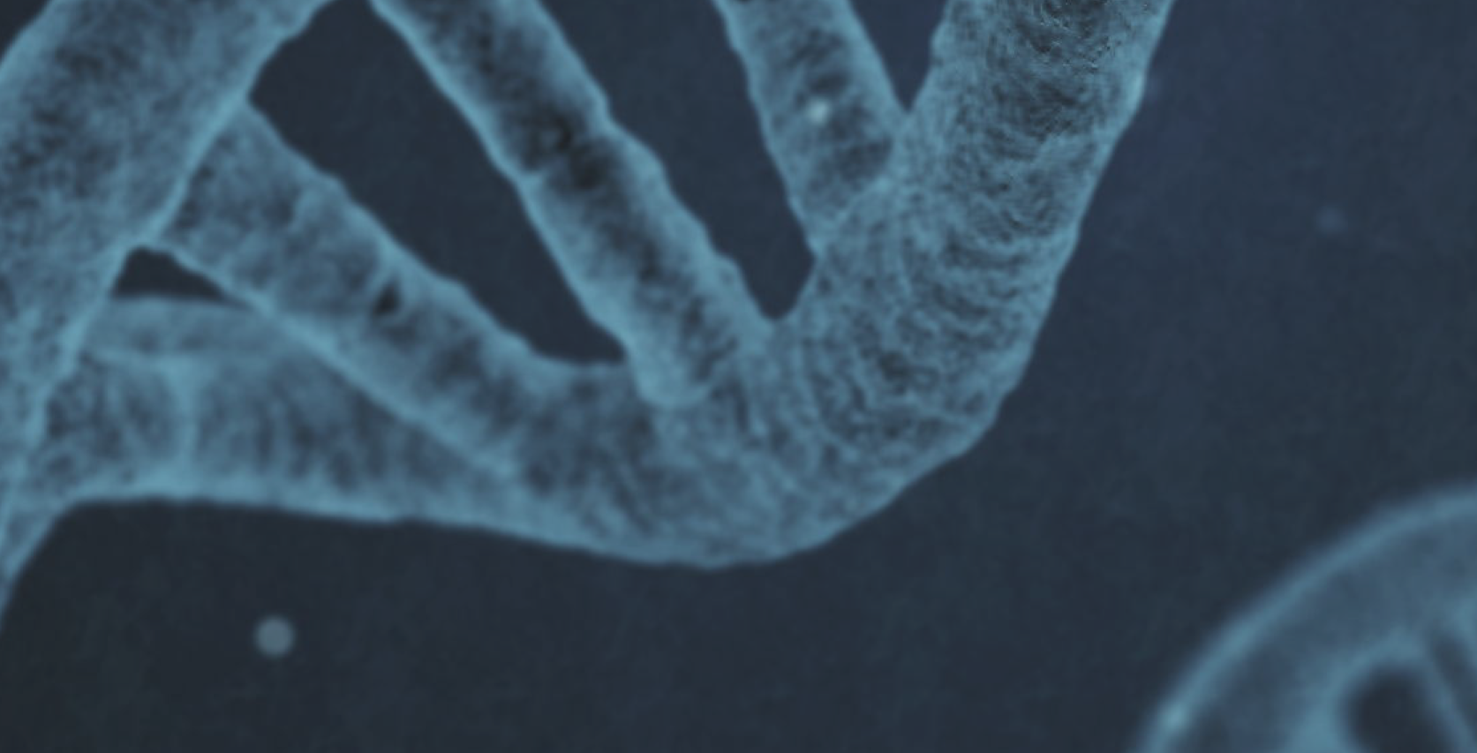
Evolutionary Algorithm with Jenetics library
MScAI_B14_IT 5408 - Evolutionary Computing
Assignment

Slide 2
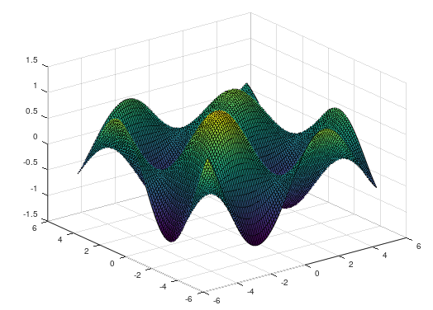
Problem definition
Optimization of a multivariable function
sin(5/(2*PI)*x[0])*sin(5/(2*PI)*x[1])*exp(-(x[0]+x[1])/20)

Slide 3
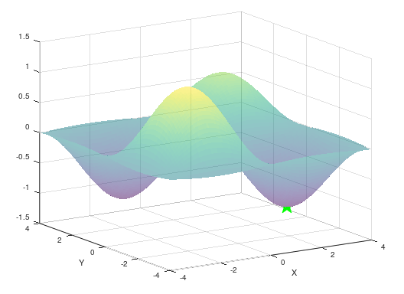
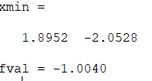
Minimizing with Octave

Slide 4
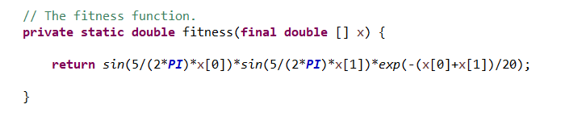
Using Jenetics library for EC solution
GitHub link https://github.com/sanjeemax/MSc_AI_EA_assignment/tree/master

Slide 5
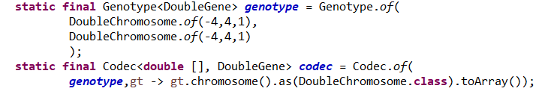
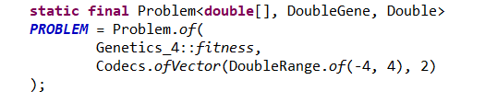
Genotype and Chromosome & Problem

Slide 6
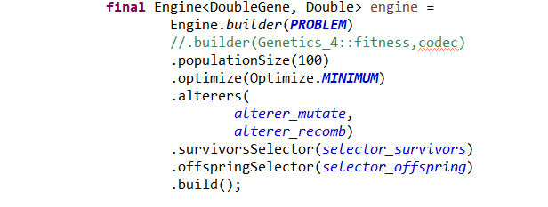
Engine parameters

Slide 7
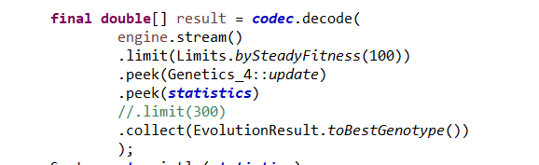
Evolution Stream

Slide 8
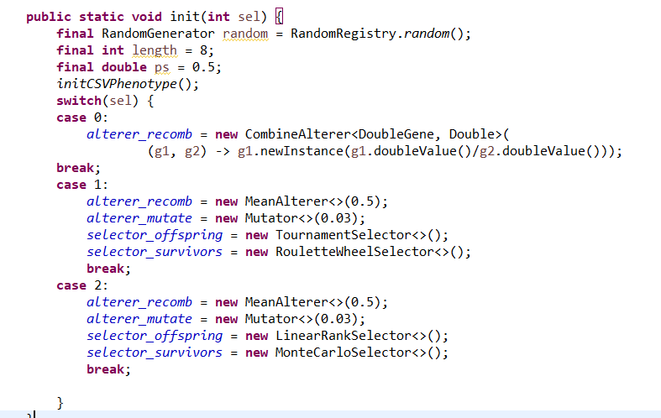
Profile selection to have different combinations

Slide 9
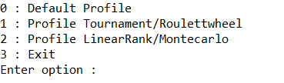
Program shell

Slide 10
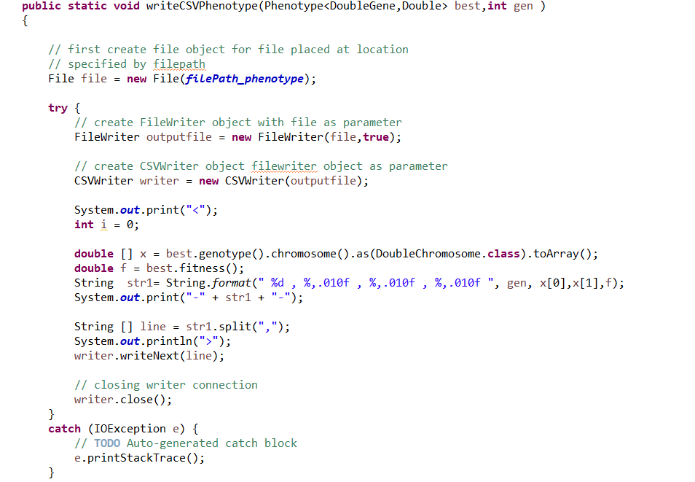
Write best phenotype at each evolution

Slide 11
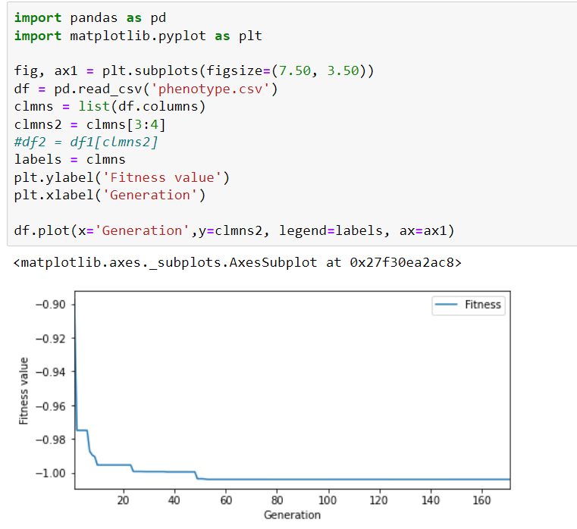
Potting best phenotype over generations with Python

Slide 12
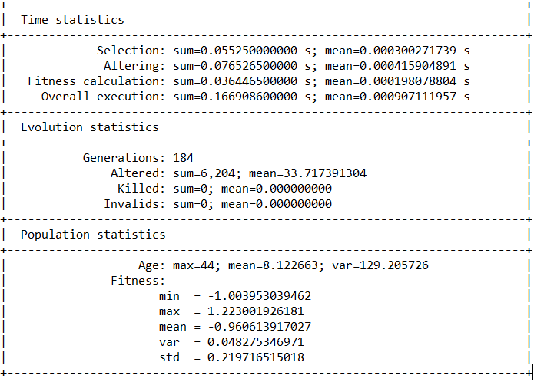
Evolution Statistics

