Slide 1
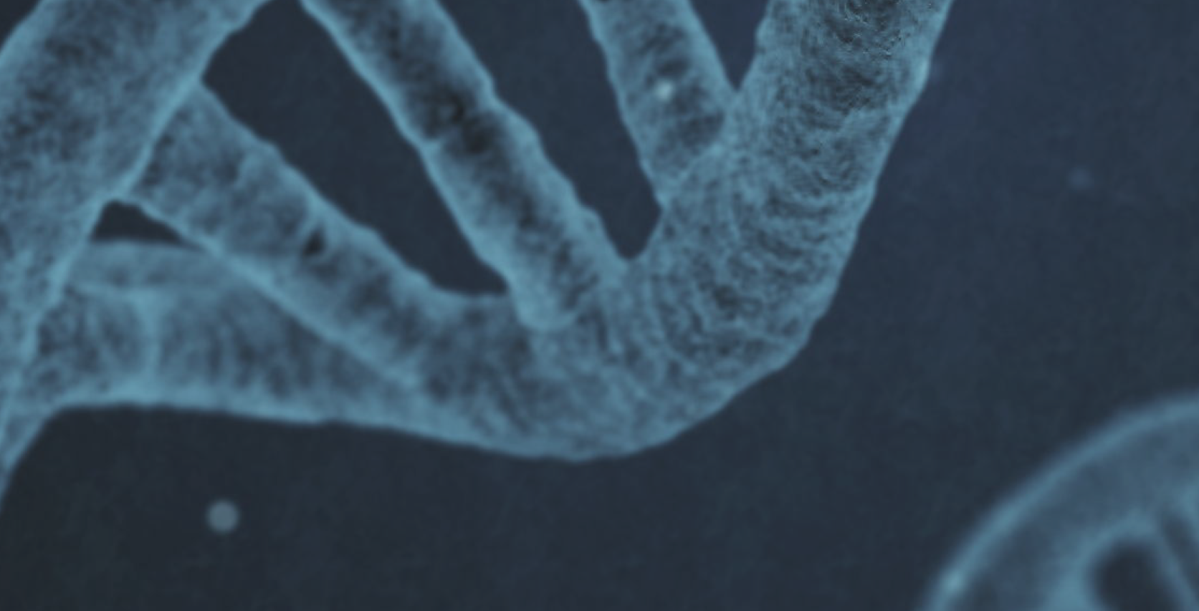
Evolutionary Algorithm with Jenetics library

Slide 2
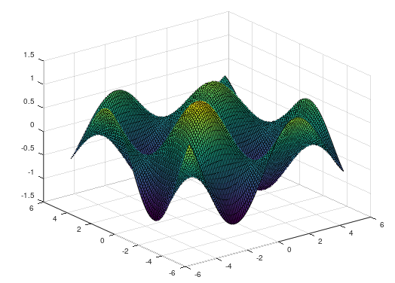
Problem definition
Optimizaion of a multivariable function

Slide 3
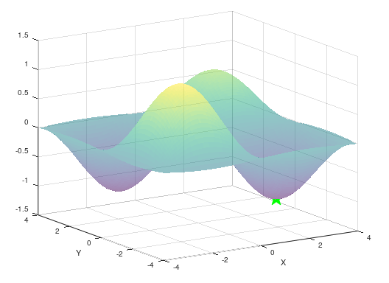
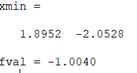
Minimizing with Octave

Slide 4
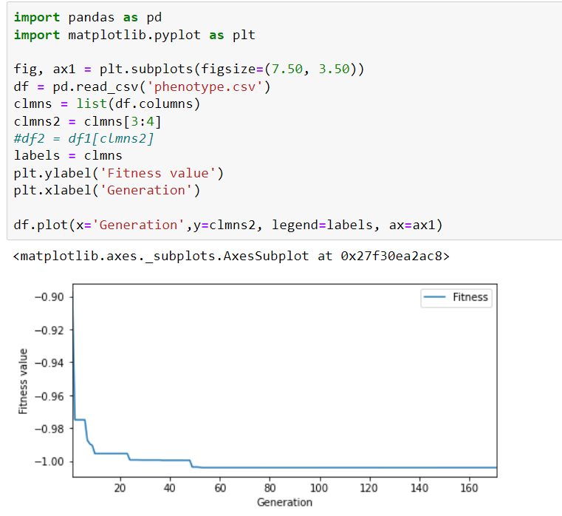
Potting best phenotype over generations

