Slide 1
Testing with jest
delightful js testing

Slide 2
why another testing framework ?
TESTing with jest
Makes testing react components a breeze
Fits our current technical landscape
Easy learning curve
Blazing fast

Slide 3
Cool features of jest
testing with jest
Watch Mode
Code-coverage is built-in
Snapshots
DOM / Render tests

Slide 4
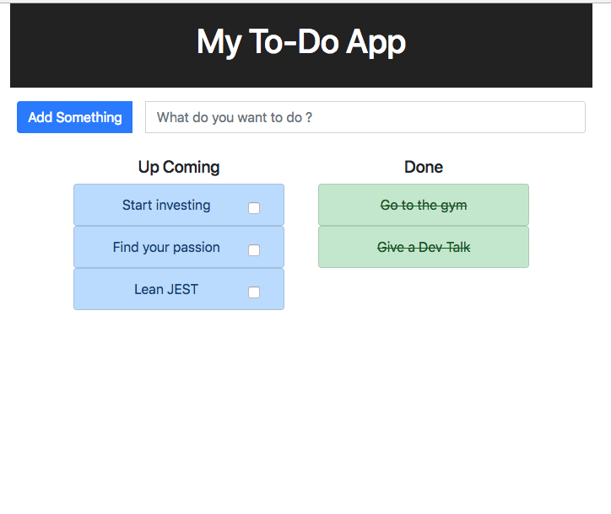
toy example
testing with jest
A simple to-do app
Made with “create-react-app”
App comes pre-configured with JEST
Available at https://github.com/sanjeet724/react-todo-app

Slide 5
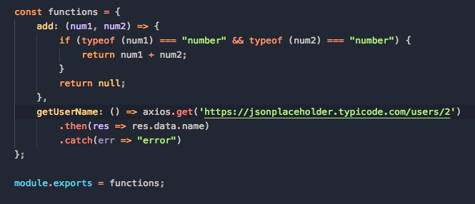
Example 1 - a function
testing with jest
functions.js

Slide 6
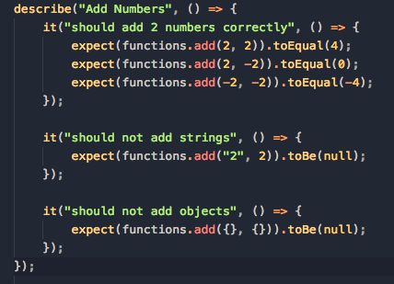
Example 1 - Testing the function
testing with jest
functions.test.js

Slide 7
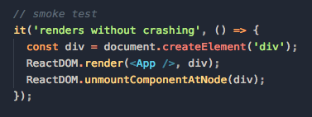
testing the app - Where/How to Start ?
testing with jest
A simple yet very valuable test
Provides a great starting point to add more tests
“npm test — —coverage” - to see which files are not tested

Slide 8
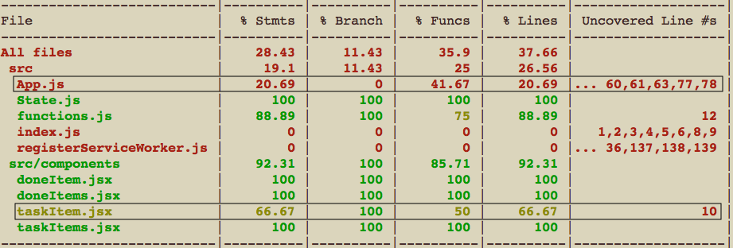
Coverage report
Testing with test

Slide 9
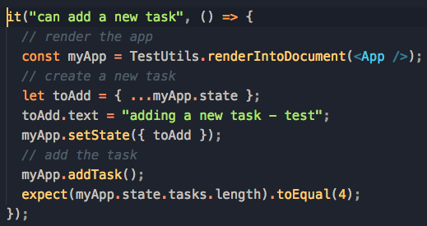
EXAMPLE 2 - Testing APP.JS
TESTING WITH JEST
Tested one of the functions in this class - addTask()
Code coverage (line) goes up from 21% to 48%
Creates positive feedback loop to keep adding more tests :)

Slide 10
EXAMPLE 3 - RENDER/DOM Testing (taskITEM.JS)
TESTING WITH JEST
Used React’s TestUtils (alternative - Enzyme)
Some useful functions :
renderIntoDocument()
findRenderedDOMComponentWithTag()
findRenderedDOMComponentWithClass()
Testing events :
TestUtils.Simulate.click

Slide 11
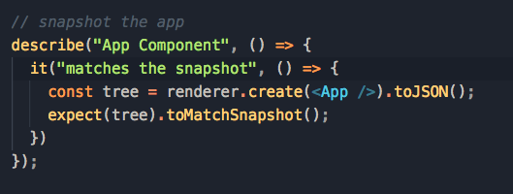
SNAPSHOTS
TESTING WITH JEST
Avoid unexpected UI changes
Saves a serialized version of the React tree
On subsequent test runs :
Compare the latest snapshot with the saved one
Snapshots are human readable

Slide 12
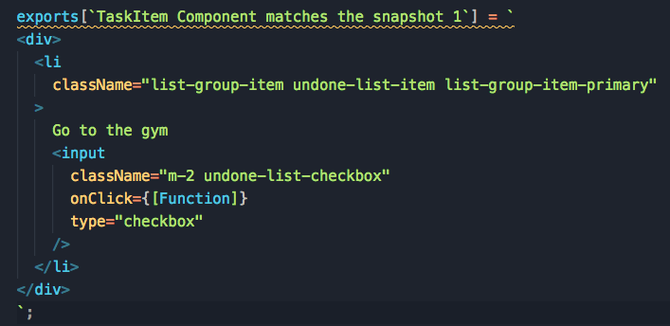
SNAPSHOTS
testing with JEST

Slide 13
DEBUGGING TESTS
TESTING WITH JEST
Integrated with VSCode
Chrome debugger to connect to the node process

