Slide 1
Testing with jest
delightful js testing

Slide 2
why another testing framework ?
TESTING WITH JEST
Makes testing react components a breeze
Fits our current technical landscape
Easy learning curve
Blazing fast

Slide 3
EASIER THINGS First
TESTING WITH JEST
Same global variables as Jasmine
afterAll & afterEach
beforeAll & beforeEach
describe & it blocks
expects
Similar matchers
toBe & toEqual
toBeNull, toBeDefined & toBeUndefined
toBeGreaterThan & toBeLessThan

Slide 4
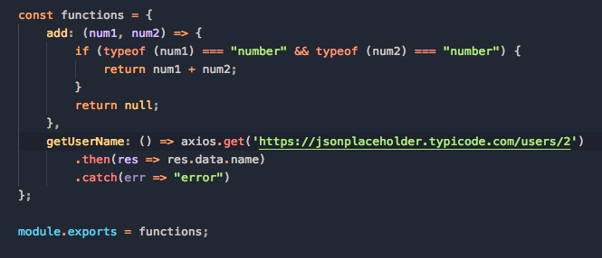
Example 1 - a function
TESTING WITH JEST
functions.js

Slide 5
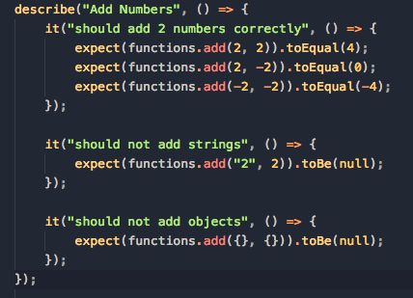
Example 1 - Testing the function
TESTING WITH JEST
functions.test.js

Slide 6
Cool features of jest
TESTING WITH JEST
Watch Mode
Code-coverage
DOM / Render tests
Snapshots

Slide 7
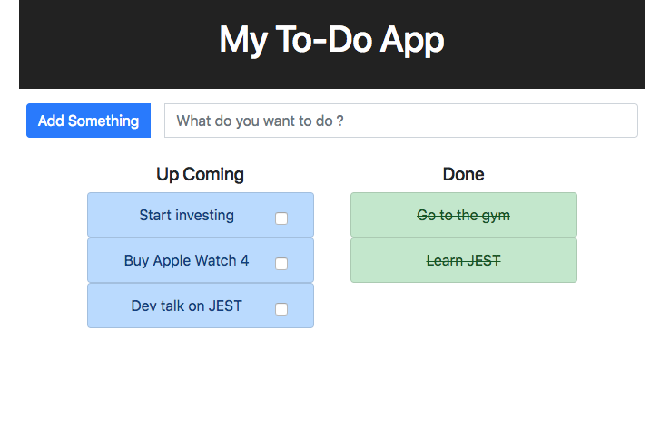
toy example
TESTING WITH JEST
A simple to-do app
Made with “create-react-app”
App comes pre-configured with JEST
Available at https://github.com/sanjeet724/react-todo-app

Slide 8
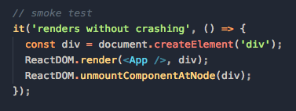
testing the app - Where/How to Start ?
TESTING WITH JEST
A simple yet very valuable test
Provides a great starting point to add more tests
“npm test — —coverage” - to see which files are not tested

Slide 9
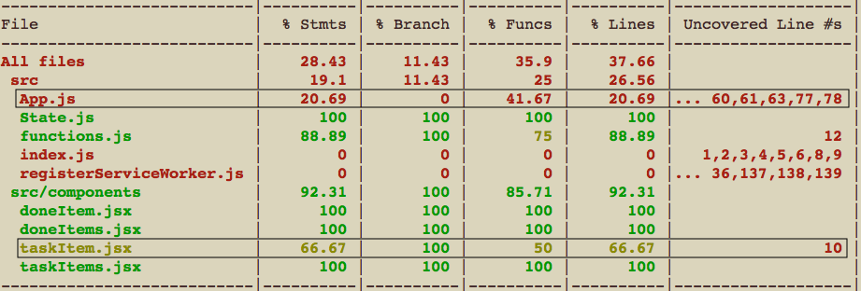
Coverage report
TESTING WITH JEST

Slide 10
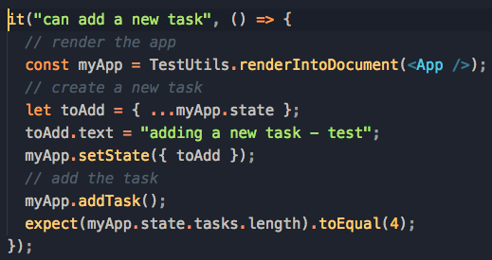
EXAMPLE 2 - Testing APP.JS
TESTING WITH JEST
Tested one of the functions in this class - addTask()
Code coverage (line) goes up from 21% to 48%
Creates positive feedback loop to keep adding more tests :)

Slide 11
EXAMPLE 3 - RENDER/DOM Testing (taskITEM.JS)
TESTING WITH JEST
Used React’s TestUtils (alternative - Enzyme)
Some useful functions :
renderIntoDocument()
findRenderedDOMComponentWithTag()
findRenderedDOMComponentWithClass()
Testing events :
TestUtils.Simulate.click

Slide 12
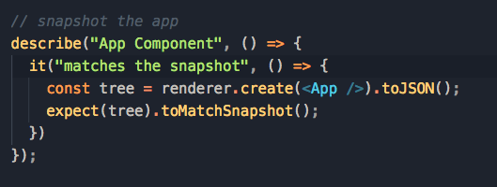
SNAPSHOTS
TESTING WITH JEST
Avoid unexpected UI changes
Saves a serialized version of the React tree
On subsequent test runs :
Compare the latest snapshot with the saved one
Snapshots are human readable

Slide 13
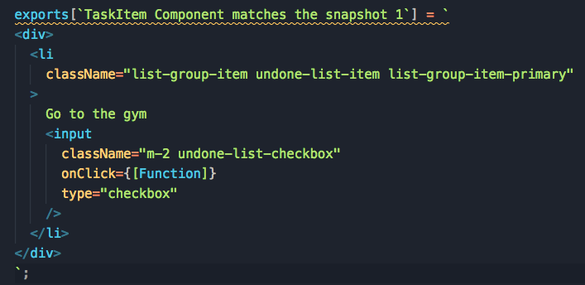
SNAPSHOTS
TESTING WITH JEST

Slide 14
DEBUGGING TESTS
TESTING WITH JEST
Integrated with VSCode
Chrome debugger to connect to the node process

Slide 15
JEST IN ORCA
TESTING WITH JEST
JEST is already available in ORCA
Run JEST tests by :
npm jest <location of test>
example commit -

Slide 16
FINAL THOUGHTs
TESTING WITH JEST
PRO’s
in-built code coverage & snapshots are compelling features
easier to test react components
Jasmine tests can be migrated to JEST
Risks
Migrating old tests take time and can be complicated
Segregating existing tests for UI5/Deku/React components will be hard
Suggestion
Definitely use JEST if writing a new React components

