Slide 1
Welcome to Linux Bash Shell Scripting
Name Sanjeet Prasad
Email sanjeet8.23@gmail.com
LinkedIn www.linkedin.com/in/sanjeet9019
GitHub github.com/sanjeet9019
Need a customized training solution? Connect with me to build a curriculum that targets your specific goals.

Slide 2
Why to Learn Linux Bash Scripting ?
Automate repetitive tasks such as file cleanup, backups, and log rotation
Manage system resources efficiently (disk usage alerts, memory monitoring, cron jobs)
Create validation scripts for test harnesses scenario
Parse and process large volumes of text or logs using tools like grep, awk, and sed
Build deployment and setup scripts for embedded systems or lab environments
Control and monitor services, processes, and network activity directly from the terminal
Integrate with other tools and languages (Python, C/C++, Git, Docker) for hybrid workflows
Essential for roles in system administration, DevOps, embedded development, and telecom automation

Slide 3
Python Programming Topics
Introduction to Shells (Bourne, C, Korn, Bash)
Shell Variables (Local, Environment, Shell)
Shell Arrays
Shell Basic Operators (Arithmetic, Relational, Logical)
String Operators
File Test Operators
Decision Making (if...fi, if...else, case...esac)
Loop Types (while, for, until, select)
Shell Substitution and Metacharacters
Input/Output Redirections
Shell Functions
Text Processing Tools (grep, sed, awk - Differences and Usage)
Shell Scripting Debugging (set -x, set -e, shellcheck, bashdb )
Useful Commands (File, Directory, Network, Compression)
File System Basics (Linux Directory Structure, Mount/Umount)
Hard and Soft Links
User Administration and System Performance
Signals and Trap
CronTab (Job Scheduling)
Real Time Projects – 4 projects hand on projects

Slide 4
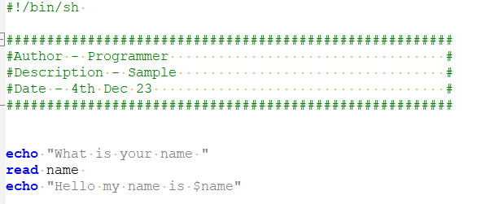
Shell Scripting
The Bourne Shell
The C Shell
The Korn Shell
The GNU Bourne-Again Shell
Shell is a command-line interpreter that translates user-entered commands into kernel understandable language.

Slide 5
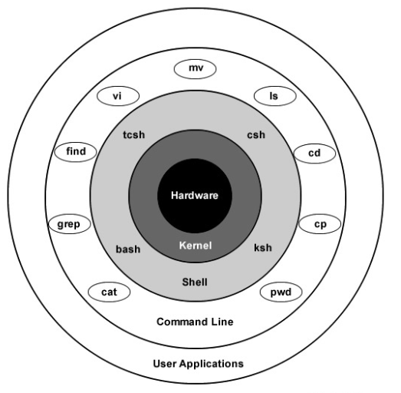
Unix / Linux - What is Shell ?
A shell is a command-line interpreter and typical operations performed by shell scripts include file manipulation, program execution, and printing text.
Bourne shell − If you are using a Bourne-type shell, the $ character is the default prompt.
C shell − If you are using a C-type shell, the % character is the default prompt.

Slide 6
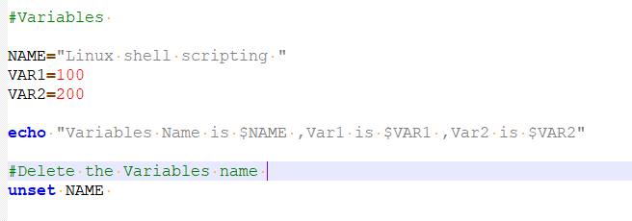
Unix / Linux - Using Shell Variables
Variables name – a-z, A-Z 0-9
NAME = “Script”
Local Variables − A local variable is a variable that is present within the current instance of the shell. It is not available to programs that are started by the shell. They are set at the command prompt.
Environment Variables − An environment variable is available to any child process of the shell. Some programs need environment variables in order to function correctly. Usually, a shell script defines only those environment variables that are needed by the programs that it runs.
Shell Variables − A shell variable is a special variable that is set by the shell and is required by the shell in order to function correctly. Some of these variables are environment variables whereas others are local variables.
Bourne shell − If you are using a Bourne-type shell, the $ character is the default prompt.
C shell − If you are using a C-type shell, the % character is the default prompt.

Slide 7
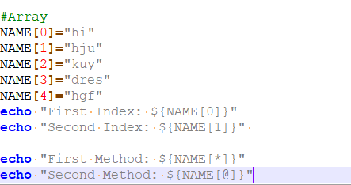
Unix / Linux - Using Shell Arrays
Variables name – a-z,A-Z 0-9

Slide 8
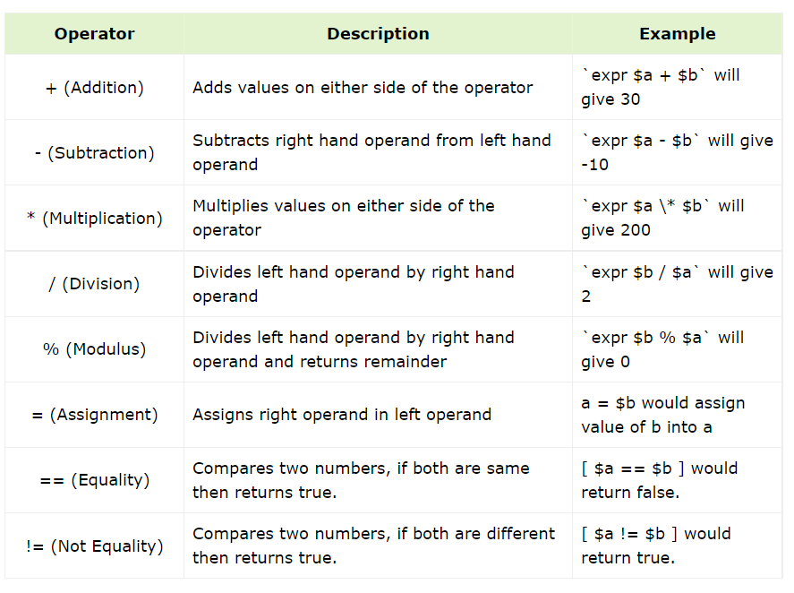
Unix / Linux - Shell Basic Operators
Variables name – a-z,A-Z 0-9
In this script, the arithmetic operation is done using double parentheses (( ))
result=$(( (a + b) * (a + b) ))
mul1=$(($a*$b))
div1=$(($a/$b))

Slide 9
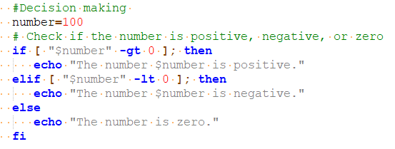
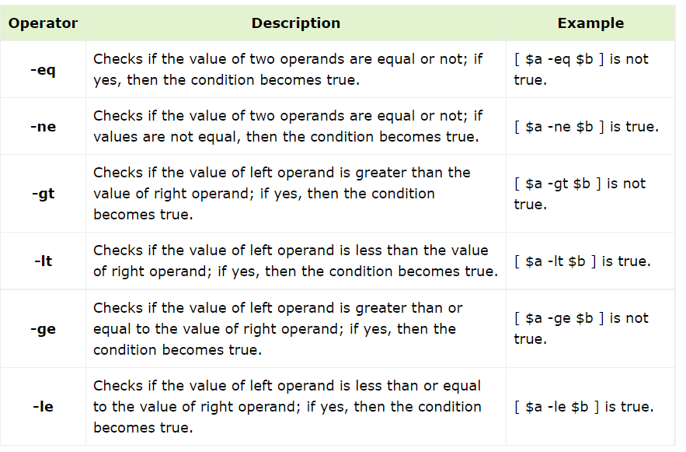
Unix / Linux - Shell Basic Operators
Variables name – a-z,A-Z 0-9

Slide 10
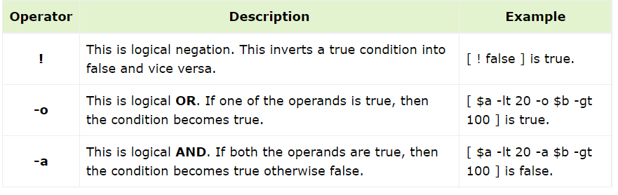
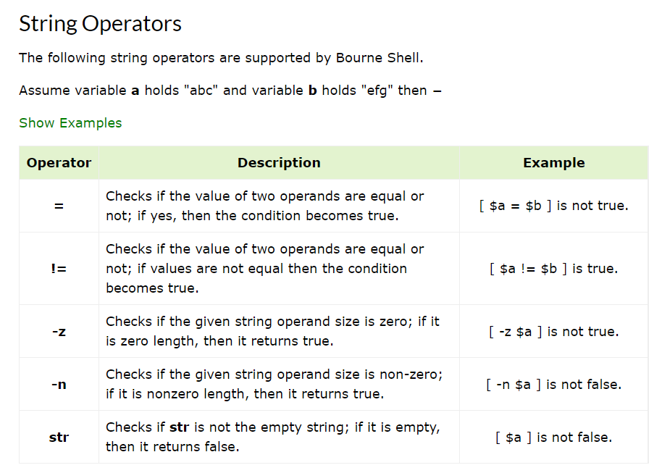
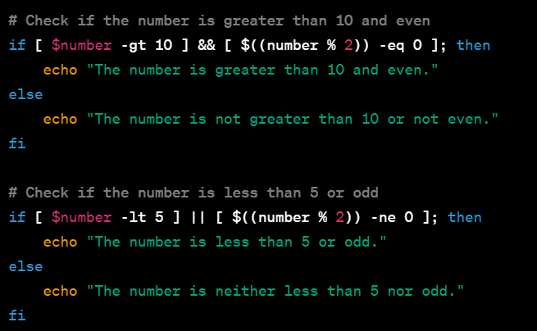
Unix / Linux - Shell Basic Operators
Variables name – a-z,A-Z 0-9

Slide 11
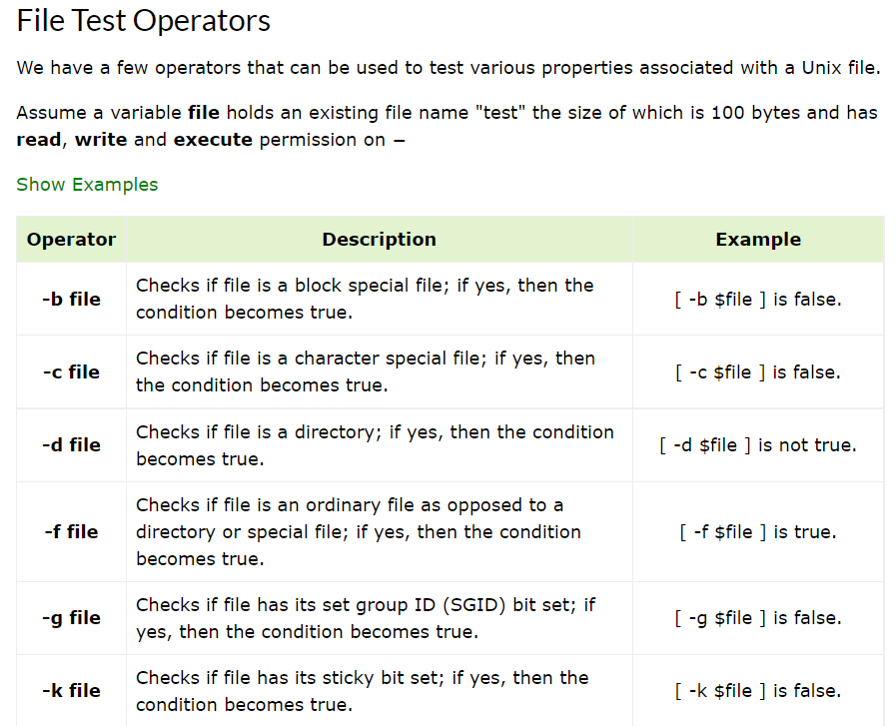
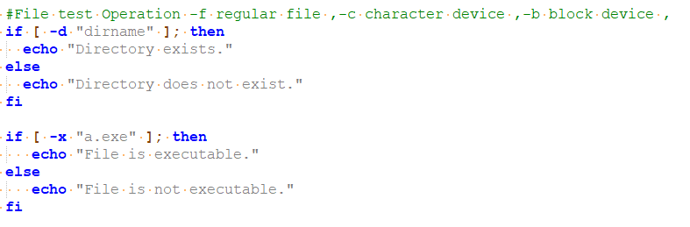
Unix / Linux - Shell Basic Operators
Variables name – a-z,A-Z 0-9

Slide 12
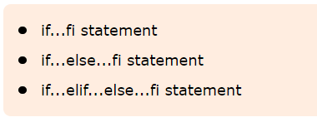

Unix / Linux - Shell Decision Making
The if...else statements
The case...esac Statement

Slide 13
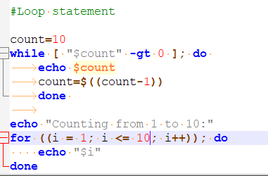
Unix / Linux - Shell Loop Type
The while loop
The for loop
The until loop
The select loop

Slide 14
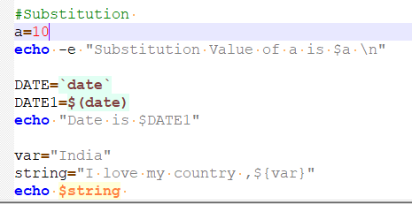
Unix / Linux - Shell Substitution
The shell performs substitution when it encounters an expression that contains one or more special characters.

Slide 15
Unix / Linux - Shell Substitution
The shell performs substitution when it encounters an expression that contains one or more special characters.
The Metacharacters
* ? [ ] ' " \ $ ; & ( ) | ^ < > new-line space tab

Slide 16
Unix / Linux - Shell Input/Output Redirections
Output Redirection
ls >file1.txt
ls >>file2.txt
input Redirection
cat < file1.txt
Discard the output
cat file1.txt > /dev/null
Discard output and error
command > /dev/null 2>&1
echo message 1>&2

Slide 17
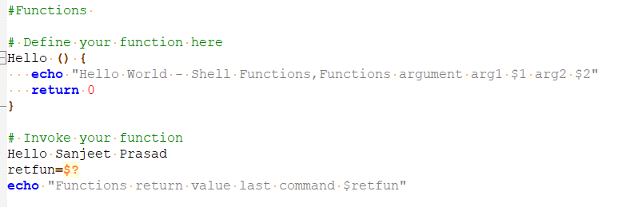
Unix / Linux - Shell Functions
function_name () {
list of commands
}
function_name
Unix / Linux - Shell Manpage Help
man command

Slide 18
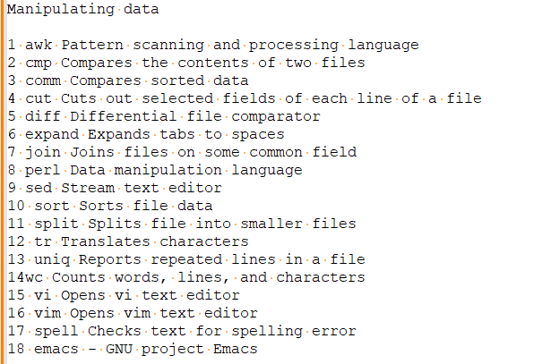
Unix / Linux - Useful Commands
Files and Directories
1.cat - Displays File Contents
2.cd - Changes Directory to dirname
3.chgrp - Changes file group
4 chmod - Changes permissions
5 cp - Copies source file into destination
6 file - Determines file type
7find - Finds files
8grep - Searches files for regular expressions
9 head - Displays first few lines of a file
10 ln - Creates softlink on oldname
11 ls - Displays information about file type
12 mkdir - Creates a new directory dirname
13 more - Displays data in paginated form
14 mv - Moves (Renames) an oldname to newname
15 pwd - Prints current working directory
16 rm - Removes (Deletes) filename
17 rmdir - Deletes an existing directory provided it is empty
18 tail -Prints last few lines in a file
19 touch - Updates access and modification time of a file

Slide 19
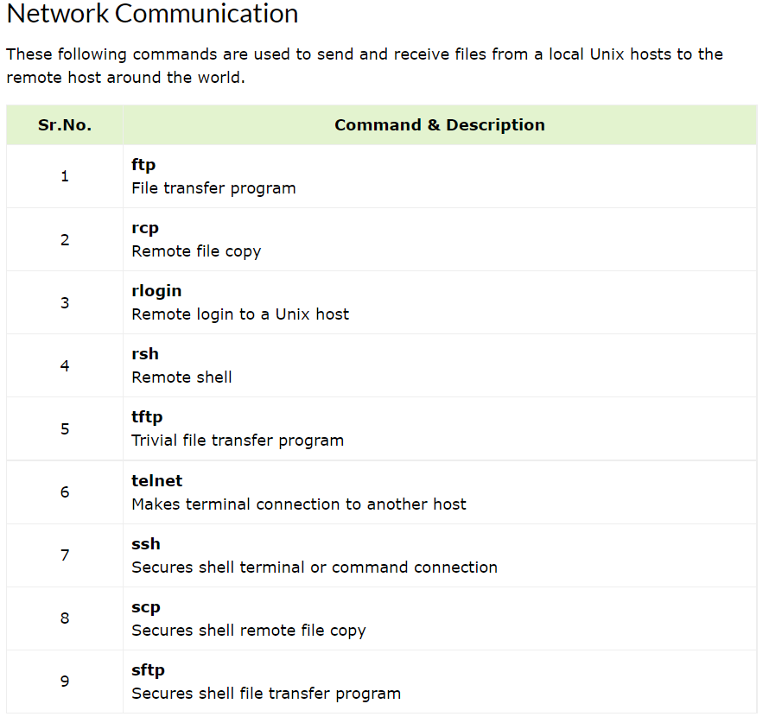
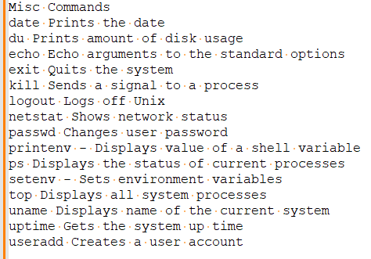
Unix / Linux - Useful Commands
Compressed Files
1 compress Compresses files
2 gunzip Helps uncompress gzipped files
3 gzip GNU alternative compression method
4 uncompress Helps uncompress files
5 unzip List, test and extract compressed files in a ZIP archive
6 zcat Cat a compressed file
7 zcmp Compares compressed files
8 zdiff Compares compressed files
Programming Utilities
1 gdb - GNU debugger
2 make Maintains program groups and compile programs
3 nm Prints program's name list
4 size Prints program's sizes
5 gcc/g++ GNU ANSI C Compiler
6.py - Python
7.mysql - Runs the mysql SQL interpreter

Slide 20
Unix / Linux - Regular Expressions with SED(stream editors)
sed (stream editor) is a powerful command-line tool for text stream processing.
/pattern/action
1.Search and Replace
input_file="fruits.txt"
sed 's/apple/orange/g' "$input_file" #replace all apple with orange
sed "s/$old_word/$new_word/g" "$input_file"
2: Delete Lines Matching a Pattern
sed '/banana/d' "$input_file"
3: Add a Line After a Matching Pattern
sed '/apple/a Mango' "$input_file"
4.Delete Empty Lines
sed '/^$/d' "$input_file"

Slide 21
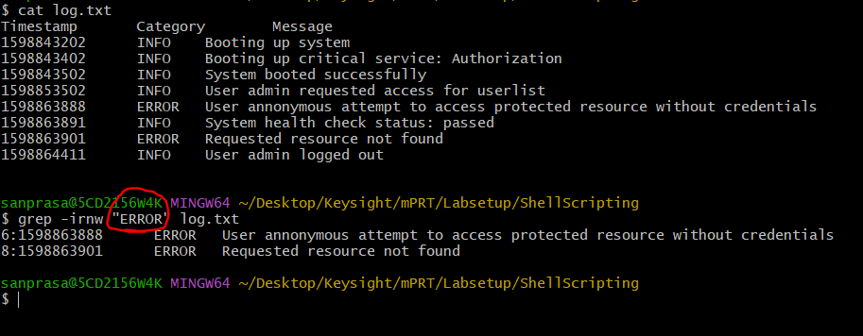
Unix / Linux - Difference Between grep, sed, and awk
-Text processing Tool in Linux - grep ,sed and awk
-Completely different tool and their functionality overlapping in some simple scenario
-Find a pattern and print in screen all three can do
grep - best for pattern match and print
sed - best for pattern match and print and substitution
awk - best for pattern match and print and substitution being the most powerful of these tools, is a scripting language that offers
a multitude of features that do not exists in the former two.
grep
The grep command searches for lines matching a regex pattern and prints those matching lines to the standard output.
It is useful when we need a quick way to find out whether a particular pattern exists or not in the given input
Basic Syntax
grep [OPTIONS] PATTERN [FILE...]
PATTERN is a regex pattern defining what we want to find in the content of the files specified by the FILE argument.
To print the five lines A a match, we can use the flag -A:
grep -A 5 ERROR log.txt
To print the five lines before a match, we can use the flag -B:
grep -B 5 ERROR log.txt
To print both the five lines before and the five lines after a match:
grep -C 5 ERROR log.txt

Slide 22
Unix / Linux - Difference Between grep, sed, and awk
sed
The sed command is a stream editor that works on streams of characters. It’s a more powerful tool than grep as it offers more options for text processing purposes, including the substitute command, which sed is most commonly known for.
SED is a powerful text stream editor. Can do insertion, deletion, search and replace(substitution).
SED command in unix supports regular expression which allows it perform complex pattern matching.
common use of SED command in UNIX is for substitution or for find and replace
sed [OPTIONS] 'COMMAND'/SCRIPT [INPUTFILE]
OPTIONS
-e or --expression: Add the script to the commands to be executed.
-i or --in-place: Edit files in place.
-n or --quiet or --silent: Suppress automatic printing of pattern space.
COMMAND: The sed script or command that specifies the text manipulation to be performed.
It consists of one or more sed commands, each separated by semicolons (;). Common commands include:
s/regexp/replacement/flags: Substitute text based on a regular expression.
d: Delete lines.
p: Print lines.
a: Append text after a line.
i: Insert text before a line.
r: Read a file.

Slide 23
Unix / Linux - awk
grep "INFO" log.txt
sed -n "/INFO/p" log.txt
awk "/INFO/{print}" log.txt
# awk [options] script file ,script-> pattern/action > pattern = INFO ,Action Print #awk
Substituting the Matching String
awk‘s built-in method gsub to substitute all ERROR occurrences with CRITICAL
awk '{gsub(/ERROR/, "CRITICAL")}{print}' log.txt
awk Adding Header and Footer to the Document
# In awk, there’s a BEGIN block that will execute before it starts processing any line of the file. On the other hand, there is also an END block
awk 'BEGIN {print "LOG SUMMARY\n--------------"} {print} END {print "--------------\nEND OF LOG SUMMARY"}' log.txt

Slide 24
Unix / Linux - awk
Column Manipulation
Processing documents having a rows and columns structure (CSV style) is when awk really shines. For instance, we can easily print the first and second column, and skip the third one of our log.txt:
awk '{print $1, $2}' log.txt
Custom Field Separator
By default, awk handles white spaces as a delimiter. If the processing text is using a delimiter that is not white space (a comma, for example), we can specify it with the flag -F:
awk -F "," '{print $1, $2}' log.txt
Arithmetic Operation
The ability of awk to carry out arithmetic operations makes gather some numerical info about a text file easy. For example, let’s calculate the number of ERROR event occurrences in log.txt:
awk '{count[$2]++} END {print count["ERROR"]}' log.txt
In the script above, awk stores the counts of each distinct value Category column in the variable count. Then the script prints the count value at the end.
Numeric Comparison
Being a full-fledged scripting language, awk readily understands decimal values. This makes text processing easy when we need our script to interpret values as a number rather than as a simple string.
$ awk '{ if ($1 > 1598863888 ) {print $0} }' log.txt
1598863891 INFO System health check status: passed
1598863901 ERROR Requested resource not found
1598864411 INFO User admin logged ou

Slide 25
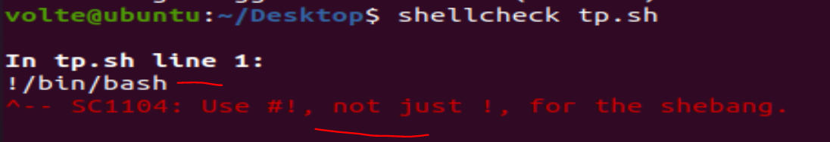
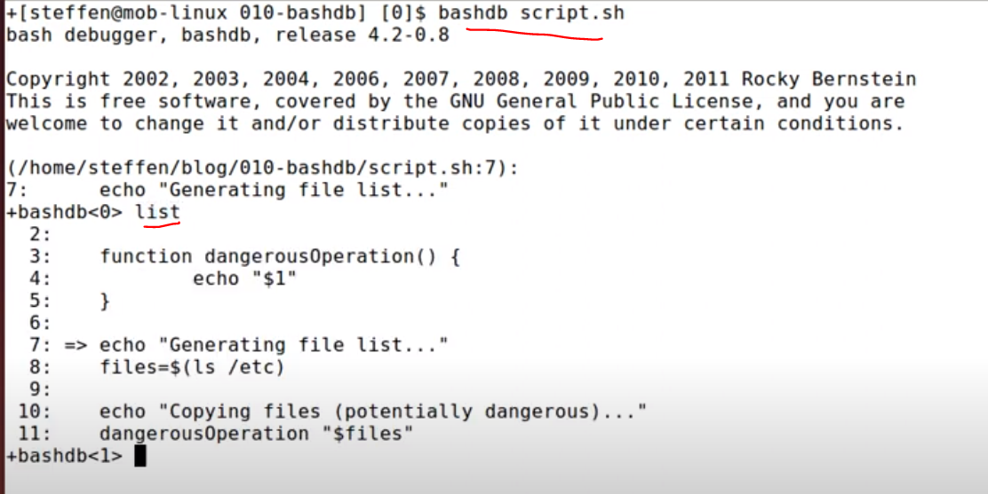
Unix / Linux - Bash Shell Scripting Debugging
1. Enable Script Tracing
set –x
# Disable tracing (optional)
set +x
2. echo Statements
# Debugging output
echo "Variable1: $variable1"
3. set -e: Exit on Error
Place set -e at the beginning of your script to make it exit immediately if any command exits with a non-zero status.
4. PS4 Environment Variable
PS4='Line ${LINENO}: ' # Customize debug output format
set -x
5. read Command
read command read variable
6.Logging - Implement logging in your script to record important events, variable values, timestamp and error messages.
7.shellcheck your_script.sh
ShellCheck is a static analysis tool for shell scripts that provides suggestions and warnings for common mistakes and pitfalls
8.logging to a file - exec > logfile.txt 2>&1 script.sh >log.txt 2>&1
9.Check and Print env variable - env
10.Use bashdb for run time analysis – Command like list ,step ,next

Slide 26
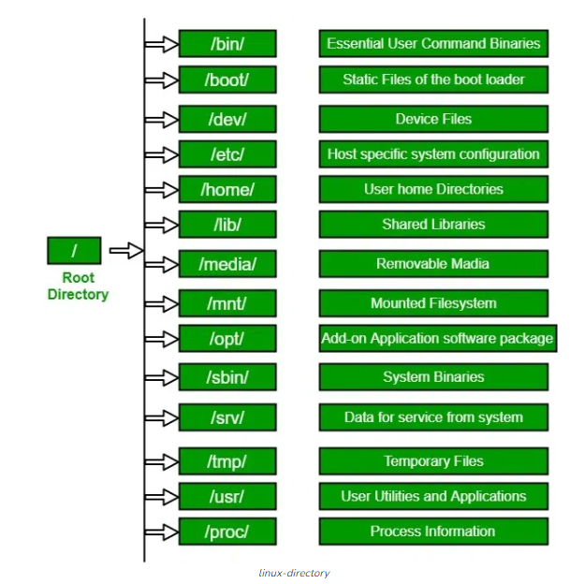
Unix / Linux - File System Basics
file system is a logical collection of files on a partition or disk. A partition is a container for information and can span an entire hard drive if desired.
file filename- Identifies the file type (binary, text, etc)
find filename dir Finds a file/directory
head filename Shows the beginning of a file
more filename Browses through a file from the beginning to the end
tail filename Shows the end of a file
touch filename Creates a blank file or modifies an existing file or its attributes
whereis filename Shows the location of a file
which filenameShows the location of a file if it is in your PATH
df -k (disk free) displays the disk space usage in kilobytes,
mount -t file_system_type device_to_mount directory_to_mount_to
umount /dev/cdrom

Slide 27
Unix / Linux - File System Basics
Unix / Linux - User Administration
Managing Users and Groups
/etc/passwd − Keeps the user account and password information. This file holds the majority of information about accounts on the Unix system.
/etc/group − This file contains the group information for each account.
useradd - Adds accounts to the system
Unix / Linux - System Performance
1 nice/renice Runs a program with modified scheduling priority
2 netstat Prints network connections, routing tables, interface statistics, masquerade connections, and multicast memberships
3 time Helps time a simple command or give resource usage
4 uptime This is System Load Average
5 ps Reports a snapshot of the current processes
6 vmstat Reports virtual memory statistics
7 top Displays system tasks

Slide 28
Unix / Linux – Signal and Trap
Unix / Linux - User Administration
Signals are software interrupts sent to a program to indicate that an important event has occurred. The events can vary from
user requests to illegal memory access errors. Some signals, such as the interrupt signal,
indicate that a user has asked the program to do something that is not in the usual flow of control.
#kill -l #list of signals
SIGHUP 1 Hang up detected on controlling terminal or death of controlling process
SIGINT 2 Issued if the user sends an interrupt signal (Ctrl + C)
SIGQUIT 3 Issued if the user sends a quit signal (Ctrl + D)
SIGFPE 8 Issued if an illegal mathematical operation is attempted
SIGKILL 9 If a process gets this signal it must quit immediately and will not perform any clean-up operations
SIGALRM 14 Alarm clock signal (used for timers)
SIGTERM 15 Software termination signal (sent by kill by default)
Sending Signals
$ kill -signal pid
kill -9 1001 #kill a process
Trapping Signals
$ trap commands signals
Clean up temporary files
Ignore signals
#cal ->calender

Slide 29
Unix / Linux – Signal and Trap
Unix / Linux - User Administration
#passwd - password change
#$ whoami
sanprasa
logout -> Logging Out
init 0 poweroff
init 6 reboot
poweroff
reboot
shutdown
Metacharacters
$ls ch*.doc
Hidden Files
.profile − The Bourne shell ( sh) initialization script
Counting Words in a File
$ wc filename
2 19 103 filename(line,words,bytes)
Unix - Pipes and Filters
$grep pattern file(s)
ls -l | grep "Aug"

Slide 30
Unix / Linux – Signal and Trap
Unix / Linux - User Administration
#passwd - password change
#$ whoami
sanprasa
logout -> Logging Out
init 0 poweroff
init 6 reboot
poweroff
reboot
shutdown
Metacharacters
$ls ch*.doc
Hidden Files
.profile − The Bourne shell ( sh) initialization script
Counting Words in a File
$ wc filename
2 19 103 filename(line,words,bytes)
Unix - Pipes and Filters
$grep pattern file(s)
ls -l | grep "Aug"

Slide 31
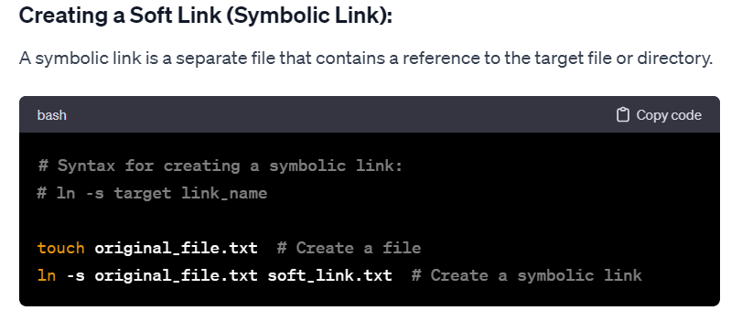
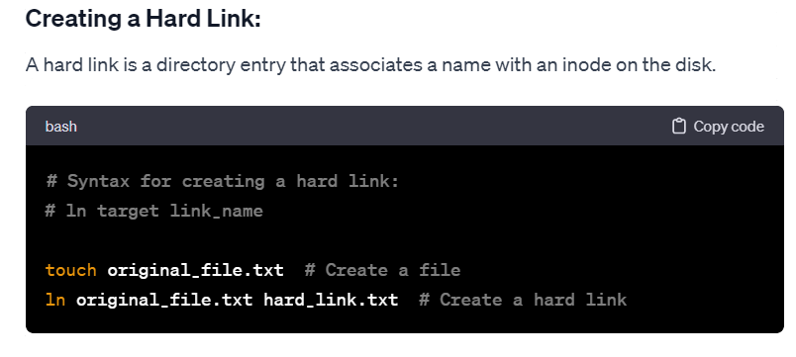
Unix / Linux – Hard and soft link
A hard link is a file that points to the same underlying inode, as another file. If delete one file, it removes one link to the underlying inode.Same fs
A symbolic link (also known as soft link) is a link to another filename in the filesystem.Different FS

Slide 32
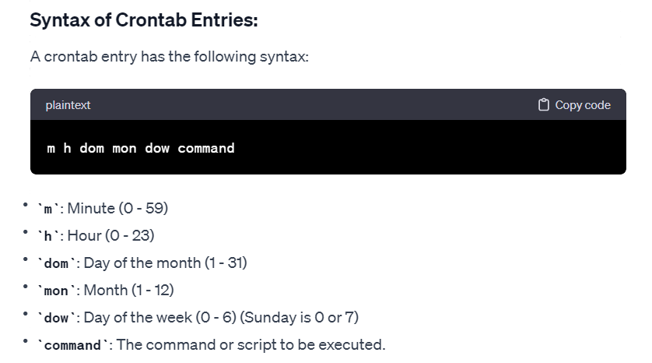
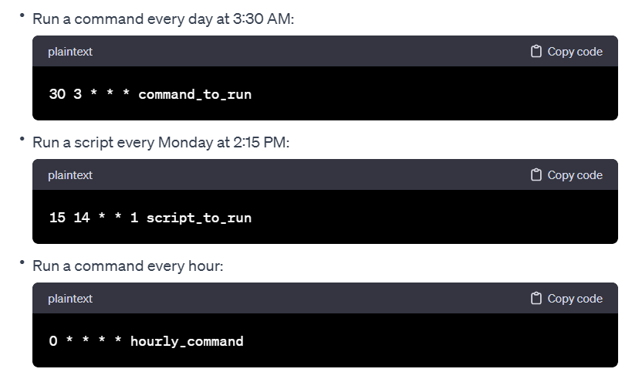
Unix / Linux – CronTab
Shell takes input from functional argument ,script command line argument & read command
echo ${variable:x:y} Where X is the starting position and y is the string length.
cron is a time-based job scheduler in Unix-like operating systems. Users can schedule tasks (commands or scripts) to run periodically at fixed times, dates, or intervals using cron. The crontab command is used to create, modify, and manage these cron jobs for individual users.
Viewing the Current User's Crontab: crontab -l
Editing the Current User's Crontab: crontab -e

Slide 33
Linux Shell Scripting - Real Time Projects
1. ListRefine
Purpose: Cleans up messy lists by removing duplicates and fixing formatting, especially for colon- or space-separated items.
2. DiskGuard
Purpose: Watches your disk space and sends an alert via mail(gmail) if it’s getting too full, so you don’t run into problems.
3. ExecFinder
Purpose: Helps you find where a program or command lives on your system, just like the which command.
4. NameFixer
Purpose: Renames files and folders by replacing spaces with dashes, making them easier to use and more consistent.

Slide 34


