Slide 1

Git and GitHub
Git and GitHub Tutorial
Present by
Sanjeet Prasad
Email sanjeet8.23@gmail.com
Dated 8th April 2024
Disclaimer Content sourced from the internet, including Google, is used for illustration purposes. We do not claim ownership and include it solely to enhance the presentation. Contact us if you wish for removal or attribution

Slide 2

Git and GitHub
What is git ?

Slide 3
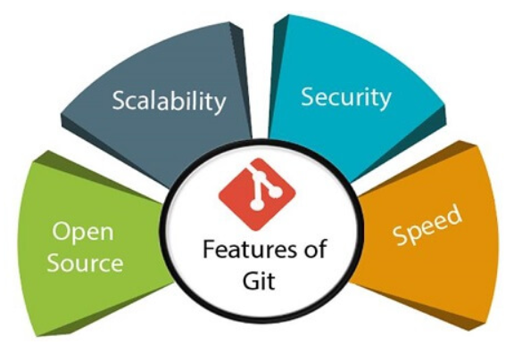
Git
Git is a opensource distributed version control system that tracks changes in any set of computer files, usually used for coordinating work among programmers who are collaboratively developing source code during software development.
Git downlink link - https://git-scm.com/downloads

Slide 4
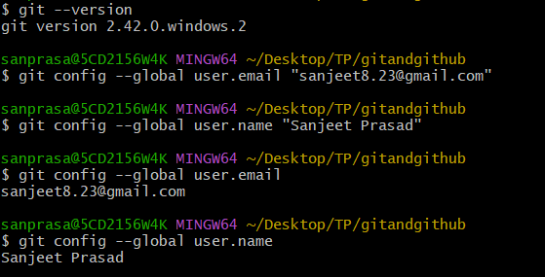

Git Commands
Git is a distributed version control system that tracks changes in any set of computer files, usually used for coordinating work among programmers who are collaboratively developing source code during software development.

Slide 5
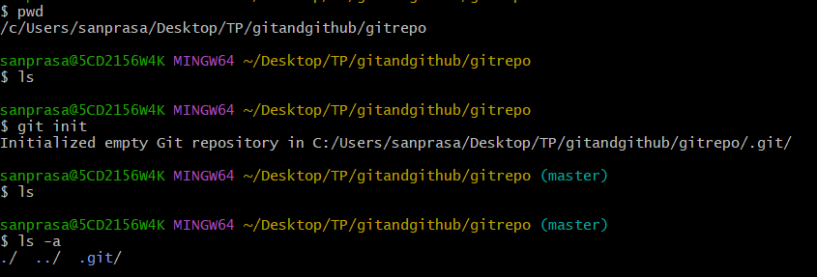
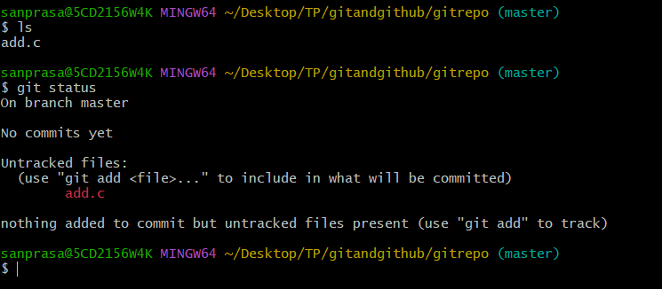
Git Repository
git-init - Create an empty Git repository or reinitialize an existing one
2) Create any files in git master branch for commit ,then use git status command to see

Slide 6
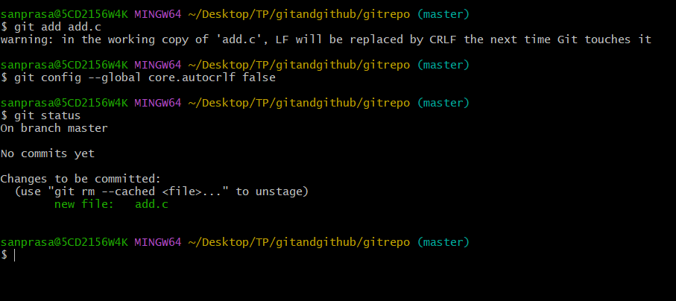
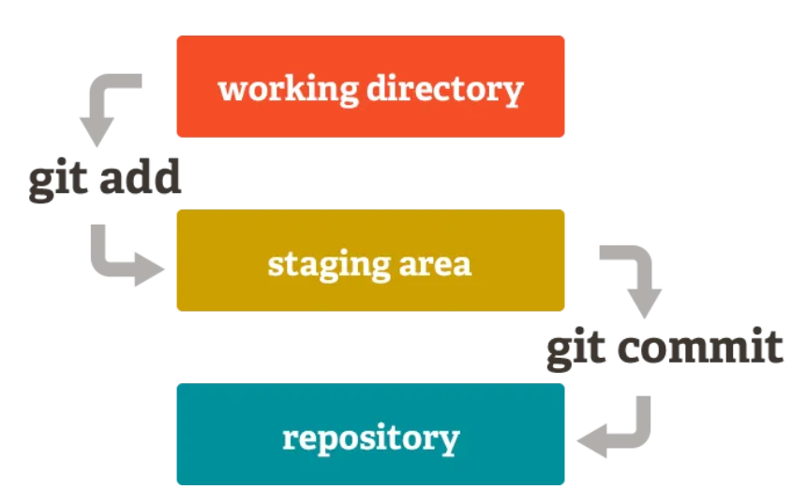
Git Repository
3) Staging(git add filename) – Add file and start tracking(staging area)

Slide 7
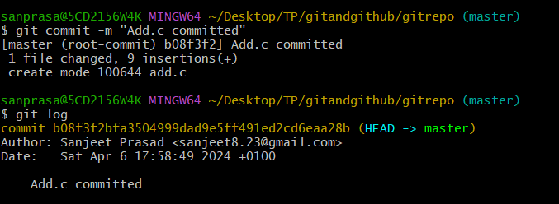
Git Repository
Commit(git commit –m “Add.c file commited” – Moving from staging to commit area
Committed items (git log )

Slide 8
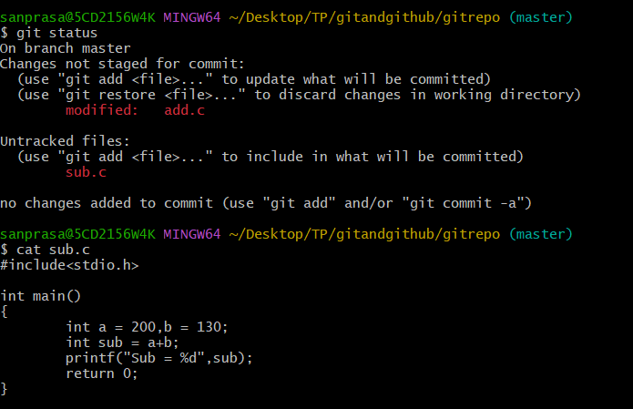
Git Repository
6) Modified add.c file and create a new file sub.c ,one is showing modified and others showing as untracked ,so use git add filename move from working dir to staging area

Slide 9
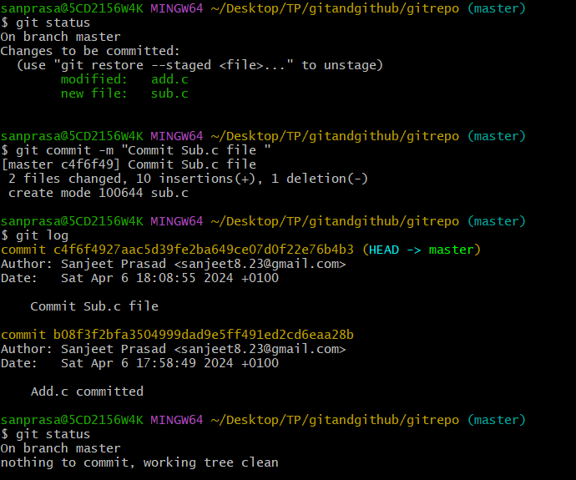
Git Repository
7)Git add all files name then do commit

Slide 10
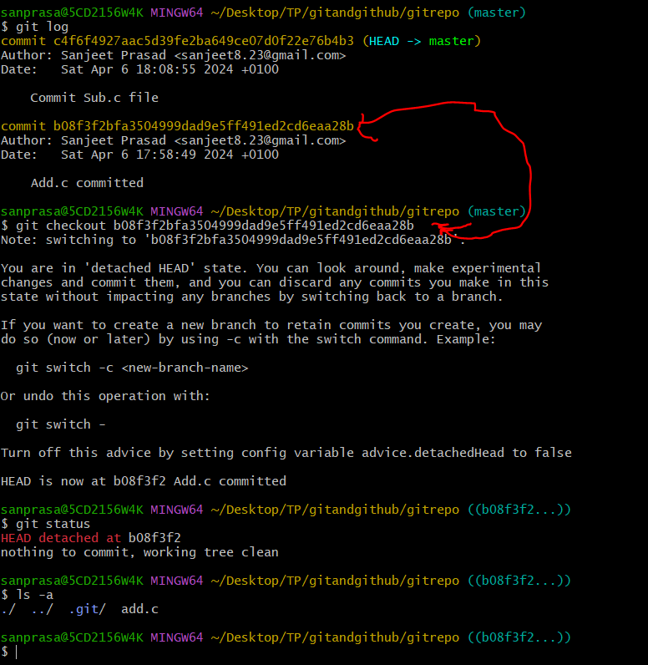
Git Repository
8)Check with different commit id /timeline ,use command git checkout branchname/commit id
9)If anyone want to come back to original or latest master ,git checkout master/commit id

Slide 11
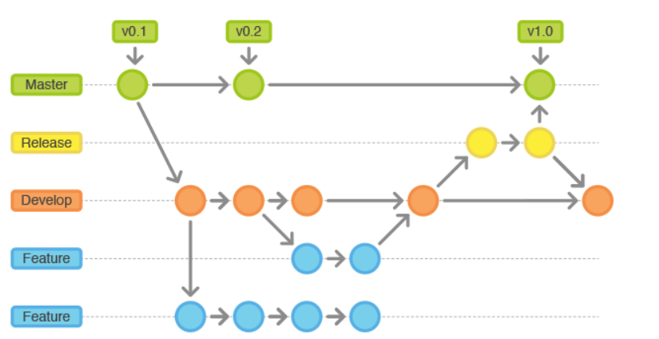
Git Repository
10)Git branch concepts
Master is a permanent branch which always reflects a production-ready state. So yes, it is for ready-product which can be downloaded on the market by user.
Release is a temporal supporting branch to support preparation of a new production release. This means mainly bug fixing, documentation, etc as pointed out by minas.

Slide 12
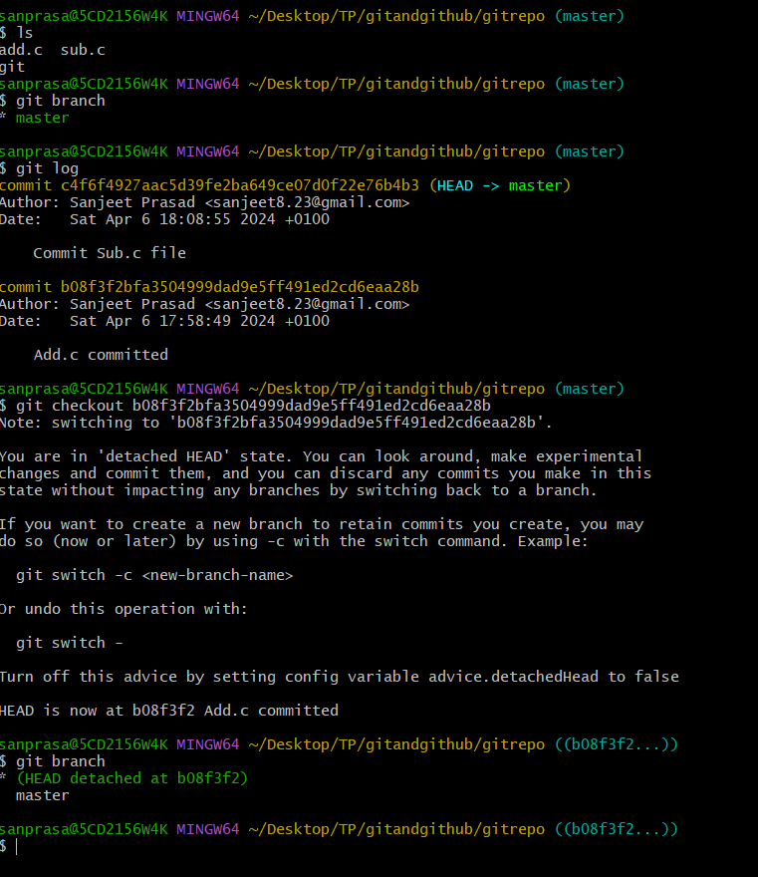
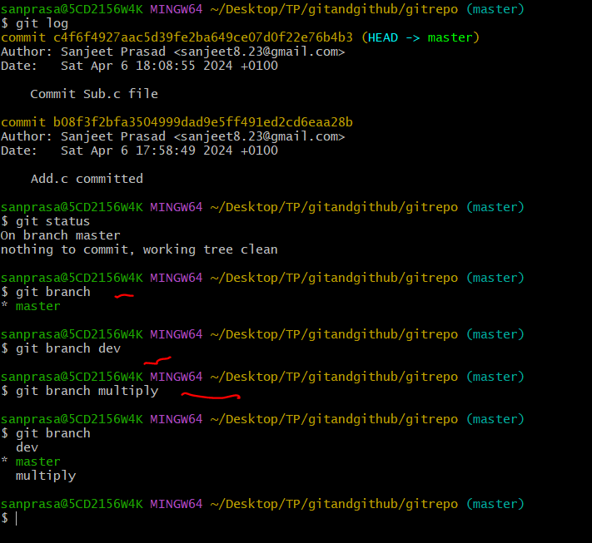
Git Repository
11)Creating a new Git branch - git branch branchname
One can see the list of branches – git branch
Create a new branch and checkout – git checkout –b branchname

Slide 13
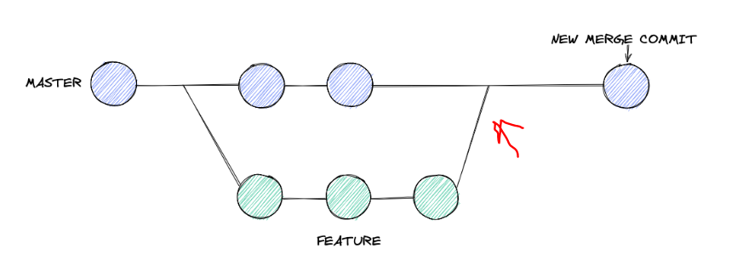
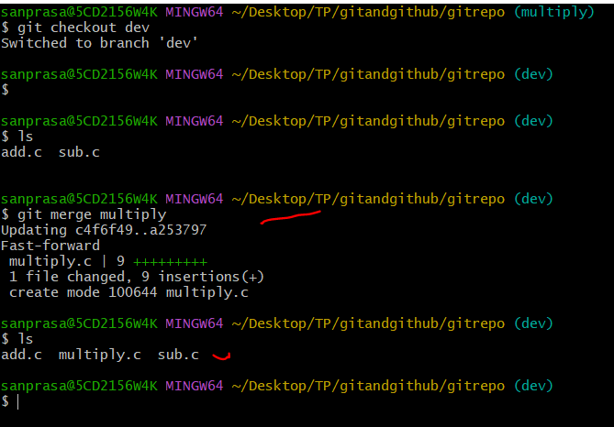
Git Repository
11)Git merge concept
Command -> git merge branchname
Example : step 1 ) First checkout to branch where want to merge(dev) and then command git merge multiply

Slide 14
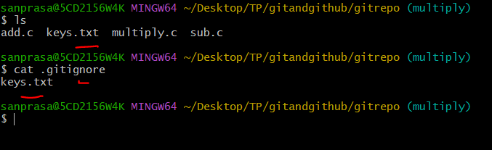
Git Repository
11)Git Ignore concept
In a project ,if someone want to hide any file and does not want to check in any repository then use .gitignore file and write the list of files to be ignore

Slide 15
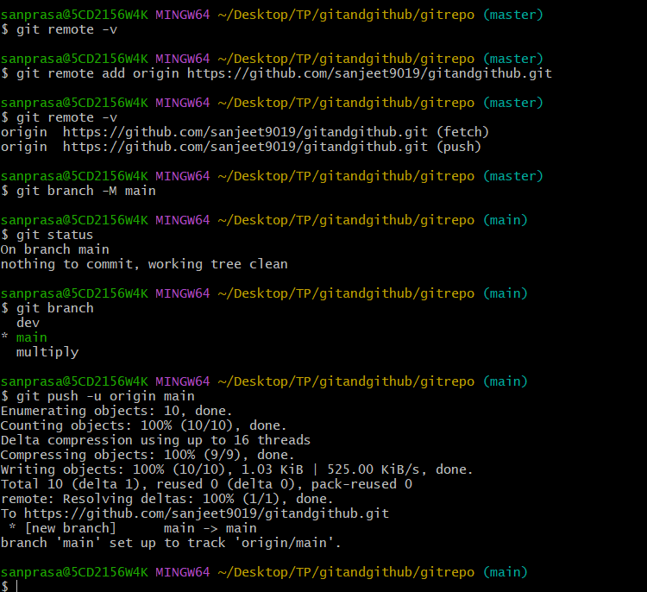
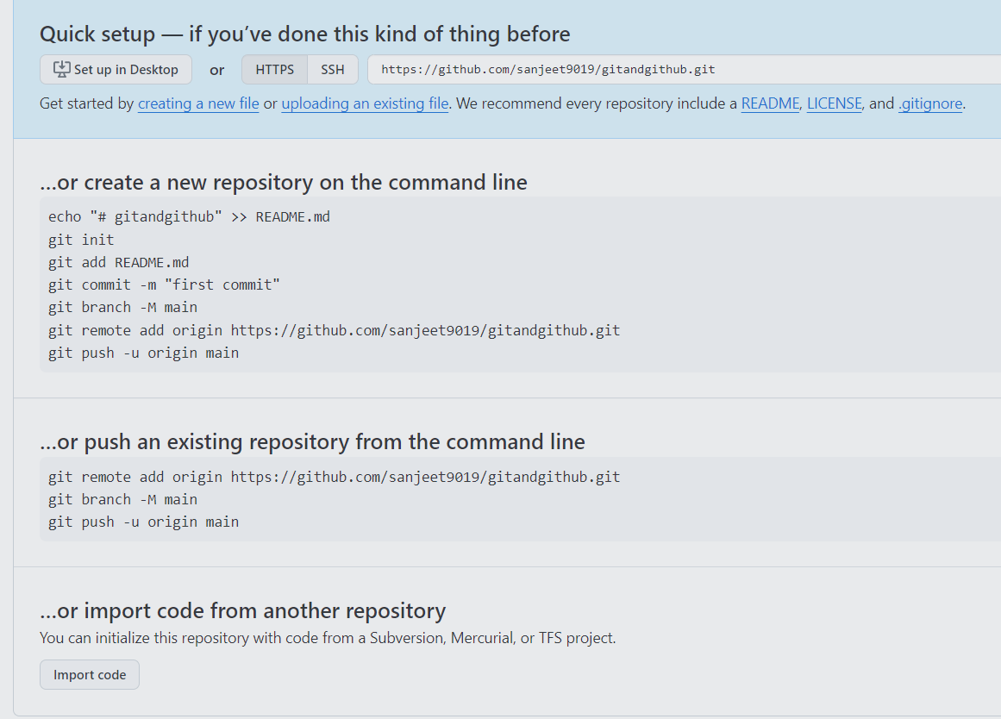
GitHub Repository
1)To push your code in GitHub ,first you need to create the git repository using create git repo
2) git remote add origin https://github.com/sanjeet9019/gitandgithub.git
git branch -M main(rename current branch (master) to main)
git push -u origin main

Slide 16
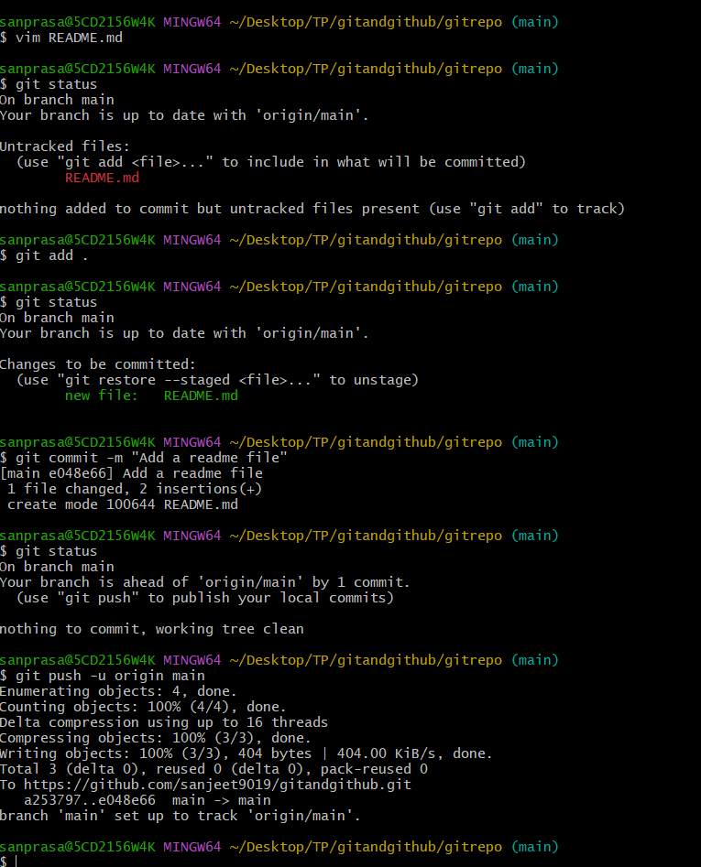
GitHub Repository
Make changes and added ,edit file and push code to GitHub as below example
git push -u origin main

Slide 17
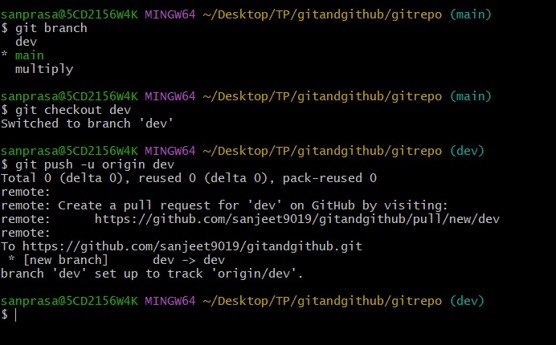
GitHub Repository
Push other branch as well in git hub

Slide 18
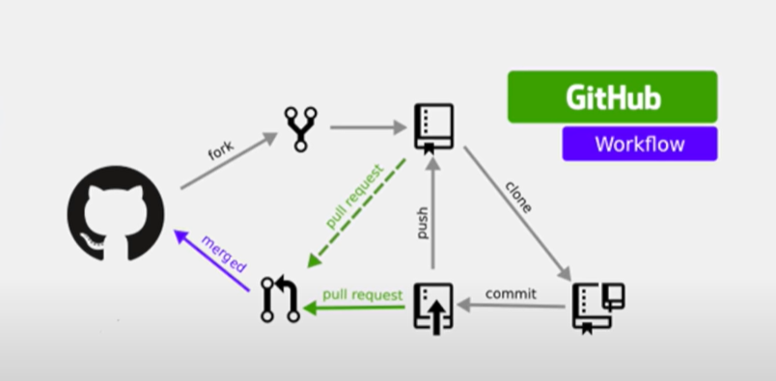
GitHub Opensoure
Open Source contribution gitHub

Slide 19


