Slide 1

Data Visualization of Bird Strikes between 2000 - 2011
WIREFRAM DOCUMENT
PREPARED BY
SANJEET AGRAWL

Slide 2
PROJECT DETAIL
Project :- Title Data Visualization of Bird Strikes between 2000 – 2011
Technologies:- Data Science
Domain :- Transportation and Communication
Project Difficulties level:- Advanced
PROBLEM STATEMENT
Transport and communication is one of the crucial domain in field of analytics. Environmental impacts and safety are, nowadays, two major concerns of the scientific community with respect to transport scenarios and to the ever-growing urban areas. These issues gain more importance due to the increasing amount of vehicles and people. Seeking for new solutions is reaching a point where available technologies and artificial intelligence, especially MAS, are being recognized as ways to cope and tackle these kinds of problems in a distributed and more appropriate way. A bird strike is strictly defined as a collision between a bird and an aircraft which is in flight or on a take-off or landing roll. The term is often expanded to cover other wildlife strikes - with bats or ground animals.
Bird Strike is common and can be a significant threat to aircraft safety. For smaller aircraft, significant damage may be caused to the aircraft structure and all aircraft, especially jet-engine ones, are vulnerable to the loss of thrust which can follow the ingestion of birds into engine air intakes. This has resulted in several fatal accidents. Bird strikes may occur during any phase of flight, but are most likely during the take-off, initial climb, approach and landing phases due to the greater numbers of birds in flight at lower levels. To have a closer look the following document visually depicts the data collected on Bird Strikes by FAA between 2000-2011.

Slide 3
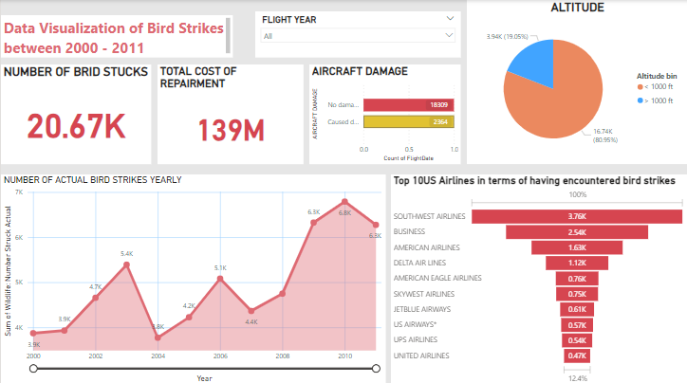
DATASET INFORMATION
This is a report related dataset that contains Information like Phase of flight, Precipitation, Cost: Total ,Pilot warned of birds or wildlife?, Number of people injured, Feet above ground, Flight Date , Impact to flight etc.
Total number if bird strikes is around 21 thousand in the span of 11 years which resulted in the repair cost of 139 million dollar.
Out of 20,673 flights that have been involved in a bird strike incident, 18,309 received no damage while 2364 received small to large scale damages.
Number of bird strikes continue to increase yearly from 2000 to 2011.
Airlines namely, Business , Southwest Airlines , American Airlines, Delta Air Airlines, US Airlines are more involved in bird strikes than other airlines.
81 percent of the planes were flying at an altitude <1000 While 19 Percent of the planes were at altitude >1000 when the strikes occurred.

Slide 4
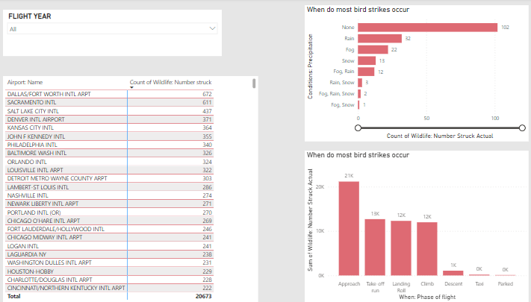
DALLAS/FORT WORTH INTL AIRPORT has the highest number of birds strikes than any other airport .it received 672 strikes, followed by SACRAMENTO INTL with 611 strikes .
SALT LAKE CITY (437), DENVER INTL AIRPORT (371) , KANSAS CITY INTL (364) , PHILADELPHIA INTL (355) are among the top airports with most number of air strikes.
Rain, Fog or Snow has little to no relation with respect to bird strikes and its seen in most of the cases when strike occurred, the weather was fine.
A high number of strikes occurred when the plane was approaching the runway.
Strikes also occurred when the planes were taking off, landing, climbing to altitude or descent almost no strikes were reported when planes were either parked or being taxied

Slide 5
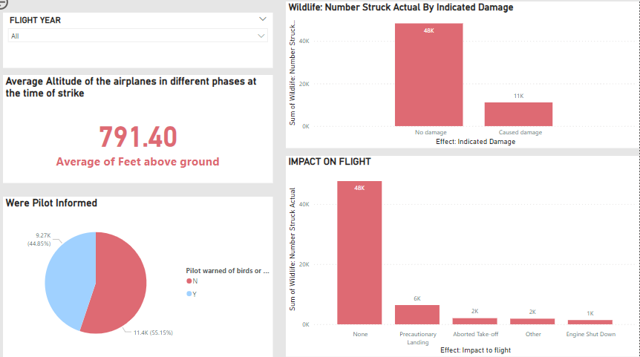
In 55 % cases pilots were not informed or were unaware of the possible bird strikes where as in 45 percent cases they were informed prior to the strikes.
81% bird strikes results in no damage to the plane or the flight schedule.
9.14% bird strikes resulted in precautionary landing of the flight. 3.12 % bird strikes resulted in Take-off being aborted.
2.16% bird strikes caused engine shut down.
Average altitude at which most of the strikes occurred is 791.40 ft. from ground

Slide 6
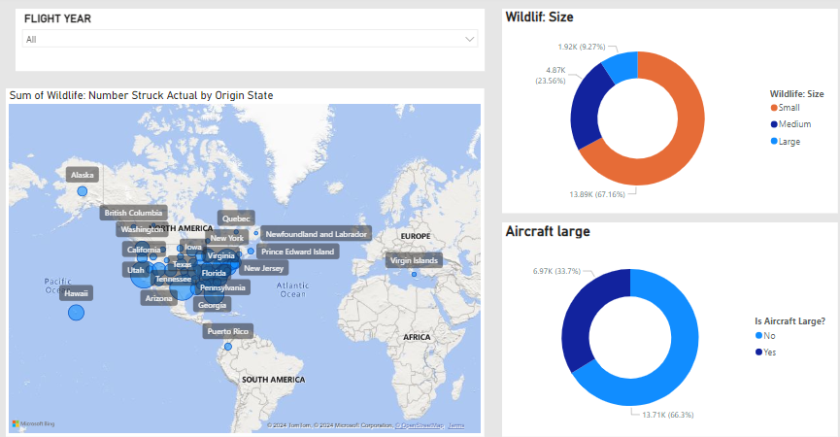
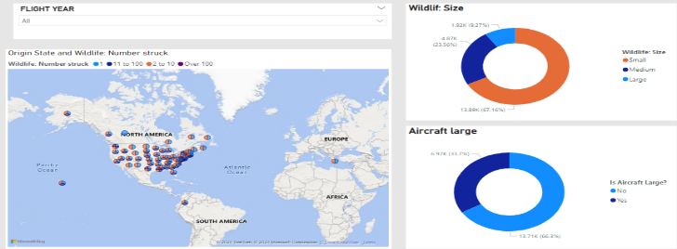
The state of California is involved with most number of bird strikes in all of the New York at 4261 strikes , followed by Taxes with .
States like Montana received a comparatively low number of strikes.
In most of the cases aircraft involved was not a large aircraft.
Size of birds was small in most of the cases of bird strikes follwed by medium and then large.

Slide 7
THANK YOU

