Slide 1

PATH TO BECOME DATA SCIENTIST
Event : Data-Strata
Tecnoesis, 2018
Presented by
Tulasi Ram
Sanjeeth Boddinagula

Slide 2
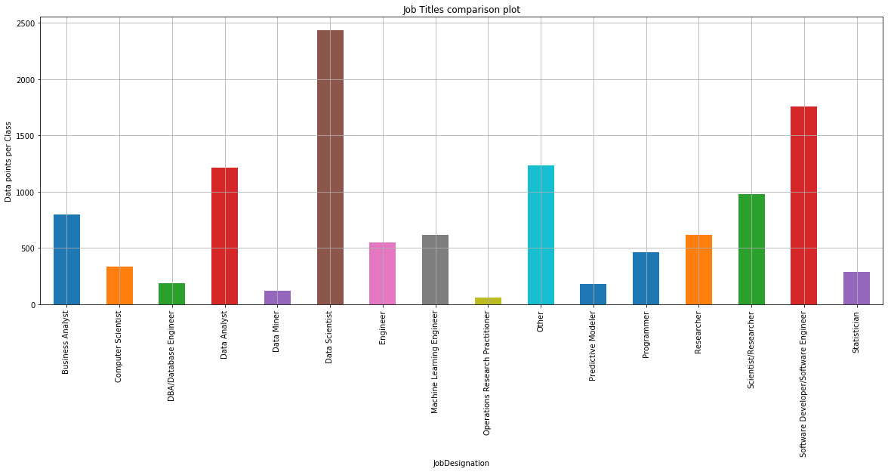
Job Profiles Distributions
Compared to all job profiles percentage of data scientists is more.

Slide 3
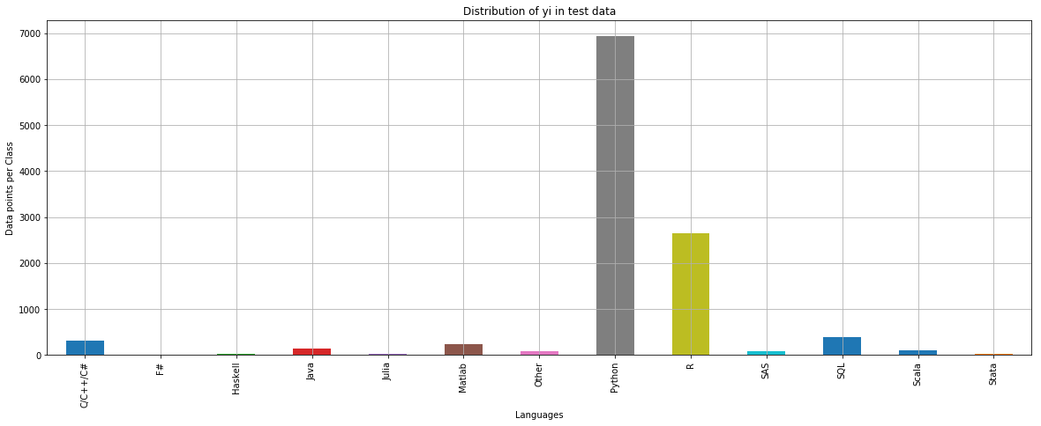
Programming Languages Used
From the distributions it is very clear that python and R are most used programming languages irrespective of the field of the work and they are outperforming other.
And compared to R language, python is far more used.

Slide 4
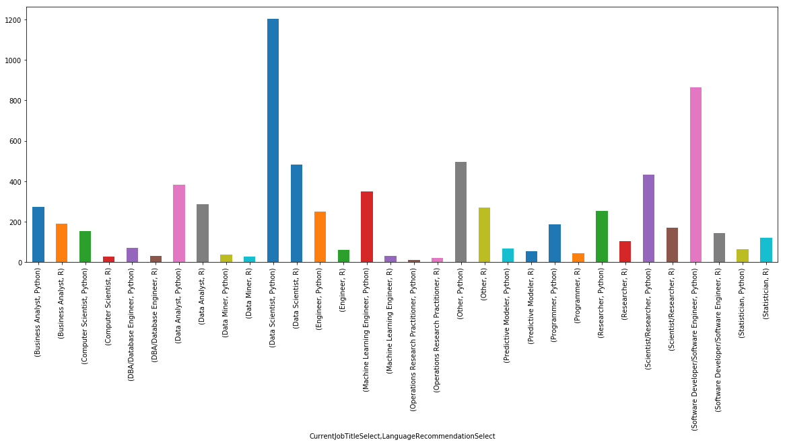
Python vs R
We can see that Python is leading programming language compared to R in every field.

Slide 5
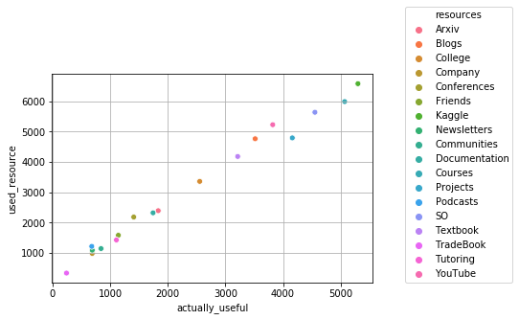
Learning Platform Usefulness for all Job Profiles
From the plot, we can observe that a lot of people used Kaggle as learning platform and found useful.
Top resources that are useful for learning are Kaggle, Stack Overflow, Online Courses, YouTube, Project, Blogs etc.
People who learnt from Friends, Podcasts, Trade Books, Communities, Tutoring, Arxiv found not that much useful.
We can see that the number of people who used YouTube for learning are greater than Projects but the usefulness of Projects is more.

Slide 6
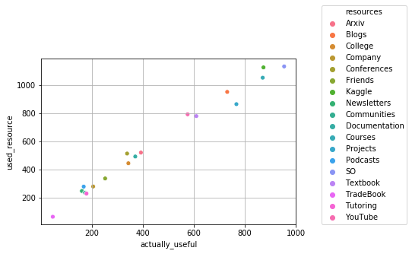
Learning Platform Usefulness for Data Scientists
Surprisingly and Obviously many Data Scientists learnt from StackOverflow. We can observe this in the above plot.
The top resources used by Data Scientists are StackOverflow, Kaggle, Projects, Courses, Blogs.

Slide 7
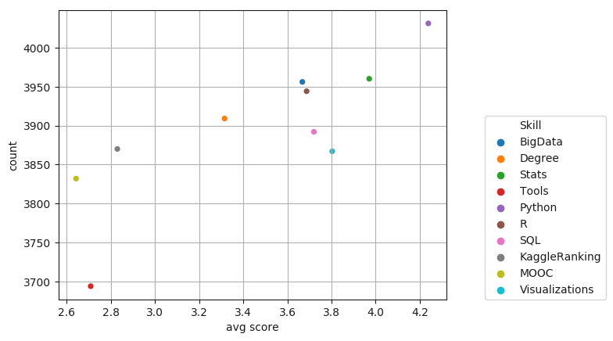
Job Skills
By considering all Fields, Python is highly demanded job skill followed by Stats, Visualizations, SQL etc.

Slide 8
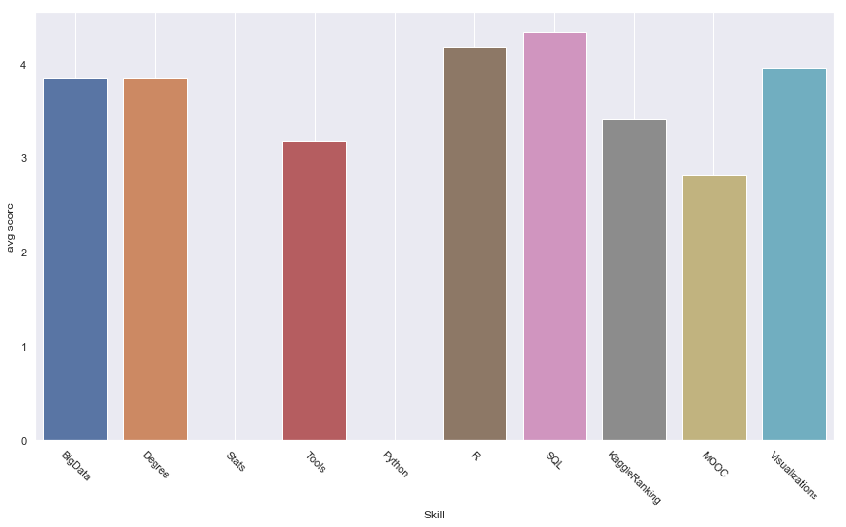
Job Skills Required for Data Scientists
Even though python is mostly asked skill throughout many fields, SQL is the most prefferred job skill for data scientists position followed by R, Data Visualization.
Python is not considered as job skill for Data scientists.

Slide 9
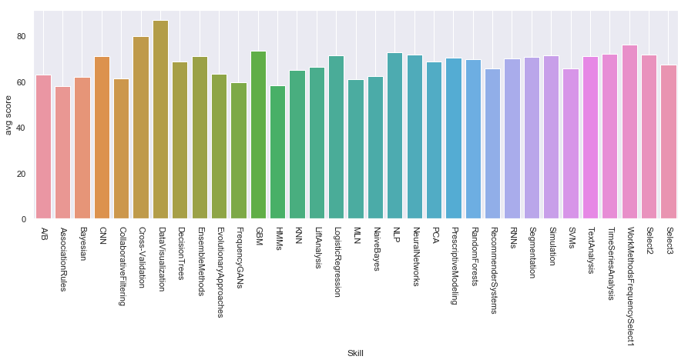
Methods/Algorithms used in each field.
Seeing the Bar graph we can clearly say that Data Visualization is mostly use method in every field.
Top methods are Data Visualization, cross-validation, GBM, CNN, Ensembles, Decision Trees etc.

Slide 10
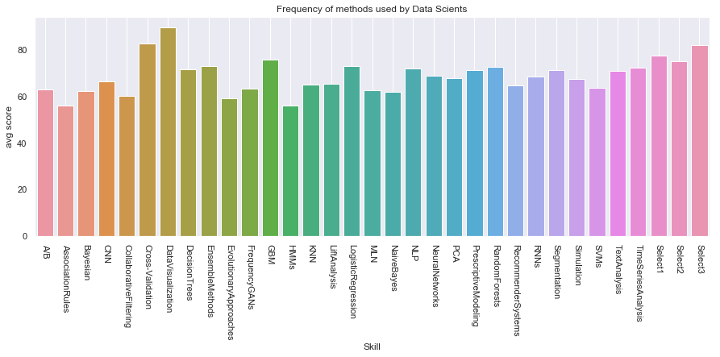
Methods used by data scientists
Top methods used by Data Scientists are Data visualizations, cross-validation, Gradient Boosting, Ensembles etc.

Slide 11
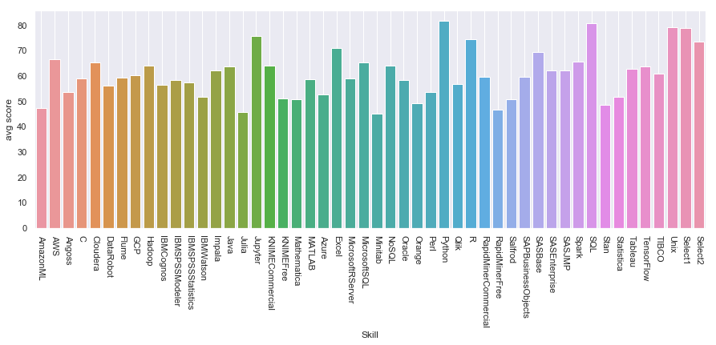
Tools
Mostly used Tools are SQL, Python, Jupyter, Java, AWS etc.

Slide 12
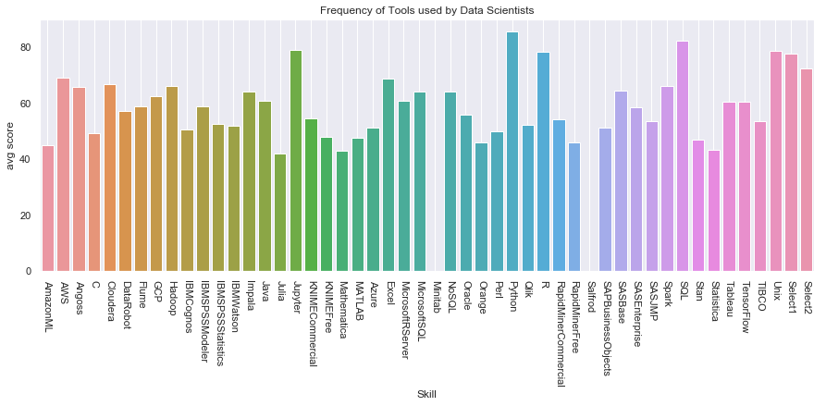
Tools Used by Data Scientists
Python, SQL, R, Jupyter Notebooks etc.. are the tools widely used by Data Scientists.

Slide 13
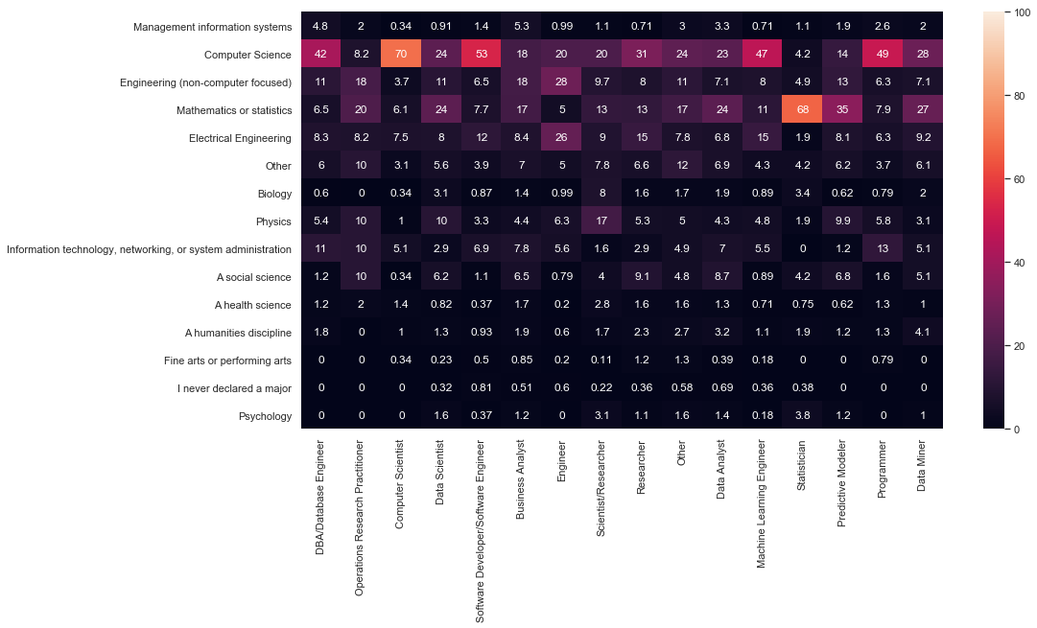
Majors

Slide 14
There was always a question on what Major a person should choose to get into a specified path.
If we look at the Heat maps, we can say each field has employee from almost all Majors, but varying the percentage of population.
If you have true passion towards a field of work, Major will not be an obstacle.

Slide 15
CONCLUSIONS
Learn Python Language Since it is mostly used programming Languages by Data Scientists followed by R (second most preferred language).
Use Learning Resources such as Kaggle, Stack Overflow, YouTube, Online Courses and Projects to become a good Data Scientist.
To excel your career as Data Scientist, the major job skills required are SQL, visualizations etc. as most of the companies prefer them.
Learn the top methods used by Data Scientists such as Data visualizations, cross-validation, Gradient Boosting, Ensembles etc.
Get a grip on tools such as Python, SQL, R, Jupyter etc..
To become a Data Scientist, Major you are going to pursue will not be an obstacle. But most of the Data Scientists come from Computer Science, Engineering, Statisticians backgrounds. Choosing them as a Major may slightly benefit you.

Slide 16
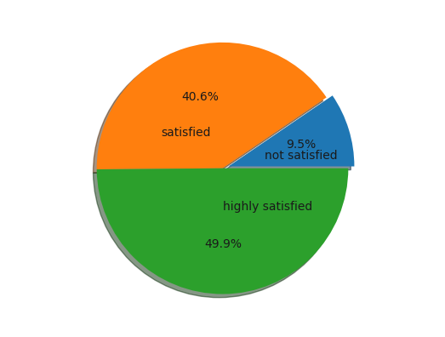
How satisfied are they?
Almost 90% are highly satisfied being Data Scientists. Only a few(9.5%) are not satisfied.

