Slide 1

An Introduction to
Cloud Computing
By
Ramandeep Singh

Slide 2
Agenda
Example
Define
  Cloud Computing
  Uses
  SaaS
  Utility Computing
What is new in cloud computing?
Components
Challenges & opportunities
Future of Cloud Computing

Slide 3
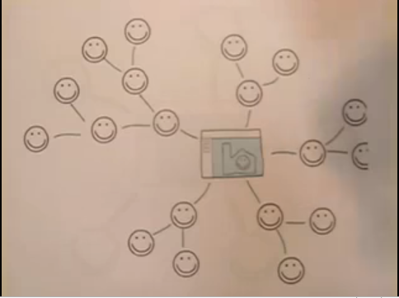
Example

Slide 4
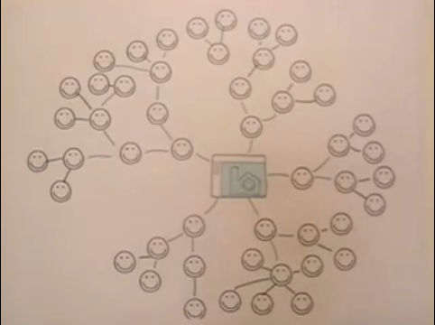
Cont.

Slide 5
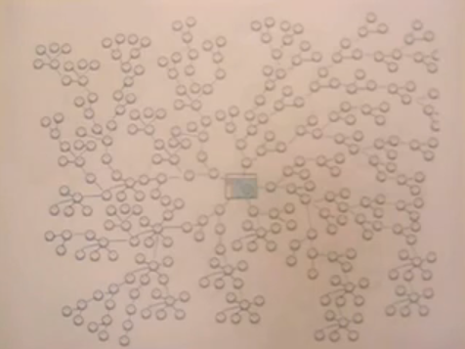
Conti.

Slide 6
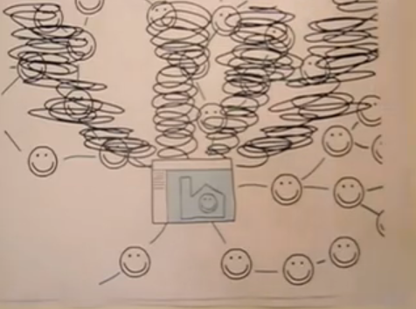
Cont.

Slide 7
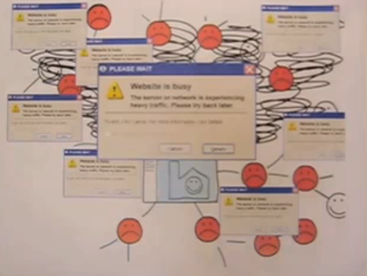
Conti.

Slide 8
Two Solutions
Buy more servers and recourses.
Move to Cloud

Slide 9
Definition
I don’t understand what we would do differently in the light of Cloud Computing other than change the wordings of some of our ads.
Larry Ellision, Oracle’s CEO
I have not heard two people say the same thing about it [cloud]. There are multiple definitions out there of “the cloud”.
Andy Isherwood, HP’s Vice President of European Software Sales
It’s stupidity. It’s worse than stupidity: it’s a marketing hype campaign.
Richard Stallman, Free Software Foundation founder
http://www.youtube.com/watch?v=6PNuQHUiV3Q&feature=related

Slide 10
Cloud Computing
Cloud Computing refers to both the applications delivered as services over the Internet and the hardware and systems software in the datacenters that provide those services.
The services themselves have long been referred to as Software as a Service (SaaS).
The datacenter hardware and software is what we will call a Cloud.

Slide 11
USES
Helps to use applications without installations.
Access the personal files and data from any computer with internet access.
This technology allows much more efficient computation by centralizing storage, memory and processing .

Slide 12
5 Essential Cloud Characteristics
On-demand self-service
Broad network access
Resource pooling
  Location independence
Rapid elasticity
Measured service
  Pay as you go.

Slide 13
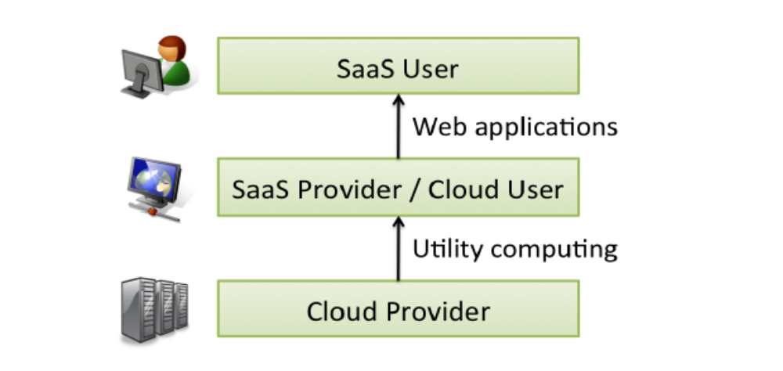
Cloud Structure

Slide 14
SOFTWARE AS A SERVICE (SAAS)
Application is used as an on demand service. Often provided via the Internet
Example: Google App (online office)
Benefits to users
  Reduce expenses: multiple computers, multiple users
  Ease of usage: easy installation, access everywhere
Benefits to providers
  Easier to maintain
  Control usage (no illegal copies)

Slide 15
UTILITY COMPUTING - BENEFIT TO USERS
Mitigate the risks of over-provisioning and under-provisioning
No up-front cost, invest on other aspects (marketing, technology…)
Less maintenance & operational cost
Save time, time = money
➔ In summary: Reduce cost

Slide 16



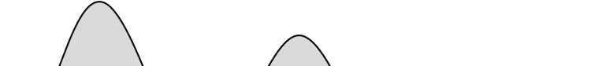

UTILITY COMPUTING – MITIGATE RISKS
Capacity
Real world utilization 5%-20%
Animoto demand surge:
from 50 servers to 3500
servers in 3 days
Black Friday sales
Demand
t
Capacity
Capacity
Demand
Demand
t
1
2
3
t

Slide 17
UTILITY COMPUTING – BENEFIT TO PROVIDERS
Make money
  Economies of scale
Resource | Cost for medium scale | Cost for large scale | Ratio
Network | $95 / Mbps / month | $13 / Mbps / month | ~7x
Storage | $2.20 / GB / month | $0.40 / GB / month | ~6x
Administration | ≈140 servers/admin | >1000 servers/admin | ~7x

Slide 18
AMAZON EC2
Elastic Compute Cloud
Rent virtual machine instances to run your software. Monitor and increase / decrease the number of VMs as demand changes
How to use:
  Create an Amazon Machine Image (AMI): applications, libraries, data and associated settings
  Upload AMI to Amazon S3 (simple storage service)
  Use Amazon EC2 web service to configure security and network access
  Choose OS, start AMI instances
  Monitor & control via web interface or APIs

Slide 19
AMAZON EC2
Characteristics:
  Elastic: increase or decrease capacity within minutes
    Monitor and control via EC2 APIs
  Completely controlled: root access to each instances
  Flexible: choose your OS, software packages…
    Redhat, Ubuntu, openSuse, Windows Sever 2003,…
    Small, large, extra large instances
  Reliable: Amazon datacenters, high availability and redundancies
  Secure: web interface to configure firewall settings
Cost:
  CPU: small instance, $0.10 per hour for Linux, $0.125 per hour for Windows (1.0-1.2 GHz 2007 Opteron or 2007 Xeon processor)
  Bandwidth: in $0.10, out $0.17 per GB
  Storage: $0.10 per GB-month, $0.10 per 1 million I/O requests

Slide 20
WHAT IS A CLOUD?
Software and hardware to operate datacenters
Public cloud: cloud used to provide utility computing
  Amazon EC2: Amazon datacenters, Xen, EC2 APIs and administrative interface
  Google AppEngine: Google data center, GFS, AppEngine APIs, administrative interface…
  Batch processing softwares: MapReduce, Hadoop, Pig, Dryad
Private cloud: datacenters, not available for rental
How about the academic clouds?
  Protected clouds

Slide 21
WHAT IS NEW IN CLOUD COMPUTING
The illusion of infinite computing resources available on demand, thereby eliminating the need for Cloud Computing users to plan far ahead for provisioning.
The elimination of an up-front commitment by Cloud users, thereby allowing companies to start small and increase hardware resources only when there is an increase in their needs.
The ability to pay for use of computing resources on a short-term basis as needed (e.g., processors by the hour and storage by the day) and release them as needed, thereby rewarding conservation by letting machines and storage go when they are no longer useful.

Slide 22
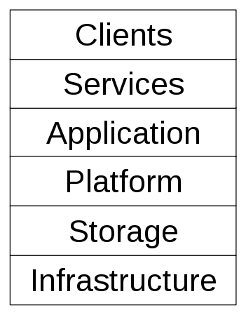
Cloud Components

Slide 23
Cloud Components
Application
A cloud application leverages the Cloud in software architecture, often eliminating the need to install and run the application on the customer's own computer, thus alleviating the burden of software maintenance, ongoing operation, and support.
Web application (Facebook)
Software as a service (Google Apps, SAP & Salesforce)
Software plus services (Microsoft Online Services)
Client
A cloud client consists of computer hardware and/or computer software which relies on The Cloud for application delivery, or which is specifically designed for delivery of cloud services and which, in either case, is essentially useless without it.
Mobile (Android, iPhone )
Thick client / Web browser (Google Chrome, Mozilla Firefox)

Slide 24
Cloud Components
Infrastructure
Cloud infrastructure, such as Infrastructure as a service, is the delivery of computer infrastructure, typically a platform virtualization environment, as a service.
For example:
Full virtualization (GoGrid, Skytap)
Grid computing (Sun Grid)
Compute (Amazon Elastic Compute Cloud)
Platform
A cloud platform, such as Platform as a service, the delivery of a computing platform, and/or solution stack as a service, facilitates deployment of applications without the cost and complexity of buying and managing the underlying hardware and software layers.
For example:
Web application frameworks
  Ajax (Caspio)
  Python Django (Google App Engine)
  Ruby on Rails (Heroku)
Web hosting (Mosso, Clustered Cloud)

Slide 25
Cloud Components
Service
A cloud service includes "products, services and solutions that are delivered and consumed in real-time over the Internet.
For example:
Identity (OAuth, OpenID)
Payments (Amazon Flexible Payments Service, Google Checkout, PayPal)
Mapping (Google Maps, Yahoo! Maps)
Search (Alexa, Google Custom Search, Yahoo! BOSS)
Storage
Cloud storage involves the delivery of data storage as a service, including database-like services, often billed on a utility computing basis, e.g., per gigabyte per month.
For example:
Database (Amazon SimpleDB, Google App Engine's BigTable )
Web service (Amazon Simple Storage Service, Nirvanix )

Slide 26
CHALLENGES
Challenge | Opportunity
Availability | Multiple providers
Data lock-in | Standardization
Data Confidentiality | Encryption, VLANs, Firewalls
Online storage service The Linkup closed August 8, 2008
- 20,000 paying subscribers lost their data
Coghead, a cloud vendor closed its business in Feb 19,2009
  - Customers need to rewrite their applications

Slide 27
CHALLENGES
Challenge | Opportunity
Data transfer bottlenecks | FedEx-ing disks, reuse data multiple times
Performance unpredictability | Improved VM support, flash memory
Scalable storage | Invent scalable storage
Bugs in large distributed systems | Invent Debugger using Distributed VMs
Scaling quickly | Invent Auto-Scaler

Slide 28
GROWTH CHALLENGES
Data transfer bottle neck
  WAN cost reduces slowest:
  2003 → 2008: WAN 2.7x, CPU 16x, storage 10x
  Fastest way to transfer large data: send the disks
Performance unpredictability
  Large variation in I/O operations
  Inefficiency in I/O virtualization

Slide 29
Future of Cloud Computing
In a May 2008 report, Merrill Lynch estimated that 12% of the worldwide software market would go to the cloud in that period.
IBM said it would spend $360 million to build a cloud computing data center in Research Triangle Park, N.C., bringing to nine its total of cloud computing centers worldwide.
Dell CEO Michael Dell says. "Now it's a several-hundred-million-dollar business, and it will be a billion-dollar business in a couple of years—it's on a tear."
Microsoft, has made cloud computing one of five priorities for fiscal 2009, according to a recent memo from CEO Steve Ballmer.

Slide 30
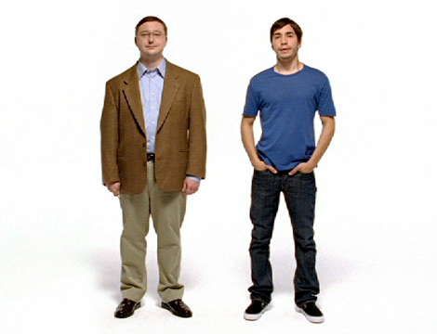
Look to the cloud!
Pay for the bandwidth and server resources that you need. When your work is done then turn the whole thing off!

Slide 31
References
Wikipedia http://en.wikipedia.org/wiki/Cloud_computing
Above the Clouds: A Berkeley View of Cloud Computing http://www.eecs.berkeley.edu/Pubs/TechRpts/2009/EECS-2009-28.pdf
How Cloud Computing Is Changing the World http://www.businessweek.com/technology/content/aug2008/tc2008082_445669.htm
The Future of Cloud Computing
http://mba.tuck.dartmouth.edu/digital/Programs/MBAFellowsProgramArchive/08_rana.pdf

