Slide 1

Statistics
Some basics before machine learning

Slide 2
Descriptive Statistics
Descriptive statistics is estimates that can be made from given dataset. In other words, it simple describes the main features of dataset.
It is conclusions made on a dataset.
Descriptive Statistics
Measures of Central Tendency
Measures of Spread/Dispersion

Slide 3
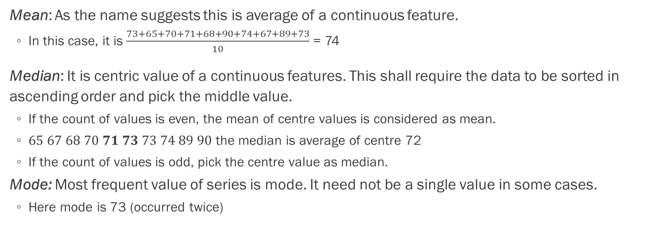
Measures of central tendency
Individual | 1 | 2 | 3 | 4 | 5 | 6 | 7 | 8 | 9 | 10
Weight (kg) | 73 | 65 | 70 | 71 | 68 | 90 | 74 | 67 | 89 | 73
Mean: As the name suggests this is average of a continuous feature.
In this case, it is $\frac{73+65+70+71+68+90+74+67+89+73}{10}$ = 74
Median: It is centric value of a continuous features. This shall require the data to be sorted in ascending order and pick the middle value.
If the count of values is even, the mean of centre values is considered as mean.
$65 67 68 70 71 73 73 74 89 90$ the median is average of centre 72
If the count of values is odd, pick the centre value as median.
Mode: Most frequent value of series is mode. It need not be a single value in some cases.
Here mode is 73 (occurred twice)

Slide 4
Mean

Slide 5
Median

Slide 6
Mean is sensitive to outliers but not median.

Slide 7

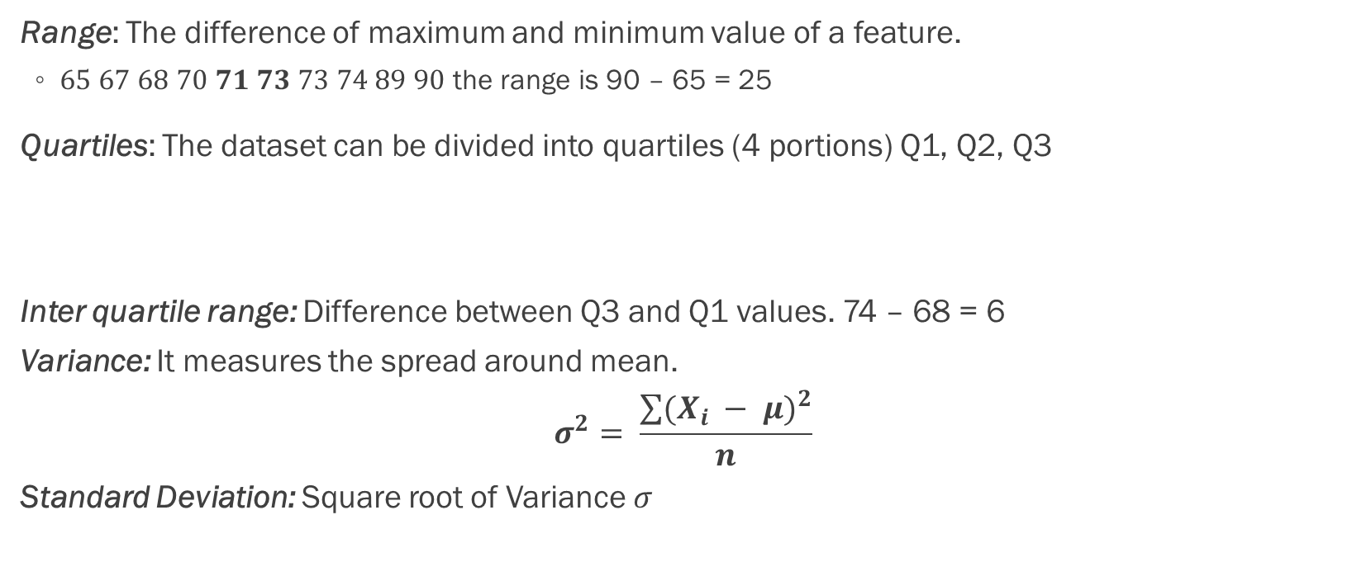
Measures of spread
Range: The difference of maximum and minimum value of a feature.
$65 67 68 70 71 73 73 74 89 90$ the range is 90 – 65 = 25
Quartiles: The dataset can be divided into quartiles (4 portions) Q1, Q2, Q3
Inter quartile range: Difference between Q3 and Q1 values. 74 – 68 = 6
Variance: It measures the spread around mean.
$$σ^{2}= \frac{\sum{{(X_{i} − μ)}^{2}}}{n}$$
Standard Deviation: Square root of Variance $σ$
Q1
Q3
$$65 67 68 70 71 73 73 74 89 90$$
Q2

Slide 8
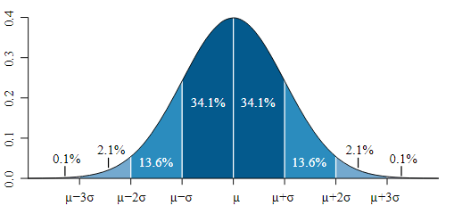
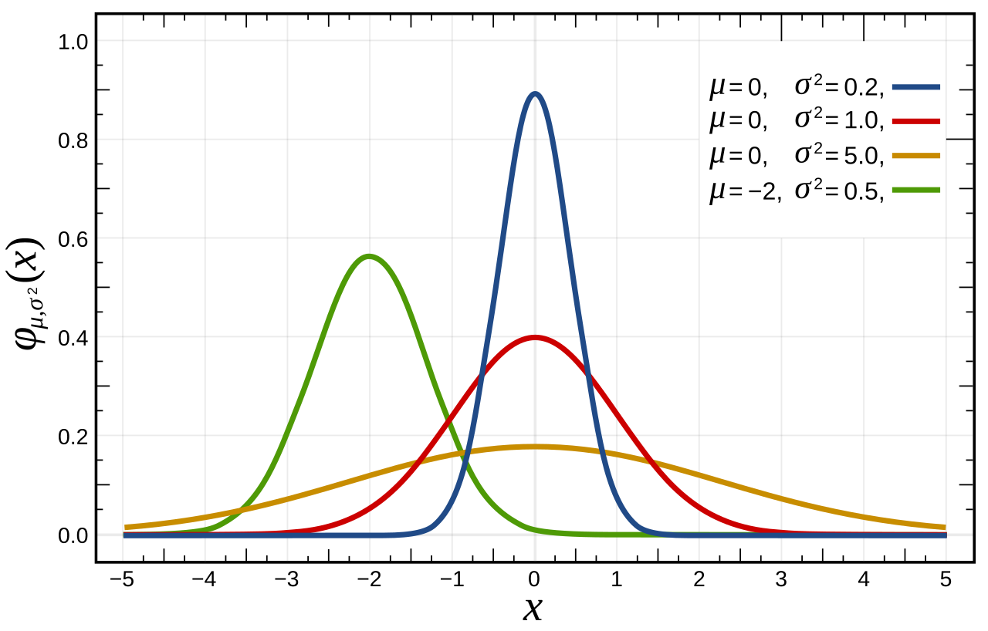
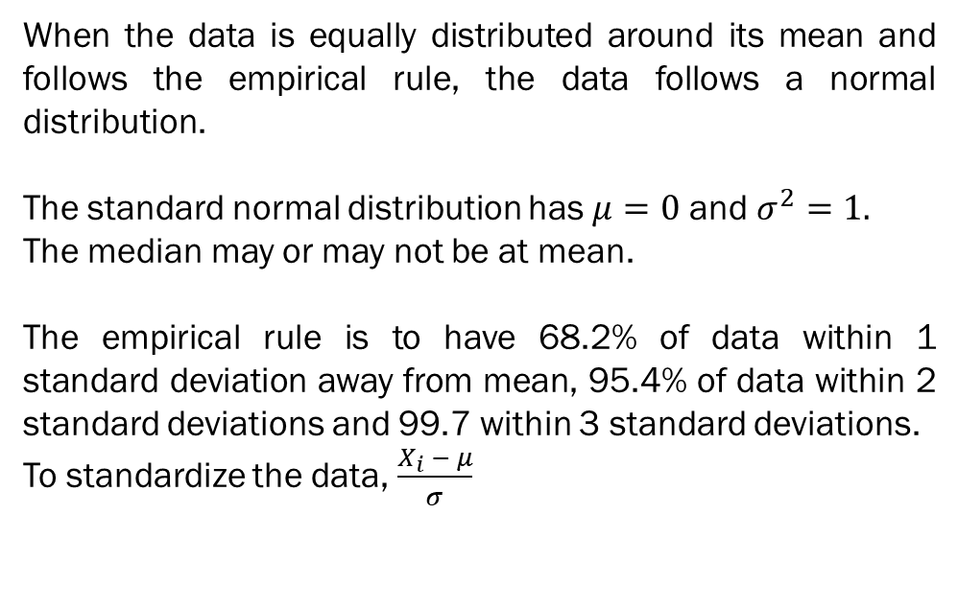
Normal Distribution
When the data is equally distributed around its mean and follows the empirical rule, the data follows a normal distribution.
The standard normal distribution has $μ=0$ and $σ^{2}=1.$
The median may or may not be at mean.
The empirical rule is to have 68.2% of data within 1 standard deviation away from mean, 95.4% of data within 2 standard deviations and 99.7 within 3 standard deviations.
To standardize the data, $\frac{X_{i} − μ}{σ}$

Slide 9
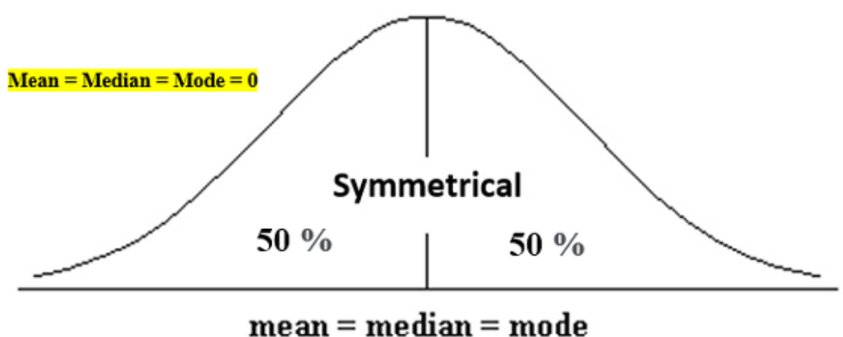
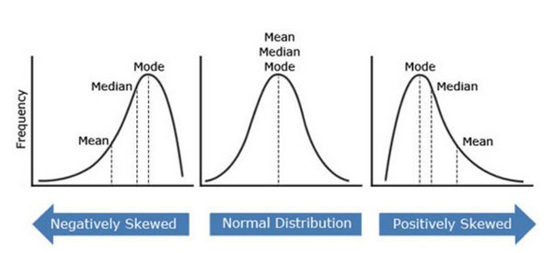
Skewness & Kurtosis
Skewness is statistical measure that assesses the asymmetry of a probability distribution. Closer the value to 0, the better the symmetry.
Kurtosis information about the tails and peak of the distribution. Positive kurtosis indicates heavier tails and a more peaked distribution, while negative kurtosis suggests lighter tails and a flatter distribution. Kurtosis helps in analyzing the characteristics and outliers of a dataset.

Slide 10
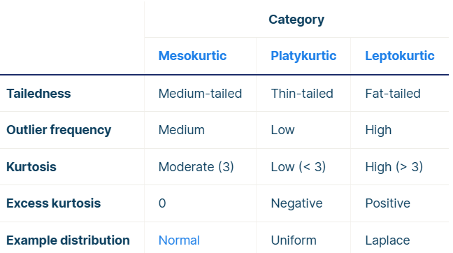
More about Kurtosis

