Slide 1

Statistics
Some basics before machine learning

Slide 2
Descriptive Statistics
Descriptive statistics is estimates that can be made from given dataset. In other words, it simple describes the main features of dataset.
It is conclusions made on a dataset.
Descriptive Statistics
Measures of Central Tendency
Measures of Spread/Dispersion

Slide 3
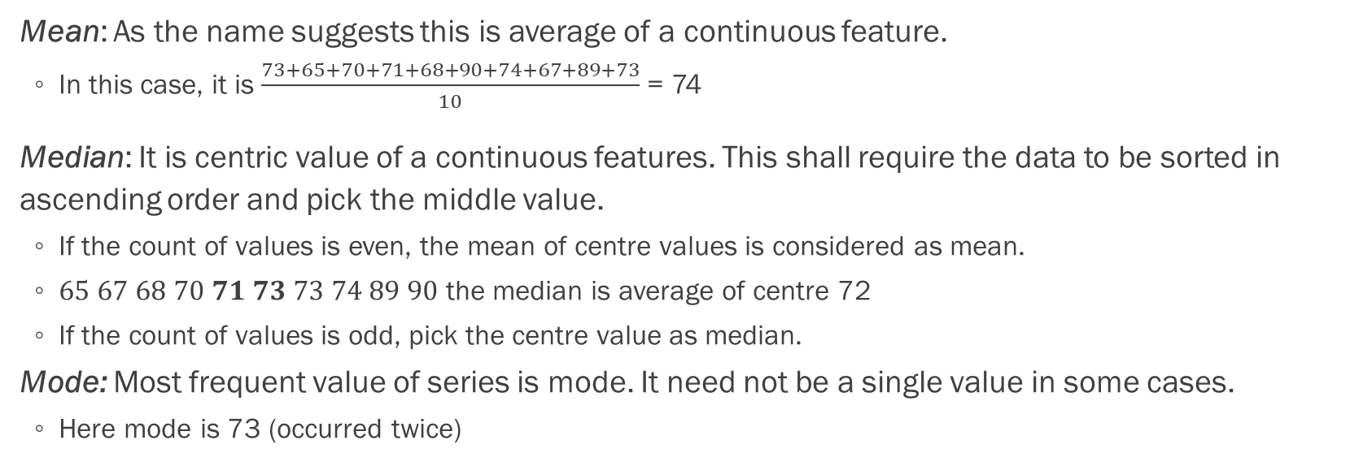
Measures of central tendency
Individual | 1 | 2 | 3 | 4 | 5 | 6 | 7 | 8 | 9 | 10
Weight (kg) | 73 | 65 | 70 | 71 | 68 | 90 | 74 | 67 | 89 | 73
Mean: As the name suggests this is average of a continuous feature.
In this case, it is $\frac{73+65+70+71+68+90+74+67+89+73}{10}$ = 74
Median: It is centric value of a continuous features. This shall require the data to be sorted in ascending order and pick the middle value.
If the count of values is even, the mean of centre values is considered as mean.
$65 67 68 70 71 73 73 74 89 90$ the median is average of centre 72
If the count of values is odd, pick the centre value as median.
Mode: Most frequent value of series is mode. It need not be a single value in some cases.
Here mode is 73 (occurred twice)

Slide 4
Mean

Slide 5
Median

Slide 6
Mean is sensitive to outliers but not median.

Slide 7

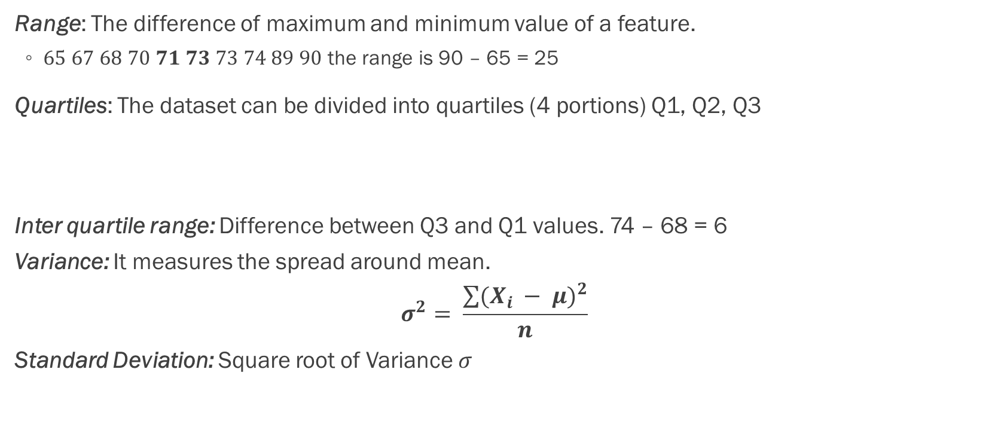
Measures of spread
Range: The difference of maximum and minimum value of a feature.
$65 67 68 70 71 73 73 74 89 90$ the range is 90 – 65 = 25
Quartiles: The dataset can be divided into quartiles (4 portions) Q1, Q2, Q3
Inter quartile range: Difference between Q3 and Q1 values. 74 – 68 = 6
Variance: It measures the spread around mean.
$$σ^{2}= \frac{\sum{{(X_{i} − μ)}^{2}}}{n}$$
Standard Deviation: Square root of Variance $σ$
Q1
Q3
$$65 67 68 70 71 73 73 74 89 90$$
Q2

Slide 8
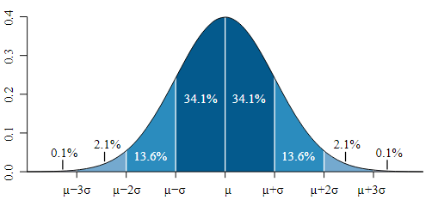
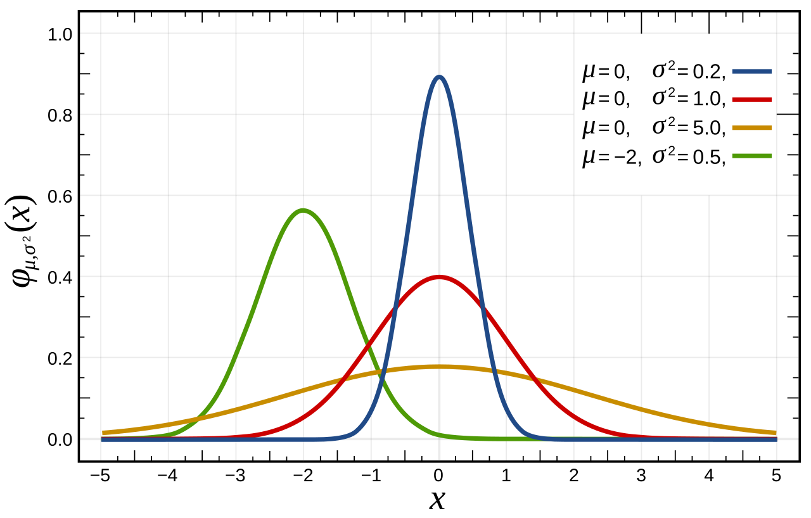
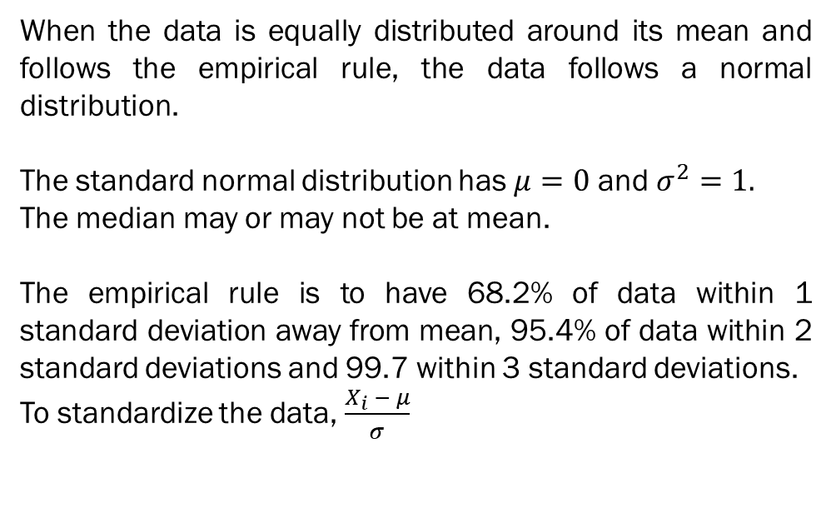
Normal Distribution
When the data is equally distributed around its mean and follows the empirical rule, the data follows a normal distribution.
The standard normal distribution has $μ=0$ and $σ^{2}=1.$
The median may or may not be at mean.
The empirical rule is to have 68.2% of data within 1 standard deviation away from mean, 95.4% of data within 2 standard deviations and 99.7 within 3 standard deviations.
To standardize the data, $\frac{X_{i} − μ}{σ}$

Slide 9
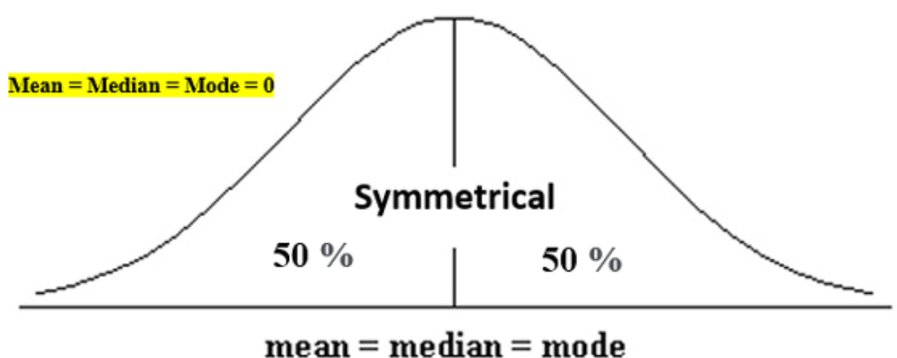
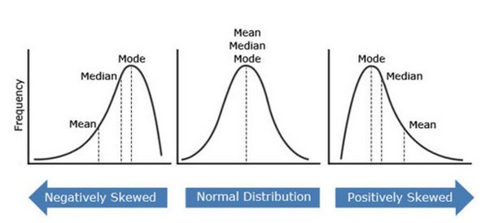
Skewness & Kurtosis
Skewness is statistical measure that assesses the asymmetry of a probability distribution. Closer the value to 0, the better the symmetry.
Kurtosis information about the tails and peak of the distribution. Positive kurtosis indicates heavier tails and a more peaked distribution, while negative kurtosis suggests lighter tails and a flatter distribution. Kurtosis helps in analyzing the characteristics and outliers of a dataset.

Slide 10
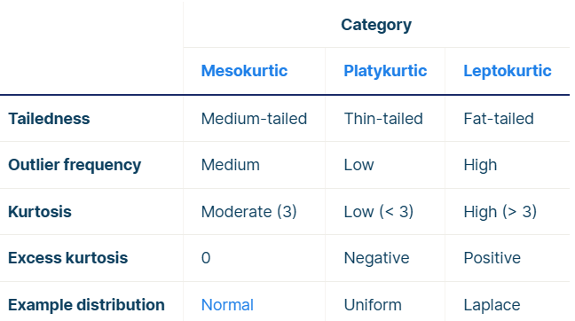
More about Kurtosis

Slide 11
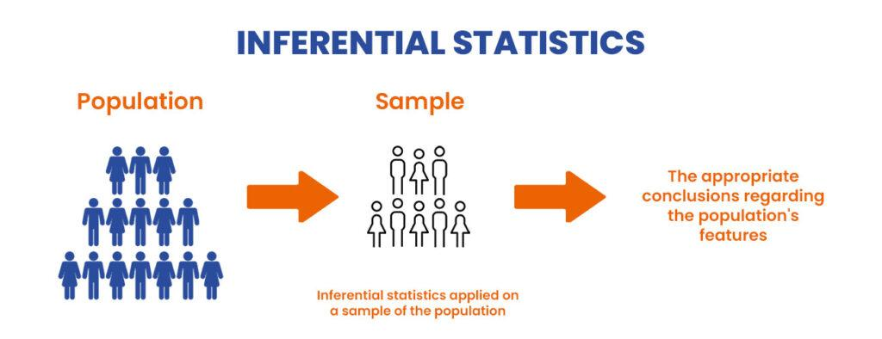
Inferential Statistics
Inferential Statistics approximately estimates characteristic of the population from which the sample was taken. It also helps in testing a research hypothesis about given population.
Descriptive statistics provides concise summary of the data and help understand it through visual aids such as histograms, bar charts and scatter plots.
Inferential statistics is concerned about drawing conclusion on a bigger data (larger population) based on a smaller sample. Also to test hypothesis about population parameters.

Slide 12
Maximum Likelihood

Slide 13
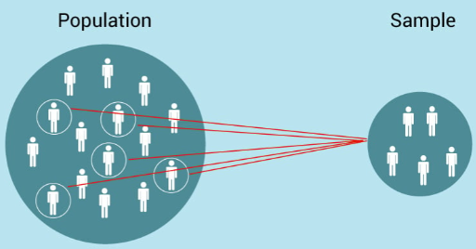
Population and Sample

Slide 14
Important characteristics
The main goal is to make generalizations of population from samples drawn. For example, the actual mean might be hard to find but using inferential statistic, we can approximate it (probabilistic approach).
Hypothesis testing: This consists of forming a null and alternative hypothesis and using statistical tests to determine whether the null hypothesis can be rejected.
Significance Testing: Inferential statistics involves significance testing to determine whether results are statistically significant, meaning that they are unlikely to have occurred by chance.

Slide 15
Hypothesis Testing
Hypothesis testing is a statistical method used to test claims about a population based on sample data. Hypothesis testing aims to determine whether the sample data provides enough evidence to support or reject a specific claim about the population.
There are two main types of hypothesis tests:
One-sample tests: One-sample tests are used to test claims about the mean or proportion of a single population. For example, you might use a one-sample test to determine whether the mean height of a population is different from a specific value or whether the proportion of a population with a certain characteristic is different from a specific value.
Two-sample tests: Two-sample tests are used to test claims about the difference between the means or proportions of two populations. For example, you might use a two-sample test to determine whether the mean height of one population is different from the mean height of another population or to determine whether the proportion of one population with a certain characteristic is different from the proportion of another population with that characteristic.
We could use chi-squared, ANOVA, Pearson’s correlation for analysis/hypothesis testing.

Slide 16
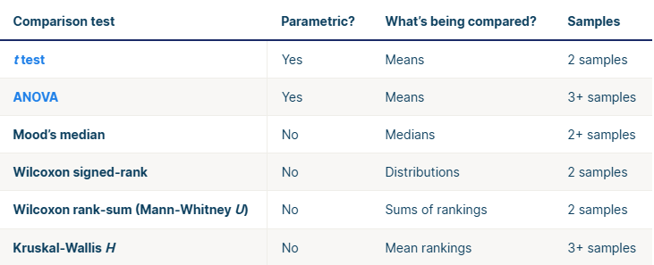
Comparison Tests
credits: Inferential Statistics | An Easy Introduction & Examples (scribbr.com)

Slide 17
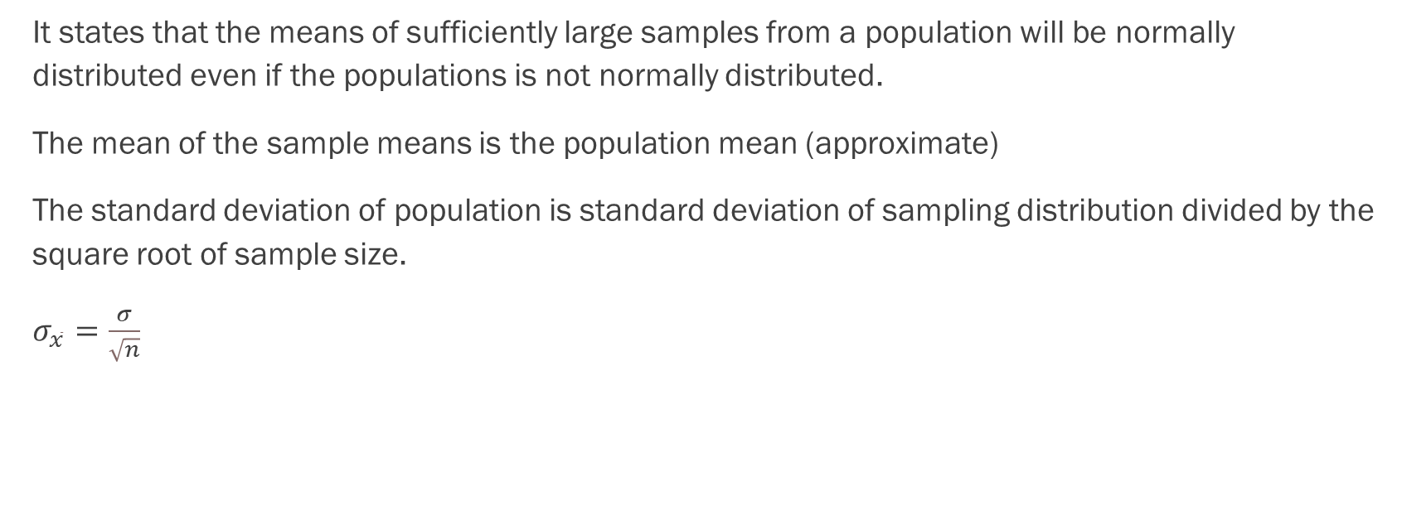
Central Limit Theorem
It states that the means of sufficiently large samples from a population will be normally distributed even if the populations is not normally distributed.
The mean of the sample means is the population mean (approximate)
The standard deviation of population is standard deviation of sampling distribution divided by the square root of sample size.
$σ_{\overline{x}}=\frac{σ}{\sqrt{n}}$

