Slide 1

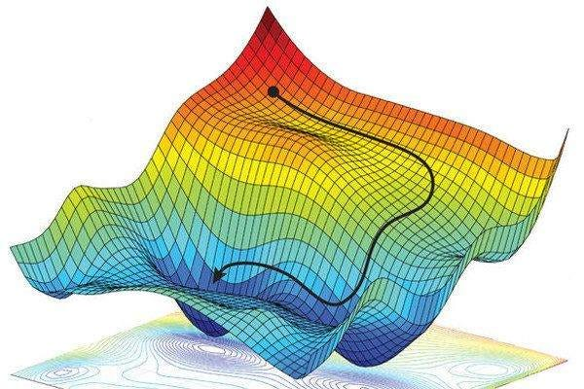
Gradient
Descent

Slide 2
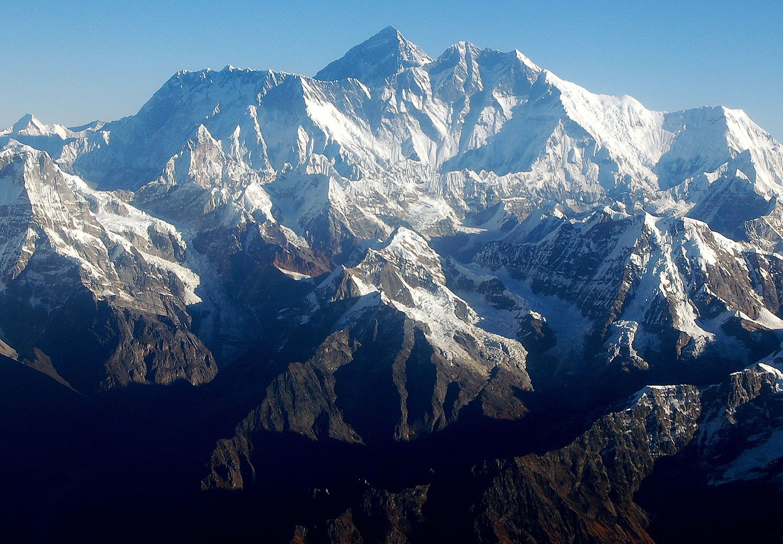
Image credits: Mount Everest | Height, Location, Map, Facts, Climbers, & Deaths | Britannica

Slide 3
Convex Functions
For a given function when we choose two random points on it, if the curve is below the line joining these points, it would be termed as a convex function. Otherwise, it would have been a concave function.
x₁
x₂

Slide 4
Minima of Convex Function
Given a convex function, it is obvious that one could find a point where the gradient of the function vanishes, the most minimum point of the convex.
Gradient, in other words would be the change in function for a given change in X feature.

Slide 5
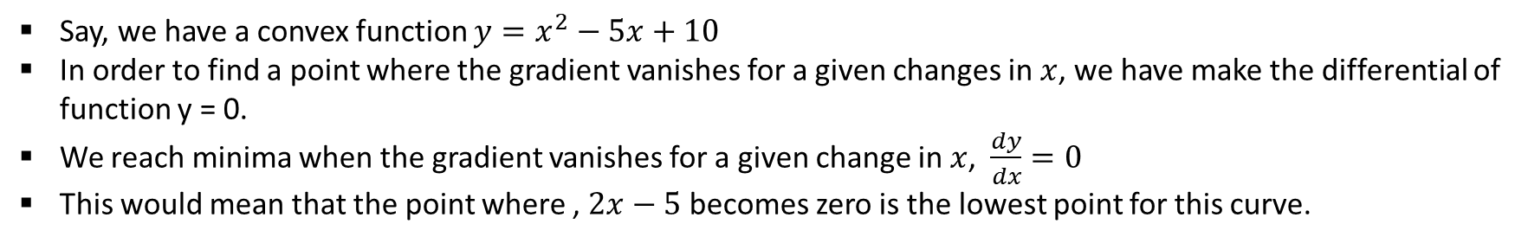
How to find minima of convex?
Say, we have a convex function $y=x^{2}−5x+10$
In order to find a point where the gradient vanishes for a given changes in $x$, we have make the differential of function y = 0.
We reach minima when the gradient vanishes for a given change in $x$, $\frac{dy}{dx}=0$
This would mean that the point where , $2x−5$ becomes zero is the lowest point for this curve.

Slide 6
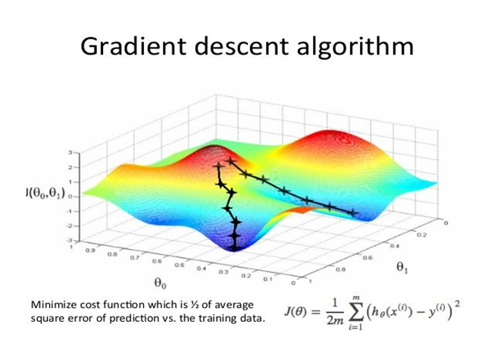
Img credits: GRADIENT DESCENT : Basics And Application | by Society of AI | Medium

Slide 7
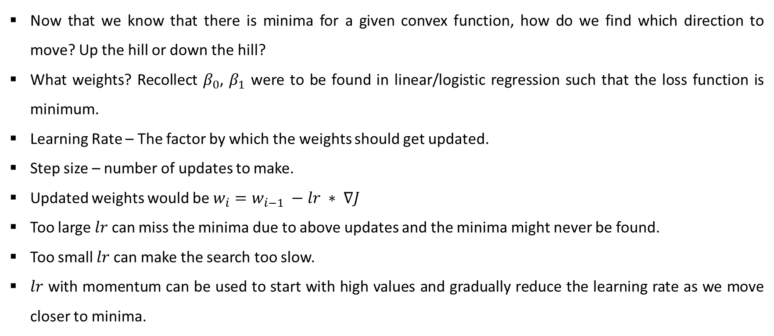
Direction and Weight Updates
Now that we know that there is minima for a given convex function, how do we find which direction to move? Up the hill or down the hill?
What weights? Recollect $β_{0}$, $β_{1}$ were to be found in linear/logistic regression such that the loss function is minimum.
Learning Rate – The factor by which the weights should get updated.
Step size – number of updates to make.
Updated weights would be $w_{i}=w_{i−1} −lr ∗ ∇J$
Too large $lr$ can miss the minima due to above updates and the minima might never be found.
Too small $lr$ can make the search too slow.
$lr$ with momentum can be used to start with high values and gradually reduce the learning rate as we move closer to minima.

