Slide 1

Measures of Impurity

Slide 2
Measures of Impurity
A feature is said to be pure when all the elements within it belongs to same class. More than one class within a features is impure.
The impurity can be measured using Gini Index, Entropy.
Models like Decision Trees, uses measures of impurity as base to create branches and leaf/child nodes.
No Impurity
some Impurity

Slide 3

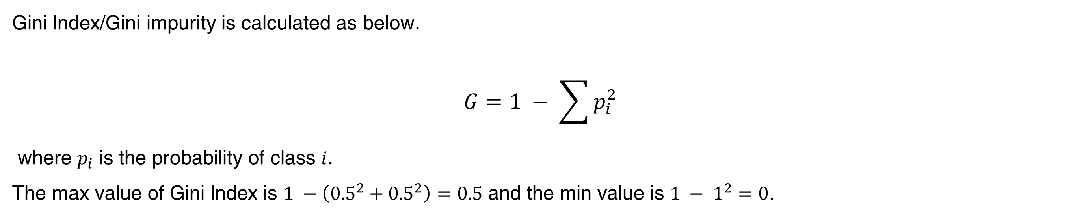
Gini Index
Gini Index/Gini impurity is calculated as below.
$$G=1 − \sum{p_{i}^{2}}$$
where $p_{i}$ is the probability of class $i$.
The max value of Gini Index is $1 −\left({0.5}^{2}+{0.5}^{2}\right)=0.5$ and the min value is $1 − 1^{2}=0$.
$G=$1 – 1 = 0
$G=1 − {\frac{9}{16}}^{2}− {\frac{7}{16}}^{2}=1 −0.3164 −0.1914=0.4922$

Slide 4
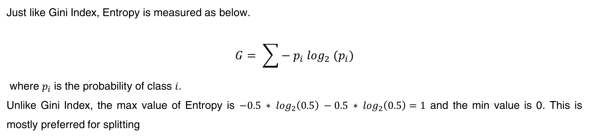
Entropy
Just like Gini Index, Entropy is measured as below.
$$G= \sum{− p_{i} \log_{2} (p_{i})}$$
where $p_{i}$ is the probability of class $i$.
Unlike Gini Index, the max value of Entropy is $−0.5 ∗ \log_{2}\left(0.5\right) −0.5 ∗ \log_{2}\left(0.5\right)=1$ and the min value is 0. This is mostly preferred for splitting
$G=$1 – 1 = 0
$G=1 − {\frac{9}{16}}^{2}− {\frac{7}{16}}^{2}=1 −0.3164 −0.1914=0.4922$

Slide 5

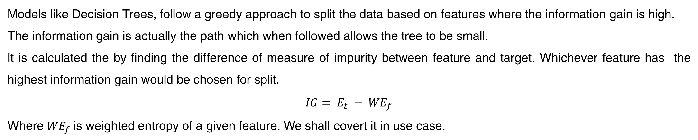
Information Gain
Models like Decision Trees, follow a greedy approach to split the data based on features where the information gain is high.
The information gain is actually the path which when followed allows the tree to be small.
It is calculated the by finding the difference of measure of impurity between feature and target. Whichever feature has the highest information gain would be chosen for split.
$$IG= {E_{t} − WE}_{f}$$
Where ${WE}_{f}$is weighted entropy of a given feature. We shall covert it in use case.

Slide 6
Use Case
Say, we have a dataset like below and the criteria is to find whether we could play given the condition of temperature, humidity and windy.
We could randomly pick any column and build decision trees from it.
A decision tree build on splits using Temp would look like below.
Temp
Hot 4
Mild 6
Cool 4
Humidity
Windy
Outlook
High 2
Normal 2
Overcast 2
Sunny 2
False 2
True 2
Windy
Play
No Play
Play
Outlook
False 2
True 2
Outlook
Outlook
Rainy 1
Overcast 1
Rainy 1
Sunny 1
Rainy 1
Overcast 1
No Play
Play
Play
No Play
No Play
Play

Slide 7
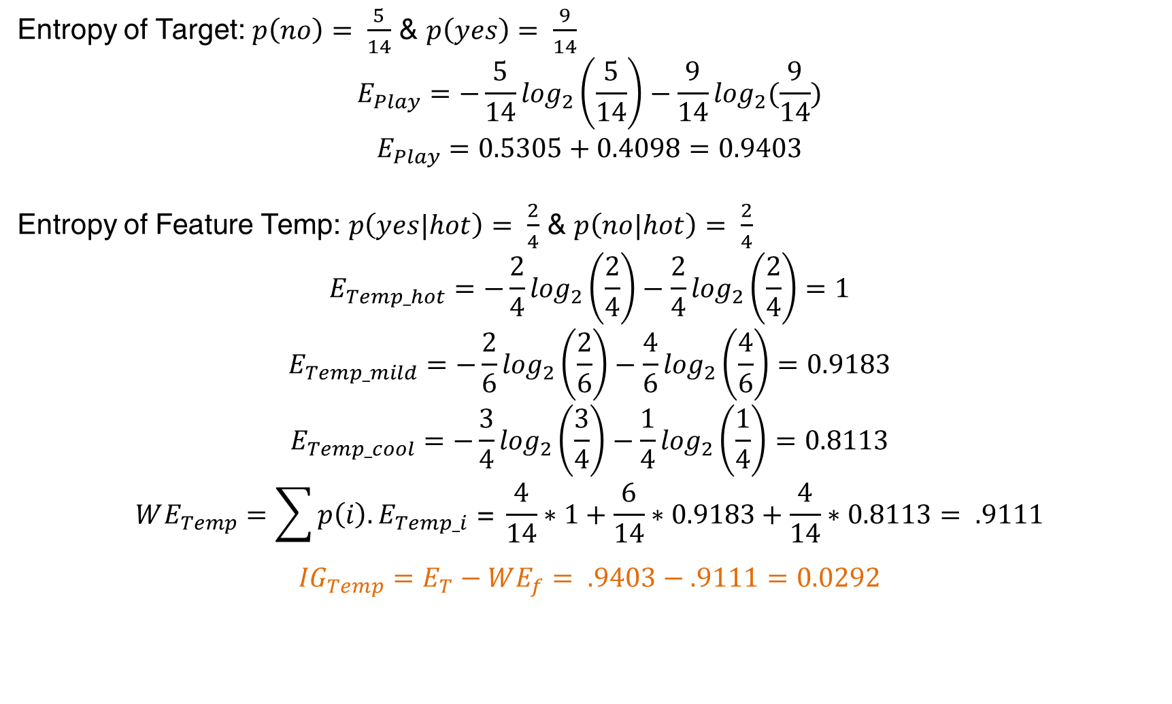
The information gain approach
Instead of randomly picking up feature to make splits, we shall evaluate Entropy and select the feature which can result in highest information gain (Greedy approach).
Entropy of Target: $p\left(no\right)= \frac{5}{14}$ & $p\left(yes\right)= \frac{9}{14}$
$$E_{Play}=−\frac{5}{14}\log_{2}\left(\frac{5}{14}\right)−\frac{9}{14}\log_{2}(\frac{9}{14})$$
$$E_{Play}=0.5305+0.4098=0.9403$$
Entropy of Feature Temp: $p\left(yes|hot\right)= \frac{2}{4}$ & $p\left(no|hot\right)= \frac{2}{4}$
$$E_{Temp_hot}=−\frac{2}{4}\log_{2}\left(\frac{2}{4}\right)−\frac{2}{4}\log_{2}\left(\frac{2}{4}\right)=1$$
$$E_{Temp_mild}=−\frac{2}{6}\log_{2}\left(\frac{2}{6}\right)−\frac{4}{6}\log_{2}\left(\frac{4}{6}\right)=0.9183$$
$$E_{Temp_cool}=−\frac{3}{4}\log_{2}\left(\frac{3}{4}\right)−\frac{1}{4}\log_{2}\left(\frac{1}{4}\right)=0.8113$$
$$WE_{Temp}=\sum{p\left(i\right).E_{Temp_i} \text{= }\frac{4}{14}∗1+\frac{6}{14}∗0.9183}+\frac{4}{14}∗0.8113= .9111$$
$${IG}_{Temp}=E_{T}−WE_{f}= .9403−.9111=0.0292$$

Slide 8
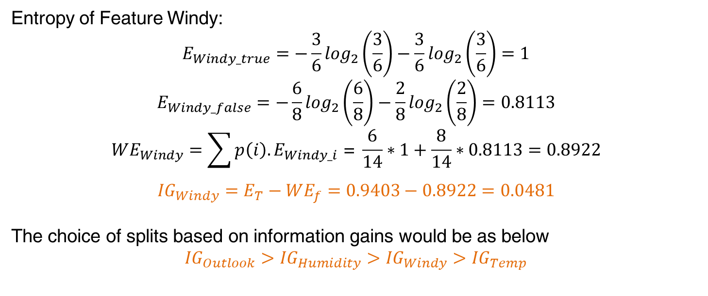
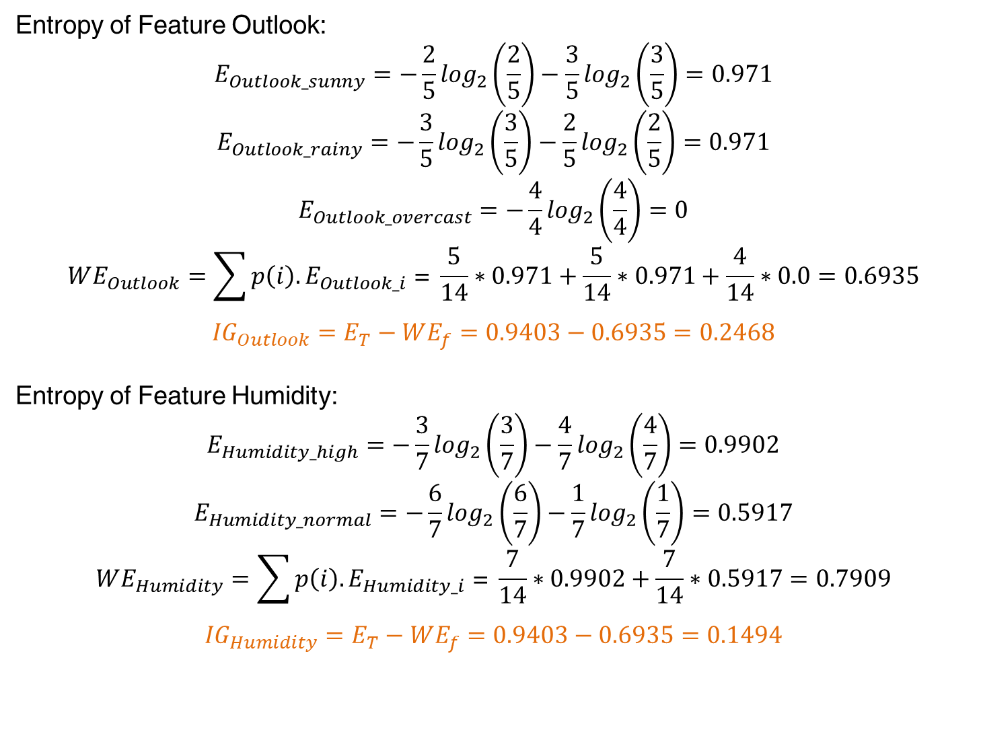
More calculations
Entropy of Feature Outlook:
$$E_{Outlook_sunny}=−\frac{2}{5}\log_{2}\left(\frac{2}{5}\right)−\frac{3}{5}\log_{2}\left(\frac{3}{5}\right)=0.971$$
$$E_{Outlook_rainy}=−\frac{3}{5}\log_{2}\left(\frac{3}{5}\right)−\frac{2}{5}\log_{2}\left(\frac{2}{5}\right)=0.971$$
$$E_{Outlook_overcast}=−\frac{4}{4}\log_{2}\left(\frac{4}{4}\right)=0$$
$$WE_{Outlook}=\sum{p\left(i\right).E_{Outlook_i} \text{= }\frac{5}{14}∗0.971+\frac{5}{14}∗0.971}+\frac{4}{14}∗0.0=0.6935$$
$${IG}_{Outlook}=E_{T}−WE_{f}=0.9403−0.6935=0.2468$$
Entropy of Feature Humidity:
$$E_{Humidity_high}=−\frac{3}{7}\log_{2}\left(\frac{3}{7}\right)−\frac{4}{7}\log_{2}\left(\frac{4}{7}\right)=0.9902$$
$$E_{Humidity_normal}=−\frac{6}{7}\log_{2}\left(\frac{6}{7}\right)−\frac{1}{7}\log_{2}\left(\frac{1}{7}\right)=0.5917$$
$$WE_{Humidity}=\sum{p\left(i\right).E_{Humidity_i} \text{= }\frac{7}{14}∗0.9902+\frac{7}{14}∗0.5917}=0.7909$$
$${IG}_{Humidity}=E_{T}−WE_{f}=0.9403−0.6935=0.1494$$
Entropy of Feature Windy:
$$E_{Windy_true}=−\frac{3}{6}\log_{2}\left(\frac{3}{6}\right)−\frac{3}{6}\log_{2}\left(\frac{3}{6}\right)=1$$
$$E_{Windy_false}=−\frac{6}{8}\log_{2}\left(\frac{6}{8}\right)−\frac{2}{8}\log_{2}\left(\frac{2}{8}\right)=0.8113$$
$$WE_{Windy}=\sum{p\left(i\right).E_{Windy_i} \text{= }\frac{6}{14}∗1+\frac{8}{14}∗0.8113}=0.8922$$
$${IG}_{Windy}=E_{T}−WE_{f}=0.9403−0.8922=0.0481$$
The choice of splits based on information gains would be as below
$${IG}_{Outlook}>{IG}_{Humidity}>{IG}_{Windy}>{IG}_{Temp}$$

Slide 9
Decision Tree based on IG
Outlook
Sunny 5
Rainy 5
Overcast 4
Humidity
Humidity
Play
High 2
Normal 3
High 3
Normal 2
No Play
Play
Windy
Windy
False 1
True 1
False 2
True 1
Play
No Play
Play
No Play
Much smaller and simpler.

Slide 10
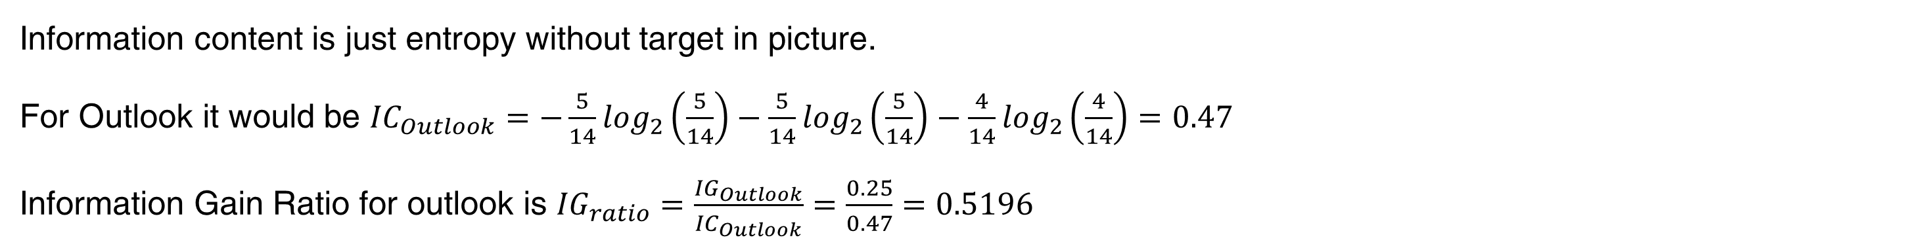
Information Content & Ratio
Information content is just entropy without target in picture.
For Outlook it would be ${IC}_{Outlook}=−\frac{5}{14}\log_{2}\left(\frac{5}{14}\right)−\frac{5}{14}\log_{2}\left(\frac{5}{14}\right)−\frac{4}{14}\log_{2}\left(\frac{4}{14}\right)=0.47$
Information Gain Ratio for outlook is ${IG}_{ratio}=\frac{{IG}_{Outlook}}{{IC}_{Outlook}}=\frac{0.25}{0.47}=0.5196$

