Slide 1


Slide 2
file.cpp
file.cpp
file.cpp
Predefined header files
User defined header files
Predefined header files
Compiler
User defined header files
Predefined header files
User defined header files
file.obj
file.obj
file.obj
Static Libraries
Linker
Static Libraries
Static Libraries
Calculate.exe
Dynamic Libraries
Loader
Dynamic Libraries
Dynamic Libraries
Process

Slide 3
My Code
My Library
C++ Runtime Library
new
OS API Library
Global Alloc
INT 2e
User Mode
Kernel Mode
Kernel
NtAlloc

Slide 4
Stack
Heap
Data Segment
Code Segment
Local data
Dynamic data
Global data
Functions

Slide 5
Local Variables
ESP
Callers EBP
EBP
Return Address
Arguments to functions

Slide 6
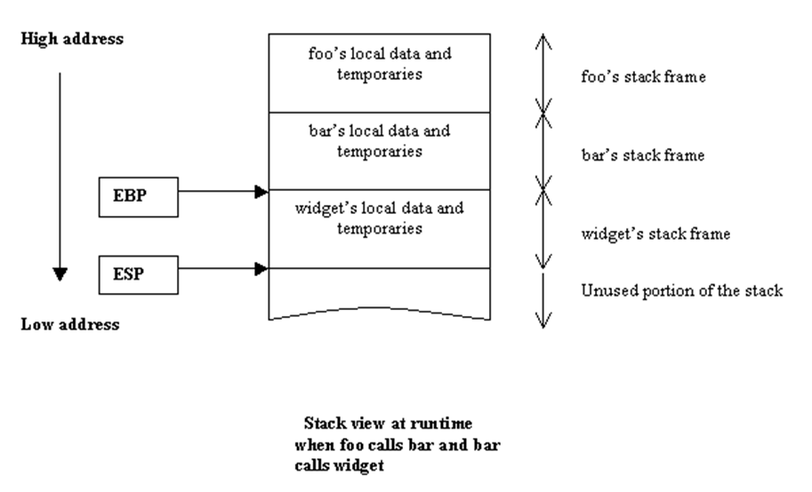

Slide 7
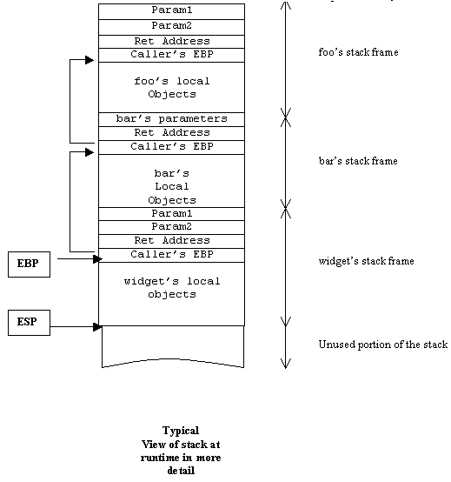

Slide 8
Stack
Heap
Data Segment
Code Segment
CA::Fx1
CA Vtable
Fx1
Fx2
Object
vptr
data1
data2
CA::Fx2
p
CB Vtable
Fx1
Fx2
CB::Fx2
CC Vtable
Fx1
Fx2
Fx3
CC::Fx3

Slide 9
Stack
Heap
Data Segment
Code Segment
CA::Fx1
CA IX Vtable
Fx1
Fx2
Object
vptr1
IX Data
Vptr2
IY Data
CA Data
CA::Fx2
p
CA IY Vtable
Fy1
Fy2
CA::Fy1
CA::Fy2

Slide 10
struct EXCEPTION_REGISTRATION
{
EXCEPTION_REGISTRATION *prev;
DWORD handler;
int id;
DWORD ebp;
};

Slide 12
fun_exc_handler()
{
MOV EAX,fun_funinfo_ptr;
jump __CxxFrameHandler;
}

Slide 14
struct funinfo
{
signature;
unwind_count;
punwind_table;
tryblock_count;
ptryblock_table;
};

Slide 15
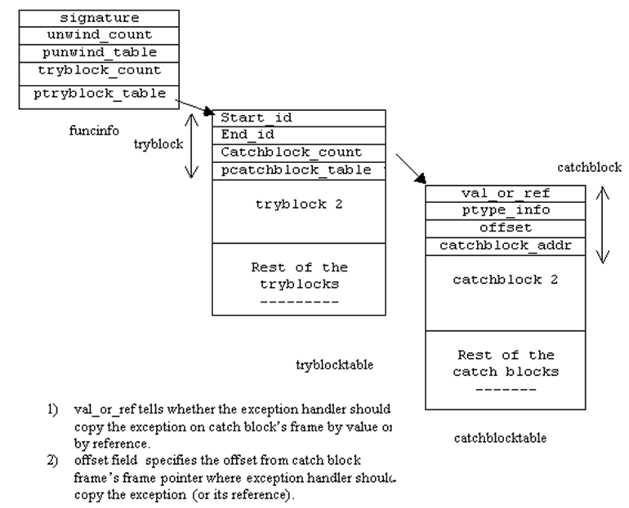

Slide 16
